Slide 1
YAKSHA - Cybersecurity Awareness and Knowledge Systemic High-level Application
EU-ASEAN research collaboration
Sara Medina | saramedina@spi.pt
Douglas Thompson | douglasthompson@spi.pt
Francisco Rocha | franciscorocha@spi.pt
Sociedade Portuguesa de Inovação (Portugal)
20 July 2021

Slide 2
YAKSHA – Horizon 2020 Project
Horizon 2020 Topic: International partnership building in low and middle income countries
YAKSHA aimed to reinforce European Union (EU) and Association of South East Asian Nations (ASEAN) cooperation and build partnerships in the Cybersecurity domain by developing a solution tailored to specific users and national needs, leveraging EU Know-How and expertise.
Project started in January 2018 and ended in December 2020.
Total project budget: 2,481,984 EUR, with contribution from the EC of 1,989,599 EUR.
Project Officer for the European Commission: Dr Rafael Tesoro

Slide 3
YAKSHA Consortium

Slide 4
The Concept
YAKSHA Motivation
Develop and implement a software toolkit to improve Cybersecurity of organisations in the ASEAN region
WHAT
WHY
YAKSHA Results
Enhance cybersecurity readiness levels for its end users, help better prevent cyber-attacks, reduce cyber risks and better govern the whole cybersecurity process.
Process & Strategy
Focus on adapting & integrating other domain technologies into innovative solutions
HOW

Slide 5
YAKSHA Specific Objectives
Assess the Cybersecurity state of the art in the ASEAN area and future developments
Enable the sustainable uptake of scientific, technical and economic results and foster EU-ASEAN cooperation
YAKSHA aimed to enhance cybersecurity readiness levels for its end users, help better prevent cyber-attacks, reduce cyber risks and better govern the whole cybersecurity process.
YAKSHA aimed to improve Cybersecurity technology adoption and development in Southeast Asia and Europe as a whole
Develop a distributed, flexible, Cybersecurity solution

Slide 6
YAKSHA Methodology
State of the art and future Cybersecurity ecosystem | Data Collection | Design and Software Development | Pilots and Validation | Communication, Dissemination, Exploitation
Data Collection

Slide 7
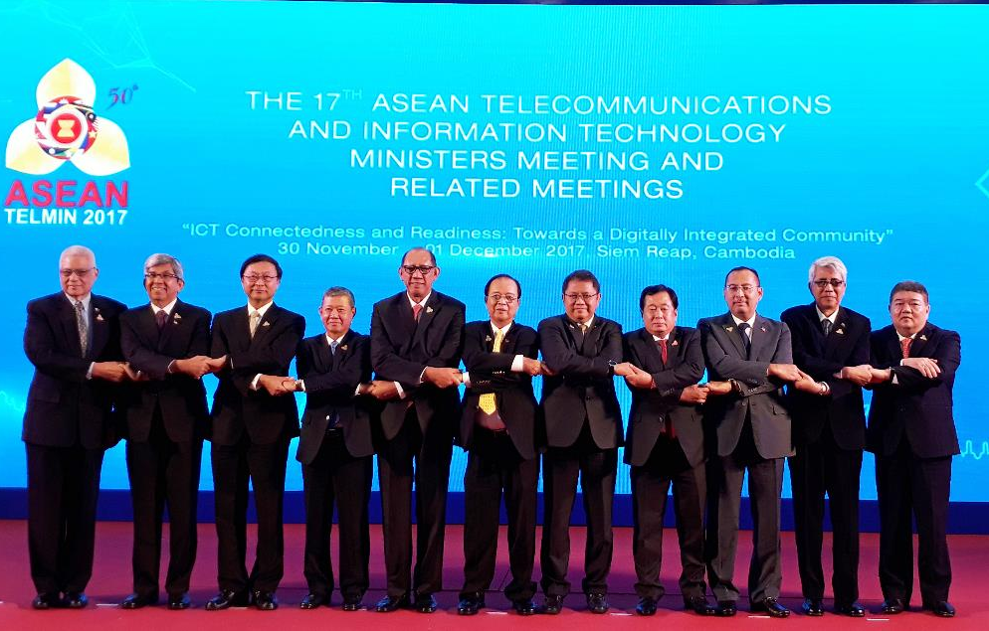
YAKSHA Target Groups
SMEs and large organisations
Critical infrastructure organisations
Government and policy making
organizations
Associations, Network of Organisations and other interested parties including media representatives and NGOs
Knowledge and R&D organizations

Slide 8
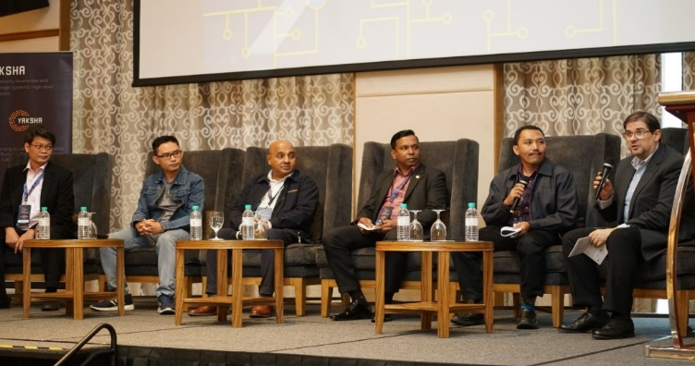
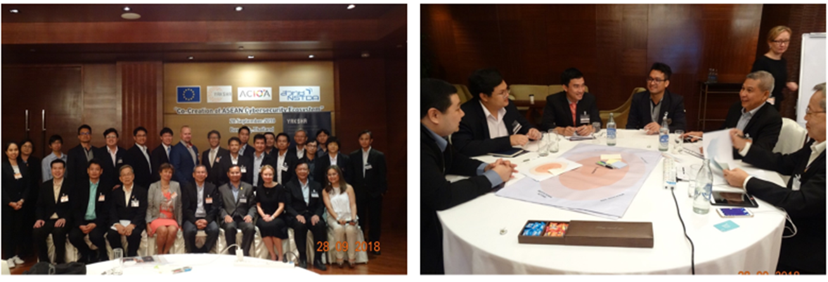
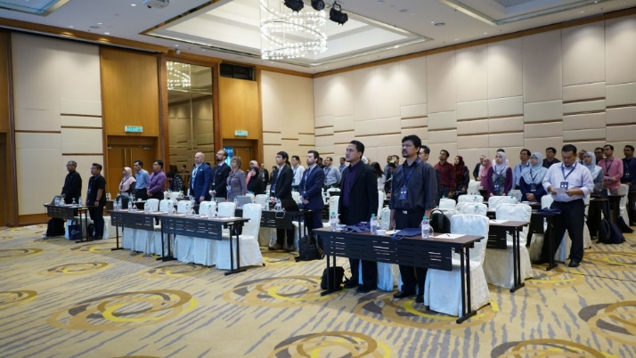
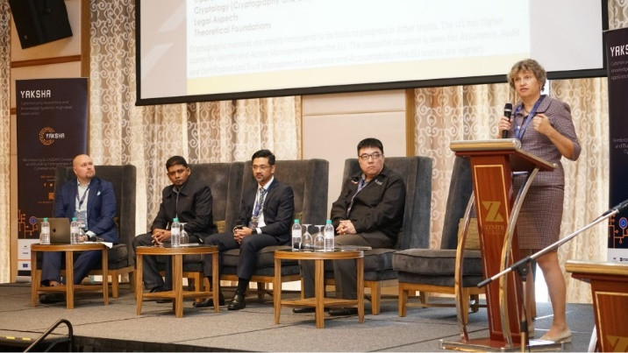
YAKSHA Events
Events developed under YAKSHA
YAKSHA End-user events
YAKSHA Workshops

Slide 9
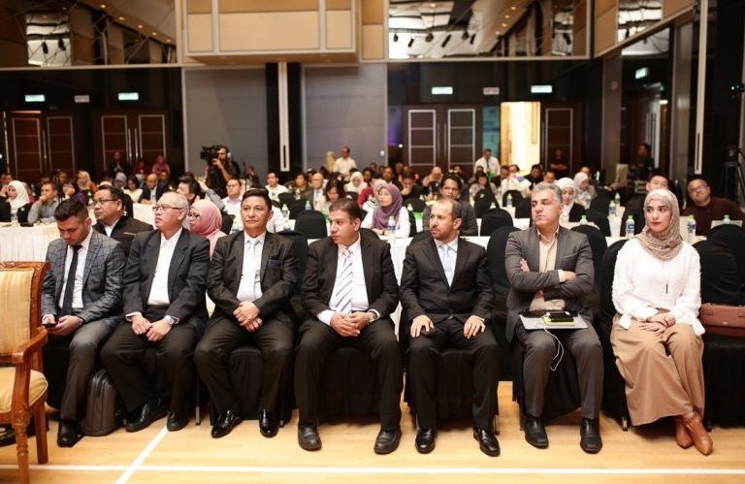
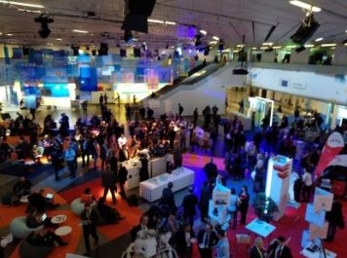
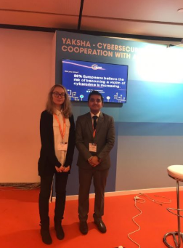
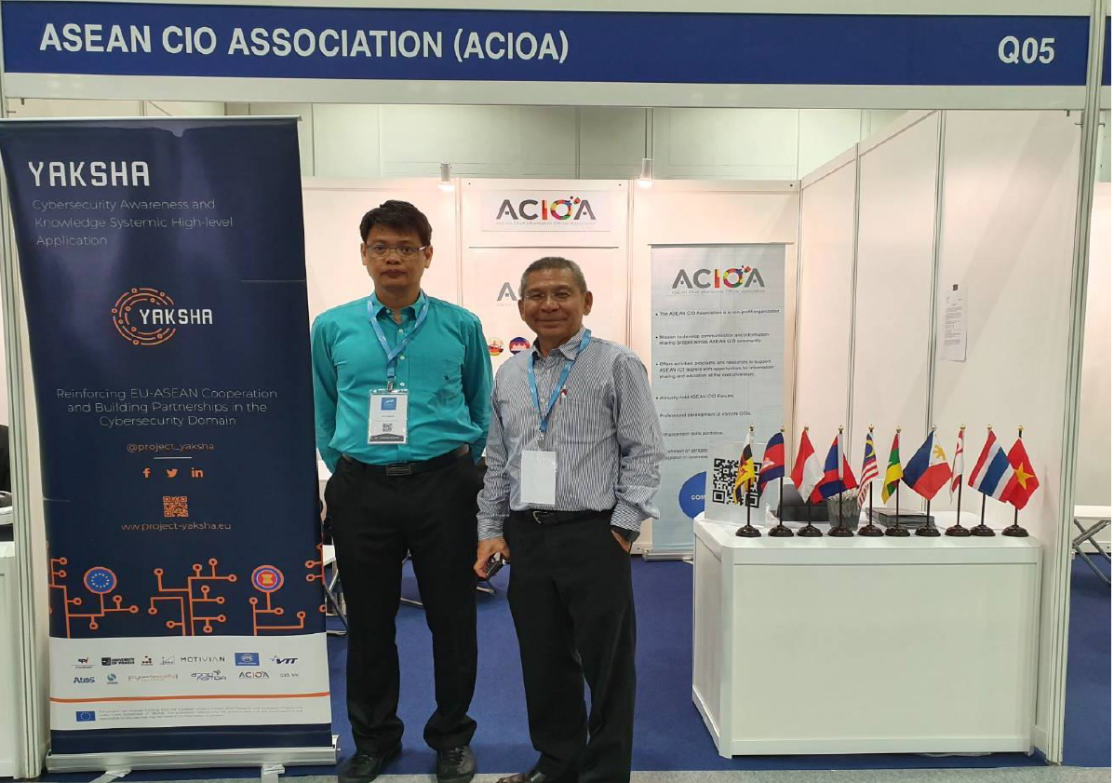
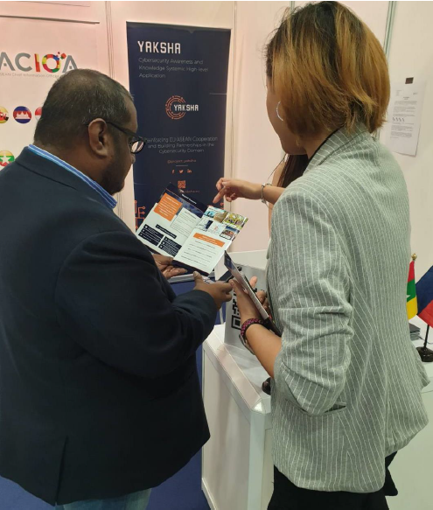
YAKSHA Events
Participation in External events
SPI and GAC at ICT 2018 - YAKSHA selected for INCO Village + networking session
CyberSecurity Malaysia - Industry Engagement on YAKSHA Ambassadors Programme in April 2019
In November 2020, OTE presented YAKSHA at Infocom World (virtual event)
ACIOA at Interpol World2019 in Singapore in July 2019

Slide 10
YAKSHA Main Output
The YAKSHA software platform
Other relevant results
Pilot tested in Greece, Vietnam and Malaysia;
Overview of cybersecurity status in ASEAN-EU and mapping of cybersecurity ecosystems actors;
Development of operational scenarios and business model for cybersecurity software;
Report on user acceptance test derived from the end user event;
YAKSHA Ambassador Programme.
Innovative cybersecurity intelligence-gathering tool that allows organisations to easily deploy and monitor large numbers of honeypot virtual machines acting both as threat samples generators and deception decoys for the actual services the organisation runs exposed on the internet.

Slide 11
YAKSHA Ambassador Programme
Community of 100+ YAKSHA ambassadors in ASEAN

Slide 12
YAKSHA Exploitation Actions
YAKSHA partners have made advanced plans to exploit their respective results.
A Memorandum of Understanding between EU and ASEAN partners was signed in December 2020.
The focus of the common exploitation strategy was the establishment of an Equity Joint Venture company formed by Motivian and StAG.
Strategic partnerships are in development with CyberSecurity Malaysia, ACIOA, and Nectec, to be formalized in 2021.

Slide 13
Thank you for your attention!
Sara Medina | saramedina@spi.pt
Douglas Thompson| douglasthompson@spi.pt
Francisco Rocha | franciscorocha@spi.pt
@project_yaksha
This project has received funding from the European Union´s Horizon 2020 research and innovation programme under grant agreement Nº 7804498

