Slide 1
Cluster 3: CIVIL SECURITY
FOR SOCIETIES – A focus on
Disaster-Resilient Societies related calls
Philippe Quevauviller, DG HOME
B4. Innovation and Security Research
22/072021

Slide 2
HORIZON EUROPE - CLUSTER 3
Pillar 1
Excellent Science
Pillar 2
Global Challenges and European Industrial Competitiveness
Pillar 3
Innovative Europe
European Research Council
Health
Culture, Creativity and Inclusive Society
Civil Security for Society
Digital, Industry and Space
Climate, Energy and Mobility
Food, Bioeconomy, Natural Resources, Agriculture and Environment
European Innovation Council
Marie Skłodowska-Curie Actions
Clusters
European innovation
ecosystems
European Institute of Innovation and Technology
Research Infrastructures
Joint Research Centre
Widening Participation and Strengthening the European Research Area
Widening participation and spreading excellence
Reforming and Enhancing the European R&I system

Slide 3
CLUSTER 3 – Civil Security for Society
OBJECTIVES:
Supporting EU policy priorities
It will support the European Commission policy priority ‘Promoting the European way of life’, as well as ‘European Green Deal’ and ‘Europe fit for the digital age’. It will in particular support the implementation of the Security Union Strategy , the Counter-Terrorism Agenda , the border management and security dimensions of the New Pact on Migration and Asylum, EU Disaster Risk Reduction policies, the new EU Climate Adaptation Strategy , the EU Maritime Security Strategy and the EU Cybersecurity Strategy.
R&I EXPECTED IMPACTS
Tackle crime and terrorism;
Increase cybersecurity and provide for a more secure online environment;
Improve air/land/sea border management and increase maritime security;
Prevent and respond to threats infrastructure
Enhance disaster risk reduction and management;
Overcome sector-specific bias and silos in security research.
First call (2021) now opened,
closing on November 23rd
Second call (2022)
June to November

Slide 4
HE CLUSTER 3: Civil Security for Society
A work programme structured in 6 destinations
STRENGTHENED SECURITY R&I
CYBERSECURITY
AND
A SECURE ONLINE ENVIRONMENT
Capability-based approach
End-User oriented
Societal dimension
Synergies and market creation

Slide 5
Fighting Crime and Terrorism (FCT)
Six areas
FCT01 - Modern information analysis for fighting crime and terrorism
FCT02 - Improved forensics and lawful evidence collection
FCT03 - Enhanced prevention, detection and deterrence of societal issues related to various forms of crime
FCT04 - Increased security of citizens against terrorism, including in public spaces
FCT05 - Organised crime prevented and combated
FCT06 – Citizens are protected against cybercrime

Slide 6
FCT Topics with international dimension
Call – Fighting crime and terrorism 2021
HORIZON-CL3-2021-FCT-01-08: Fight against trafficking in cultural goods (RIA)
HORIZON-CL3-2021-FCT-01-09: Fight against organised environmental crime (IA)
HORIZON-CL3-2021-FCT-01-10: Fight against firearms trafficking (IA)
Call – Fighting crime and terrorism 2022
HORIZON-CL3-2022-FCT-01-05: Effective fight against corruption (IA)
HORIZON-CL3-2021-FCT-01-06: Effective fight against illicit drugs production and trafficking (IA)
HORIZON-CL3-2021-FCT-01-07: Effective fight against trafficking in human beings (IA)

Slide 7
Border Management (BM)
Three areas
BM01 – Efficient border surveillance and maritime security
BM02 – Secured and facilitated crossing of external borders
BM03 – Better customs and supply chain security

Slide 8
BM Topic with international dimension
Call – Border Management 2021
HORIZON-CL3-2021-BM-01-04: Advanced detection of threats and illicit goods in postal and express courier flows (RIA)

Slide 9
Resilient Infrastructure (INFRA)
Two areas
INFRA01 – Improved preparedness and response for large-scale disruptions of European infrastructures
INFRA02 – Resilient and secure smart cities

Slide 10
INFRA Topics with international dimension
Call – Resilient Infrastructure 2021
HORIZON-CL3-2021-INFRA-01-02: Ensured infrastructure resilience in case of Pandemics (IA)
Call – Resilient Infrastructure 2022
HORIZON-CL3-2022-INFRA-01-01: Nature-based Solutions integrated to protect local infrastructure (RIA)

Slide 11
Disaster-Resilient Society for Europe (DRS)
Three areas
DRS01 – Societal Resilience: Increased risk awareness and preparedness of citizens
DRS02 - Improved Disaster Risk Management and Governance
DRS03 – Strengthened capacities of first and second responders

Slide 12
DRS Destination – Expected impacts (extract)
Enhanced understanding and improved knowledge and situational awareness of disaster-related risks by citizens, empowered to act, thus raising the resilience of European society (DRS-01).
More efficient cross-sectoral, cross-disciplines, cross-border coordination of the disaster risk management (DRS-02) cycle (from prevention, preparedness to mitigation, response, and recovery) from international to local levels.
Enhanced sharing of knowledge and coordination regarding standardisation (DRS-03 and SSRI) in the area of crisis management and CBRN-E.
Strengthened capacities of first responders (DRS-03) in all operational phases related to any kind of (natural and man-made) disasters so that they can better prepare their operations, have access to enhanced situational awareness, have means to respond to events in a faster, safer and more efficient way, and may more effectively proceed with victim identification, triage and care.
Call | Budgets (EUR million) |  | Deadline(s)
 | 2021 | 2022
HORIZON-CL3-2021-DRS-01 | 26.00 |  | 23 Nov 2021
HORIZON-CL3-2022-DRS-01 |  | 46.00 | 23 Nov 2022
Overall indicative budget | 26.00 | 46.00

Slide 13
DRS Topics with international dimension
Call – Disaster-Resilient Society for Europe 2021
HORIZON-CL3-2021-DRS-01-03: Enhanced assessment of disaster risks, adaptive capabilities and scenario building based on available historical data and projections (RIA)
HORIZON-CL3-2021-DRS-01-05: Fast deployed mobile laboratories to enhance situational awareness for pandemics and emerging infectious diseases (IA) – Ref. to EU-Japan cooperation
Call – Disaster-Resilient Society for Europe 2022
HORIZON-CL3-2022-DRS-01-01: Enhanced citizen preparedness in the event of a disaster or crisis-related emergency (RIA)
HORIZON-CL3-2021-DRS-01-05: Improved impact forecasting and early warning systems supporting the rapid deployment of first responders in vulnerable areas (IA)
HORIZON-CL3-2021-DRS-01-07: Improved international cooperation addressing first responder capability gaps (RIA) - – Ref. to IFAFRI fir which Japan is a member
HORIZON-CL3-2021-DRS-01-08: Enhanced situational awareness and preparedness of first responders and improved capacities to minimise time-to-react in urban areas in the case of CBRN-E-related event (IA)

Slide 14
HORIZON-CL3-2021-DRS-01-05 Fast deployed mobile laboratories to enhance situational awareness for pandemics and emerging infectious diseases (IA)
H2020 Legacy about technologies for first responders & pandemics (not exhaustive)
PANDEM-2, STAMINA, SAFECARE, PathoCERT
Area: Strengthened capacities of first and second responders
Expected Outcome:
Inventory and comparison of existing mobile laboratories, including heavy structures (both military and civilian) and light self-sustained systems, evaluation of quality management systems for maintenance, validation and testing;
New (mobile laboratory) solutions for the fast, reliable and unambiguous detection and identification of infectious agents, diagnostic tests, monitoring and mapping of contamination and enhanced field data communication to decision-making authorities.
Strategies to orchestrate mobile laboratory capacities in the EU, and improvements in the management of trained staff in Europe.
Total indicative budget: 8 M€ (2 projects) - This topic requires the active involvement, as beneficiaries, of at least 3 first responders’ organisations or agencies and representatives of local or regional authorities in charge of managing sanitary crises from at least 3 different EU Member States or Associated countries

Slide 15
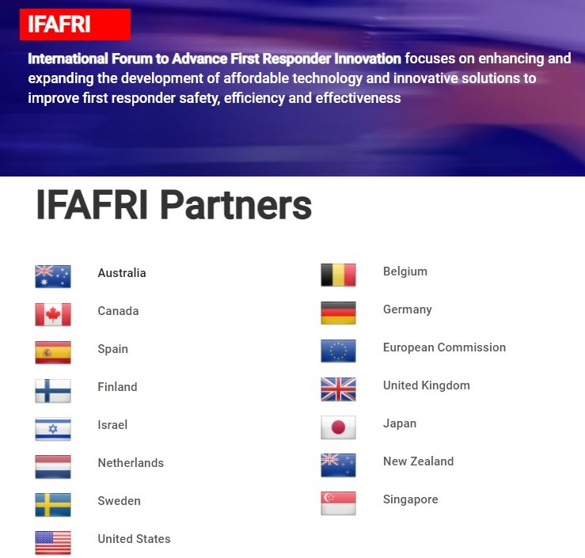
HORIZON-CL3-2022-DRS-01-07 Improved international cooperation addressing first responder capability gaps (RIA)
https://www.internationalresponderforum.org/partners
Area: Strengthened capacities of first and second responders
Expected Outcome:
Improved real-time detection, tracking and analysis of different situations, incidents and risks (including the location and well-being of first responders);
More targeted actionable intelligence and more efficient command operations due to the fast analysis of different information sources;
Enhanced European and global interoperability for different types of first responders (e.g. firefighters, medical responders, police, civil protection);
Availability of first responder solutions that are oriented on internationally defined requirements and recognised practices, and thus can be used with different national systems and equipment .
Total indicative budget: 5 M€ - This topic requires the active involvement, as beneficiaries of at least 3 first responders’ organisations or agencies from at least 3 different EU or Associated countries
Global capability gaps have been identified by international expert groups such as the UNDRR Scientific and Technical Advisory Group and the International Forum to Advance First Responder Innovation (IFAFRI), involving scientific experts, firefighters, medical responders and police officers from several EU and non-EU countries.

Slide 16
HORIZON-CL3-2022-DRS-01-08 Enhanced situational awareness and preparedness of first responders and improved capacities to minimise time-to-react in urban areas in the case of CBRN-E-related events (IA)
H202 Legacy about CBRN-E (not exhaustive)
ENCIRCLE, eNOTICE, PROACTIVE, TERRIFIC, EU-RADION, EU-SENSE
Area: Strengthened capacities of first and second responders
Expected Outcome:
Development of tools and technologies, including novel multiplatform CBRN-E systems, to enhance situational awareness to prepare for and rapidly react to CBRN-E events both for responders on the ground as well as for dispatch and crisis centres, especially in urban areas;
Support of first responders’ situational awareness via high level processing solution, e.g. based on dispersion modelling or threat recognition / prediction solution using sensor data fusion and algorithms that combine heterogeneous sensor data in order to reduce the likelihood of false alarms and contribute to an improved decision-making process for the responders;
Development of fast, reliable and portable devices for responders to perform an in-situ provisional identification of CBRN-E suspicious samples, enabling to decide which personal protective equipment (PPE) is required for first responders, including smart wearable equipment;
Solutions integrating different commercial and experimental sensors/platforms, which should improve the state-of-the-art products in terms of communication (e.g. by using novel and open communication protocols, pre-processing of data), power consumption (e.g. by offering supplemental power source to the existing sensors), interfacing capability (e.g. by proposing an open interface specification). The proposals should also cover the system transportability, online capability and continuous operation issues.
Total indicative budget: 11 M€ (2 projects) - Expected TRL 6-8 - This topic requires the active involvement, as beneficiaries, of at least 3 first responders’ organisations or agencies from at least 3 different EU Member States or Associated countries

Slide 17
Community for European Research and Innovation for Security (CERIS)
CERIS EXPERT GROUP
INFRA
TWGroup
DRS
TWGroup
FCT
TWGroup
BM
TWGroup
SSRI
TWGroup
HORIZONTAL ROLE FOR NETWORKS OF PRACTITIONERS,
NAT. CONTACT POINTS & EXISTING PLATFORMS
THEMATIC WORKSHOPS
INFRA
DRS
FCT
BM
SSRI
Sub-themes
Sub-themes
Sub-themes
Sub-themes
Sub-themes
Sub-themes
Sub-themes
Sub-themes
Sub-themes
Sub-themes
Representatives of respective policies,
EU-funded projects, industry/SMEs, Practitioners, DGs
NATIONAL AND/OR REGIONAL PLATFORMS
JAN
FEB
MAR
APR
MAY
JUN
SEP
OCT
NOV
DEC
THEMATIC WORKSHOPS
THEMATIC EVENTS
CERIS
BOARD

Slide 18
EU Security Research and Innovation: More Information and Resources
EU Innovation and Industry for Security
Frontex on EU research
Community for European Research and Innovation for Europe
Eu-LISA on EU research
Horizon Europe Strategic Plan > Cluster 3 “Civil Security for Society”
Annual Security Research Event
EU Funding & Tenders Portal
National Contact points for EU security research
@EUHomeAffairs
#EUSecurityResearch #SecureSocieties
SEREN Network of NCPs
EUHomeAffairs
Notes:
Delete/update as appropriate

Slide 19
Thank you!
https://www.securityresearch-cou.eu/suscribe
VIDEO INFO-DAY
https://youtu.be/fV_ixKBm3bw
CONTACT
philippe.quevauviller@ec.europa.eu

