Slide 1
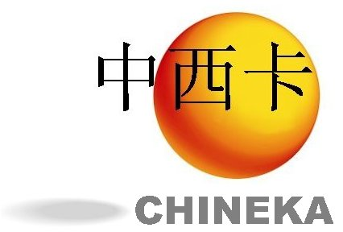
RESEACRH, DEVELOPMENT AND INNOVATION IN SPAIN
CHINEKA
Carlos Quintana, CDTI
秦开朗
西班牙国家创新署
西班牙国家工业技术发展署

Slide 2
General Background information on Spanish R&D System
COUNCIL FOR SCIENCE, TECHNOLOGY AND INNOVATION POLICY
ADVISORY COUNCIL ON SCIENCE, TECHNOLOGY AND INNOVATION
Min. of Science
State-Secretariat R&D& Innovation
SPANISH COMMITTEE FOR RESEARCH ETHICS
SPANISH SCIENCE AND TECHNOLOGY STRATEGY
SCIENCE, TECHNOLOGY AND INNOVATION INFORMATION SYSTEM
SPANISH INNOVATION STRATEGY
NATIONAL-LEVEL FUNDING AGENCIES | Min of Science (70% of Central Gov. Funding for R&D) National Agency for Research Center for Industrial Technological Development (CDTI)- supports innovative enterprises Sectorial Ministries: Industry &Energy (ICT,20%), Defence (2.7%)
PERFORMER ORGANIZATIONS | Public R&D Centres Research Infrastructures | Universities | Public-private initiatives Private Sector
Notes:
The funding instruments for R&D & innovation activities operates at three levels, with European, National and Regional programmes.
This slide depicts the coordination of R&D activities from the central government and the existing national-level funding agencies.

Slide 3

Spanish Strategy on R&D & Innovation (2013-2020), “from Concept to Market”
Scientific and Innovative Talent
Attractive Environnment for R&D and Innovation
Technologic and entrepreneurial leadership
Internationalization
MARKET
Resources for R&D
Talent attraction
Support to innovative companies
Development of future technologies
Efficiency
Societal Challenges
CONCEPT
Prioritisation and rationalisation
Excellence
Notes:
The new Spanish strategy on R&D & Innovation aims to facilitate the transference of knowledge to market and to promote research addressing major societal challenges.
It shares three pillars with the European Framework Programme Horizon 2020: Excellence, Industrial leadership and Societal Challenges.
It has an additional 4th pillar dealing with the attraction of scientific and innovative talent.

Slide 4
Spain: Some relevant figures of the R&D & Innovation system
INSTITUTIONAL RANKING
WORLD SCI. PRODUCTION
(SCI Journals, SIR)
CSIC – 7th in the world
12 UNIVERSITIES among first 500 most productive institutions
OVERALL PRODUCTION
10th world position (2013), 3% of world citable documents (SCR).
Most productive areas (% Spanish Prod.):
Medicine: 18.2%
Biochemistry, Genetics & Molec. Biol.: 7.8%
Engineering: 7.4%
Physics & Astronomy: 7.3%
Agriculture & Biol.Sci.: 7.1%
INNOVATIVE ENTERPRISES
6 companies among the top world 500 companies investing the most in R&D activities.
2014 EU Industrial R&D Investment Scoreboard
GRIFOLS & INDITEX among the world 100 most innovative companies (Forbes, 2014)
WORLD QUALITY
(publications in top 25% of journals in a given field)
11 Institutions among the first 100 world institutions
Notes:
… Technological expertise. This slide shows just some examples. There are many others in these very same fields and in the renewable energy, biomedical, biotechnology, water management, and agrofood sectors.

Slide 5




R&D & Innovation Performers
78 SPANISH UNIVERSITIES
26,7% of total R&D expenditure (3.7000M€)
77.200 people working on R&D
PUBLIC RESEARCH CENTERS
Funded by Central Adm. Budget
– All fields. 11.00o res. & technicians.
– Energy & Environ. 1.130 res.& tech.
– Nat. Inst. Health Carlos III. Biomedical. 700 res. & technicians.
IEO – Marine & Oceanic. 530 res. & techns.
IAC – Astrophysical Res. 260 res. & techns.
– Agron. & Forestr. 700 res. & techs.
IGME – Geol. & Mining. 350 res. & techns.
INTA – Aerospace R&D. 1000 res. & techs.
Academia
119 Technol.
Centers
45 Scientific & Technol. Parks
Innovative
Enterprises
Notes:
The Research and Development performers mainly include Universities and eight national laboratories devoted to specific fields of interest – but for CSIC which operates in all fields. Some of them, like CSIC, have branches all over Spain. In addition, there are regional research centers which are funded by the regional governments.
Technological Transfer to market is mainly carried out at the Technological Centers and Scientific and Technological Parks, which involve both Academia and Innovative enterprises in thier activities.

Slide 6

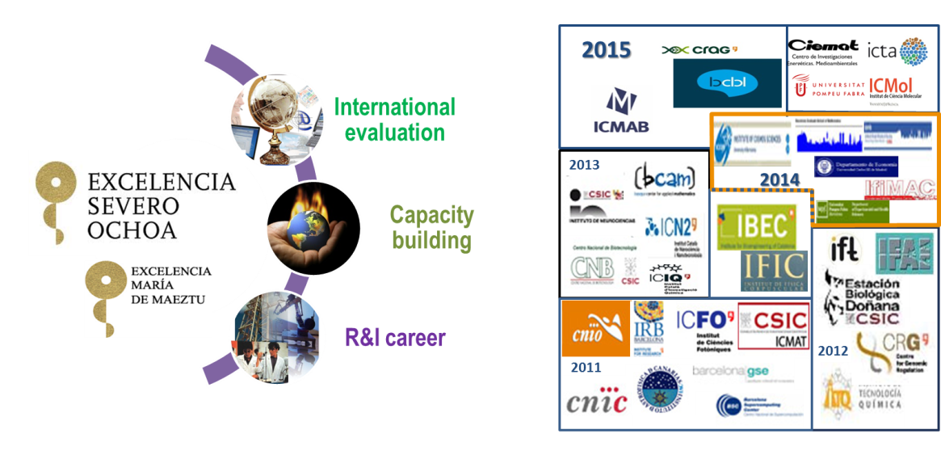
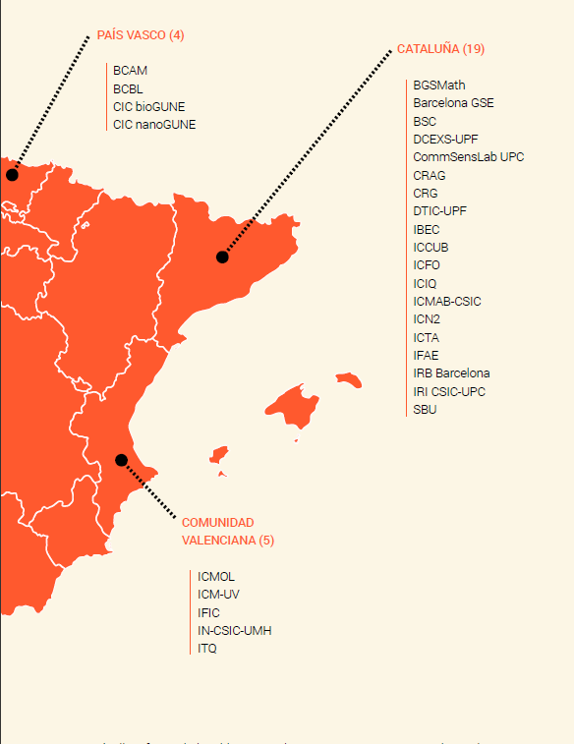
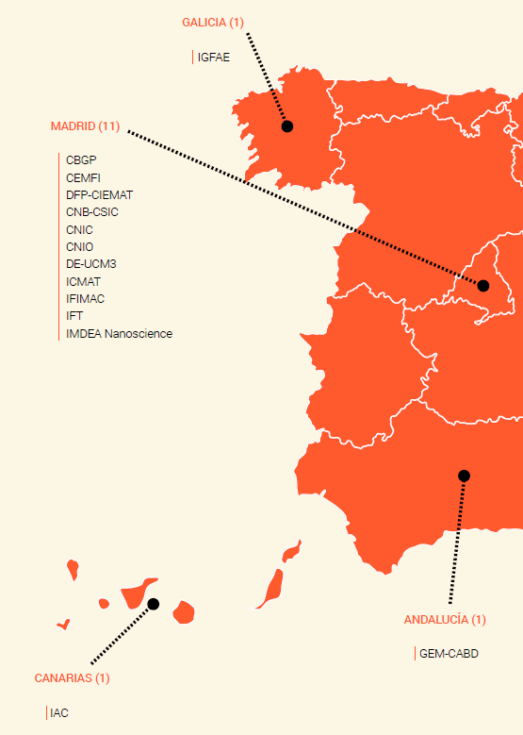
EXCELLENT RESEARCH INSTITUTIONS
Research Excellence
26 Centres and 15 Units awarded with Severo Ochoa and María de Maeztu Recognition
Notes:
6
This slides depicts the excellence of our system. Our present strategies promotes excellence – the Severo Ochoa award is provided to the best research centers and University Departments. This award provides them with additional funds and a specific training and mobility programme.

Slide 7
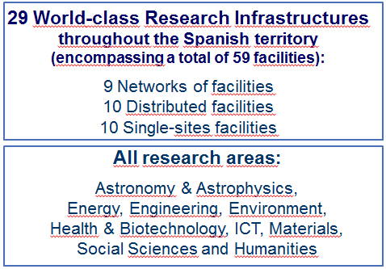
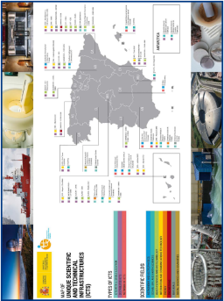
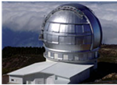
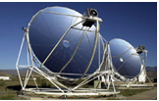
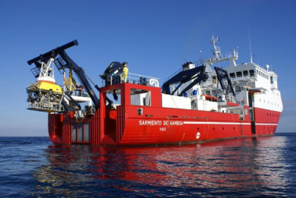
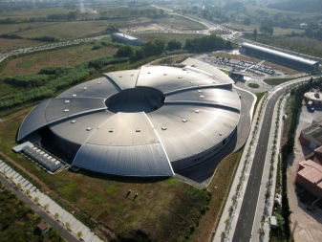
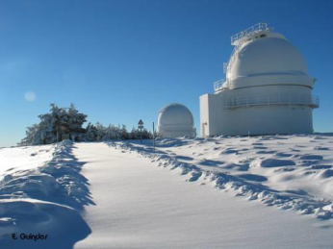
WORLD-CLASS RESEARCH INFRASTRUCTURES
SINGULAR SCIENTIFIC AND TECHNOLOGICAL INFRASTRUCTURES (ICTS)
2013-2016
2016-2020
Continuous updating and follow-up of the map:
Continous high standard scientific and technological evaluation,
Increasing access to users and internationalization (ESFRI, RPFs),
Consolidation of existing infrastructures and strategic priorization on new ones attending to criteria of resources rationalization and coordination,
Promotion of inovation, technolgy transfer and private participation.

Slide 8
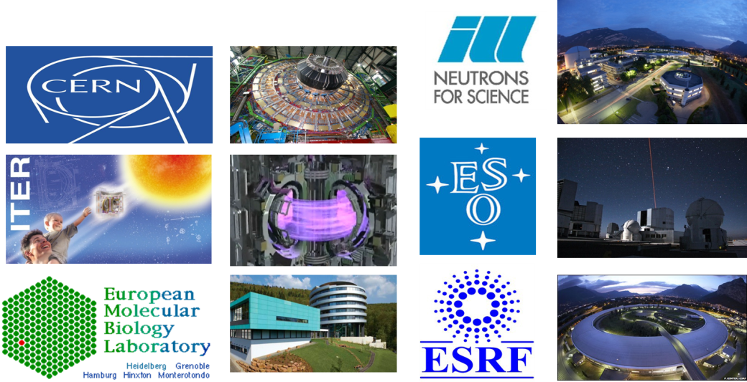
PARTICIPATION IN INTERNATIONAL ORGANIZATIONS
Notes:
8

Slide 9
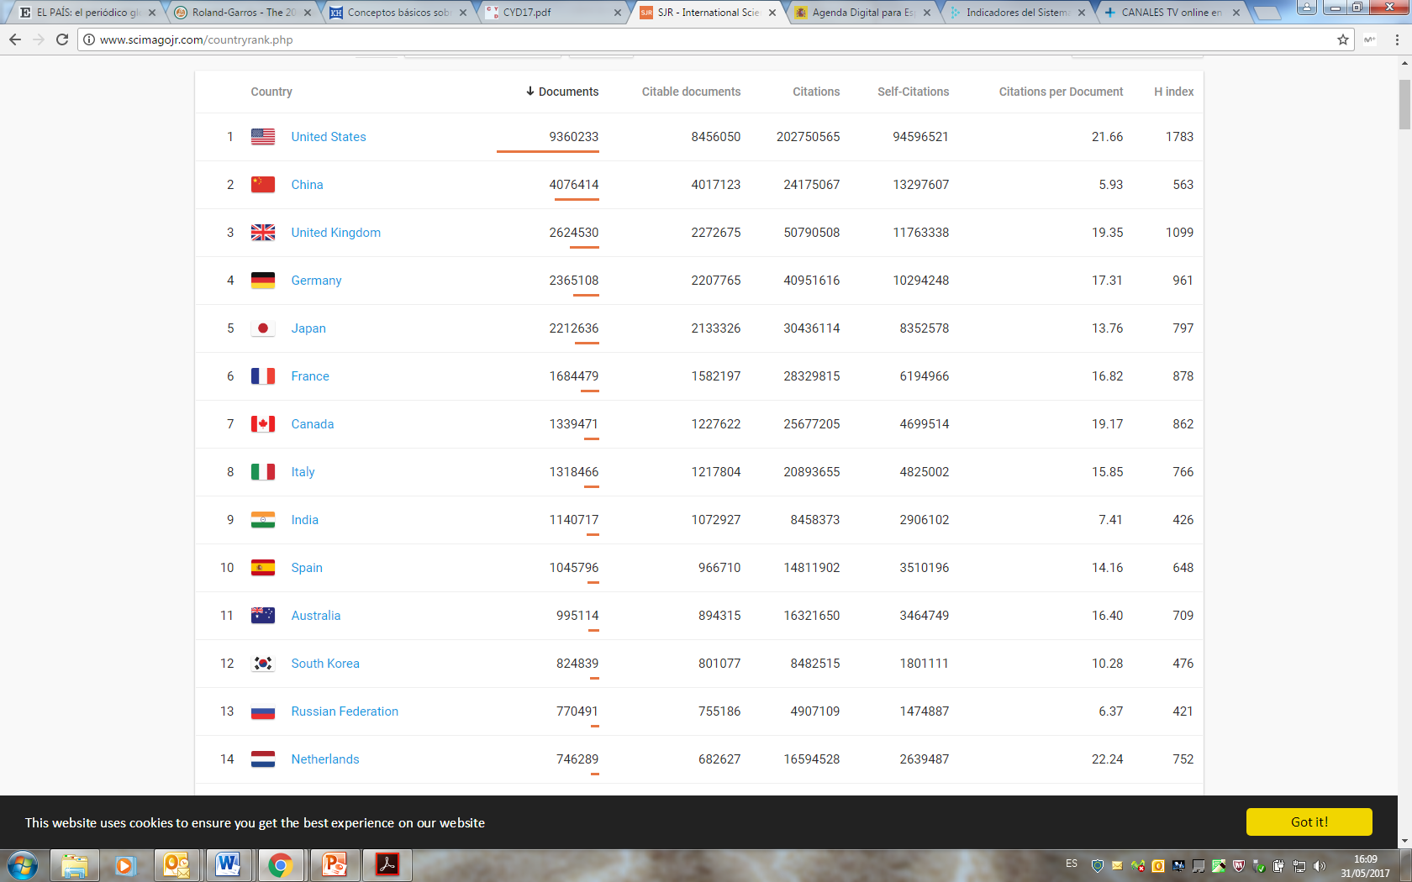
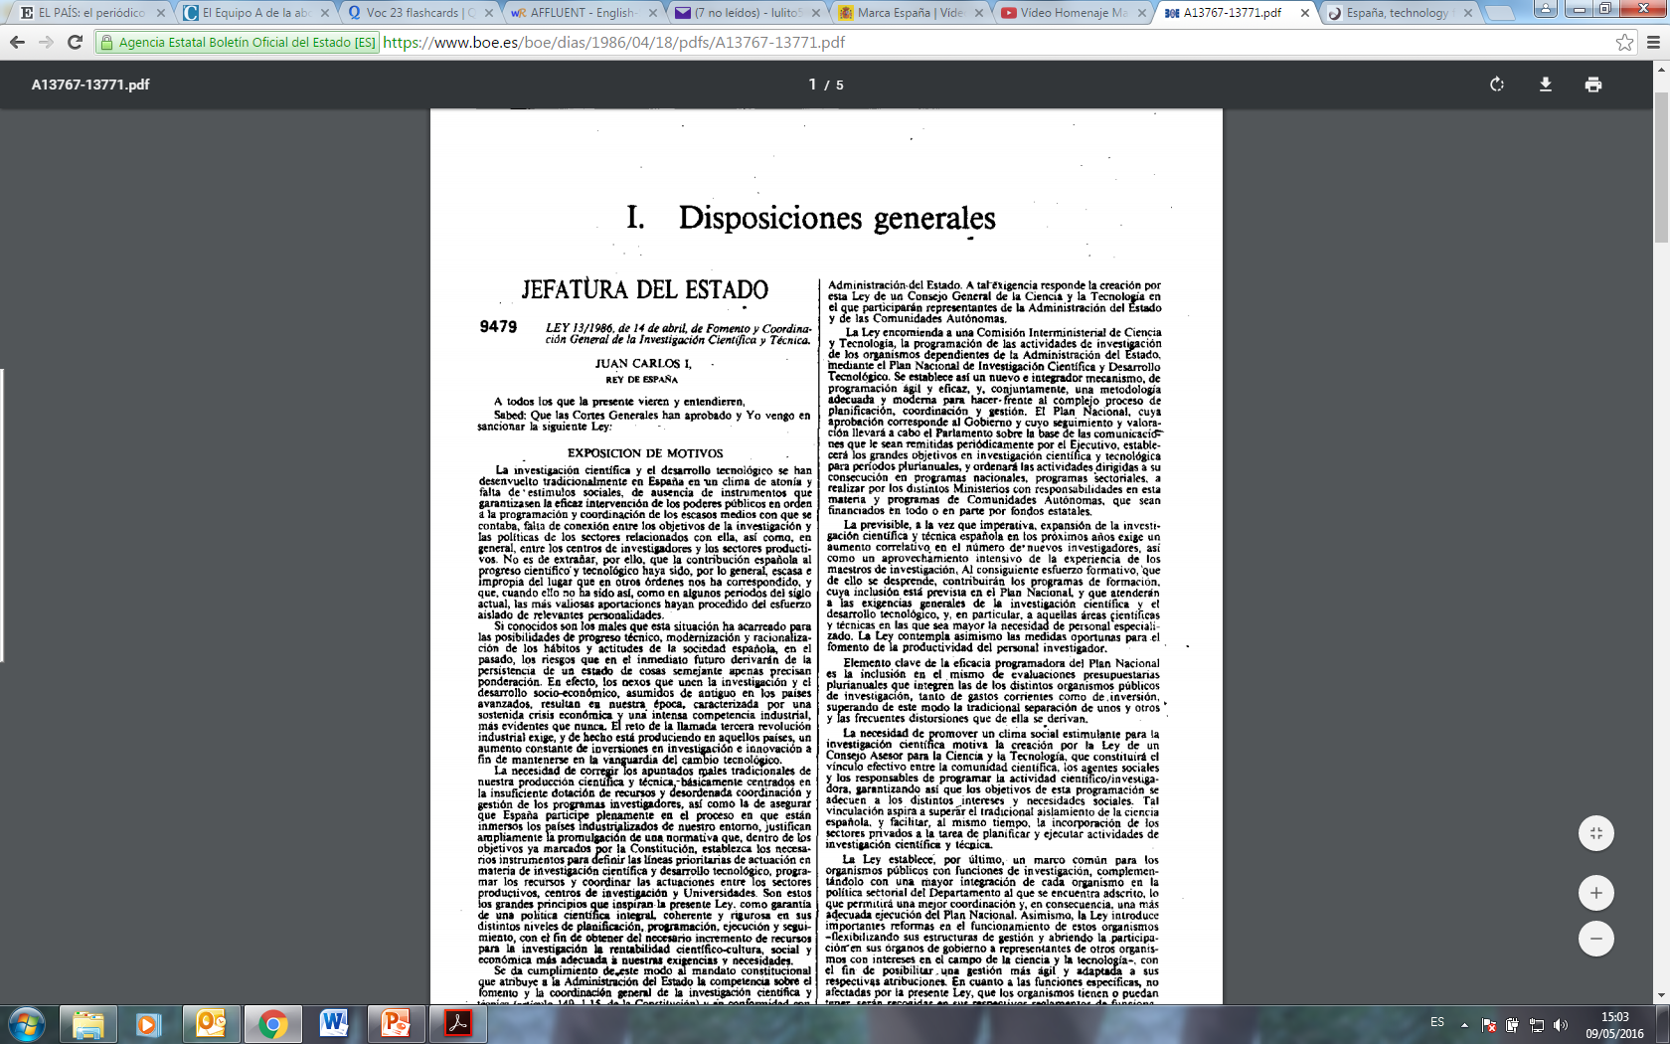
PUBLICATION LEADER IN 30 YEARS
SCIMAGO 1996-2015 ranking
First Law for Science
1986
Second Law for Science
2011
30 years

Slide 10



SPANISH SCIENCE IN A NUTSHELL
3,2 % of world’s scientific production
4,3% of excellent scientific publications
6,7% of the publications included in the most relevant journals
7,7% of research with international collaboration
0,7% of world’s population
1% of world’s expenditure in R&D
1,7% of researchers

Slide 11

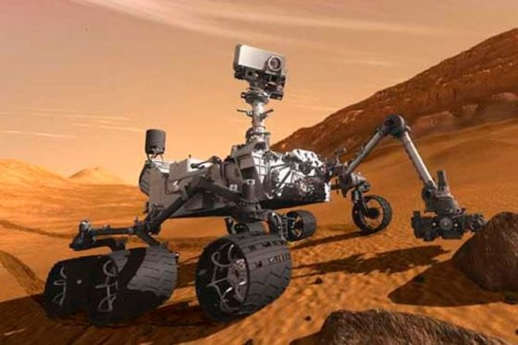







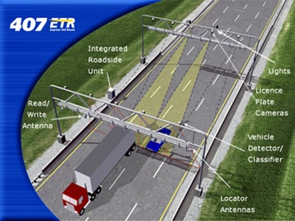

INNOVATIVE TECHNOLOGY
CASA one of the founding companies of EADS
ITP world referent in low-pressure turbines for aeronautical engines.
REMS instrument in Mars, by CRISA.
High Gain Antena, by EADS CASA & SENER
GMV world-lider for control centres for tele-communication satellites
CINTRA implemented Freeway 407 ETR (Toronto, Canada) – first completely electronic & freeflow highway in the world.
CNIC-Ferrer PPP developing the first Polypyll in administrating different drugs for chronic cardiovascular patients.
Notes:
11

Slide 12

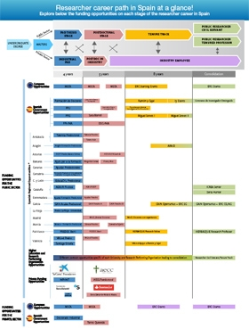


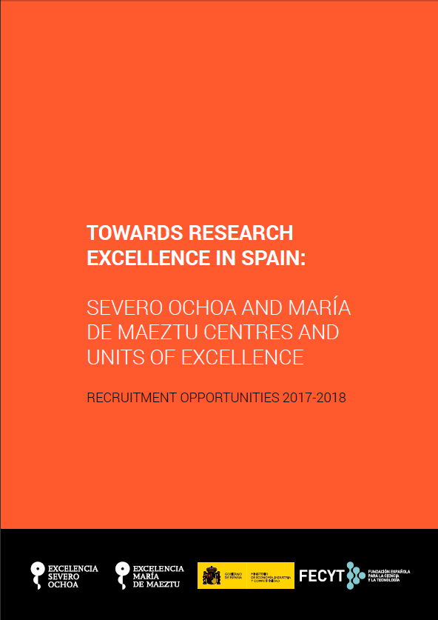
OPPORTUNITIES FOR RESEARCHERS IN SPAIN
http://www.euraxess.es/eng/jobs/researchers-career-development-in-spain

Slide 13
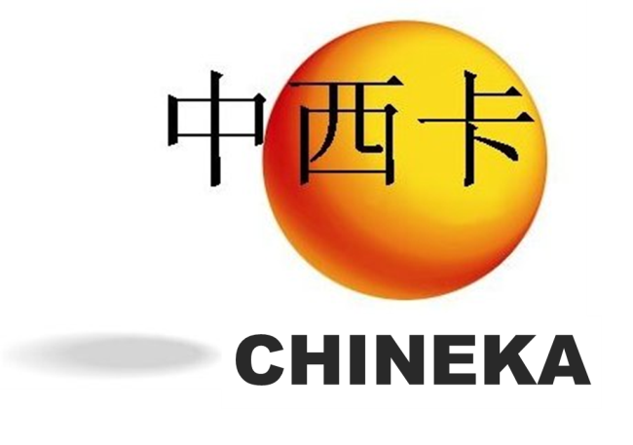

RELEVANT PROGRAMMES FOR SPANISH-CHINESE COOPERATION
MINISTRY OF SCIENCE Training and Mobility programmes
Researcher Training: “FPI”
Senior Researcher: “Ramón y Cajal”
Young Researcher: “Juan de la Cierva”
Doctors in Companies: “Torres Quevedo”
Technical Support Staff
Technologists in Companies: “Inncorpora”
Centres of Excellence: “Severo Ochoa”
http://http://www.ciencia.gob.es/portal/site/MICINN/
http://www.cdti.es/
  CHINEKA Programme
  Bilateral technology projects with market-oriented results.
  Call for tenders open the whole year.
  Minimum 2 companies (Chinese & Spanish) + Institutions.
  Decentralized funding: No common pot for exchange of funds.
  Quality label “CHINEKA” - appreciated & appropriate for SMEs.
Notes:
There are two major programmes enabling the Spanish-Chines cooperation.
The first one are the MINECO’s training and mobility programmes which cover all the research career. There are additional regional programmes; also ISCIII has similar instruments just devoted to clinical research.
The second one is MINECO-CDTI’s CHINEKA programme devoted to bilateral technology projects focused on market-oriented results.

Slide 14
THANKS!
非常感谢!
Carlos Quintana
Delegate of CDTI in China
+86 21 6218 11 22
carlos.quintana@cdti.es

