Slide 1
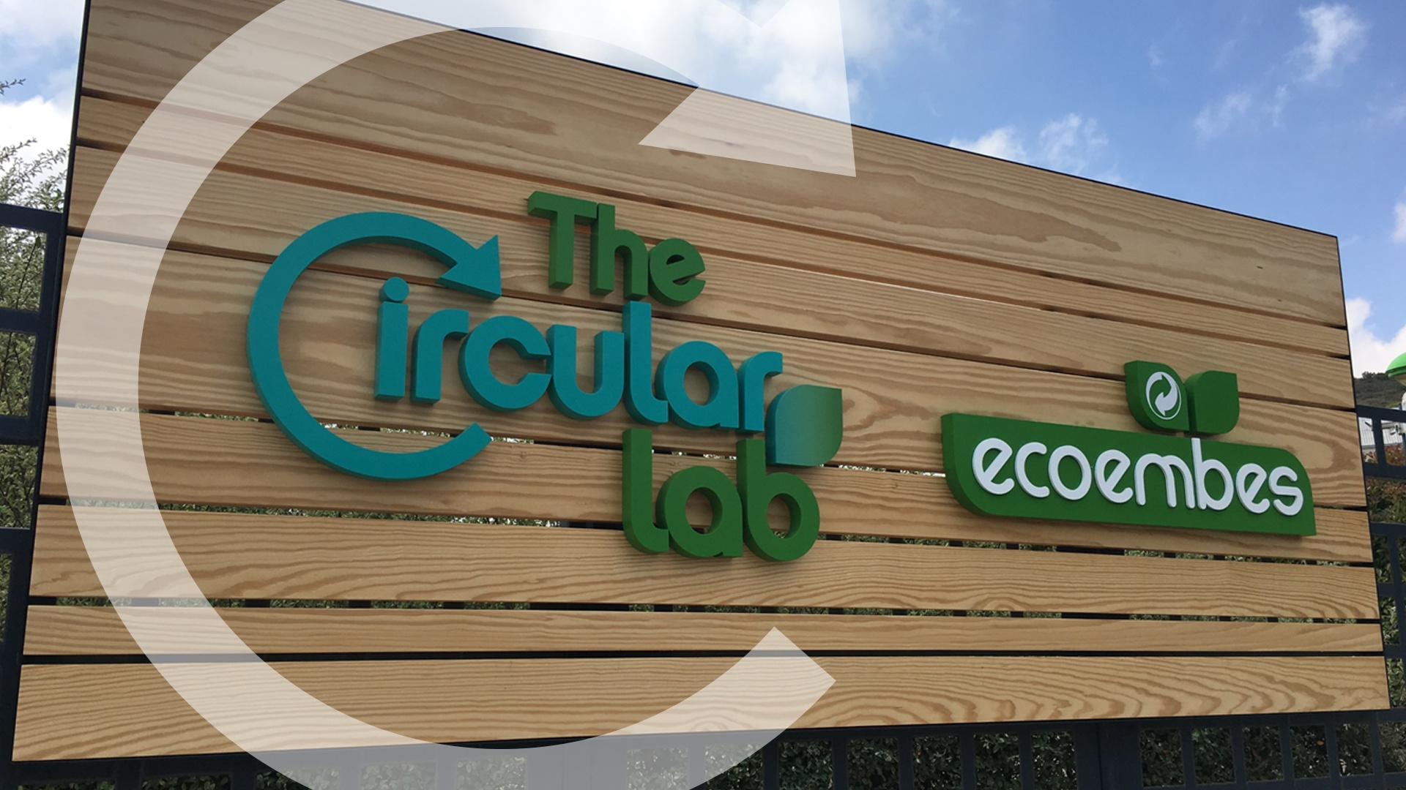



Slide 2
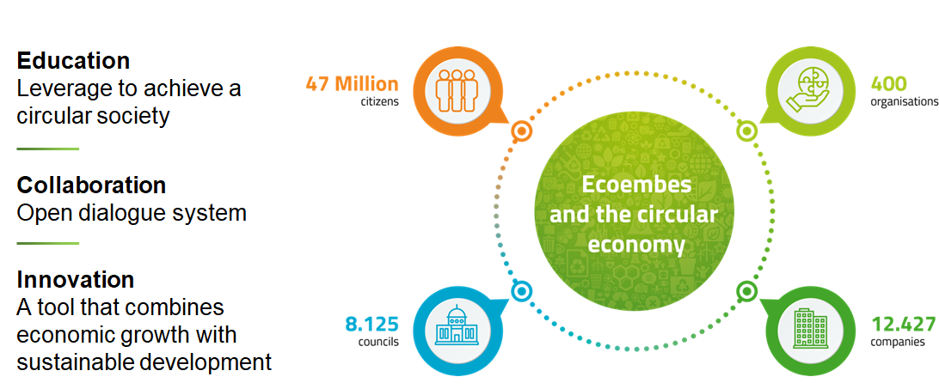
Ecoembes and the Circular Economy

Slide 3
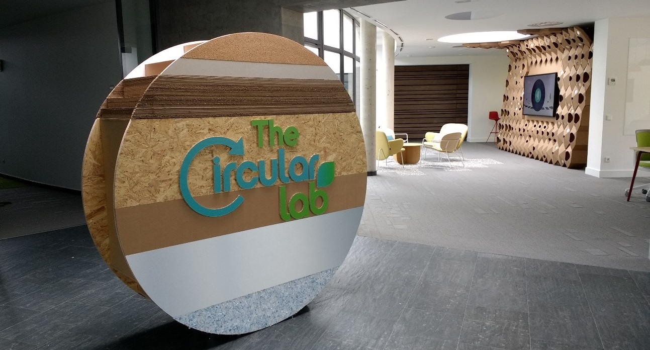
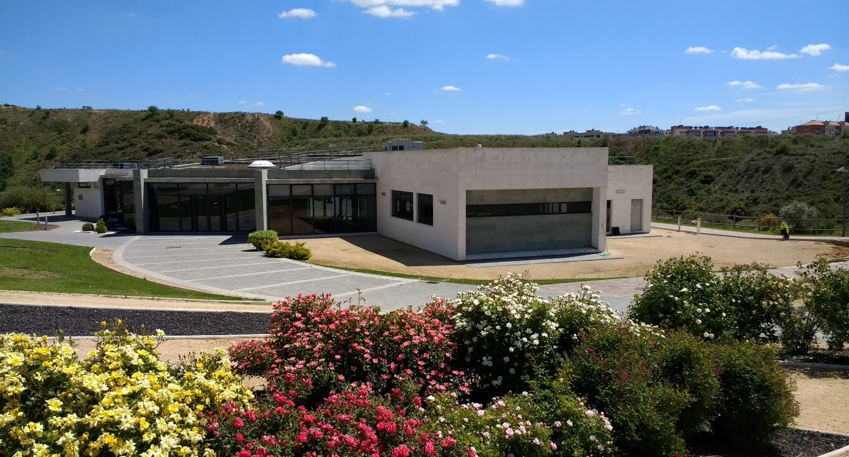
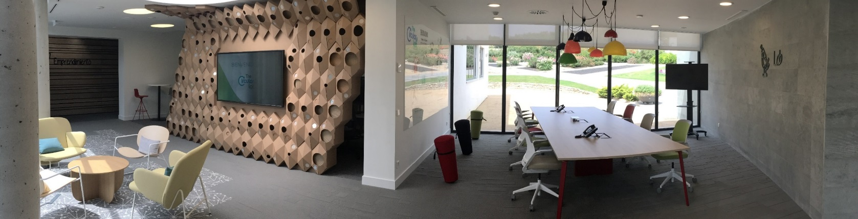
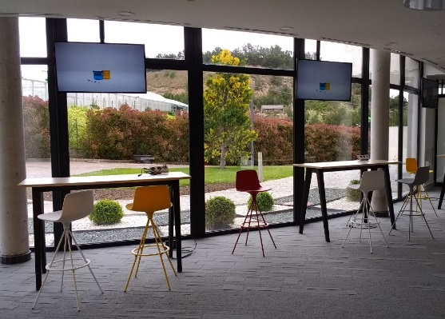
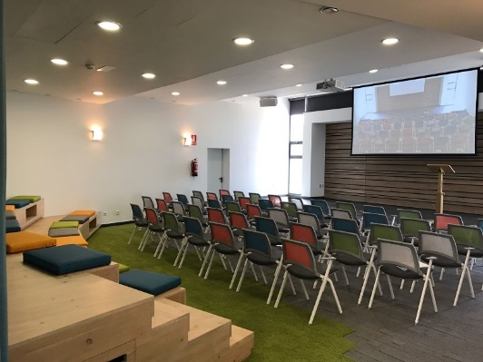
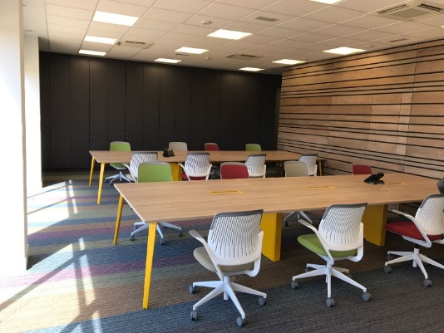

International-reference Real-scale laboratory for the research and validation of solutions related with packaging in a circular economy framework.
> 900 m²
Auditorium
Meeting rooms
44 work spaces
Focus groups room
Show Room

Slide 4


TheCircularLab’ innovation lines
ECODESIGN
Creating more sustainable packaging
SMARTWASTE
Evolving waste management through Artificial Intelligence and IoT
CITIZEN SCIENCE
Helping citizens to recycle more and better through innovative solutions
ENTREPRENEURSHIP
Supporting the development of new ideas that help improve waste management

Slide 5
Our Data
+150
INNOVATION PROJECTS
30
+200
PARTNERS
UNIVERSITIES & RESEARCH CENTERS
10
81
26
MILLIONS € INVESTED UNTIL 2020
250
STUDENTS
+2
STARTUPS ACCELERATED
EVALUATED STARTUPS
MILLIONS €
INVESTED IN STARTUPS
+600.000
+400
+350
PEOPLE TESTING OUR SMARTWASTE PILOTS
PARTICIPANTS IN CIRCULAR DESIGN WORKSHOPS & CHALLENGES
IDEAS PRESENTEN IN OUR INTER-ENTERPRENEURSHIP PROGRAMS

Slide 6

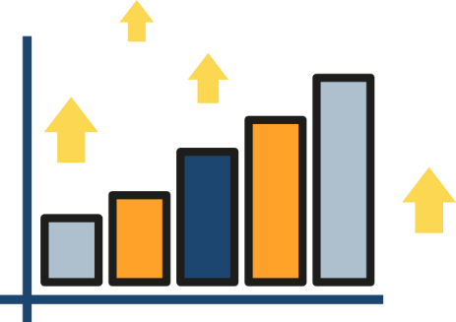
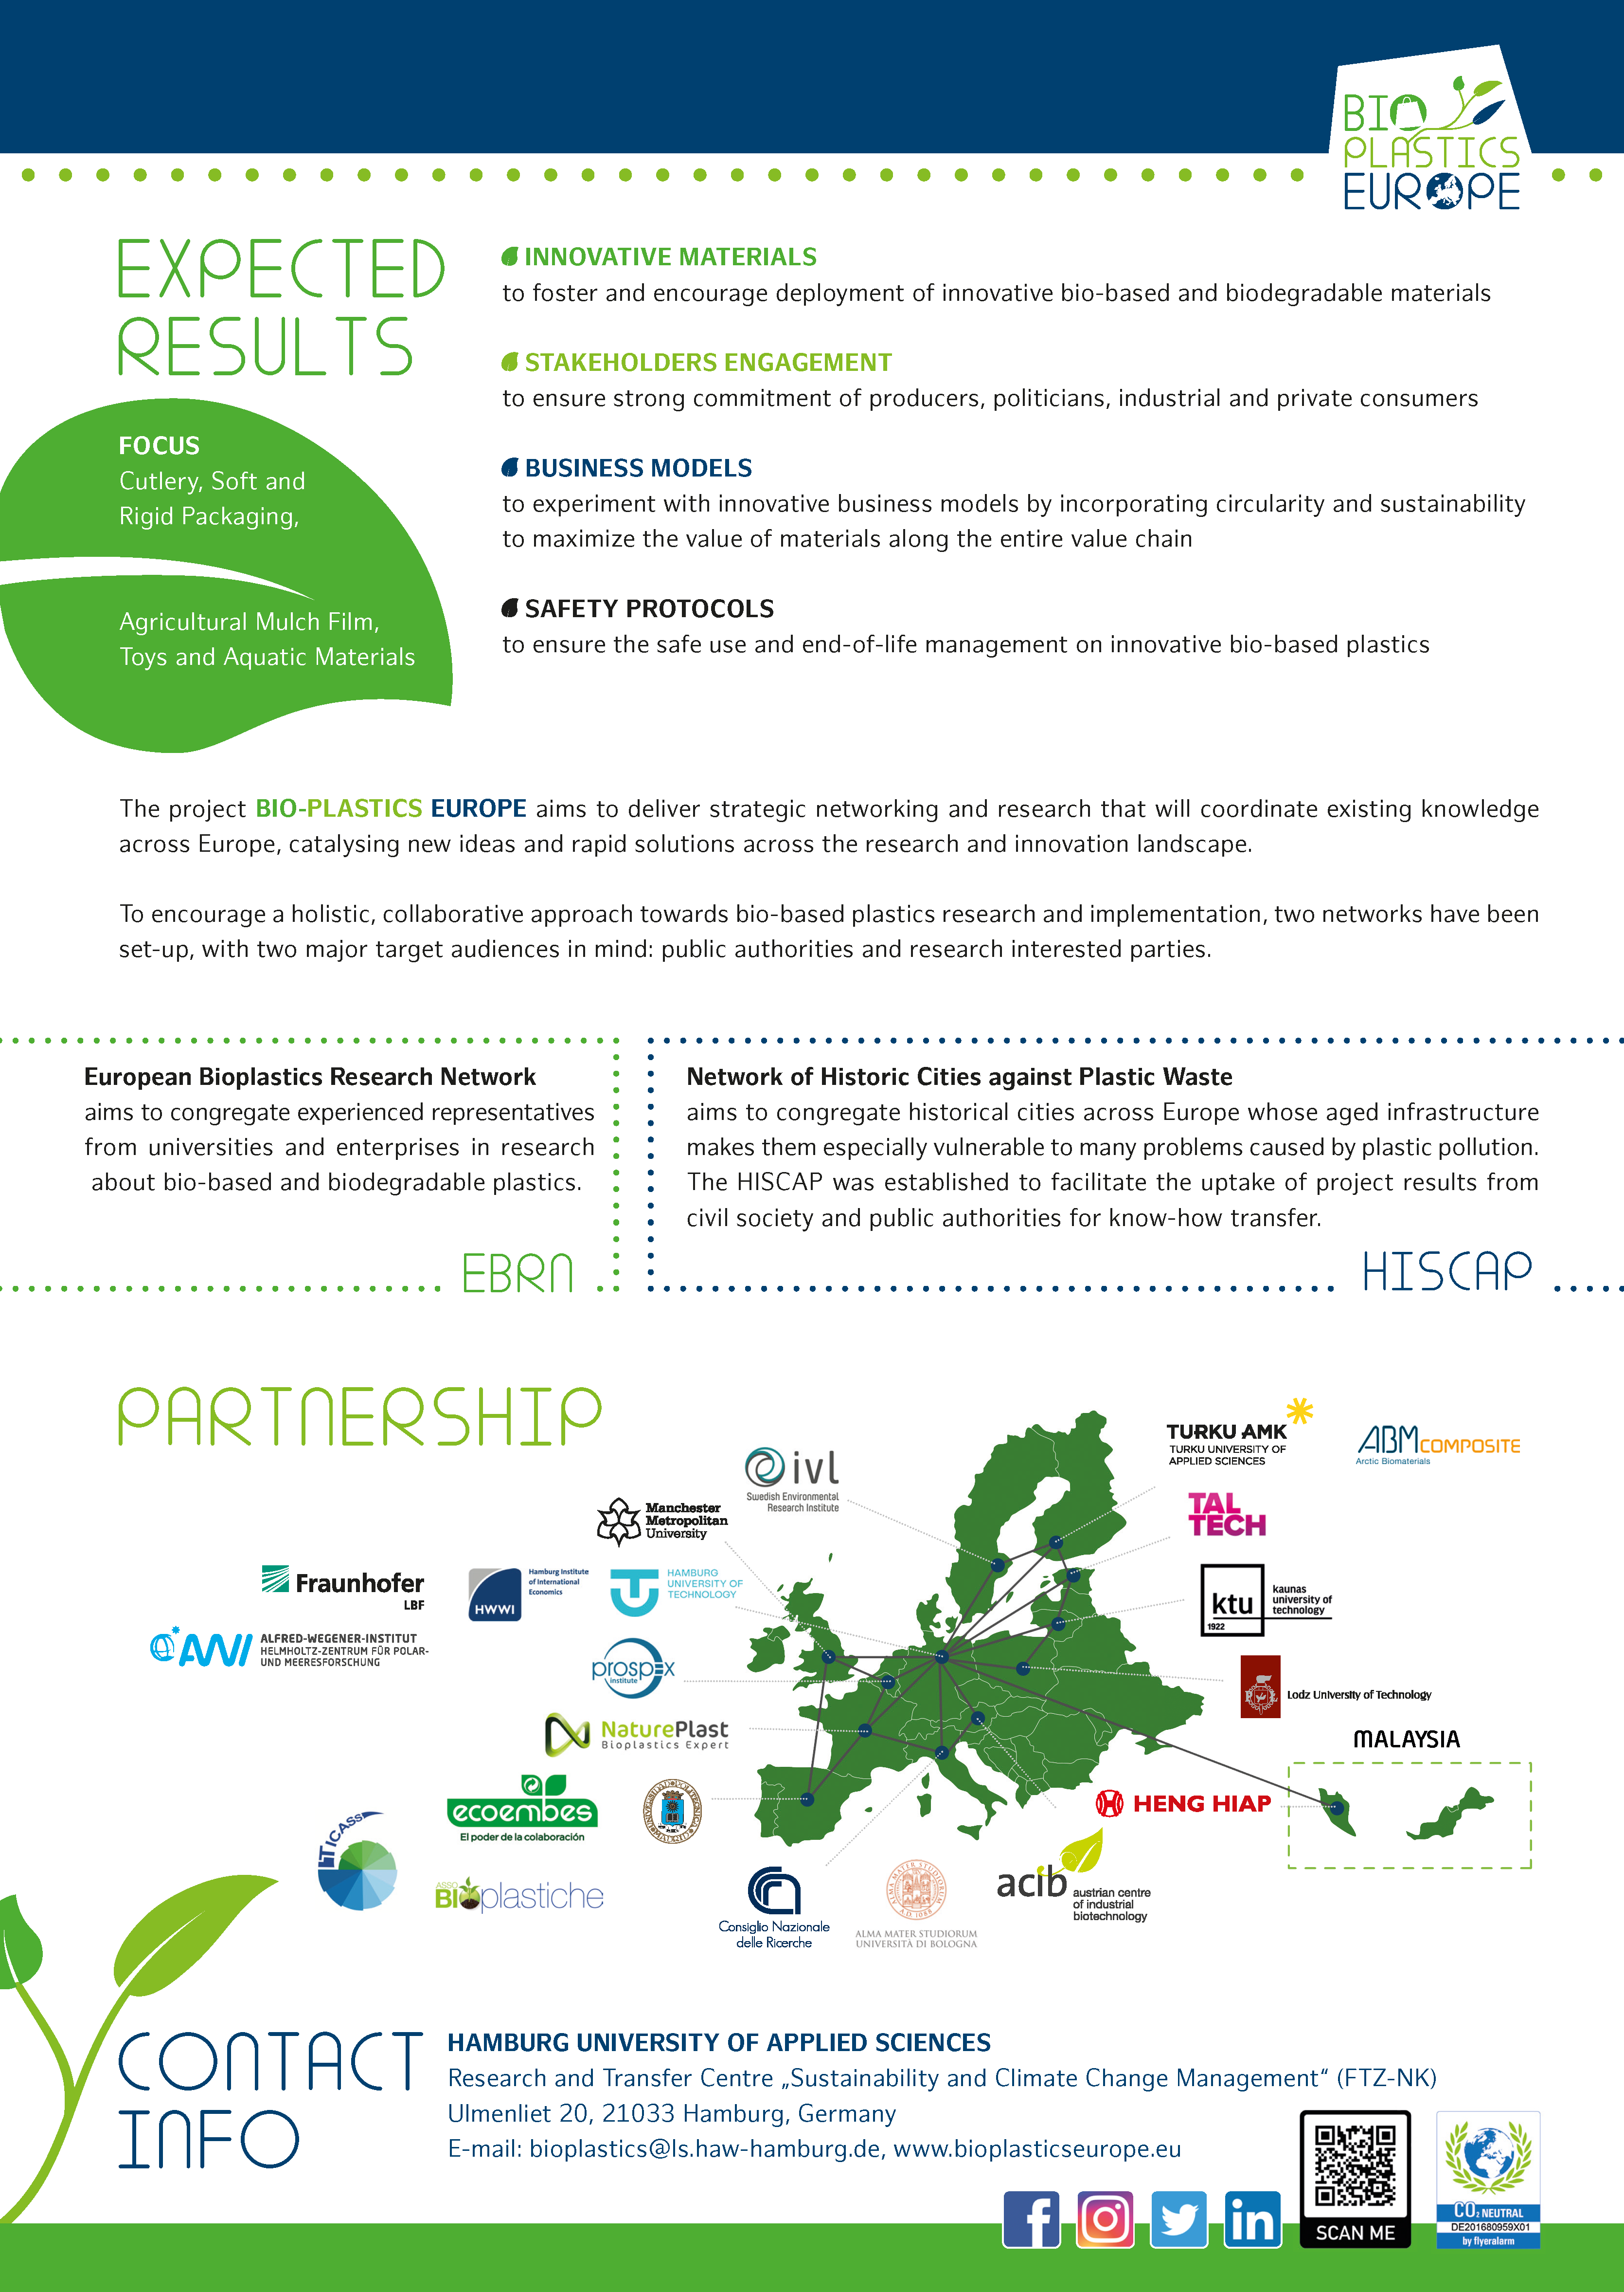
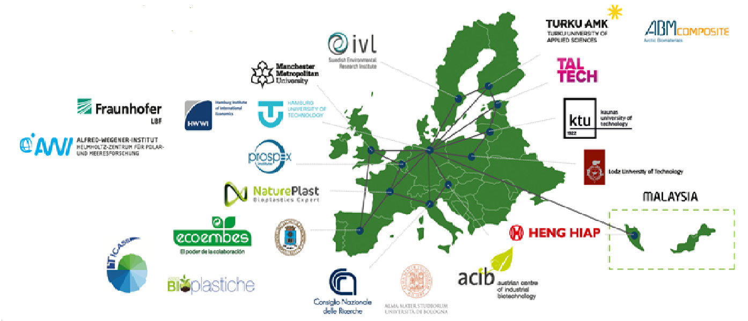

BIOPLASTICS EUROPE
MAIN OBJECTIVE:
To develop sustainable strategies and solutions for bio-based biodegradable plastic products, as well as the to develop approaches focused on circular innovation for the whole bioplastics system. These may be deployed to support policy-making, innovation and technology transfer.
.
SOME FIGURES:
48 months (October 2019 – September 2023)
8.5 million Euros
2 networks created: cities & research centers
22 partners
13 countries
EXPECTED RESULTS:

Slide 7




SEPARA PROJECT
Inside the MISSIONS program of CDTI:
Mission 1: Safe, efficient and clean energy for the 21st Century
Mission 2: Sustainable and Smart mobility.
Mission 3: Promote a sustainable and healthy agro-food sector
Mission 4: Boost Spanish industry in the industrial revolution of the 21st century
Mission 5: Provide a sustainable response to diseases and needs derived from aging
Research into technological solutions capable of generating a disruptive transformation in the waste management and treatment sector.
SOME FIGURES:
4 years (2020 –2023)
5.98 million Euros
80% of the budget for Research activities
8 partners (Ecoembes: leader)
5 research centers and universities (20%)
The project is aligned with the Digital Transformation Strategy of the sorting plants.
Main technologies:
  Big Data
  Deep Learning
  Industrial IoT
  Augmented Reality
  Optical separation by advanced robotics
  Remote sensing and spectroscopy
  Artificial vision

Slide 8
HOW TO COLABORATE WITH US
Entrepreneurs
Young talent
Companies
Universities
Open Innovation Ecosystem
Young Talent
Circular
Talent
Labs
(CTL)
Circular
Design
Sprint
(CDS)
Start-ups
Acceleration
University Challenge
Go Circular Program
Start-ups circular economy projects
Young Talent
Companies: Minilabs
Entrepreneurs: Mentoring
Entrepreneurs
Professionals
Young Talent
Start-ups

Slide 9


THANK YOU!

