Slide 1
ACCELERATING THE IMPACT OF INNOVATION THROUGH SPAIN-ASEAN STRATEGIC PARTNERSHIPS IN BIOECONOMY, URBAN AND FOOD SUSTAINABILITY

Slide 2
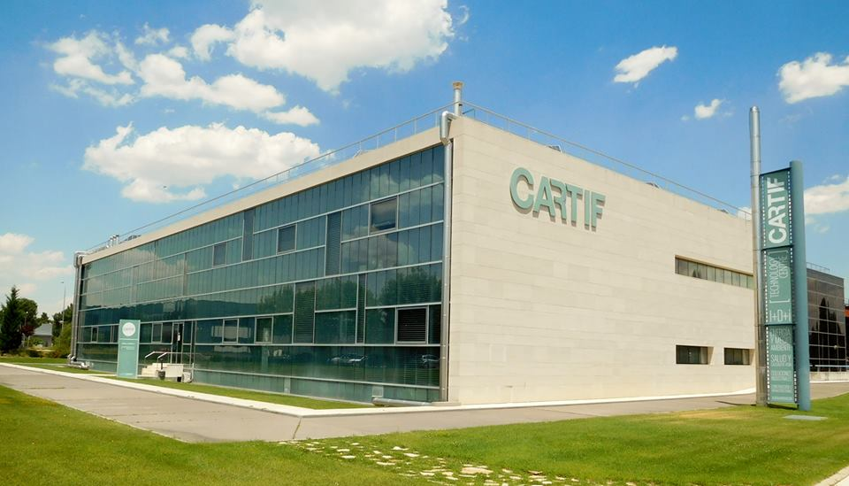
What is CARTIF?
Technological Centre whose mission is to generate technological knowledge and innovative ideas for companies in order to improve their competitiveness
Foundation. Private non-profit organization, with a general interest purpose: INNOVATION

Slide 3
How is CARTIF organized?
Agrofood and
processes
Industrial and digital services
Energy

Slide 4
NATURAL RESOURCES AND CLIMATE
CIRCULAR ECONOMY
SMART GRIDS
BIOTECHNOLOGY AND SUSTAINABLE CHEMISTRY
ENERGY AND CLIMATE
POLICIES
FOOD
SMART CITIES
INDUSTRY
ENERGY EFFICIENCY
CONSTRUCTION AND INFRASTRUCTURES
ENERGY SYSTEMS
HEALTH AND QUALITY OF LIFE
CULTURAL AND NATURAL HERITAGE

Slide 5
Business model
CARTIF develops R + D + i projects for companies, offering personalized technological services and technological consulting of the highest level.
CARTIF develops R + D + i projects financed through public funds obtained in competitive calls at national and international level.
CARTIF advises public administrations (city councils and regional governments) in the planning and development of innovative projects with high economic returns.

Slide 6
Financing model

Slide 7
ASEAN Entities
The Association of South East Asian Nations (ASEAN) is currently made up of 10 countries in the Southeast Asian region: Malaysia, Indonesia, Brunei, Vietnam, Cambodia, Laos, Myanmar, Singapore, Thailand and the Philippines.
CARTIF has direct contact with Singapore and Vietnam in the context of URBAN GreenUP project.

Slide 8
URBAN GreenUP Overview
Program: HORIZON 2020 - Work Programme 2016 - 2017
Topic: SCC02-2016-2017: Demonstrating innovative NBS
Name of the coordinating person: Raúl Sánchez
Technical Coordination Team: Nuria Garcia, Jose Fermoso, Laura Pablos,
Silvia Gómez, Paloma González, María González, Esther San José.
Administrative Coordination: Daniel Martín
Dates: 1st June 2017/1st May 2022
Total effort: 1.230,5 person month
Total Eligible Costs: 14,811,824.44 € (EC contribution: 13,970,642.25€)
The consortium: 25 Partners (8 municipalities, 9 RTD – 6 tech. centers, 3 universities – , 2 large industries, 3 SMEs, 2 Non Profit organizations and 1 public body)
Nationalities: 9 ( Spanish, English, Turkish, German, Italian, Portuguese, Chinese, Vietnamese, Colombian)

Slide 9
URBAN GreenUP Overview / impacts
URBAN GreenUP is the demonstration of an innovative methodology to re-naturing cities (the concept of Re-naturing Urban Planning –RUP-) through NBS interventions, considering new technologies, towards the adaptation of the cities to fight against the climate change
URBAN GreenUP Impacts
New global NBS market, new economic opportunities, products, local green jobs (more than 500 direct jobs)
Increasing awareness of the benefits of re-naturing cities
Enhancing stakeholder and citizen participation (processes for co-design, co-development and co-implementation).
Fostering the creation by 2020 of healthier and greener cities
Increasing the international cooperation
Enhancing the implementation of EU environmental policies
Improving living conditions and biodiversity
Improving Mobility conditions – green corridors associated with promoting the use of bicycles

Slide 10
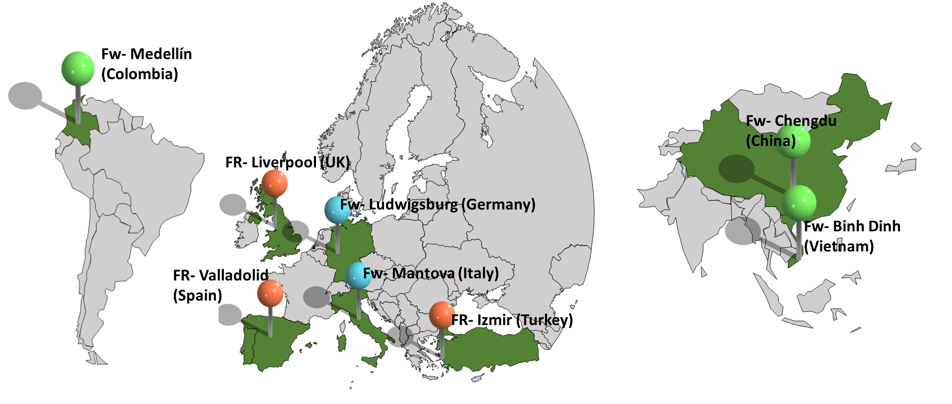
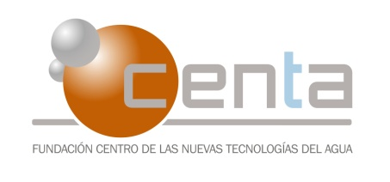
URBAN GreenUP Worldwide Dimension

Slide 11
URBAN GreenUP Project - ASEAN Entities
Urban greenup Vietnamese partners
Socialist Republic of VietNam BINH DINH PEOPLE’S COMMITTEE - QUY NHON CITY. Follower city
RMIT University Vietnam

Slide 12
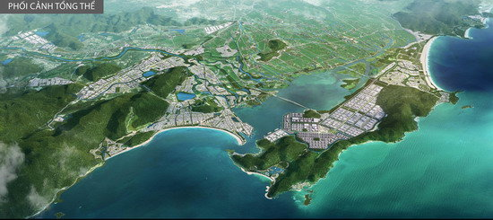
URBAN GreenUP Project - ASEAN Entities
Review the Characterization of front-runner and follower cities by areas with Quy Nhon team
Identify the specific city’s climate, water management and regeneration, renature challenges
Screen the list of NBS applicable (from the NBS catalogue, from front-runner demo)
Identify the specific NBS to mitigate the challenge that suitable for Quy Nhon condition
QUY NHON CITY
Analyze all the selected NBS for its relevancy, and its most suitable financial mechanism .
Use of financial instruments for the implementation of NBS (public and private)
Co-creation of specific procedure and methodology applicable to local condition and city
Technical KPI for NBS implementation, monitoring procedures

Slide 13
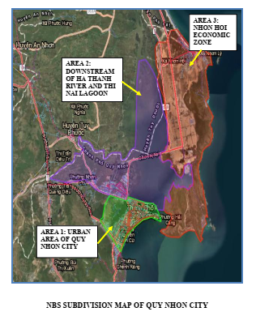
URBAN GreenUP Project - ASEAN Entities
QUY NHON CITY
QUY NHON Urban zoning and nbs considered
Developed the mapping of NBS with Quy Nhon climate, water management and urban renature challenges
Currently separated into three zones (the new urban area zone – with water management challenges; the city center zone with renature challenges; the flood affected district with flood management challenges)
Further analysis will be carried out for the selected NBS to be included in the RUP.

Slide 14
URBAN GreenUP Project ASEAN Entities
QUY NHON CITY

Slide 15
URBAN GreenUP Project - ASEAN Entities
RMIT University Vietnam
WP6. REPLICATION AND CLUSTERING
Characterization of FR and FW cities by areas
Development of a model for replication potential
Analysis of the replication potential in FW cities
Development of an implementation/replicability plan
Coaching and mentoring actions
Currently: EC Task Forces and Biodiversity Work Stream

Slide 16
Singapore: Vertical Greening in high density city environments
Yvonne Tan Singapore Green Building Council

Slide 17
CARTIF – ASEAN Entities
Working lines
Working lines
Bio-urbanism and re-naturalization
Air quality improvement
Water management systems (natural waste water treatments)
Green-blue infrastructure
Sustainable management of Natural resources
Direct actions
Staff exchange
Sharing knowledge
Collaborative projects (Horizon Europe, Bilateral programmes…)
Direct collaboration through Strategic Projects

