Slide 1
EURAXESS BHO Meeting
02 December 2021
Apostolia KARAMALI
European Commission, DG R&I
R&I Actors and Research Careers

Slide 2
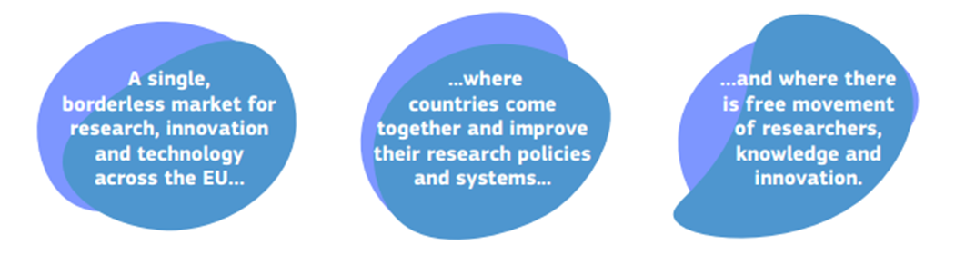




1. The New European Research Area
What is the new ERA?
What are the objecties of the new ERA?
Boost market uptake
Strengthen the mobility of researchers and free flow of knowledge and technology
Prioritise investments in research and innovation
Improve access to excellence

Slide 3



2. The Pact for R&I in Europe (1)
A - Principles for R&I in Europe
Upholding values
Working better
Working together
Ethics and integrity
Freedom of scientific research
Gender equality and equal opportunities
Free circulation
Pursuit of excellence
Value creation
Coordination, coherence and commitment
Global outreach
Inclusiveness
Societal responsibility
Notes:
.

Slide 4
2. The Pact for R&I in Europe (2)
B - Priority areas for joint action
Deepening ERA
Broadening ERA and relevance – twin transition and society’s participation
Open Science
Research Infrastructures
Gender equality, equal opportunities for all
Careers and mobility of researchers and research assessment and reward system
Knowledge valorisation
Scientific leadership
Global engagement
Challenge-based ERA actions
Synergies with education EU Skills Agenda
Synergies with sectoral and industrial policy, to boost innovation ecosystems
Active citizen and society engagement
Amplifying access to excellence
Advancing R&I investments and reforms
More investments/ reforms in countries and regions with lower R&I performance
Synergies between Union, national and regional funding programmes
Increased links and integration of research-performing organisations
Prioritise and secure long-term R&I investments and policy reforms
Coordination of R&I investments

Slide 5
2. The Pact for R&I in Europe (3)
C - Prioritising investments and reforms
Inviting Member States to contribute to the Union-level target of 3% of EU GDP in R&D
Member States take note of other targets to raise Union-level investment:
  1.25% EU GDP public R&D effort by 2030
  5% of national public R&D funding to joint programmes and European partnerships by 2030
  50% increase for Member States that are below the EU average R&D investment in the next 5 years.
D - Monitoring and Coordination

Slide 6
3. ERA Governance: Architecture and Roles
ERA Forum & sub-groups
Council
ERAC
Two independent bodies
adopts (upon Commission initiatives)
  Pact
  Policy Agenda
political steering, adopts (upon Commission initiatives)
  Pact
  Policy Agenda
high-level strategic policy body, providing early advice on​:
  strategic policy orientations and trends​
  shared new policy demands or needs
body for policy coordination and reinforced implementation of the ERA​:
co-design of Commission initiatives​
involvement of stakeholders​
Criteria for actions
Notes:
.

Slide 7
4. ERA Policy Agenda: Actions (1)
Deepening a truly functioning internal market for knowledge
Upgrade EU guidance for a better knowledge valorisation
Strengthen sustainability, accessibility and resilience of research infrastructures in the ERA
Promote a positive environment and level playing field for international cooperation based on reciprocity
Enable the open sharing of knowledge and the re-use of research outputs, including through the development of the European Open Science Cloud (EOSC)
Propose a EU copyright and data legislative and regulatory framework fit for research
Advance towards the reform of the Assessment System for research, researchers and institutions to improve their quality, performance and impact
Promote attractive and sustainable research careers, balanced talent circulation and international, transdisciplinary and inter-sectoral mobility across the ERA
Promote gender equality and foster inclusiveness, taking note of the Ljubljana declaration
Deepening the ERA through protecting academic freedom in Europe
Taking up together the green transition and digital transformation and other challenges with impact on society, and increasing society’s participation in the ERA
Make EU R&I missions and partnerships key contributors to the ERA
An ERA for green transformation
Accelerate the green/digital transition of Europe’s key industrial ecosystems
Empower Higher Education Institutions to develop in line with the ERA, and in synergy with the European Education Area
Bring Science closer to Citizens

Slide 8
4. ERA Policy Agenda: Actions (2)
Amplifying access to research and innovation excellence across the Union
Build-up regional and national R&I ecosystems to improve regional/national excellence and competitiveness
Improve EU-wide access to excellence
Enhance the strategic capacity of Europe’s public research performing organisations
Advancing concerted research and innovation investments and reforms
Facilitate a national process or ERA policy vehicle preparation for identification of running or planned measures contributing to the implementation of ERA
Establish an efficient and effective ERA monitoring mechanism
Support to the prioritisation, coordination and direction of R&I investments and reforms

Slide 9




5. Next Steps
Adoption on 26 November
Establishment of the new ERA Forum (EC Decision in Dec.)
Co-design and coordinate the implementation of the ERA actions, prepare future updates of the ERA Policy Agenda and analyse its implementation
Pact for R&I
Council conclusions on new ERA governance + ERA Policy Agenda as annex
Set-up of monitoring
Including a scoreboard, online policy platform and regular (2022)
Explanatory documents on ERA actions
Member States will then choose the actions, in which they participate (1st semester 2022)

Slide 10
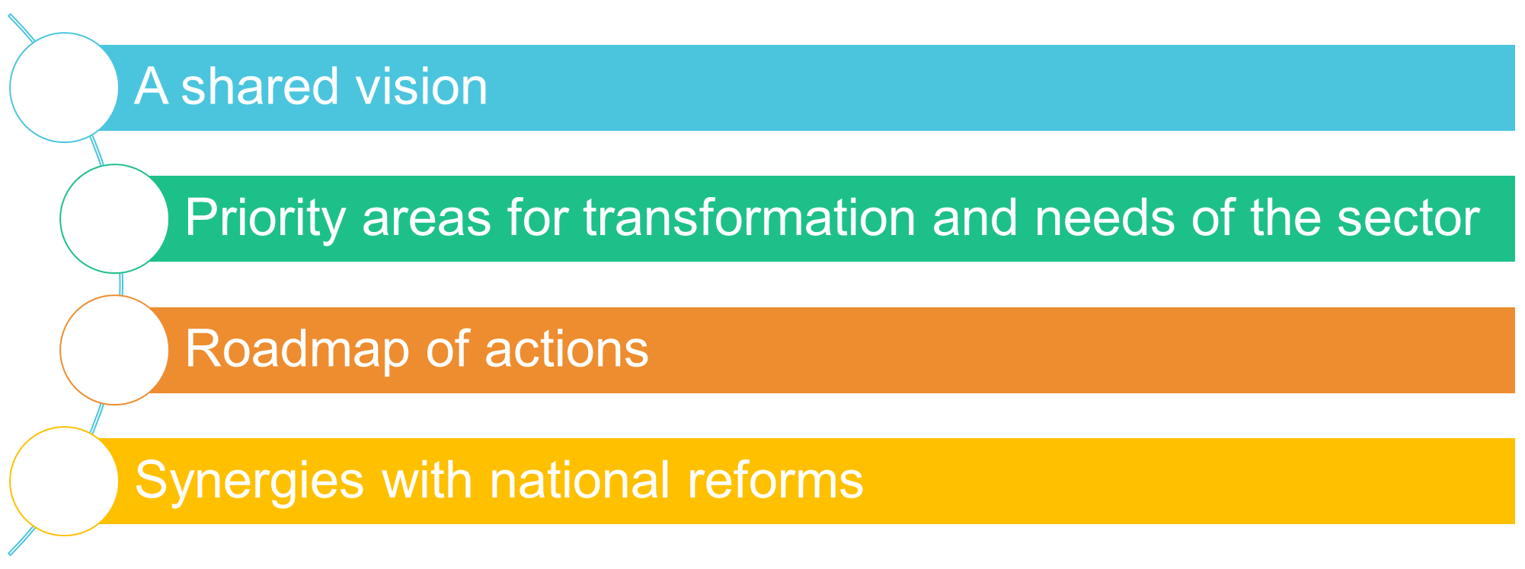
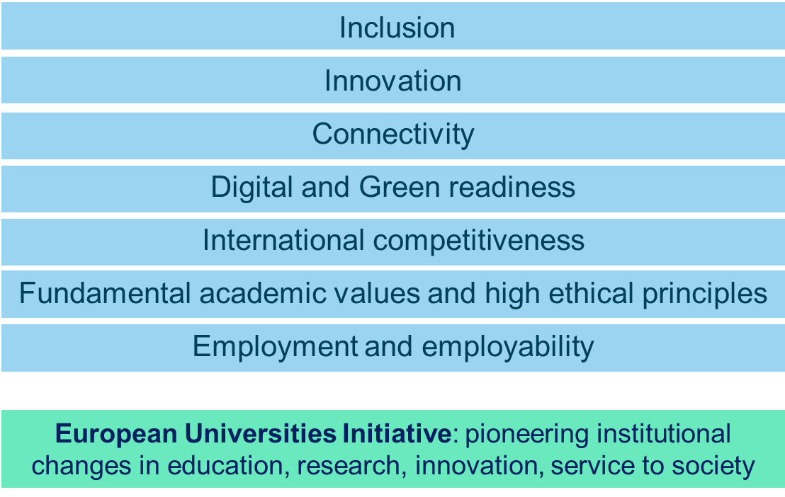
Towards a European Strategy for Universities
Synergies between EEA and ERA
Council Resolution (26-02-2021), building blocks of the Strategy

Slide 11
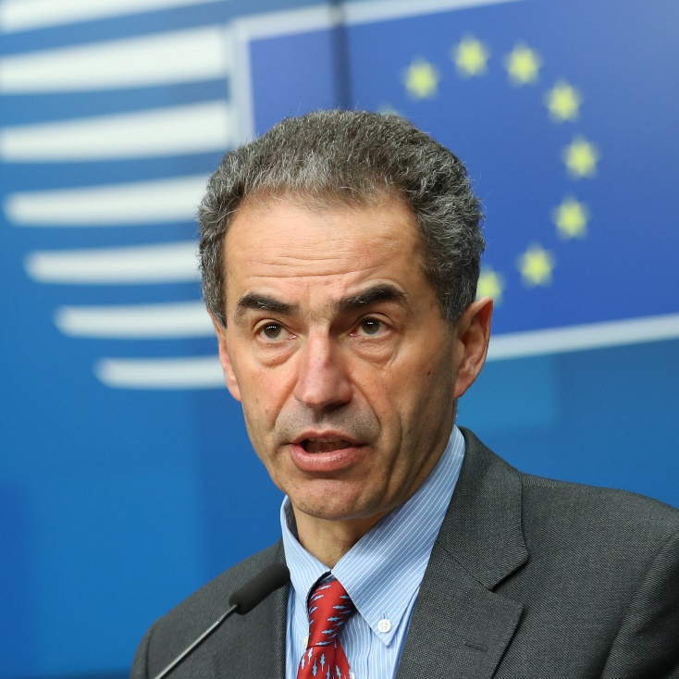
Deepening the European Research Area: Providing researchers with attractive and sustainable careers and working conditions and making brain circulation a reality“
The improvement of researchers' careers has been a top priority for the Portuguese Presidency. The pandemic further highlighted that this is very much needed in order to preserve and promote a resilient and competitive Europe. These conclusions mark a first step towards making research careers across Europe more attractive and sustainable and allowing brain circulation to become a reality.
Manuel Heitor, Portuguese Minister for Science and Technology and Higher Education
Council Conclusions adopted on 28.05.2021
https://www.consilium.europa.eu/media/49980/st09138-en21.pdf

Slide 12





European Framework for Research Careers
Synergies with employment and social policy
Synergies with the European Education Area
Nourishing and attracting talent
Recognition of the profession
European Strategy for Universities (human capital development module)
European Universities as testbed
Brain circulation
Intersectoral mobility
Training and career development
Widening
ESCO update
Skills taxonomies
Competence framework
Transposition through EURES
Links with Europass and EQF
Research policy
ERA4You
ERA Talent Platform
expanding EURAXESS:
Entry and employment conditions
ERA Priority 3 assessment (Charter and Code, HRS4R, EURAXESS) jointly with ERAC Task Force
Framework to address challenges:
Employment conditions including transferability of pensions, social security
Access to labour market (Students and Researchers’ Directive)
Governance
Network & services
Portals and tools
within academia (e.g. tenure track, assessment, diversification, international)
outside academia (e.g. interoperability of research careers in industry)
Data intelligence and monitoring labour market patterns, trends and dynamics
Set up an Observatory on Research careers

Slide 13
Competence Framework for researchers and
Taxonomy of skills for researchers
Skills
+
Occupations
=
Update of ESCO
ESCO: European Skills, Competences, Occupations and Qualifications classification
+
Better recognition of the research profession
Researchers understand what skills and competences they need
Targeted training → Researchers are equipped with the skills and competences they need for careers in academia and beyond
Employers have a better overview of what researchers can offer
Facilitated mobility of researchers across ERA and across sectors
competence categories
Emerging skills: Citizen Science / Open Science / Big Data Analysis…
+
Occupations: analysis ongoing (job vacancies→ linking skills with jobs)
career progressions
=
Career progression:
R1: First Stage Researcher (PhD Candidate)
R2: Recognised Researcher (Postdoc)
R3: Established Researcher (Assistant/Associate Professor)
R4: Leading Researcher (Full Professor)
European Competence Framework for Researchers

Slide 14
Reform of the research assessment system
Towards a new modus operandi for science (& careers)
Current System (dominant) |  | Open Science approach
Excellence defined largely on the basis of where scientists publish |  | Composite definition of excellence
Incentivises researchers to produce specific outputs (mainly publications) and to publish as much and as fast as possible (publish or perish!) | Use of quantitative metrics | Incentivises researchers to share knowledge/data early and openly, to collaborate, and to increase quality and impact; While considering diversity of outputs and research cultures | Use of qualitative and quantitative metrics
Rewarding individual competing scientists - gaining scientific prestige |  | Rewarding team work, collaboration and sharing to achieve societal impact (e.g. Covid-19)
Agreement by 2022 (such as an MoU) with a coalition of willing RPO and RFP?
Academic career assessment reform as priority in European Strategy for Universities?

Slide 15
ERA4You
ERA4You aims to
  enable a geographically more balanced circulation of research and innovation talents, strengthening retaining, attracting, and return activities through favourable working conditions and better access to mobility funding programmes
  boost permeability and employability of research and innovation talents across sectors and improve interaction between ecosystem actors for training and career development

Slide 16
European Talent Platform
EURAXESS extended
  For researchers
  For institutions
Career Development
Different levels of support:
Mobility Support
Enhanced services for researchers and families:
Social-cultural integration
Labour integration
Basic career orientation: information and signposting
Advanced services: mentoring, career advisor, training and coaching
Communities of Practice
Sub-practices of talent management
Networking activities
To connect researchers, employers and local/regional R&I Communities
Formal and informal settings enabling interaction with large groups and bilateral discussions
Keep R&I communities alive and informed about ERA policy measures in different areas
Enable best-practice sharing

Slide 17
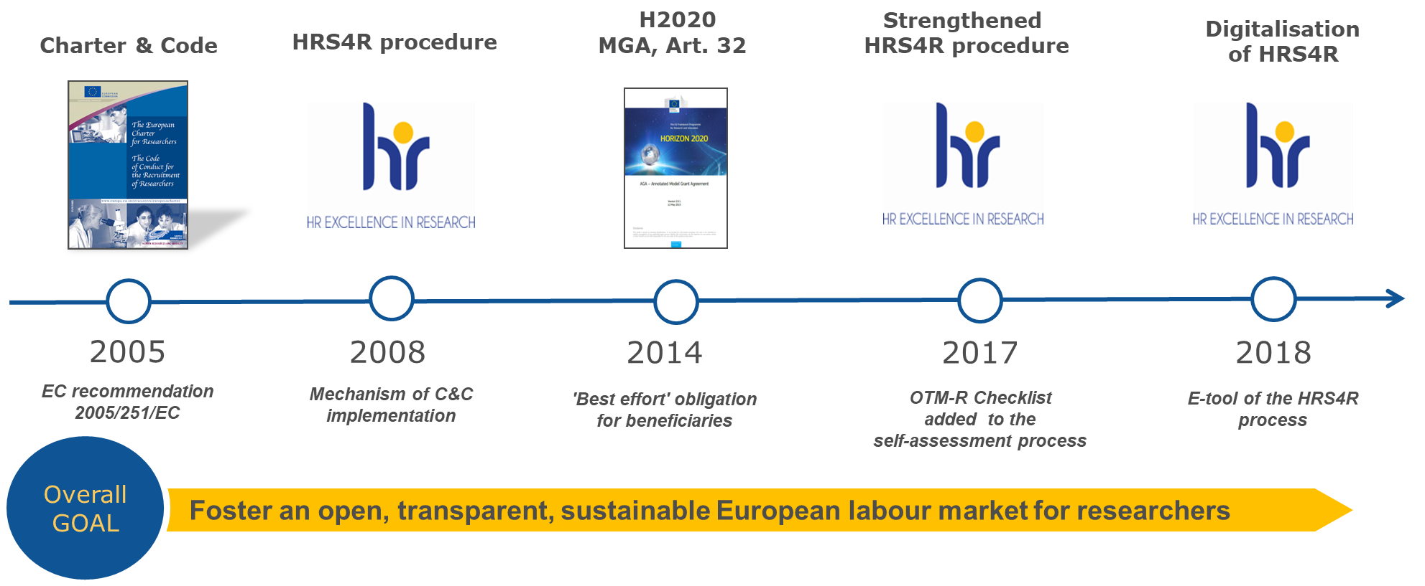
The Charter & Code for Researchers
Revamping, increasing ambition
2021: assessment
Taking stock (Charter & Code, HRS4R, EURAXESS)
Defining needs to revamp (future set-up)
Towards more ambitious C&C:
  Human Resouces and Mobility trends
  Open Science
  Gender
1279 Institutions have endorsed the Charter & Code principles
600 research institutions in 40 Countries received the HR Excellence in Research Award

Slide 18
Building evidence
ERA priority 3 assessment
Taking stock of existing policy measures (Charter & Code, HRS4R, EURAXESS) and defining needs of transformations to review/ revamp/strengthen the policy measures towards a European framework for research careers
Knowledge Ecosystems
Ecosystem level
Ecosystem actor level
Individual R&I talent level
Competence framework for R&I talents
Analysis on employment conditions, social security, remuneration, and key actions recommended
Analysis on brain drain (mapping, causes, appropriate solutions)
Observatory on research careers and mobility
Actions stimulating intersectoral mobility
Toolbox of legal measures supporting attractive careers
Mapping & gap analysis of ecosystems across ERA
Design of ERA Hub concept promoting connectivity
Observatory on ecosystems, incl. indicators & methodology
Development of Higher Education Transformation Agenda
Observatory to monitor institutional progress on implementing the Agenda, incl. monitoring European Universities pilot
Toolbox of legal measures facilitating cooperation
Investment strategy to help institutions delivering on the Agenda

Slide 19
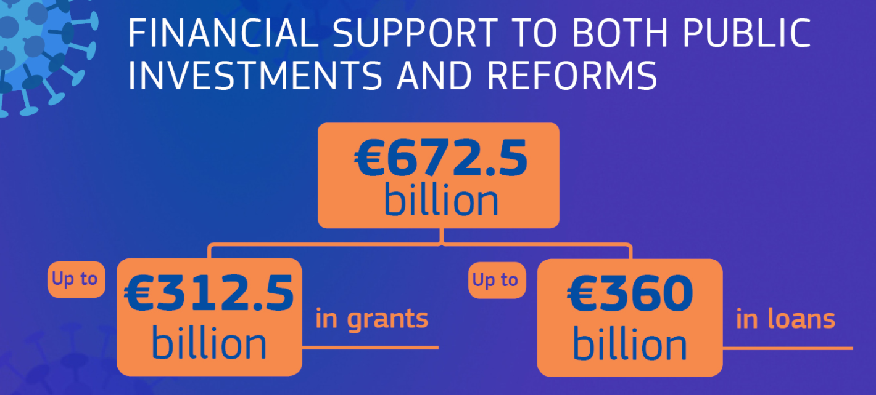
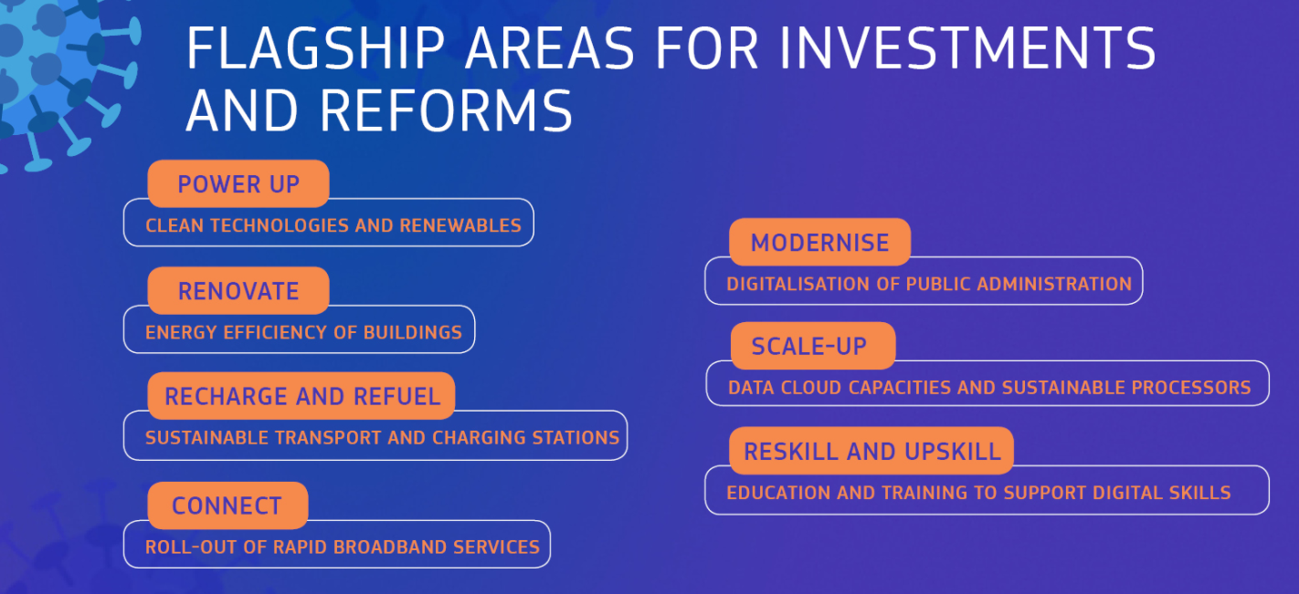
Recovery and Resilience Facility (RRF)
Mobilising R&I for accelerating the twin transitions
Strengthening the public science base and developing human resources for R&I
  Investments in human resources (improving the attractiveness of research careers, training and top talents)
  Reforms of research careers
  Incentives for researchers’ mobility (incl. intersectoral)
  Investments and reforms on Digital Education, skills, emerging professions, infrastructure
Support to more structured cooperation between public research and businesses
  E.g. investments in knowledge transfer structures

Slide 20
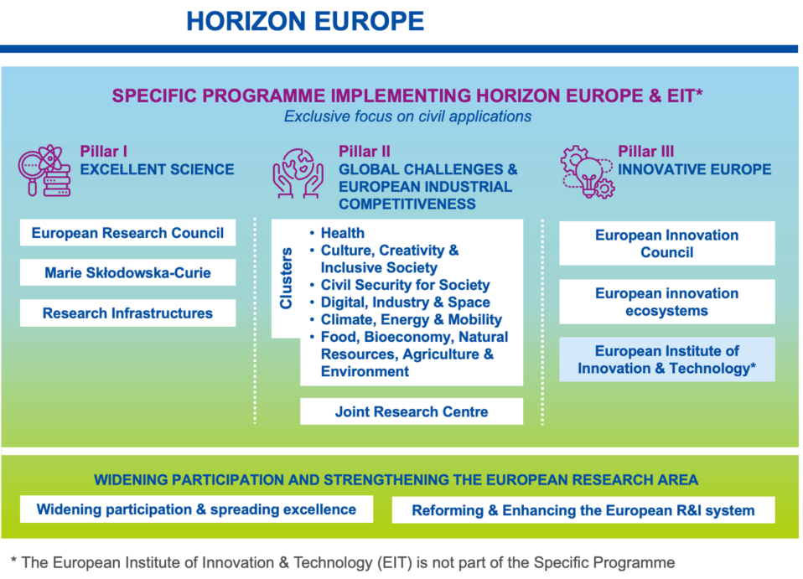
Horizon Europe, contributing to strengthening the ERA
Funding & Tenders portal
Horizon Europe Infodays

