Slide 1
FUNDING OPPORTUNTIES FOR RESEARCHERS IN SPAIN
(The Mobility Compass - EURAXESS Worldwide China – 3rd November 2020)
euraxess-spain@fecyt.es
Fundación Española para la Ciencia y la Tecnología

Slide 2
BUDGET (2020)
25.654 M€
STAFF
119
86 Women
33 Men
Born in 2001
Depending on the Ministry of Science and Innovation
MISION
We work to better link science and society through activities promoting
Open, inclusive science
Scientific culture and education
and
Supporting the Spanish R&D&i system towards its openness and internationalisation
VISION
We want a society acknowledging science as a key element of its development and well-being.

Slide 3
The EURAXESS initiative
EC Initiative
Mobility and career development support services to professional researchers, while enhancing scientific collaboration between Europe and the world.
42 national networks
+600 EURAXESS “Centres”
8 EURAXESS Worldwide regions

Slide 4
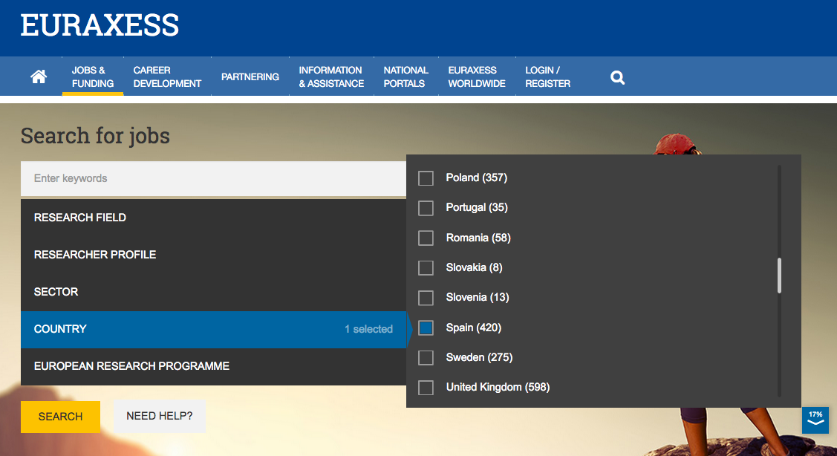
EURAXESS jobs.
Science job opportunities in the EU and beyond
https://euraxess.ec.europa.eu/jobs/search

Slide 5
Science in Spain
https://www.euraxess.es/spain/science-spain

Slide 6
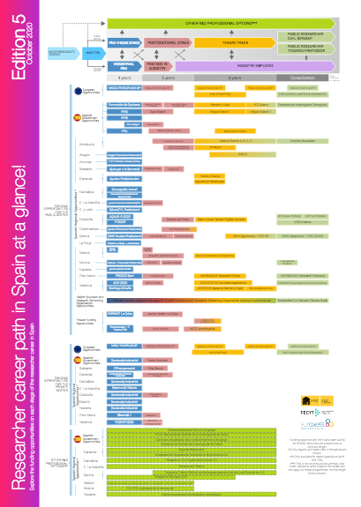
Career path in Spain at a glance!
Opportunities for researchers in Spain at European, national and regional level; both in the private and public sector.
https://www.fecyt.es/es/publicacion/researcher-career-path-spain-glance-5th-edition

Slide 7
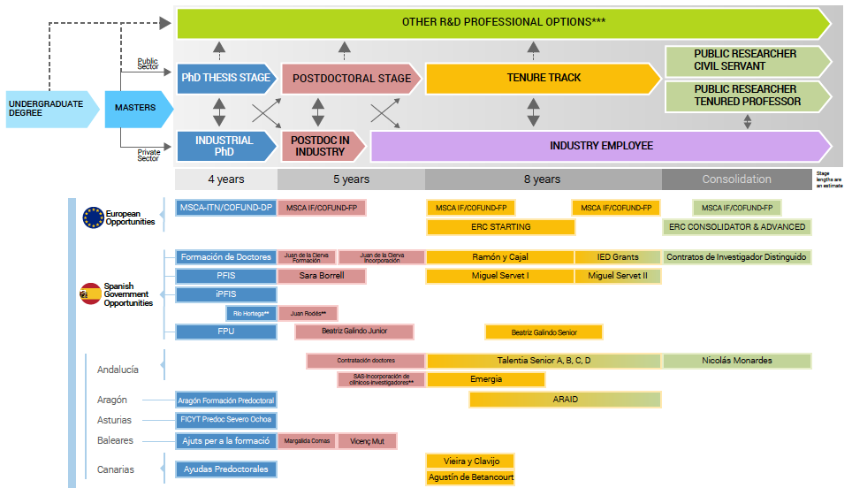

Slide 8
European calls
IF & Cofund closed in Sept 2020
Cristina Gómez y Jesús Rojo (msca@oficinaeuropea.es)
Estefanía Muñoz (estefania.munoz@oficinaeuropea.es ) y Laura Mohedano (l.mohedano@eu-isciii.es )
EMBO Long-Term Fellowships
FEBS Long-Term Fellowships
Human Frontier Science Program

Slide 9
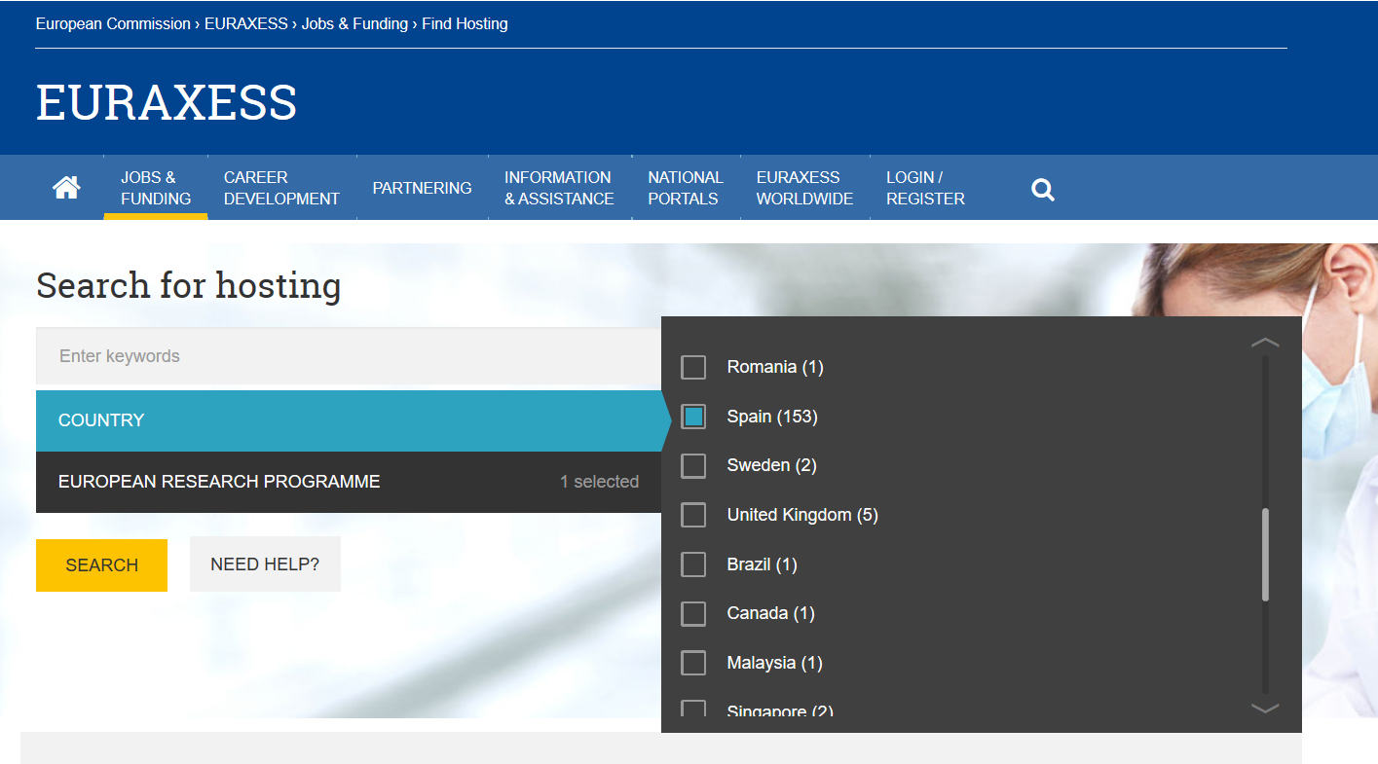
EURAXESS hosting.
Hosting opportunities for IF MSCA
https://euraxess.ec.europa.eu/jobs/hosting/search

Slide 10
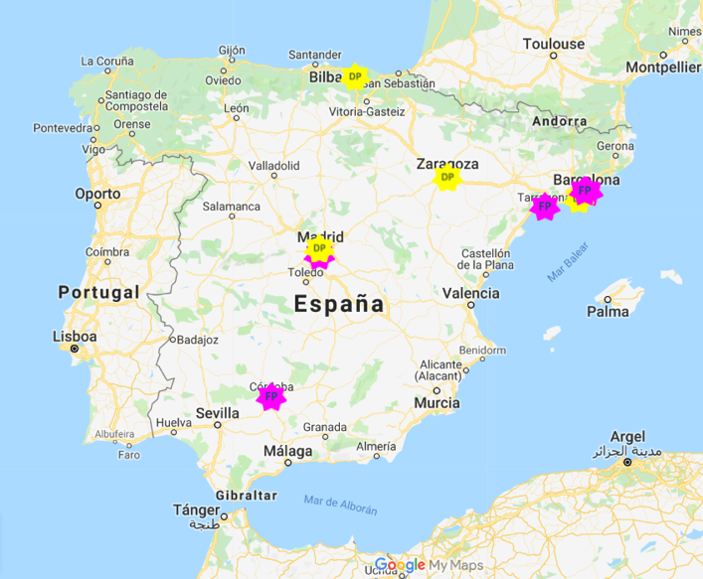
MSCA Cofund in Spain
https://www.euraxess.es/node/331026/
Programmes for recruiting pre and postdoctoral researchers.
Co-financed by the European Commission (candidates need to comply with mobility rule).
11 programmes with forthcoming recruiting calls (both for pre and postdoctoral researchers).
250 postdoctoral and 70 predoctoral positions in 2019-2021.
Not exhaustive!

Slide 11
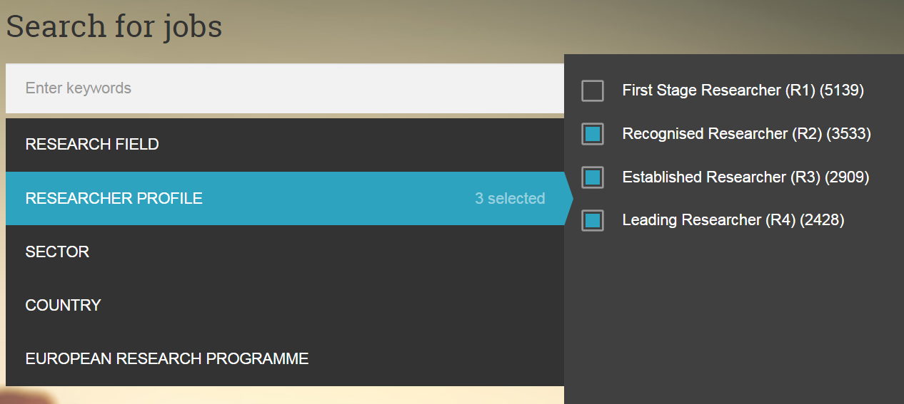
MSCA Cofund in Europe
https://euraxess.ec.europa.eu/jobs/search
Not exhaustive!

Slide 12
National calls – public research funding bodies

Slide 13
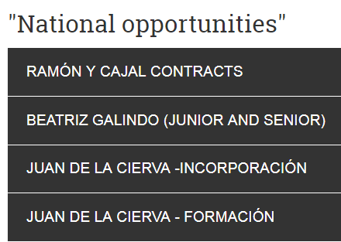
National calls

Slide 14
National calls – PhD Candidates
Call for predoctoral training for future university teachers (FPU)
4-year training contracts
Salary: 1.100€ - 1.500€ (14 payments/year)
Last call: October 2019 – ca. 850 contracts
Previous: December 2017, October 2018
Call for predoctoral training of researchers (FPI)
4-year contracts
Salary: ca. 21.000 €/year
Last call: 13-27 October 2020 – ca. 1100 contracts
Previous: September 2017, October 2018, October 2019.
Call for industrial PhDs (Doctorados Industriales)
4-year contracts in industry
Salary: co-financing (max 70% ca. 16.000€)
Last call: January 2020 (2019) – 61 contracts
Previous: January 2019 (2018), January 2018 (2017)

Slide 15
National calls – Postdoctoral
Juan de la Cierva
JdC formación:
2-year contracts
Last call 2019 (January 2020). 225 positions
25,000 Euros/year although co-financing from the hiring institution is expected
The organization presents the candidate.
JdC incorporación:
3-year contracts
Last call 2019 (January 2020). 225 positions
29,000 Euros + 6.000 euros ODC/year although co-financing from the hiring institution is expected
The organization presents the candidate.

Slide 16
National calls – Postdoctoral
Ramón y Cajal
Tenure-track 5-year contracts
Last call 2019 (January 2020): 200 positions
Funding: 33.720 € /year + 40,000 € ODC
Support of 100,000 euros for the creation of a permanent position.
Beatriz Galindo
Recruit researchers in Spanish Universities with experience abroad
4-year contracts 50.000-90.000€ / year
Since 2018 Last call 2019 (February 2020) ca. 100 contracts contracts were offered with. Two categories:
BG Junior <7 years abroad
BG Senior >7 years abroad

Slide 17
National calls – Postdoctoral
Torres Quevedo
Recruiting doctors in
Companies, including spin-offs
Technological Centre
Innovation support centres
Business associations
Science Parks
3-year contracts
Max. 38.000€/year (70% co-financing)
Last call 2019 (January 2020): 176 contracts
Pervious calls: 2018 (January 2019), 2017 (January 2018)

Slide 18
National calls – Consolidation
Contracts to distinguished researchers
New research lines, direction of teams, infrastructures, etc.
Public Research Organizations (OPIS):
La Agencia Estatal Consejo Superior de Investigaciones Científicas (CSIC)
El Instituto de Salud Carlos III (ISCIII)
El Centro de Investigaciones Energéticas, Medioambientales y Tecnológicas (CIEMAT)
El Instituto Nacional de Investigación y Tecnología Agraria y Alimentaria (INIA)
El Instituto Español de Oceanografía (IEO)
El Instituto Geológico y Minero de España (IGME)
El Instituto de Astrofísica de Canarias (IAC)
Non-periodic calls
Last call: April 2019 (44 positions)

Slide 19
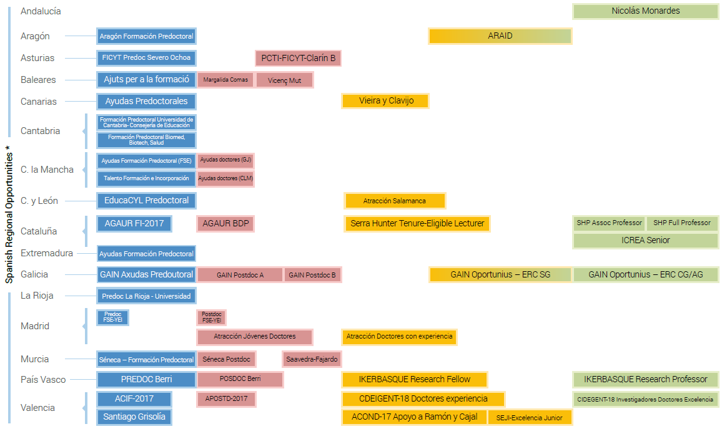
Regional calls

Slide 20
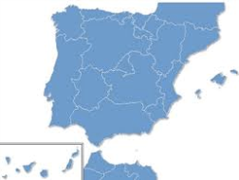
Regional opportunities
BASQUE COUNTRY
GALICIA
CATALUNYA
Oportunius
MURCIA
Axudas Posdoutorais
Isidro Parga Pondal
MADRID
Consejería de Educación
ANDALUCIA
CANARIAS
Vieira y Clavijo

Slide 21
Other professional options

Slide 22
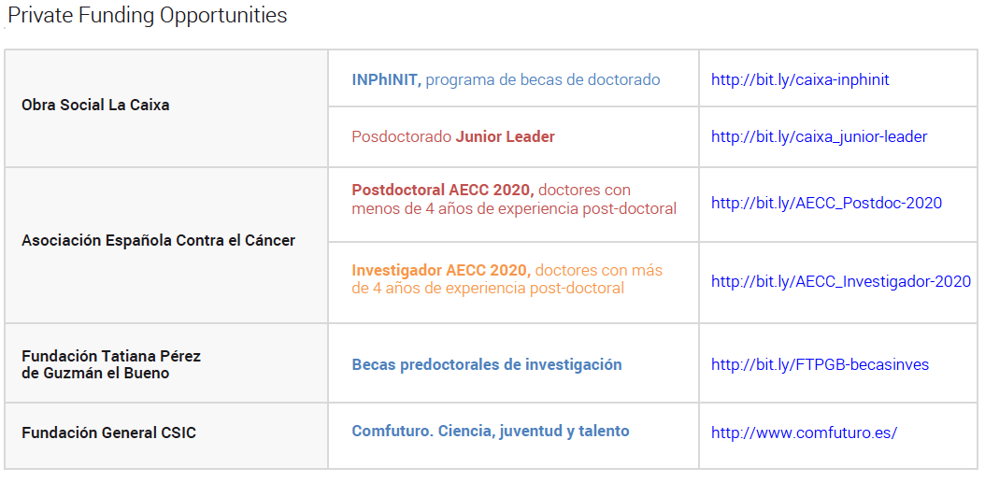
Private funding opportunities

Slide 23
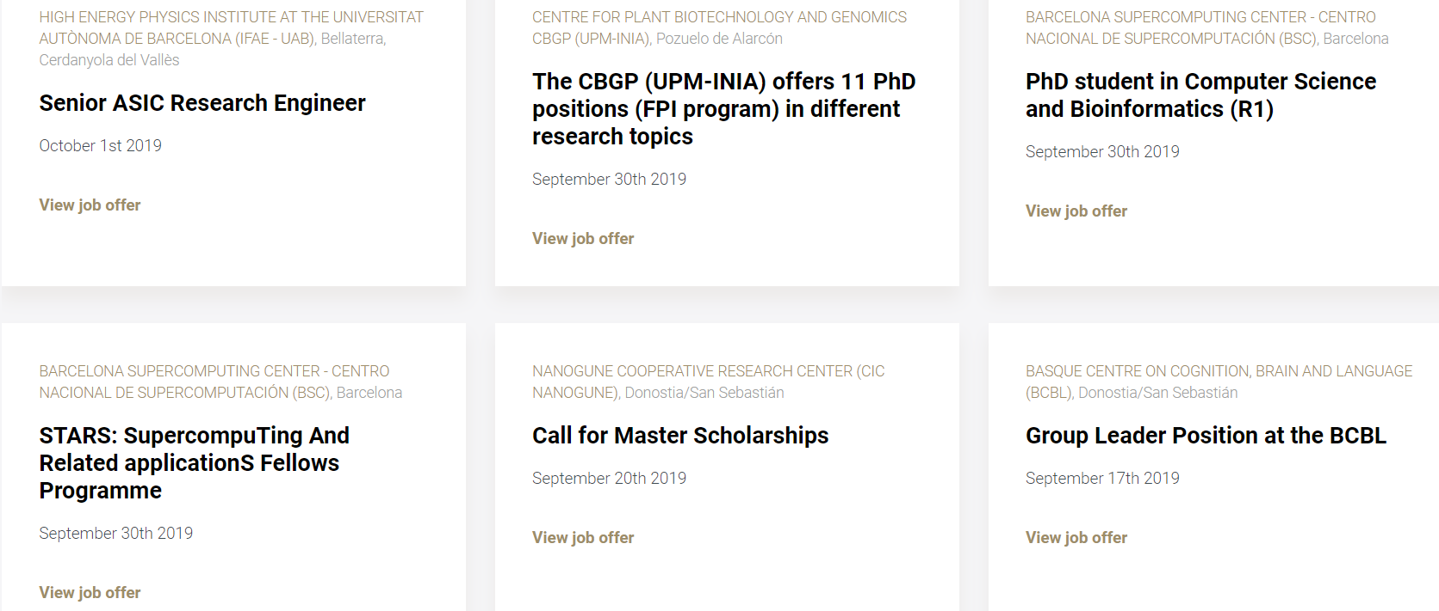
http://www.somma.es/jobs

Slide 24
¡GRACIAS!
https://www.euraxess.es/
euraxess-spain@fecyt.es
Fundación Española para la Ciencia y la Tecnología Tlf: + 34 914250909
Notes:
24

Slide 25
Follow us in:
https://www.facebook.com/fecyt.ciencia fecyt_ciencia
https://www.instagram.com/fecyt_ciencia
https://www.youtube.com/FECYT

