Slide 1
This presentation does not engage the Commission, please refer to the official documents.
Dr. Kostas Glinos
Lee Kuan Yew School of Public Policy
& European Commission - DG RTD

Slide 2
EU
7% of the World's population
20% of world expenditure on research
32% of high-impact publications
32% of patent applications
Horizon 2020
77 €B budget over 7 years
44 countries contributing
40,000 proposals p.a.
5,000 projects and
22,000 participations p.a.

Slide 3
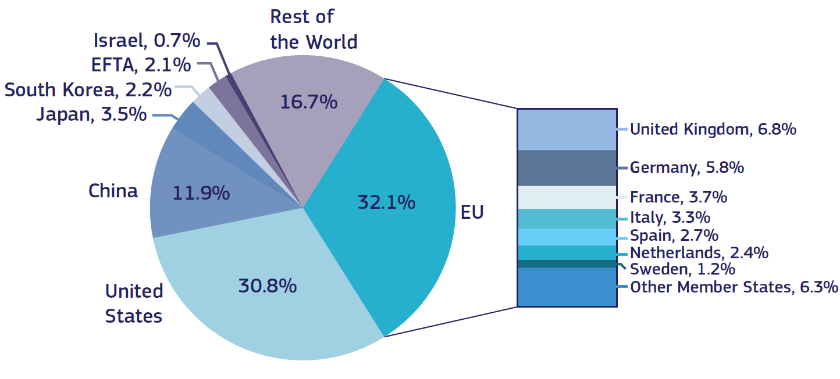
EU lead in highly cited scientific publications maintained

Slide 4
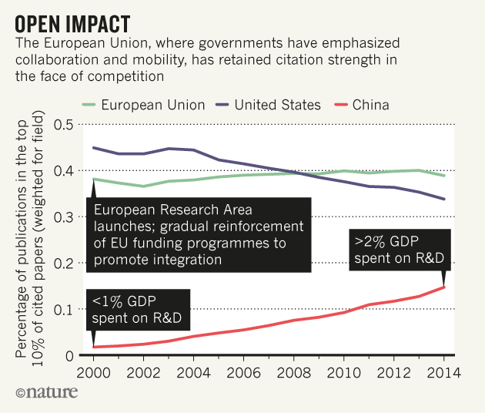
Collaboration
Open countries have strong science; Nature, 4 October 2017

Slide 5
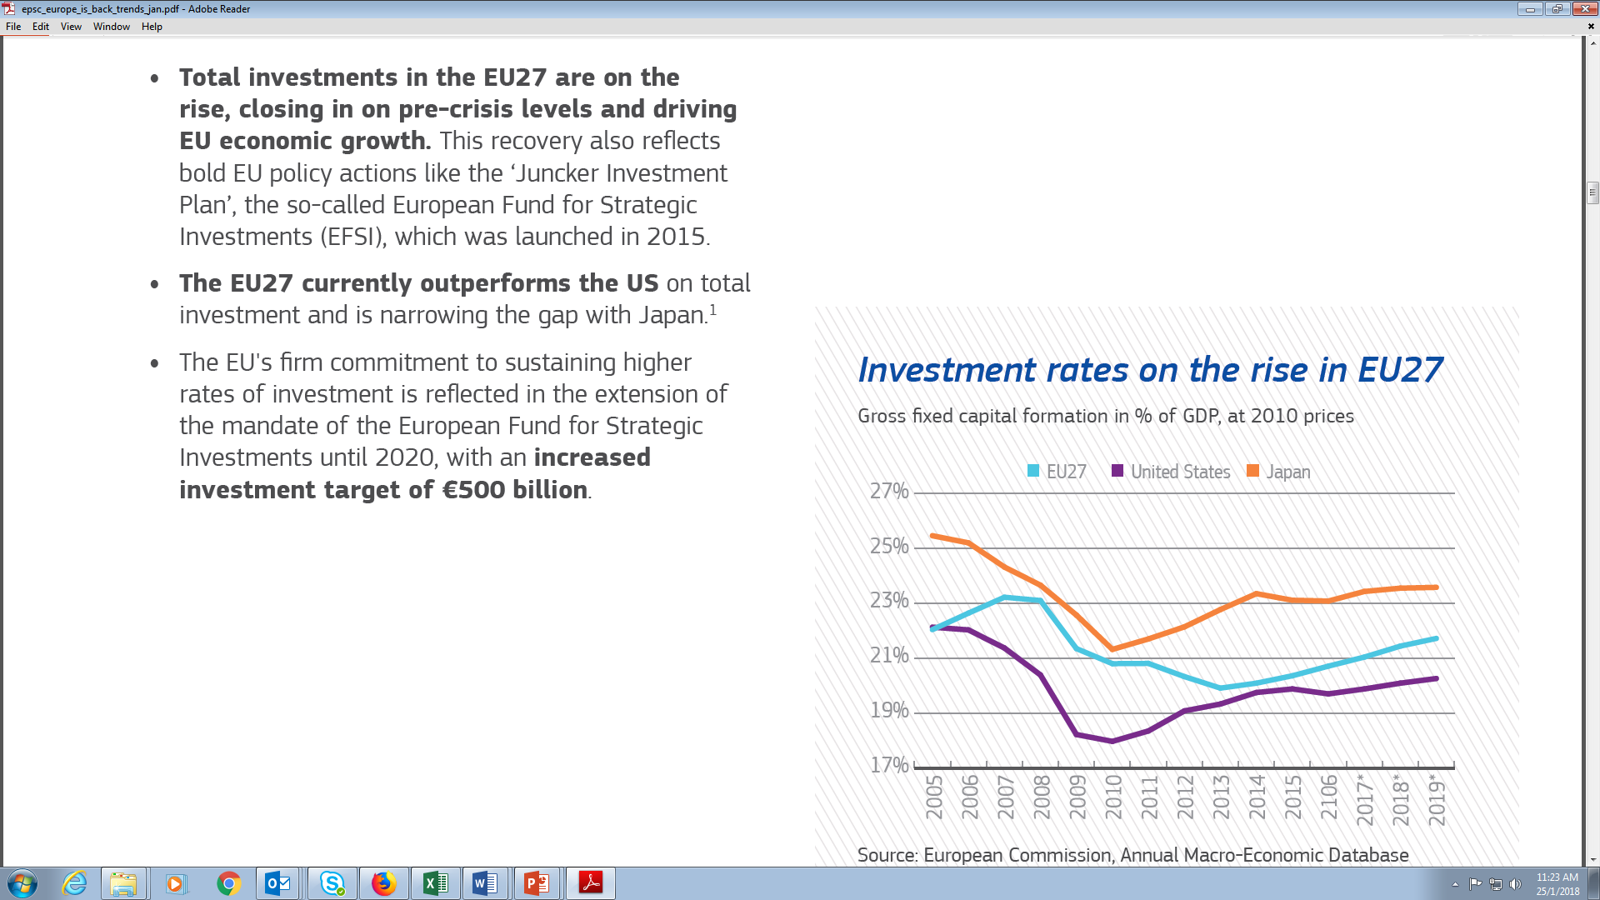
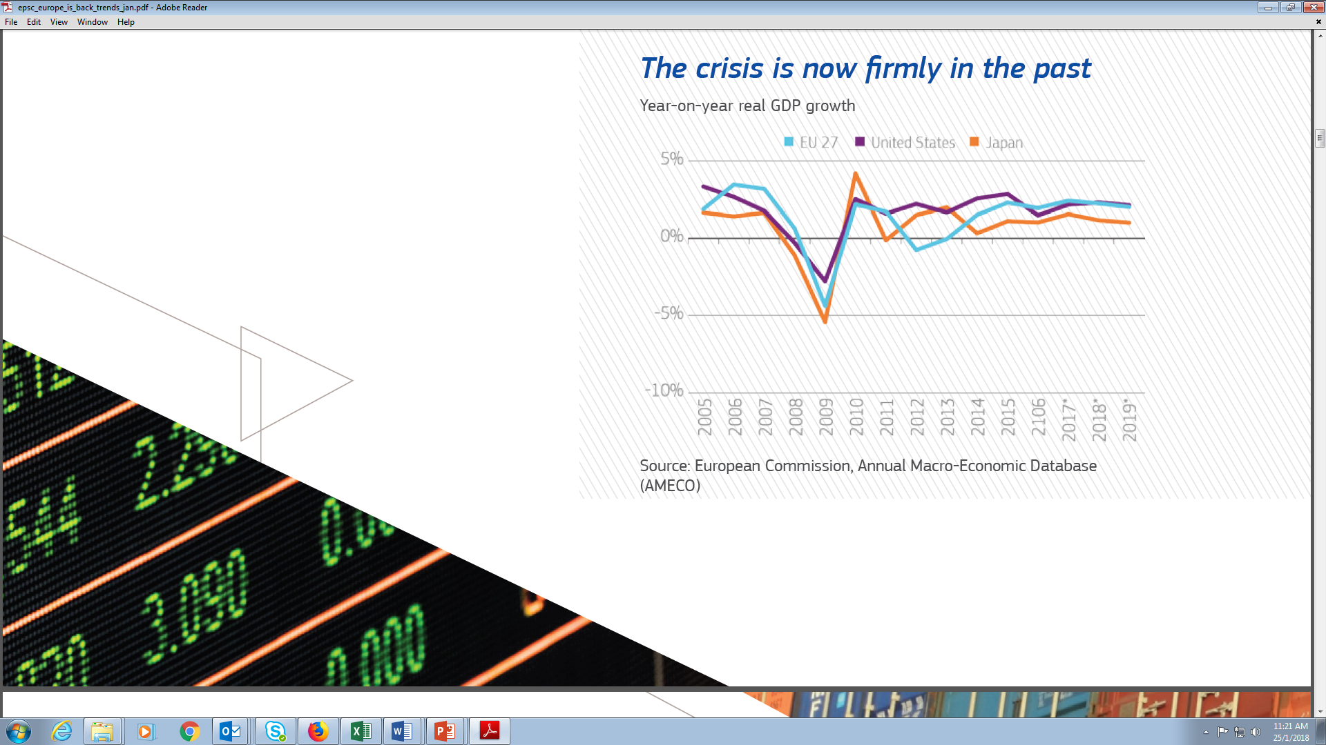
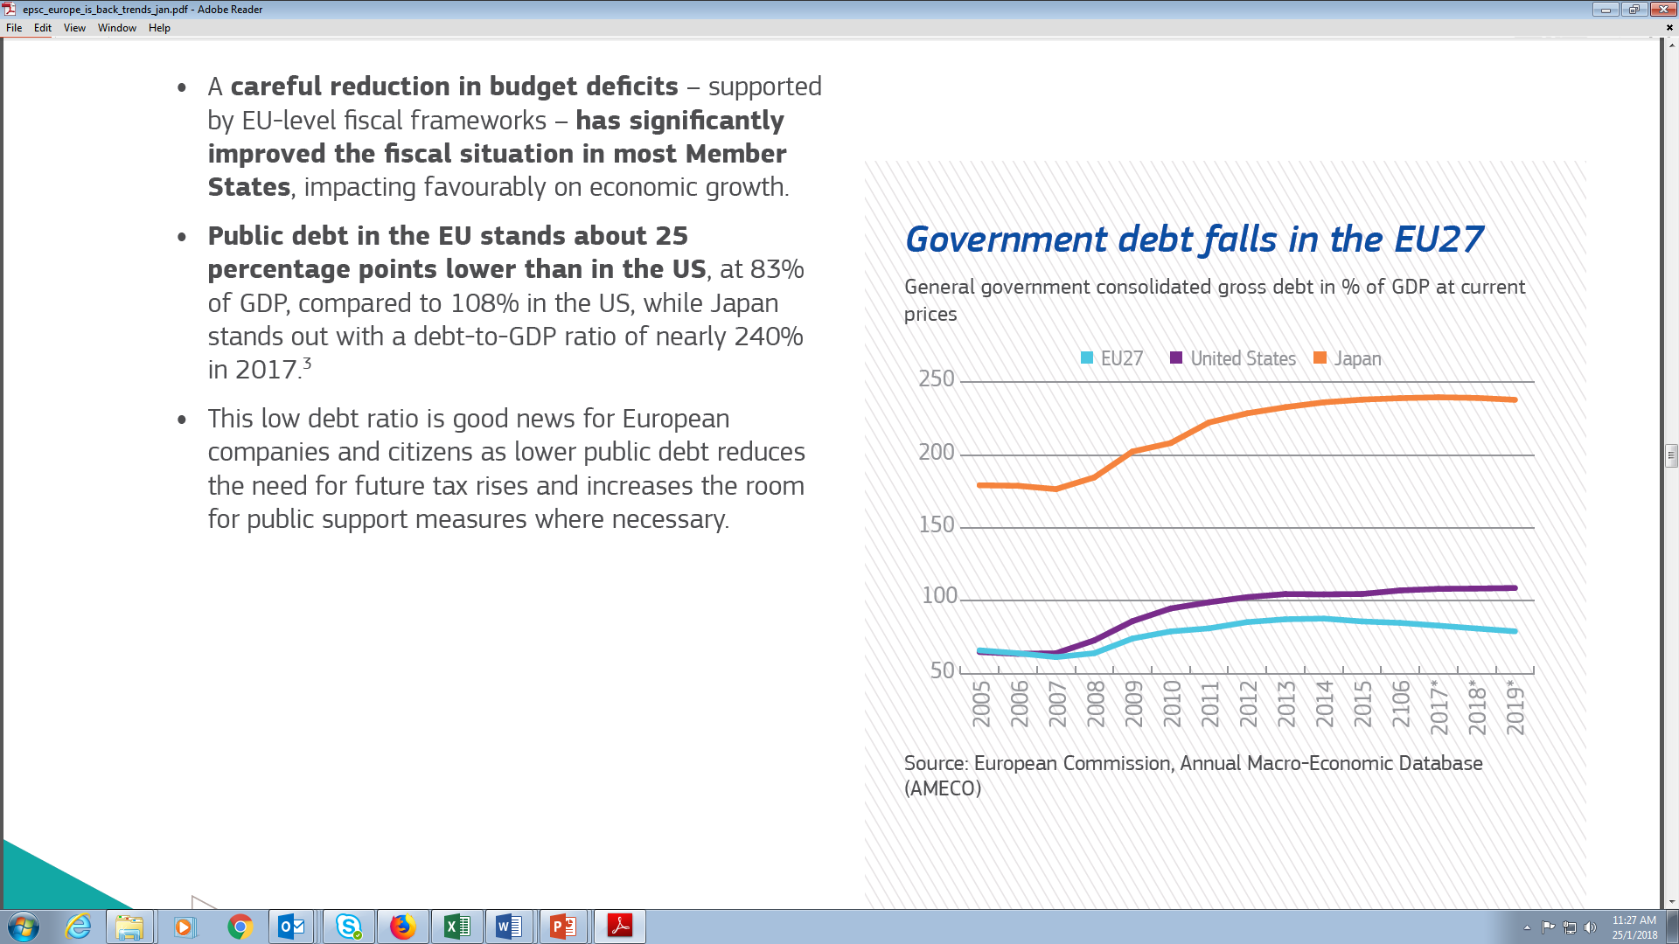
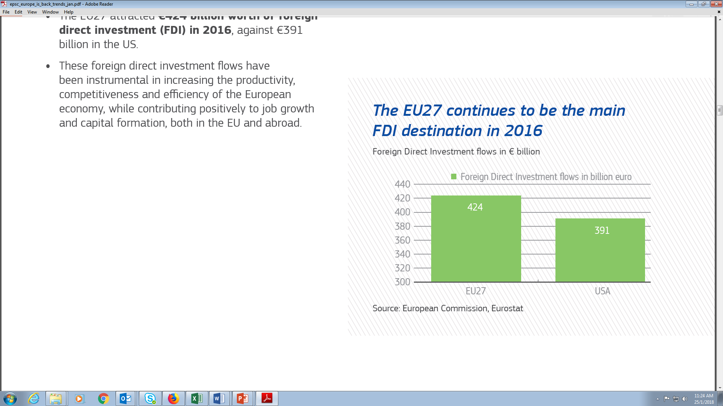
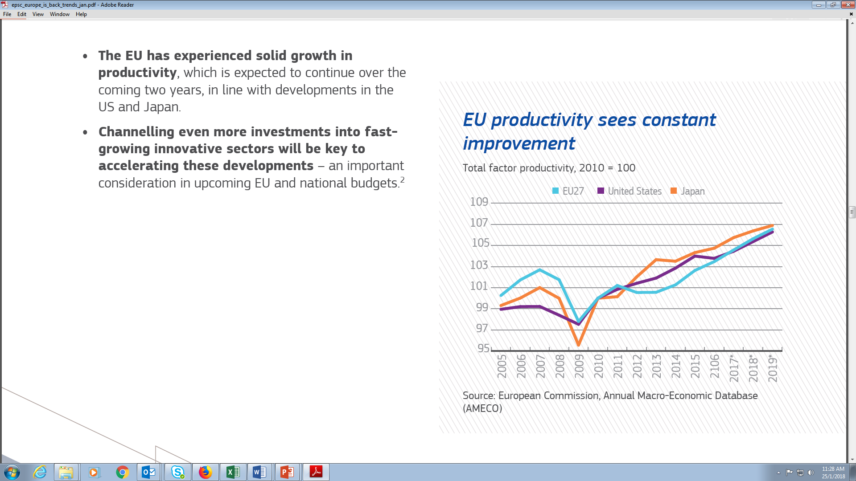
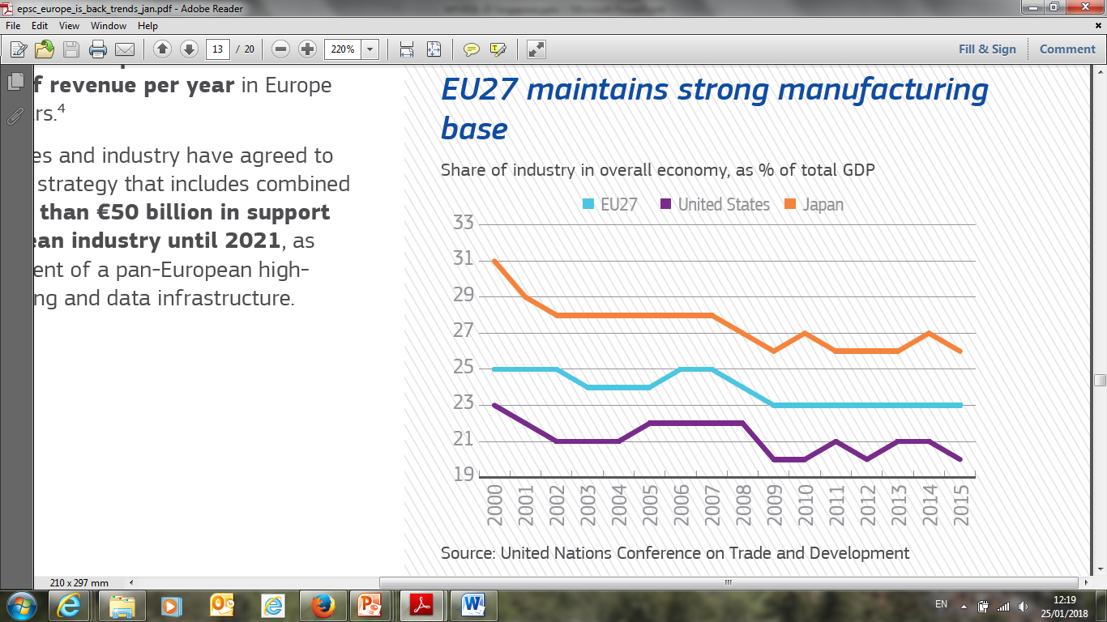
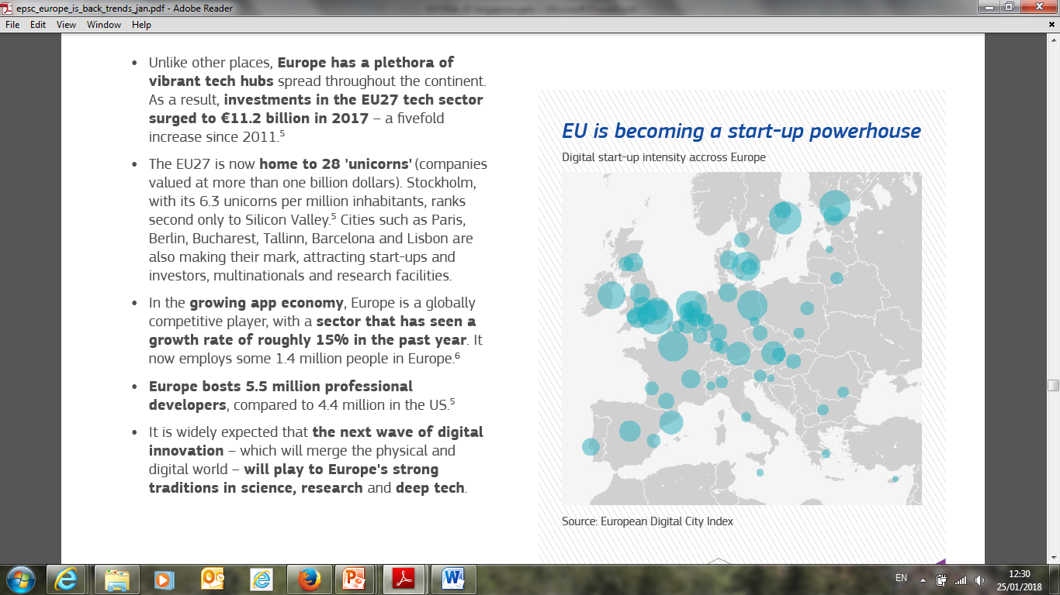

Slide 6
Horizon 2020 – Three priorities
Excellent science
Industrial leadership
Societal challenges

Slide 7
Three core values
Excellence
  Funding decisions on merit, not geography
Openness
  Open innovation, open science, open to the world
Impact
  Broad range of impacts: scientific, societal, economic, policy, etc

Slide 8
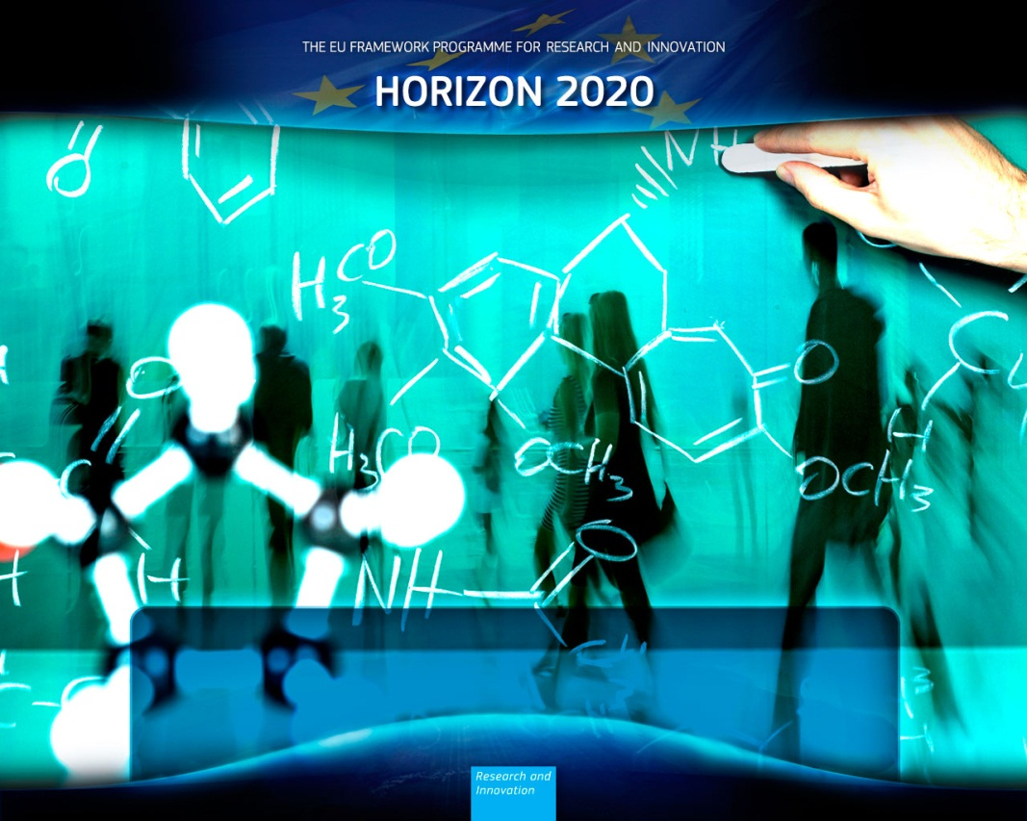
Rules for participation
Minimum Conditions:
For standard (cooperative) research projects:
3 participants from different Member States or associated countries
In addition, organisations from any country in the world may participate
For actions aimed at individuals, like European Research Council or Marie Skłodowska-Curie:
1 researcher
1 host institution
1 project
Notes:
For standard collaborative actions, at least three legal entities, each established in a different Member State or Associated Country; Once these 3 entities are determined, a participant from anywhere in the world can be included in the consortium.
A researcher in an international partner country can even be the coordinator of a research consortium – but the minimum conditions must still be met.
[NOTE: in practice this is very rare since EU researchers have a stronger institutional and national support structure to help them in the preparation of proposals . Also the coordinator is responsible for the financial aspects of the whole project and this is easier in a EU/Associated country especially if the international partner is not eligible for funding]
There can be additional conditions for participation that will be set out in the relevant work programme
For the European Research Council, the applicant (who can be from anywhere in the world) must identify in the proposal the host institution in an EU/associated country in which she/he will establish their research group.
For Marie Sklodowska Curie Grants, pre-Doctoral positions in Europe are published (on MCSA website and on Euraxess Jobs Portal) and are open to applicants from anywhere in the world. Post doc and other opportunities in Europe available through open call for proposals (current call closes in September). Note that there is also a possibility for a European to apply to go to an international partner country for up to 2 years (with a compulsory return phase).

Slide 9
Automatically eligible for EU funding
EU Member States including their overseas departments
Countries Associated to Horizon 2020
  Albania, Armenia, Bosnia and Herzegovina, Faroe Islands, Former Yugoslav Republic of Macedonia, Georgia, Iceland, Israel, Norway, Montenegro, Serbia, Turkey, Moldova, Switzerland, Tunisia, Ukraine
International European interest organisations
List of countries identified in Annex A to the work programme
Not automatically eligible for EU funding
Entities in other countries may be granted EU funding when:
  Provision in the work programme; or
  Commission deems participation essential for carrying out the action (project case-by-case assessment)

Slide 10
Matching funds for international partners
A number of non-EU/non-Associated countries make funding available for their participants in Horizon 2020 actions:
  Australia, China, India, Japan, Mexico, Russia, South Korea and regions of Brazil and Canada. Some cover all topics – others selected topics, e.g. AHMRC in Australia
  See http://ec.europa.eu/research/participants/docs/h2020-funding-guide/cross-cutting-issues/international-cooperation_en.htm#countries

Slide 11
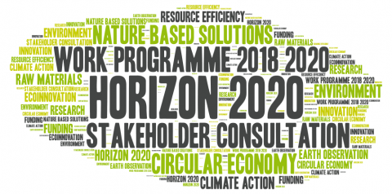
  Work Programme 2018-2020
  R & I investment of € 30 billion for 3 years
  Addressing main concerns of citizens such as security, migration and economic situation…
  Focus on impact (fewer & broader topics with sharpened impact statements, better dissemination of results, open access to data…)
  Piloting new initiatives and flexibility for 2020, with 'minimum' content of calls and other actions at this stage
Notes:
Main concerns of citizens at European level (according to Eurobarometer spring 2017) are security, migration and the economic situation.

Slide 12
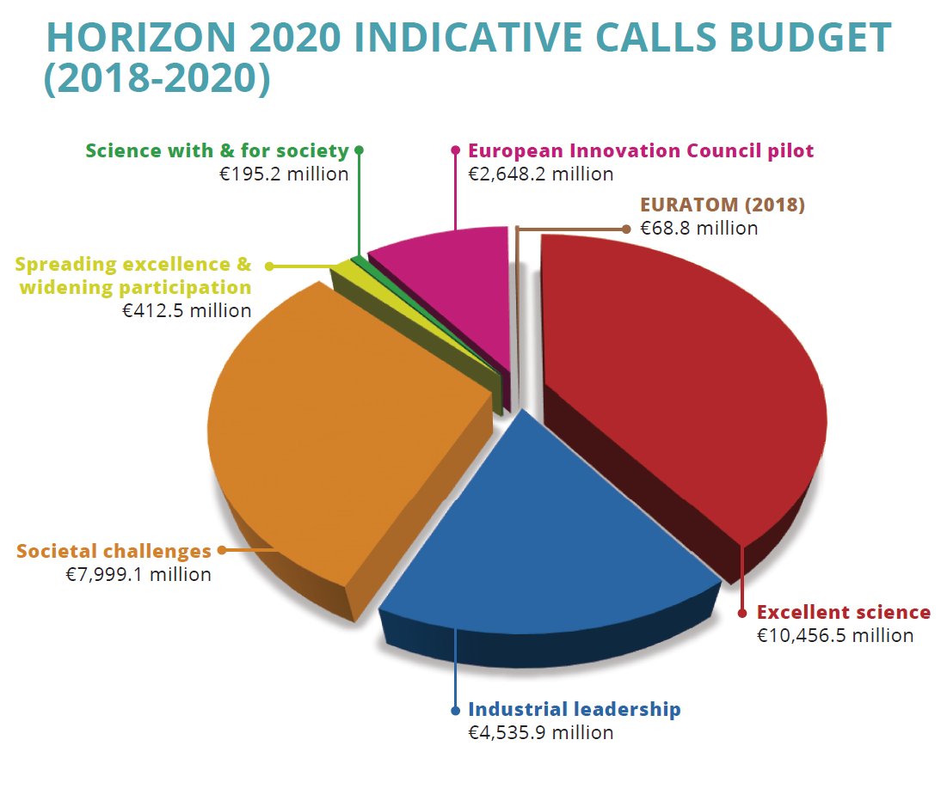
Notes:
NOTE. In this slide the call budget for the European Innovation Council pilot includes the budget for the FET OPEN call (which is therefore not included under 'Excellent Science').
There is a difference between the budget announced , and the actual money available for calls under Horizon 2020 €30 billion versus over €26 billion (excluding Euratom)?
Work programmes set out the activities, budgets, conditions, deadlines etc within the framework of the Specific Programmes agreed by legislators.
The main type of action are calls for proposals. These are the more visible and well known by the research and innovation communities. But other activities are also supported, to create, strengthen and consolidate the research and innovation landscape in the EU. These include first of all financial instruments (debt and equity measures), but also prizes, public procurements, identified beneficiaries, expert contracts, etc.
All research and innovation activities financed by the EU that address the same objectives are set out under the same work programme thereby ensuring transparency. Moreover, in budget and legal terms a financing decision is needed for all these activities, whatever the way they are implemented. This explains the difference between the figures from the work programmes related to the calls for proposals and the total amount for the financing decision.

Slide 13
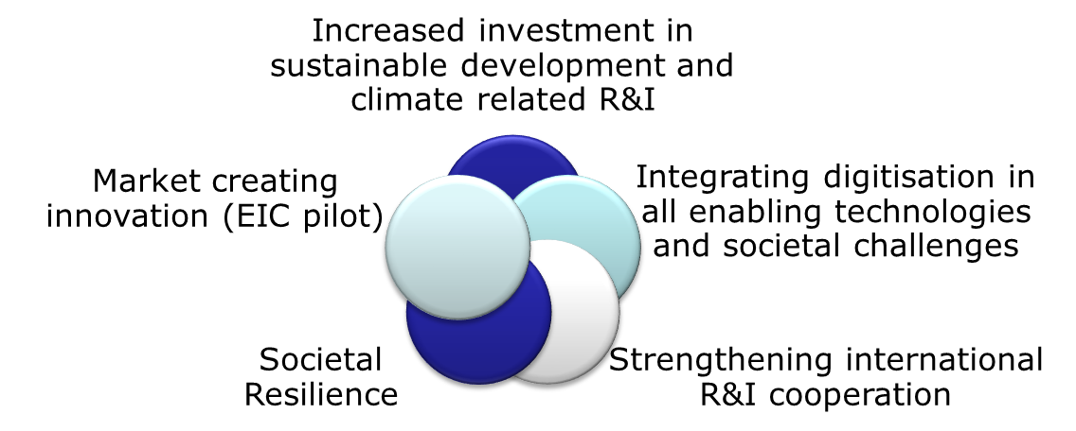
Work Programme 2018-2020
  Five mutually reinforcing strategic orientations addressing some main concerns of citizens:
Notes:
Background information to be released at WP launch:
Translation of five strategic directions into dedicated initiatives, including four focus areas (virtual calls) with a total budget of €7 billion :
1) Increased investment in sustainable development and climate related R&I:
Focus area 'Building a low Carbon, Climate-resilient Future' Budget: € 3.3 billion.
Focus area 'Connecting economic and environmental gains – the Circular Economy' – Budget: € 1 billion
2) Integrating digitisation in all enabling technologies and societal challenges:
Focus area 'Digitising and transforming European industry and services' - Budget: € 1.7 billion.
3)Strengthening international R&I cooperation:
30 International cooperation flagships – Budget: 1 billion
4) Societal Resilience:
Focus area 'Boosting the effectiveness of the Security Union'- budget: € 1 billion.
Additional focus on Migration (around € 200 million)
5) Market creating innovation:
EIC pilot – Budget: € 2.7 billion

Slide 14

Excellent science
Over 3000 grants from the
European Research Council
(2018-2020: €6 billion)
Over 30 000 Marie Skłodowska-
Curie fellows
(2018-2020: €2.9 billion)
Future and Emerging Technologies
(HPC, Flagships,…)
(2018-2020: €0.8 billion)
Research Infrastructures
(2018-2020: €1.2 billion)

Slide 15
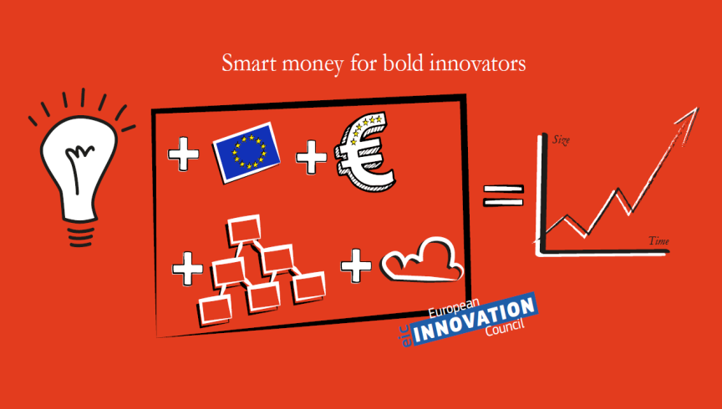
European Innovation Council (EIC) Pilot (1)
Objective: Strengthen breakthrough innovations and boost the number of high-growth companies
Focus on people and companies with ideas for :
  Radically new, breakthrough
  products, services, processes
  or business models
  That open up new markets with
  the potential for rapid European
  and global-scale growth (high
  risk, need for significant investment)
  Take shape at the intersection between different technologies, industry sectors and scientific disciplines
  Video
© European Union, 2017.

Slide 16
European Innovation Council (EIC) Pilot (2)
Brings together, adapts and aligns innovation schemes addressing different communities in a bottom-up approach:
SME Instrument: close-to-market projects of single SME or a consortium of SMEs (new: non-thematic, focus on cross-disciplinarity, revised evaluation criteria; face-to-face interviews in Phase 2)
Fast Track to Innovation (FTI): close-to-market projects of consortia with industry participation (new: revised evaluation criteria)
FET Open: early stage research by consortia exploring novel ideas for radically new future technologies
Six EIC Horizon Prizes for breakthrough innovations bringing major benefits to society
Cross-cutting: coaching, mentoring (for SME beneficiaries), monitoring progress with innovation radar
Total Budget: € 2.7 billion

Slide 17
European Innovation Council (EIC) Pilot (3)
EIC Horizon Prizes
Innovative Batteries for eVehicles (€ 10 M)
Fuel from the Sun: Artificial Photosynthesis (€ 5 M)
Early Warning for Epidemics (€ 5 M)
Blockchain for Social Good (€ 5 M)
Low-Cost Space Launch (€ 10 M)
Affordable High-Tech for Humanitarian Aid (€ 5 M)

Slide 18
Focus Areas and other cross-cutting priorities
€ 7 billion for 4 mutually reinforcing focus areas
aligned to political priorities
expected to have exceptional impact
implemented through 'virtual calls cutting across the programme (description in 'General Introduction', common call identifier of contributing calls and topics)
Low Carbon
Circular Economy
Circular Economy
Digitisation
Security
Further cross-cutting priorities
Migration (€ 200M)
Batteries (€ 100M + € 100M to come)
Blue Growth, Cities ……
Notes:
Yearly investment in Blue Growth around €250 million, i.e. around €750 million over the three years.

Slide 19

  Focus Area 'Building a low-carbon, climate resilient future' (LC)
  Contributing to implement the Paris Agreement:
  Accelerate transformation towards carbon neutrality through clean technologies
  Enhance climate resilience in Europe and beyond
  Contribute to long-term mitigation and adaptation policy planning
Contributions from work programme parts Industrial Technologies; Space; Food security and Bioeconomy; Energy; Transport; Climate
€ 3.3 bn
Notes:
Goals of Paris Argeement:
limit global temperature rise to well below 2°C, make efforts to limit this to 1.5°C;
enhance adaptive capacity, strengthening resilience and reducing vulnerabilities;

Slide 20
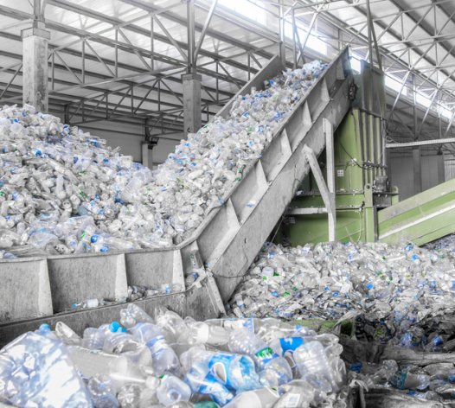
  Focus Area 'Connecting economic and environmental gains – the Circular Economy' (CE)
  Supporting the circular economy policy:
  Ensure that growth no longer requires increasing consumption of resources, energy, water and primary raw materials
  Reduce waste, including from plastics
  Create new business opportunities and safeguard competitive advantages
Contributions from work programme parts Industrial Technologies; Food security and Bioeconomy; Energy; Climate
€ 940 m

Slide 21

  Focus Area 'Digitising and transforming European industry and services' (DT)
  Enhancing the benefits from the Digital Single Market Strategy:
  Foster uptake of digital technologies and innovations & synergies with other key enabling technologies through
              Cross-sectorial digital platforms and large scale pilots for co-creation with users (e.g. personalised health, ICT solutions for agriculture, automated driving, inclusive public services)
              Innovation hubs
Contributions from work programme parts ICT; Space; Industrial Technologies; Health; Food security and Bioeconomy; Energy; Transport; Societies
€ 1.7 bn

Slide 22
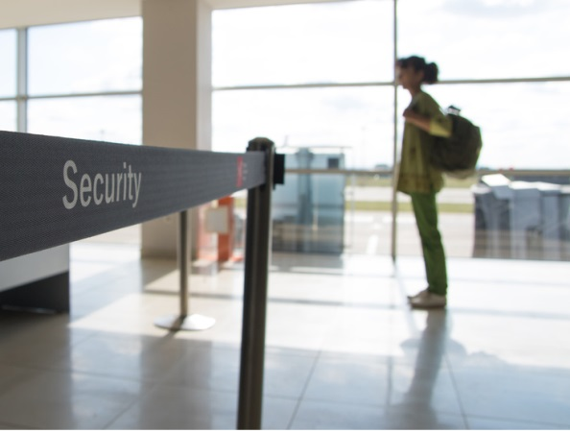
  Focus Area 'Boosting the effectiveness of the Security Union' (SU)
  Assisting to implement the Security Union:
  Provide innovative security solutions with involvement of security practitioners
  Build a secure digital economy and infrastructures
  Understand phenomena such as violent radicalisation and develop effective policies
  React to and recover from natural and man-made disasters
Contributions from work programme parts ICT; Space; Health; Energy; Societies; Security
€ 1 bn

Slide 23
  Horizon 2020 – Work Programme 2018-2020
  Open to the World
600+ topics open for international cooperation
150+ topics targeting cooperation with specific (group of) countries
Over €1 billion investment for around 30 international cooperation flagship initiatives: e.g. Climate action in support of the Paris Agreement; clean energy in context of Mission Innovation; All Atlantic Ocean Research Alliance Flagship; wide range of bilateral cooperation initiatives.
Strong international component in European Research Council & Marie Skłodowska-Curie actions

Slide 24
Where are the H2020 flagships?

Slide 25
More information:
Participant Portal http://ec.europa.eu/research/participants/portal/
Horizon 2020 National Contact Points http://ec.europa.eu/research/participants/portal/desktop/en/support/national_contact_points.html
Research Enquiry Service http://ec.europa.eu/research/index.cfm?pg=enquiries

Slide 26
ANNEX with more elaborate slides on the Focus Areas and further elements

Slide 27


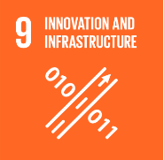




Focus Area 'Building a low-carbon, climate resilient future'
Covers the main actions in Work Programme 2018-2020 which can contribute to the goals of the Paris Agreement
limit global temperature rise to well below 2°C, make efforts to limit this to 1.5°C;
enhance adaptive capacity, strengthening resilience and reducing vulnerabilities;
Integrating multiple angles of society, economy, technology, industrial value chains, the energy system, environment, health, land use and governance
Aims to develop ground-breaking solutions capable of achieving
carbon neutrality and climate resilience of Europe and beyond in the second half of the century
Total indicative budget (2018-2020):
EUR 3 343 million
Notes:
The Focus Area "Building a low-carbon, climate resilient future" covers the main actions in the Horizon 2020 Work Programme 2018-2020 which can contribute to the goals of the Paris Agreement. These goals are, notably, to:
limit global temperature rise to well below 2°C
make efforts to limit this to 1.5°C, and
enhance adaptive capacity, strengthening resilience and reducing vulnerabilities.
The Focus Area aims to develop ground-breaking solutions capable of achieving the carbon neutrality and climate resilience of Europe in the second half of the century, and contributing substantially to similar achievements in neighbouring and development countries.
This will require an approach integrating the multiple angles of society, economy, technology, industrial value chains, the energy system, environment, health, land use and governance.
The total indicative budget of the Focus Area is €3 343 million.
As well as contributing to the goals of the Paris Agreement, this Focus Area also contributes to Sustainable Development Goal 13 "Climate action", as well as several other SDGs including "Renewable energy", "Good jobs and economic growth", "Innovation and infrastructure", "Sustainable cities and communities", "Life below water" and "Life on land".

Slide 28
Focus Area 'Building a low-carbon, climate resilient future'
Objectives
Operationalise the Paris Agreement goals (including input to the IPCC's 6th Assessment Report)
Accelerate transformation towards carbon neutrality through clean technologies
Enhance climate resilience in Europe and beyond
Contribute to long-term mitigation and adaptation policy planning
Notes:
The objectives of this Focus Area are:
the operationalisation of the Paris Agreement goals, on the basis of high quality policy-relevant evidence from the scientific community – including through peer-reviewed literature to be assessed in the IPCC's 6th Assessment Report;
the accelerated transformation towards carbon neutrality, through co-design, co-development and co-deployment of technologies and services by researchers, entrepreneurs and citizens;
enhanced climate resilience in Europe and beyond;
and long term mitigation and adaptation policy planning, deployment of technology to reduce emissions and enhanced climate change resilience in developing countries.

Slide 29
Focus Area - 'Building a low-carbon, climate resilient future'
Industrial technologies (LEIT-NMBP): some topics in call 'Industrial Sustainability' (notably on Energy Efficient Buildings and Clean Energy through Innovative Materials), €271 million
Space (LEIT-Space): topics on Earth Observation, €82 million
Food security (SC2): some topics in calls 'Sustainable Food Security', 'Blue Growth' and 'Rural Renaissance', €203 million
Energy (SC3): all topics in call 'Building a low-carbon, climate resilient future: secure, clean and efficient energy', €1 953 million
Transport (SC4): all topics in call 'Green vehicles' and some topics in call 'Mobility for Growth' ('Low-carbon and sustainable transport'), €408 million
Climate (SC5): all topics in call 'Building a low-carbon, climate resilient future: climate action in support of the Paris Agreement', €426 million
Notes:
The Focus Area represents a substantial investment and is made up of contributions from across the 2018-2020 Work Programme:
The Industrial technologies (LEIT-NMBP) work programme part contributes with topics in the call 'Industrial Sustainability' (notably on Energy Efficient Buildings and Clean Energy through Innovative Materials), total budget €271 million.
The Space (LEIT-Space) work programme part contributes with topics on Earth Observation, with a total budget of €82 million.
The Food security (SC2) work programme part contributes with some topics in calls 'Sustainable Food Security', 'Blue Growth' and 'Rural Renaissance', totaling €203 million.
The Energy (SC3) work programme part plays a crucial role in the Focus Area, with practically all topics in the call 'Building a low-carbon, climate resilient future: secure, clean and efficient energy' contributing, with a total budget of €1 953 million.
The Transport (SC4) work programme part contributes with all the topics in the call 'Green vehicles' and with some topics in call 'Mobility for Growth' ('Low-carbon and sustainable transport'), with a total budget of €408 million.
The Climate (SC5) work programme part contributes with all the topics in the call 'Building a low-carbon, climate resilient future: climate action in support of the Paris Agreement', totaling €426 million.

Slide 30




'Connecting economic and environmental gains
– the Circular Economy'
Focus Area
Covers the main actions in Work Programme 2018-2020 which will directly support the circular economy policy
– integrating production, consumption, waste management and raw materials
* Ensure that growth no longer requires increasing consumption of resources, energy, water and primary raw materials
* Minimise waste, including from plastics
* Enhance industrial competitiveness
Total indicative budget
(2018-2020):
EUR 940 million
SDGs:

Slide 31
'Connecting economic and environmental gains
– the Circular Economy'
Focus Area
Objectives
Use resources efficiently
– including primary and secondary raw materials
Reduce waste and environmental pollution
Competitive advantages for businesses
Opportunities for new business

Slide 32
'Connecting economic and environmental gains
– the Circular Economy'
Focus Area
Industrial technologies (LEIT-NMBP): topics in call 'Industrial Sustainability' (notably Sustainable Process Industry and Catalysing the Circular Economy); and in industrial biotechnology: €370 million
Food security and Bioeconomy (SC2): topics in calls 'Sustainable Food Security', 'Blue Growth' and 'Rural Renaissance', including access to risk finance: €253 million
Energy (SC3): Carbon dioxide reuse: €12 million
Climate, Environment and Raw Materials (SC5): topics in call 'Greening the economy in line with the SDGs' – circular economy and raw materials: €306 million

Slide 33






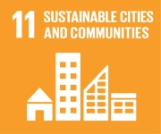

Focus Area
'Digitising and transforming European industry and services'
Aims to contribute to:
enabling all sectors to adapt, transform and benefit from digitisation;
developing new business models;
connecting to MS and regions,
removing barriers for innovation enabled by digitisation.
Covers the main actions of the work programme addressing the priorities of the Digital Single Market Strategy of the EC and helping seizing the opportunities offered by digital technologies.
Integrates R&I related to major technological trends with application-driven initiatives through a multidisciplinary approach.
Total indicative budget (2018-2020):
EUR 1 689 million

Slide 34
Focus Area
'Digitising and transforming European industry and services'
Objectives
Support the implementation of the DEI strategy, notably through innovation hubs, platforms and large-scale pilots
Foster the uptake of digital technologies and innovations, as well as synergies with other KETs
Leverage possibilities offered by ICT to address major societal challenges
Address and prepare Europe for the societal impact of the digital transformation

Slide 35
Focus Area
'Digitising and transforming European industry and services'
Food security (SC2): digital innovation hubs and platforms for agriculture and rural economies + several topics in all three calls, €107 million
Energy (SC3): smart homes and grids, Big Data for energy, €30 million
Transport (SC4): automated road transport, €103 million
Innovative, inclusive and reflective societies (SC6): modernisation of public services, new
approaches to policy making, digitisation of cultural heritage, inclusion, €166 million
Health and wellbeing (SC1): smart and healthy living at home, smart hospital, €60 million
LEIT- Information and Communication Technologies: Digital Innovation Hubs, platforms and large-
scale pilots, € 461 million
LEIT-Nanotechnologies, advanced materials, biotechnology, advanced manufacturing and
processing open innovation test beds, computational modelling, factories of the future, €703 million
LEIT - Space: Copernicus and EGNSS market uptake, space hubs, €59 million

Slide 36

Focus Area
'Boosting the effectiveness of the Security Union'
Covers the main actions in Work Programme which contribute to developing the EU as a Security Union:
- reacting to & recovering from natural and man-made disasters
- fighting crime (including cybercrime) and terrorism
- improving border security
- protecting infrastructure and public spaces
- digital security and privacy
- better understanding of societal contexts of security challenges
Total indicative budget
(2018-2020):
EUR 1 billion
SDGs:

Slide 37
Focus Area
'Boosting the effectiveness of the Security Union'
Objectives
New solutions and technologies for end-users (police, customs, firefighters, etc)
Involving researchers, industry and end-users in the entire research cycle
A strong security industry underpining EU autonomy
Promoting market uptake of research results

Slide 38
Focus Area
'Boosting the effectiveness of the Security Union'
Cyber and Digital Security: all topics in calls 'Cyber Security' (LEIT-ICT) and 'Digital Security' (SC7), €290 million
Space (LEIT-Space): topics in calls 'Space 2018-2020' and EGNSS market uptake 2019-2020', €90 million
Health (SC1): topics in Call 'Trusted digital solutions and Cybersecurity in Health and Care', €36 million
Energy (SC3): contribution to topic on Electrical Power and Energy System in SC7 call 'Digital Security', €20 million
Inclusive Societies (SC6): topics on trafficking of cultural goods, drivers of violent extremism, addressing radicalisation through inclusion, €30 million
Secure Societies (SC7): all topics in calls 'Security' and 'Infrastructure Protection', €615 million

