Slide 1
BILAT USA 4.0
Presented by
Claire Chen
NCURA Global
National Council of University Research Administrators

Slide 2

About NCURA
Our Members – Research Administrators
3 Annual Conferences
Horizon 2020 Pilot National Contact Point
  Claire Chen, chen@ncura.edu
Over 800 members in Top 20 U.S. Research Universities
C
40
7500

Slide 3


Mission
Funded by the European Union, the BILAT USA 4.0 project aims to:
  Facilitate the policy dialog
  Identify emerging research topics
  Foster transatlantic research partnerships
  Engage the private sector
http://www.euussciencetechnology.eu/

Slide 4
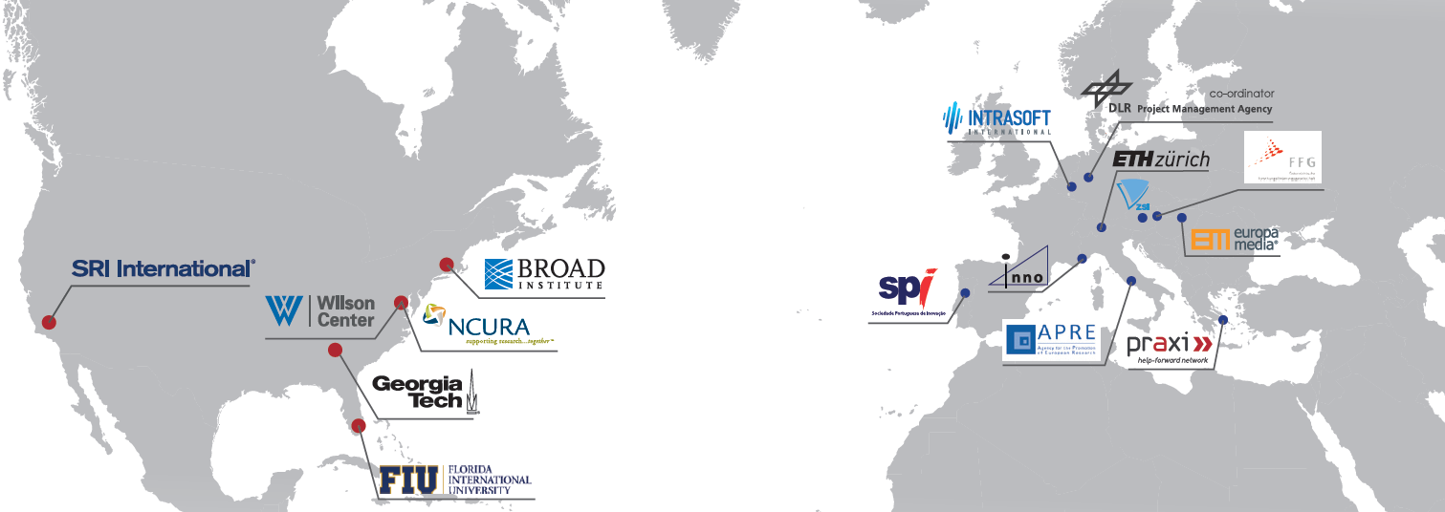

Consortium partners
6 U.S. Partners
10 EU Partners
Private Companies
Government Agencies & affiliated organizations
University
Research Institutions
Universities
Think Tanks
University Association

Slide 5
How can Bilat USA 4.0 Help?
  Up-to-date information and news (Website and social media)
  Informational Webinars and Training Programs
  Resources
  Nationwide information system
  Connecting Researchers, Policy-makers, and Private Sector
http://www.euussciencetechnology.eu/

Slide 6
Outputs
BILAT 4.0 Report: US Funding Opportunities for EU Researchers
Designed to increase awareness about which non-native funding sources are appropriate and viable to a non-US based researcher.
Does NOT include individual listings of FOAs/Calls (out-dated method)
Rather, sets for descriptions of federal agencies and curated list of non-federal funders
Aims to educate non-US researcher on US research landscape

Slide 7

Outputs
Report on U.S. Funding Opportunities for EU Researchers
  Federal Agencies
  Non-Federal Agencies/ Private Foundations
  Additional Resources
  Provides:
      Sponsor Name and Type of Funding
      Foreign Research Allowance
      Relevant Academic Mission
      Structure of Organization
Database http://www.euussciencetechnology.eu/funding
If not direct awardee, non-US researchers commonly partnering with US researchers as subawardee, or co-funded party or collaborative party.
Notes:
The project BILAT USA 4.0 – a Coordination and Support Action (CSA) funded under Horizon 2020 – is structured in six work packages, all of them containing different sub-tasks
____________ you can skip the following slides

Slide 8
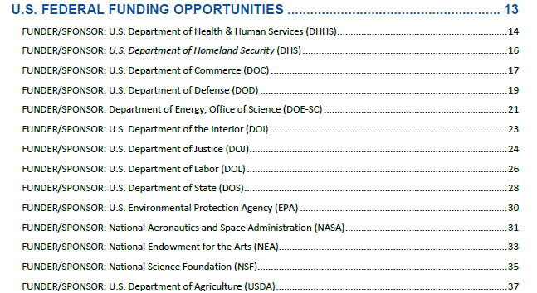
Outputs

Slide 9
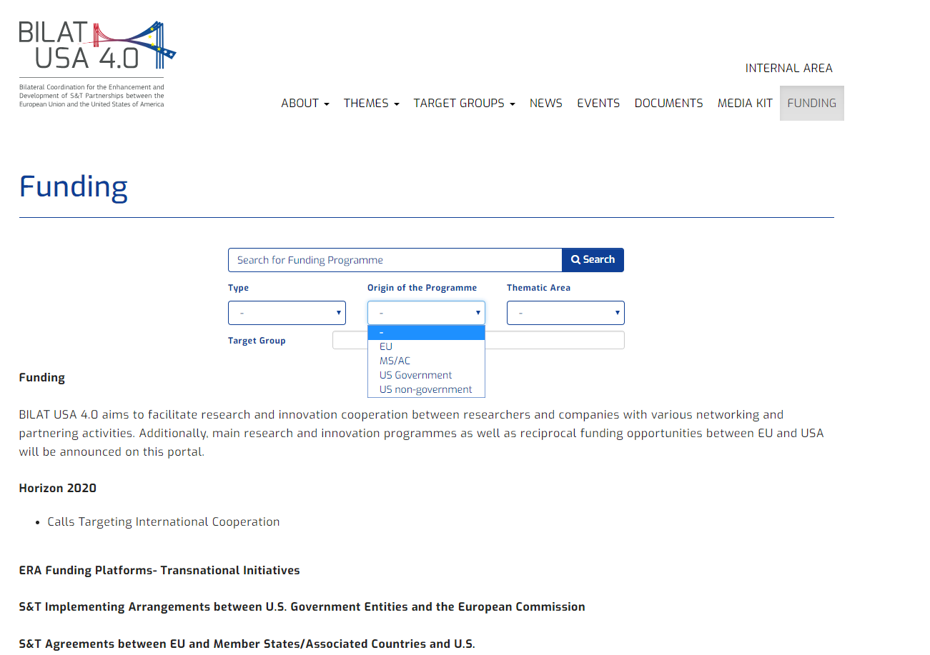
Website -> Funding

Slide 10
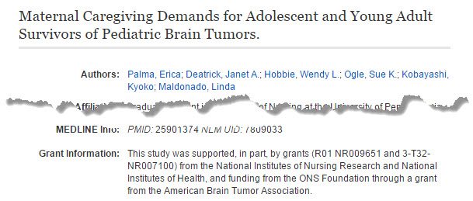
Identifying funding opportunities application: how do I find them?
“Reverse Engineer” funding opportunities:
Look at acknowledgements listed in articles/papers in your field; check for how that research was funded.
Look at citations and references; check for how those projects were funded or supported
Notes:
Discuss search parameters to be more useful

Slide 11

Outputs
Terminology Guide
  Obstacle of research collaboration
  Wiki format
Link: https://bilat-wiki.ethz.ch/wiki/Main_Page
Cost-Share | In-kind Contribution
Sub-recipient | Third Party
F&A Rate | Indirect Cost
Notes:
The project BILAT USA 4.0 – a Coordination and Support Action (CSA) funded under Horizon 2020 – is structured in six work packages, all of them containing different sub-tasks
____________ you can skip the following slides

Slide 12
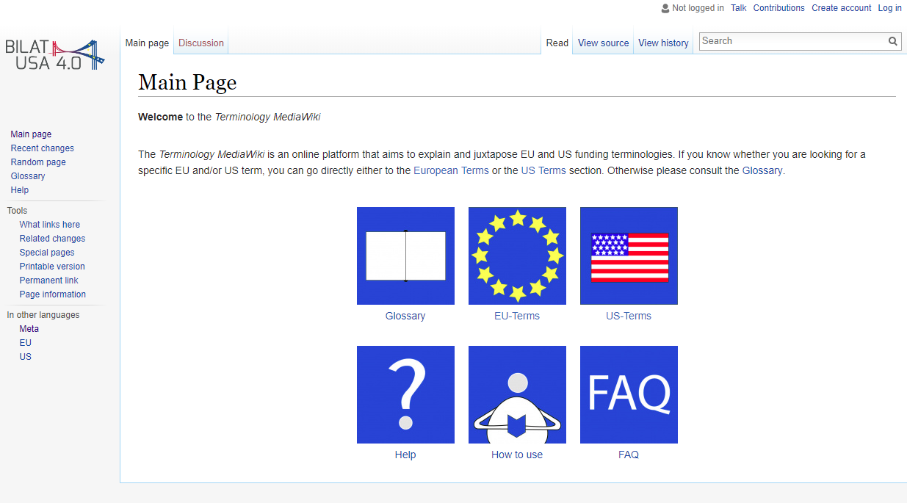

Slide 13
EU | US
Accession forms | Subaward
Account Administrator | Account Administrator
Amendment | Modification
Annex | Appendix
Annotated Model Grant Agreement | Research Terms and Conditions
Applicant | Applicant
Award | Award
Background | Background Inventions
Beneficiary Register | System for Award Management
Budget | Budget
Call for proposals | Funding Opportunity Announcement
Call Identifier | Opportunity Number

Slide 14


Outputs
Transnational Researchers Career Program
  Program for postdocs and PhD students
  Pre-award and Post-award training for both EU and US funding
  Career needs for International research administrators
  Spearheaded by ETH Zurich and Harvard University
Notes:
The project BILAT USA 4.0 – a Coordination and Support Action (CSA) funded under Horizon 2020 – is structured in six work packages, all of them containing different sub-tasks
____________ you can skip the following slides

Slide 15
http://www.euussciencetechnology.eu
Thank you!
Claire Chen
NCURA Global
National Council of University Research Administrators
Telephone +1 202.466.3894 | chen@ncura.edu http://www.ncura.edu
More info:

