Slide 1





Xi’an Meeting
18 April 2019
Halldor Berg
Country Representative
EURAXESS China
Organised by

Slide 2


Section 1
INTRODUCTION TO EURAXESS
AND THE EUROPEAN RESEARCH AREA
00:00

Slide 3




EURAXESS is a European Commission‘s Directorate General for Research and Innovation initiative
http://china.euraxess.org

Slide 4


EURAXESS is a unique pan-European initiative delivering information and support services to professional researchers regardless of their career stage.
Backed by the European Union and its Member States, it supports researcher mobility and career development, while enhancing scientific collaboration between Europe and the world.
http://china.euraxess.org

Slide 5

EXCELLENCE
CREATIVITY
DIVERSITY
欧洲研究领域
http://china.euraxess.org

Slide 6




INDUSTRIAL LEADERSHIP
行业领导力
EXCELLENT SCIENCE
优质的科学
SOCIETAL CHALLENGES 社会挑战
NOW MORE THAN
100.000
RESEARCHERS FUNDED
MARIE SKŁODOWSKA-CURIE ACTIONS:玛丽·居里计划
INDIVIDUAL FELLOWSHIPS 单独研究基金
FELLOWSHIPS FOR OUTSTANDING RESEARCHERS
为优秀的研究人员提供的研究基金
COMPLICATED
- RESEARCHERS IN MOTION -
EUROPEAN RESEARCH COUNCIL:欧洲研究委员会
SUPPORTING TOP RESEARCHERS FROM ANYWHERE IN THE WORLD
支持世界各地的顶尖研究人员
+
100s OF NATIONAL FUNDING PROGRAMMES

Slide 7
EURAXESS : GATEWAY TO THE EUROPEAN RESEARCH AREA
通向欧洲研究领域的大门
EURAXESS PORTAL
EUROPEAN RESEARCH AREA
EURAXESS WORLDWIDE
EURAXESS CENTRES
http://china.euraxess.org

Slide 8

Search for new job & funding opportunities
Find answers to your questions when moving to a new country
Connect with employers and other researchers
Explore the collection of resources that will help you to navigate through your career
http://china.euraxess.org

Slide 9

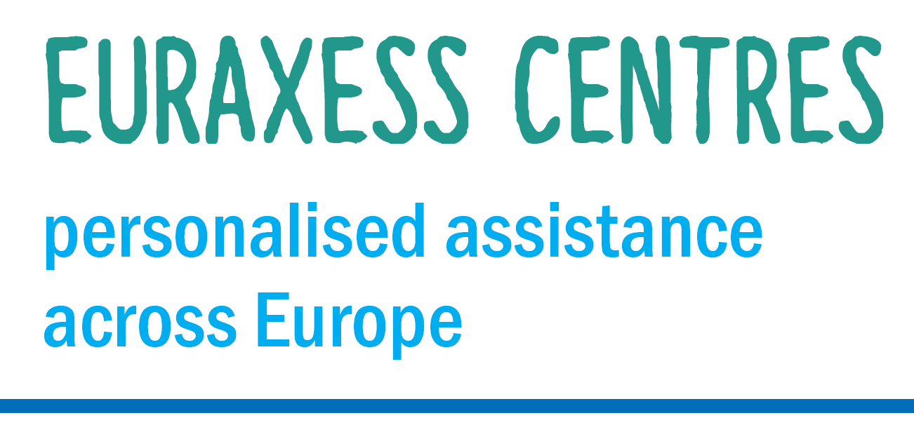
Free relocation advice
Support for your career development
Networking opportunities for you and your family
http://china.euraxess.org

Slide 10


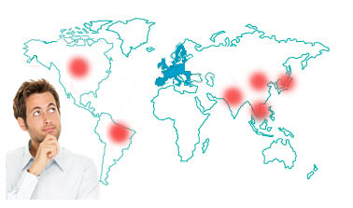
Keep yourself updated about opportunities in Europe
Benefit from networking and collaboration opportunities
http://china.euraxess.org

Slide 11
EURAXESS : CHINA
中国网络
Finding information to move between China and Europe
查找中国和欧洲的来往信息
Finding Funding & Jobs
查找经费资助及就业信息
Meeting new potential research partners
认识新的研究合作伙伴
Networking, Sharing Intelligence & Experience
联络、共享资讯与经验
http://china.euraxess.org

Slide 12
EURAXESS : CHINA
中国网络
Website
网站
Newsletter, Publications
通讯及其他出版物
Events
活动
http://china.euraxess.org

Slide 13

EURAXESS : CHINA
中国网络
DEVELOP YOUR NETWORK OF CONTACTS IN THE SINO-EUROPEAN RESEARCH COMMUNITY
在欧-中研究群体中建立自己的联系网络
KEEP TRACK OF THE LATEST DEVELOPMENTS IN SINO-EUROPEAN RESEARCH
了解最新发展趋势
FIND OUT NEW FUNDING AND CAREER OPPORTUNITIES
发现资金和就业机会
EURAXESS IS YOUR PARTNER FOR RELOCATING TO EUROPE
EURAXESS是您转向欧洲的伙伴
FREE TO JOIN
免费注册
CHINA.EURAXESS.ORG
CHINA@EURAXESS.NET
Facebook, linkedin
微信: EURAXESS
http://china.euraxess.org

Slide 14
Section 2
QUICK OVERVIEW OF THE
EUROPEAN FUNDING LANDSCAPE AND HORIZON 2020
00:15

Slide 15
INDUSTRIAL LEADERSHIP
行业领导力
EXCELLENT SCIENCE
优质的科学
SOCIETAL CHALLENGES 社会挑战
NOW MORE THAN
100.000
RESEARCHERS FUNDED
MARIE SKŁODOWSKA-CURIE ACTIONS:玛丽·居里计划
INDIVIDUAL FELLOWSHIPS 单独研究基金
FELLOWSHIPS FOR OUTSTANDING RESEARCHERS
为优秀的研究人员提供的研究基金
- RESEARCHERS IN MOTION -
EUROPEAN RESEARCH COUNCIL:欧洲研究委员会
SUPPORTING TOP RESEARCHERS FROM ANYWHERE IN THE WORLD
支持世界各地的顶尖研究人员
+
100s OF NATIONAL FUNDING PROGRAMMES

Slide 16




INDIVIDUAL EU COUNTRIES
EU COUNTRIES
Austria Italy Belgium Latvia
Bulgaria Lithuania Croatia Luxembourg
Cyprus Malta Czechia Netherlands
Denmark Poland Estonia Portugal
Finland Romania France Slovakia
Germany Slovenia Greece Spain
Hungary Sweden Ireland United Kingdoms
- RESEARCHERS IN MOTION -
Networks like RISE
Big H2020 projects
ASSOCIATED COUNTRIES
Albania Ukraine Georgia Israel
Montenegro Serbia Turkey Moldavia
Armenia Tunisia Iceland
Faroe Islands Norway Switzerland
Bosnia and Herzegovina North Macedonia
Sino-EU
co-funding

Slide 17
Section 3
OPPORTUNITIES FOR INDIVIDUAL RESEARCHERS:
IN THE EUROPEAN UNION
00:25

Slide 18
EUROPEAN RESEARCH COUNCIL:欧洲研究委员会
An autonomous funding body set up by the EU in 2007 and led by scientists 在2007年由科学家牵头，欧盟建立的一个独立资助机构
Funding excellent researchers to carry out frontier research in Europe, via annual competitions 通过年度竞争，资助优秀科学家在欧洲开展前沿研究活动
Attractive, long-term funding for the very best 长期且具有吸引力的资助项目，只为最好的研究人员
In all fields, without thematic priorities 覆盖所有领域，无预设优先资助领域
Substantial grants and a recognised label of excellence 可观的资金以及卓越的认可
- RESEARCHERS IN MOTION -

Slide 19
EUROPEAN RESEARCH COUNCIL:欧洲研究委员会
1 researcher, 1 Host Institution in Europe 一名研究人员，一个欧洲接收机构
No consortia or partnerships: 1 project, 1 selection criterion – excellence 无联盟或伙伴关系：一个项目，一个筛选标准—卓越
Any topic, nationality, age and current workplace 不限研究课题，不限国籍，不限年龄以及目前工作地点
Grants are portable (= the PI can change Host Institution) 资金可转移（受资助者可变更接收机构）
The PI has all the Freedom to design the project and choose their team 受资助者可自由设计项目并选择他们的团队
Implementing arrangement“ with non-eu funding bodies, such as NSFC in China!
Single and long-term (6-12 months) or multiple short-term visits for chinese researchers (deadline was in april)
- RESEARCHERS IN MOTION -

Slide 20
EUROPEAN RESEARCH COUNCIL:欧洲研究委员会
初级研究人员
（获博士之后2-7年），最多五年资助200万欧元
2-7 years after PhD, grant up to € 2.0 Mio for 5 years
Starting Grants
(7-12 years after PhD), grant up to € 2.75 Mio
for 5 years
中级研究人员
（获博士之后7-12年），最多五年资助275万欧元
Consolidator Grants
在过去10年内有显著研究成果，最多五年资助350万欧元
Significant research
achievements in the
last 10 years, grant up to € 3.5 Mio
for 5 years
Advanced Grants
初级研究基金
中级研究基金
资深研究基金
Proof of Concept
Bridging gap between research and innovation
up to €150,000 for ERC grant holders
为欧洲研究委员会资助人员最多提供15万欧元
缩小研究和创新间的差距
概念论证
- RESEARCHERS IN MOTION -

Slide 21
MARIE SKŁODOWSKA-CURIE ACTIONS:玛丽·居里计划
WORLDWIDE AND CROSS-SECTOR MOBILITY THAT IMPLEMENTS EXCELLENT RESEARCH IN ANY FIELD
提升世界范围内跨行业无特定研究领域的优秀研究活动的流动性
NOW MORE THAN
100.000
RESEARCHERS FUNDED
INDIVIDUAL FELLOWSHIPS 单独研究基金
FELLOWSHIPS FOR OUTSTANDING RESEARCHERS
为优秀的研究人员提供的研究基金
- RESEARCHERS IN MOTION -
European Fellowships 欧洲研究基金:
International mobility within or into Europe 欧洲内部或进入欧洲的国际人员流动
Experienced researchers of any nationality 不限国籍的优秀研究人员
Funding for researcher and institution 为研究人员和研究机构提供资金
Global Fellowships 全球研究基金:
  International mobility from europe to a third country and return 从欧洲到第三国并返回服务的国际人员流动
  Support to experienced researchers – european nationals or long-term residents 支持任何国籍的有经验的研究人员—具有欧洲国籍或为欧洲长期居民

Slide 22
MARIE SKŁODOWSKA-CURIE ACTIONS
MSCA
Training
Mobility
Career
FOCUS ON THE RESEARCHER HIMSELF
Notes:
All AREAS of researchers
Different from other kind of funding – less focus on the research (althought that‘s still important) and more on YOU the researcher

Slide 23
MARIE SKŁODOWSKA-CURIE ACTIONS
FOUR DIFFERENT PROGRAMMES
RISE
ITN
COFUND
IF
Research and Innovation Staff Exchange
Innovative Training Networks
Co-financing fellowships or doctoral programmes with transnational mobility
Individual Fellowships.
Deadline 11 September 2019 – 17:00 Brussels Time – 23:00 Beijing Time.
Notes:
Many different programmes to achieve the goals of training, mobility and career development of researchers.
Today we are focusing on the Individual Fellowships.

Slide 24
MARIE SKŁODOWSKA-CURIE ACTIONS
INDIVIDUAL FELLOWSHIP (IF)
Individual
Experienced Researchers
Host Institution
Academic or Non-Academic
A personal fellowship to support mobility, fully funded
Notes:
What is experienced researcher?
The host Insitution can be a univeristy, research organisation or any other academic institution OR it can also be a non-academic institution, such as industrial research centre og an NGO.
There is a great emphasis on making the fellowships attractive, so they are fully funded and include reasonably good salaries and budget for research costs and managerial cost in included in the proposal.

Slide 25
NO UPPER EXPERIENCE LIMITS
NO AGE LIMITS
MSCA Individual Fellowship
ELIGIBLE RESEARCHERS
At the time of CALL DEADLINE
Doctoral track
Non-Doctoral track
NOT PhD Student
Have PhD Degree
After Masters have four years of full time equivalent research experience.
ANY CAREER STAGE
MANY OTHER OPPOR-TUNITIES
NEED TO COMPLY WITH THE MOBILITY RULE

Slide 26
MSCA Individual Fellowship
MOBILTY RULES
2 TYPES OF IF
EUROPEAN FELLOWSHIP
GLOBAL FELLOWSHIP
FROM WORLD TO EUROPE
FROM ONE EUROPEAN COUNTRY TO ANOTHER
FROM EUROPE TO THE WORLD (INCLUDING CHINA)
INCUDES 12 MONTHS BACK IN EUROPE
EUROPE =
28 Member +
14 Associate
1-2 YEARS
2-3 YEARS
NO MORE THAN 12 MONTHS IN COUNTRY FOR LAST 3 YEARS
MANY OTHER OPPOR-TUNITIES
NEED TO COMPLY WITH THE MOBILITY RULE
AVAILABLE TO CHINESE RESEARCHERS

Slide 27
MSCA Individual Fellowship
EUROPEAN FELLOWSHIPS
OPEN TO THIRD COUNTRY APPLICANTS – SUCH AS CHINESE RESEARHCERS
DON‘T NEED TO LIVE IN EUROPE – CAN APPLY FROM CHINA
CAN‘T APPLY ALONE
  YOU NEED HOST ORGANISATION AND SUPERVISOR IN EUROPE TO SUPPORT YOUR APPLICATION
  HOW TO FIND?
  Use your own connections
  Maybe you are familiar with European resarchers from your work or maybe your chinese supervisor know somebody.
  Use EURAXESS
  Read our flashnotes for opportunities – Sign up for the EURAXESS Portal and upload your CV online – Check out our hosting offer database
  Have Inititative
NEED TO COMPLY WITH THE MOBILITY RULE

Slide 28
MSCA Individual Fellowship
HOST INSTITUTION -> BENEFICIARY
Recruits, Hosts, and trains the fellow (Supervisor)
Must be located in a MS or AC
Receives funding from European Commission.
Signs the Grant Agreement with the European Commission
YOU DECIDE WHERE TO CARRY OUT YOUR RESEARCH
  Academic host
  Public or private Higher Education Institutions awarding academic degreees
  Public or private non-profit research organizations
  International European Interest Organisations (CERN, EMBL)
  Non-Academic Host
  Any other socio-economic actor not included in the academic sector definition ( SME, enterprises, NGOs, hospitals, government nobides, museums, libraries…)
NEED TO COMPLY WITH THE MOBILITY RULE

Slide 29
MSCA Individual Fellowship
EUROPEAN FELLOWSHIPS – 4 PANELS
STANDARD EF
CAREER RESTART
SOCIETY & ENTERPRISE
REINTEGRATION
For those coming to or moving within Europe
Mobility Rule: Can only apply with a host in a country where you have lived for no more than 12 months in the 3 years before the call deadline (14th September 2016)
For those coming to or moving within Europe
For people who have taken a career break (any reason) for at least 12 months before call deadline
Can only apply with a host in a country where you have lived for no more than 3 years in the 5 years before the call deadline
For those who wish to (or recently have) relocated to Europe from outside
Must be a European citizen or previous long-term resident (> 5 years of research work in Europe)
Can only apply with a host in a country where you have lived for no more than 3 years in the 5 years before the call deadline
For those coming to or moving within Europe
The host must be a non-academic organisation e.g. a company, an NGO, a voluntary organization…
Can only apply with a host in a country where you have lived for no more than 3 years in the 5 years before the call deadline
NEED TO COMPLY WITH THE MOBILITY RULE

Slide 30
MSCA Individual Fellowship
Newest “panel“
Not strictly Marie Curie Fellowship but a second opportunity for researchers that had good application to go to do special fellowship in a Widening Country.
Otherwise the same or very similar requirements and benefits as MSCA Individual Fellowship.
Aim: healp spread excellence and close the research and innovation gap within Europe
Normal award criteria, scoring and thresholds for MSCA – IF will apply.
Single ranking list
At submission stage applicants are asked in section 5 (Part A – Call Specific Questions) whether or not they wish to be considered for this funding opportunity
No restriction to nationality applies.
WIDENING FELLOWSHIP
NEED TO COMPLY WITH THE MOBILITY RULE

Slide 31
MSCA Individual Fellowship
SECONDMENTS
DURING THE EF OR GF, RESEARCHER CAN BE SECONDED TO ANY OTHER ORGANISATION IN EUROPE
BEST IF IT‘S IN ANOTHER SECTOR – FOR EXAMPLE, FROM UNIVERSITY TO COMPANY OR FROM COMPANY TO UNIVERSITY
  Less than 18 months Fellowship
  Secondment up to 3 months maximum
  More than 18 months fellowship
  Secondment up to 6 months maximum
SECONDMENT CAN BE SPLIT INTO SEVERAL SHORTER PERIODS
Also consider Partner
Organisations for GF or for secondments in Europe. Need Letter of Commitment.
NEED TO COMPLY WITH THE MOBILITY RULE

Slide 32
IN A NUTSHELL
Researchers apply with European Host
Host signs contract with EC
Host employs researcher
Joint preparation: ER and the Host Institution (Beneficiary)
A researcher (ER) can only submit one proposal
A supervisor can submit different proposals with different ER
Competitive proposals are prepared in a collaborative way by all actors
Aim for the best match fellow/supervisor/institution
Involve the European Offices / managers of the Host institution: submission + pre-screening
Individual research project: Training through research under supervision
Hands on training: For specific skills
Intersectoral or interdisciplinary transfer of knowledge: Secondments
Organization of scientific / Training / dissemination events
Communication, outreach activities, public engagement
NEED TO COMPLY WITH THE MOBILITY RULE

Slide 33
MSCA Individual Fellowship
IF IS MORE THAN JUST RESEARCH PROJECT
WHEN APPLYING TRY TO TAKE INTO ACCOUNT THAT IT‘S A CAREER DEVELOPMENT FELLOWSHIP AND SHOULD INCLUDE:
  Training through research (individual project)
  Additional scientific skills (new techniques, instruments etc.)
  Transferable skills (e.g. communication, IPR, entrepreneurship etc.)
  Interdisciplinary/inter-sectoral transfer of knowledge (e.g. secondments). Opportunity to link with industry, NGO, public sector, national archive etc.
  Research and financial management of the fellowship
  Organising and taking part in events (including public engagement)
  Training in gender, ethics issues and open science
NEED TO COMPLY WITH THE MOBILITY RULE

Slide 34
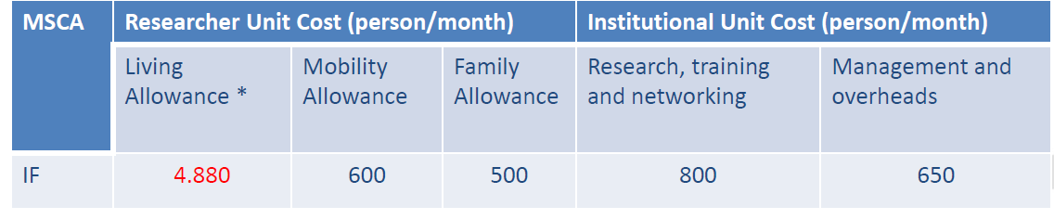
MSCA Individual Fellowship
HOW MUCH FUNDING WILL YOU RECEIVE
Fellow‘s salary = Living Allowance + Mobility allowance (+ Family allowance – only for married people or people with children)
There is a country specific correction factor to account for different costs of living in each country – E.G. Iceland 117%, Belgium 100%, Romania 68%
Take home ammount varies by country – depends on taxes, pension rules etc in each country. Ask NCP in the country you are interested in
NEED TO COMPLY WITH THE MOBILITY RULE

Slide 35
HOW TO APPLY
EUROPEAN FELLOWSHIP
10 PAGES IN THE MAIN PROPOSAL:
  Excellence
  Impact
  Implementation
5 PAGES RESEARCHER‘S CURRICULUM VITAE
ETHICS SECTION (IF APPLICABLE)
TABLES WITH DETAILS OF HOST ORGANISATION – 1 TABLE PER ORGANISATION
NEED TO COMPLY WITH THE MOBILITY RULE

Slide 36
HOW TO APPLY
EUROPEAN FELLOWSHIP
All online submission
Via EU Participant Portal
  http://ec.europa.eu/research/participants/portal/desktop/en/opportunities/index.html
Guide for Applicants (including proposal template) is available on the Participant Portal – section on “H2020 Calls” – look for H2020-MSCA-IF-2018
NEED TO COMPLY WITH THE MOBILITY RULE

Slide 37
HOW TO APPLY
DOCUMENTS
PART A
General information (about proposal, including the abstract)
Administrative data of participating organisations
Budget
Ethics
Call specific questions
Part B
Document 1 (Single PDF – 10 pages)
Excellence
Impact
Quality and Efficiency of the Implementation
Document 2 (Single PDF)
CV of the experienced researcher (5 pages)
Capacities of the participating organisations (1 page each)
Ethical aspects
Letters of commitment of partner organisation (GF only or Secondments)
NEED TO COMPLY WITH THE MOBILITY RULE

Slide 38
HOW IS YOUR APPLICATION EVALUATED
EUROPEAN FELLOWSHIP
Evaluated using international peer review
Proposals are read and scored by at least 3 experts in the field
Consensus meeting to agree scores and comments
Use 8 disciplinary evaluation panels:
  Chemistry (CHE)
  Physics (PHY)
  Mathematics (MAT)
  Life Sciences (LIF)
  Economic Sciences (ECO)
  Information Sciences and Engineering (ENG)
  Social Sciences & Humanities (SOC)
  Environment and Geosciences (ENV)
DOES NOT INCLUDE RESEARCH COVERED BY EURATOM or BANNED BY EU or DUAL USE
For example
Cloning, Heritable genetic changes, experiments on human embryos.

Slide 39
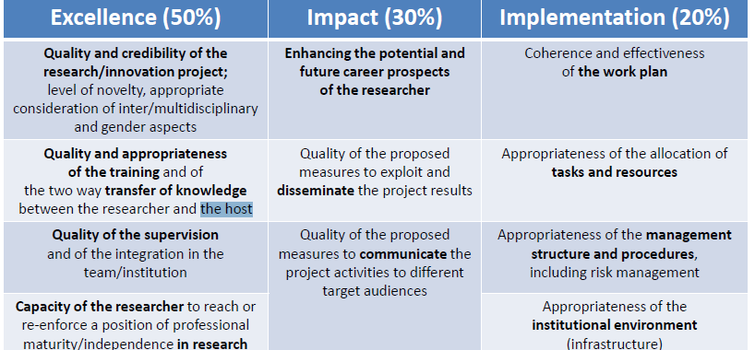
HOW IS YOUR APPLICATION EVALUATED
EUROPEAN FELLOWSHIP
NEED TO COMPLY WITH THE MOBILITY RULE

Slide 40
TIPS AND TRICKS
EXCELLENCE CRITERIA 1
Quality and credibility of the research/innovation project;
level of novelty, appropriate consideration of inter/multidisciplinary and gender aspects
Introduction and state of the art: do not write an abstract, write an introduction (not as a start: „This research project focuses…“, but „Since Einstein‘s ground-breaking theory of relativity, curvature of space is …“) – draw the bigger picture and raise curiosity. Then focus on you specifics and how they are embedded.
Objectives (i.e. research goals) and overview of the action (Research Work Packages should be mentioned here): describe your research goals and how they are embedded into your work plan (the research work packages)
NEED TO COMPLY WITH THE MOBILITY RULE

Slide 41
WHAT HAPPENS AFTERWARD
EUROPEAN FELLOWSHIP
Results are issued around February 2020
What happens if I am successful?
  Paperwork (grant agreement) will be finalised by the host organization by May 2020
  You need to arrange a start date with the host organisation
  You can start the fellowship in June 2020, or postpone up to May 2021
What if I am not successful?
  You can re-apply to the 2020 Call (Opens May 2020 with a deadline in September 2019) as long as you are still eligible
  You can use the feedback from the first application to improve the new application
NEED TO COMPLY WITH THE MOBILITY RULE

Slide 42
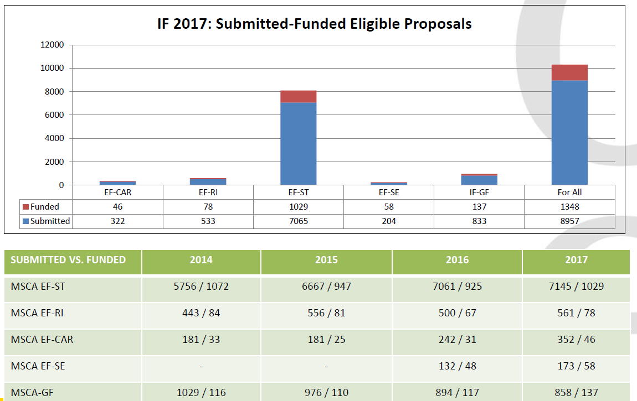
SUCCESS RATE AND SUBMITTED PROPOSAL
NEED TO COMPLY WITH THE MOBILITY RULE

Slide 43
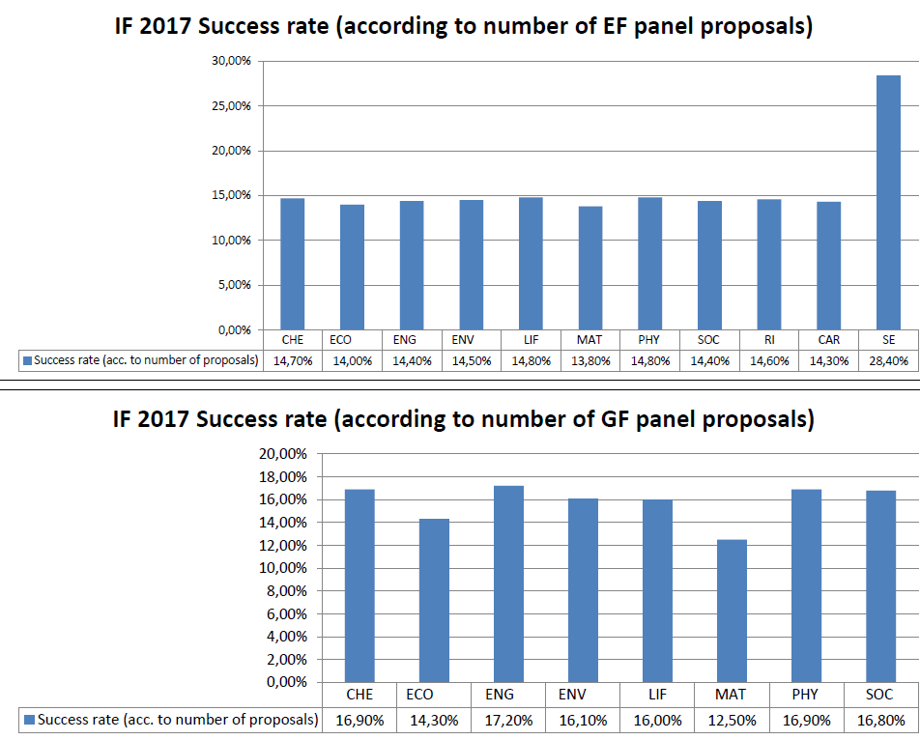
SUCCESS RATE AND SUBMITTED PROPOSAL
NEED TO COMPLY WITH THE MOBILITY RULE

Slide 44
FURTHER HELP
EUROPEAN FELLOWSHIP
National Contact Points
In the European Country you are Interested in going to
See full List of them here:
  http://ec.europa.eu/research/participants/portal/desktop/en/support/national_contact_points.html
  https://www.net4mobility.eu/ncp-contacts.html
Chinese National Contact Point
  CECO: China-European Union Science and Technology Cooperation Promotion Office
  http://www.ceco.org.cn
  ceco@cstec.org.cn
  Tel: 68513370
EURAXESS
  Not experts – but here to help.
How-to pieces/ hints and tips/ training
National Contact Points
There are materials from various sources from the past few years:
MSCA IF Guide for Applicants 2017
Net4Mobility's 'Survival guide to MSCA IF'
About the MSCA IF and RISE programmes (4.45 MB)
How to find a host institution in Europe for your MSCA-IF proposal (2.96 MB)
How to write a competetive MSCA-IF proposal (4.45 MB)
Find all LINKS here.
NEED TO COMPLY WITH THE MOBILITY RULE

Slide 45
Section 4
TESTIMONIAL
DR TIANCHENG LI
Current Position :
Marie Skłodowska Curie Fellow, Faculty of Sciences, University of Salamanca (USAL), Spain
MSCA research Project:
“Smartphone-based mobile positioning system”
01:00
NEED TO COMPLY WITH THE MOBILITY RULE
Notes:
Dr. Tiancheng Li graduated from Harbin Engineering University, China, double majoring in Mechatronics Engineering and in Business Administration, in 2008.
He received a Ph.D. degree in Electrical and Electronic Engineering from London South Bank University, UK, in the July of 2013 and another Ph.D. degree in Mechatronics Engineering in Northwestern Polytechnical University, China, in June 2015.
Dr. Tiancheng Li currently holds a Marie Skłodowska-Curie Individual Fellowship (CALL: H2020-MSCA-IF-2015; Grant No. 709267) with Prof. Juan Corchado.
He is an Associate Editor (2016-2018) of ADCAIJ (Advances in Distributed Computing and Artificial Intelligence Journal, http://adcaij.usal.es)
His research interests cover the general areas of statistical signal processing and information fusion with particular focus on nonlinear filtering, finite set statistics and multiple object tracking.
They can be categorized as follows
.Radar Data Mining, Distributed Information Fusion and Sensor Networking (for tracking)Sequential Monte Carlo (particle filter) methods, Finite Set StatisticsMarkov-free Data-driven Novel Estimation Framework for Joint Smoothing, Tracking and Forecasting (STF).

Slide 46
Section 5
COLLABORATION OPPORTUNITIES FOR CHINESE INSTITUTION:
IN THE EUROPEAN UNION
01:20

Slide 47
Marie Skłodowska-Curie Actions
玛丽·居里计划
RISE (RESEARCH AND INNOVATION STAFF EXCHANGE) 研究创新人员交流（rise）
exchange programme for staff: 工作人员的交流项目
Organisations from the academic and non-academic sectors based in Europe and outside Europe (third countries) 欧洲和欧洲以外（第三国）的学术与非学术组织
at least three partners – international (or intersectoral) 至少三个伙伴—国际（或跨行业）
Short-term staff Exchange (1-12 months) 短期人员交流（1-12个月）
Length of project is max. 48 months. 项目期限最长为48个月
Annual deadline 年度截至日期
China-based partners in the project can apply to the Co-Funding Mechanism of MOST 设立在中国的项目机构可申请科技部联合资助机制的支持

Slide 48

EU-China Co-funding Mechanism (CFM)
-中欧科研创新联合资助机制
EU-based partners in the project receive funding from Horizon 2020
设立在欧盟国家的项目机构由“地平线2020”资助
China-based partners in the project can apply to the Co-Funding Mechanism of MOST
设立在中国的项目机构可申请 科技部联合资助机制支持
100 million euros
1亿欧元
200 million RMB
2亿元人民币
Per year until 2020
至2020年，年度资助规模

Slide 49
5 EU-China STI Flagship Areas (total of 12 topics)
-5个中欧科技创新旗舰领域 （共12个课题）
•Food, Agriculture and Biotechnologies 食品、农业与生物技术：科技部（MOST）
•Sustainable Urbanisation 可持续城镇化: 科技部（MOST）
•Surface Transport 地面交通：科技部（MOST）
•Aviation 航空:工信部（MIIT）
•Biotechnologies for Environment and Health 环境与健康生物技术:国家自然科学基金委员会（NSFC）
9 Priority Themes Eligible for MOST Co-Funding
科技部联合资助支持的9大优先领域
ICT, intelligent and green manufacturing, safe clean and efficient modern energy, … health, marine, space, new materials, public security …
信息通讯技术、智能绿色制造、安全清洁有效的现代能源、…健康、海洋、空间、新材料、公共安全…
14 Additional Horizon 2020 topics targeting China
-“地平线2020”14个其他针对中欧合作的课题）

Slide 50
Upcoming Horizon 2020 calls Targeting China
Agriculture:
SFS-37-2019: Integrated approaches to food safety controls across the agri-food chain
以综合方法实现对横跨整个农业食物链的食品安全管控
CE-SFS-39-2019: High-quality organic fertilisers from biogas digestate
从沼气池中获得高质量的有机肥料
SFS-40-2020 - Healthy soils for healthy food production (Information to be published soon)
以健康土壤实现健康食品生产（详细信息近期发布）
Environment:
SC5-25-2020: Strengthening EU-China cooperation on sustainable urbanisation: Enhanced natural treatment solutions for water security and ecological quality of water in cities (Information to be published soon)
加强中欧关于城市可持续发展方面的合作：加强城市水资源安全和水生态质量的自然处理解决方案 （详细信息近期发布）
Biotechnologies:
NMBP-21-2020: Custom-made biological scaffolds for specific tissue regeneration and repair (RIA) (Information to be published soon)
定制生物支架用于特殊组织再生与修复（详细信息近期发布）
Aviation:
LC-MG-1-6-2019: Aviation operations impact on climate change
C) Propose and evaluate mitigation strategies towards greener flight trajectories (ensuring complementarities with SESAR JU activities.
(China)
D) Propose and evaluate mitigation strategies based on changes in the use of alternative fuels (China)
航空业对气候变化的影响
C）建议并评估对绿色飞行轨道的缓解策略（确保与SESAR JU相补充）（中国）
D) 依据使用替代燃料所发生的变化提出并评估缓解策略
MORE TO COME IN HORIZON EUROPE AFTER 2020

Slide 51
Section 6
OTHER FUNDING OPPORTUNITIES IN EUROPE
AND EUROPEAN UNION MEMBER STATES
AND ASSOCIATED COUNTRIES
01:35
Notes:
Questions for before – what is the best way to make partners in other countries?

Slide 52
100s OF NATIONAL FUNDING PROGRAMMES
+

Slide 53

ONE OF THE WORLD’S MOST
RESEARCH-INTENSIVE NATIONS
WORLD’S 5TH LARGEST ECONOMY
A HIGH LEVEL OF SCIENTIFIC OUTPUT
INTERNATIONALLY RECOGNIZED RESEARCHERS
Worldwide research networks
France’s major research bodies (CNRS, CIRAD, INRA, INSERM, IRD, Institut Pasteur, INRIA, IFREMER etc) operate in more than 250 locations around the world
CNRS is the world’s top research institution in terms of high-level publications (Scimango 2016)
COOPERATION BETWEEN CHINA AND FRANCE
More than 2000 French scientists come to China every year and 5% of joint publications between China and foreign countries are with France. Around 65 Franco-chinese joint research structurese
AGREEMENTS AND JOINT DECLARATIONS
Scientific and technical cooperation, intellectual property, cooperation in space, climate change, among others.
MOBILITY PROGRAMS
Cai Yuanpei Programme – exchange of PhD and Post-Docs
Xu Guangqi Programme – launching and developing collaboration
Youth Talents Programme
INNOVATION PROGRAMMES
COOPOL Innovation – explorative missions of French SMEs from competitiveness clusters to China
SCHOLARSHIPS AND GRANTS
Eiffel PhD Scholarships
Fernand Braudel-IFER
Enhanced Eurotalents
ANR Hosting High-level Researchers
Summer Schools France Excellence
http://china.euraxess.org
Notes:
France is of course a country we all know – but not only for the famous culture, history and food but also as the 5th largest economy in the world and one of the main research powers globally.
The major research bodies of French are all global players and operate in more than 250 locations around the world, including China.
These are institutions like LIST end with CNRS
CNRS is the worlds top research institution in terms of high-level publications.
As you might have seen, President Macron was in Beijing just last week and France is very active in cooperation with China. This goes also for scientific cooperation –More than 2000 French scientists come to China every year and [LIST].

Slide 54

JOINT DECLARATIONS
Platform on innovation
Research and Innovation Program Clean Water
Innovation Platform on Life Science
Electromobility
1st - 3rd Sino-German Intergovernmental Consultations:
Strategic Partnership on High School Education
Vocational Training
LED Technology
Ocean and Polar Research
City of the Future
1978: implementation of the Scientific & Technology Cooperation
Work areas: innovation, research funding, environmental technologies, electric mobility, manufacturing, life sciences, maritime research, vocational education.
S&T is of high significance for the annual intergovernmental consultations, and the Meeting of Science & Technology Cooperation.
July 2017: Meeting of the Plattform Innovation. 2018: Innovation conference in the course of the 40th anniversary of S&T cooperation.
Research organizations in China: Fraunhofer Society, Helmholtz Association of German Research Centres, German Research Foundation, Max Weber Foundation.
Numerous research institutions, universities and companies work together through scientific programs, joint labs and joint R&D centres.
Funding Opportunitites
DAAD Research Fellowships
DAAD Research Stays
China/Germany Joint Research Programme
DFG Research Grants
Sino-German Centre Projects and visits
Humboldt Foundaion
German Chancellor Fellowship
http://china.euraxess.org
Notes:
Next door neighbours to France is of course Germany – one of the biggest research powers in Europe and the world.
Everybody in China knows how advanced Germany is when it comes to technology and engineering and they are just as strong when it comes to world-leading universities, basic and applied research output and globally active funding and research organisations like Fraunhofer, Max Weber Foundation, Helmholtz Association and the German Research Foundation, all which have presence here in China..
Germany has also very deep and long standing history of close-cooerpation with China in the field of research, science, technology and education focusing on work areas like LIST. This is in addition to numerous research instituions, universities and companies LIST.

Slide 55

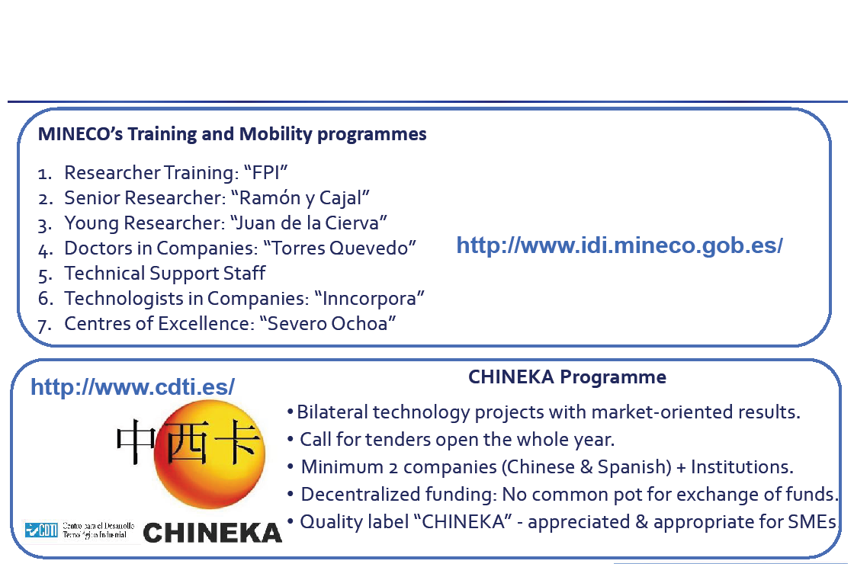
Cultural heritage, arts, contrasting landscapes, tourist resorts, sports, cuisine, and internationally well-known firms
RELEVANT PROGRAMMES FOR SPANISH-CHINESE COOPERATION
http://china.euraxess.org
Notes:
Spain is a countyr know for it‘s LIST.
They are also very active country in research and development and very open to international cooperation.
For the people in here that represent companies the CHINEKA programme is of particular interest. It‘s a LIST.

Slide 56

Applied basic science (chemistry, mathematics and physics), energy and environment, space and aeronautics, information communication technology; nanotechnology and advanced materials, technologies applied to cultural heritage
Sino-Italian Innovation Centre for Technology Transfer, Beijing China.
Sino-Italian Centre for e-government, Shenzhen, China
Sino – Italian Centre for design, Shanghai, China350 agreements have been signed between Italian and Chinese Universities for collaboration in education and research
COOPERATION BETWEEN CHINA AND ITALY
Government Scholarships and fellowships for foreigners
Italy China Project for Exchange of Researchers and Joint Research Projects
INFN Postdoctoral Fellowships in experimental physics
General Framework Agreement between CAS and INFN, June 2011
Exchange of researchers, senior and junior. 20 + 20 three months scholarships
Agreement with CNR
Chinese Academy of Agricultural Sciences (CAAS), Chinese Academy of Forestry (CAF), Chinese Academy of Sciences (CAS)Annual callsm
http://china.euraxess.org
Notes:
Italy is a country that is well known for it‘s long history of scientific research and discoveries, and they are still today among the strongest science powers in the world.
Research Areas that Italy is particularly strong in include LIST.
Italy also has a very strong presence in China having many joint centers like LIST
I know for a fact there are many more projects and joint labs that we could add to that list.
Some of the highligths in Sino-Italian Cooperation include LIST

Slide 57
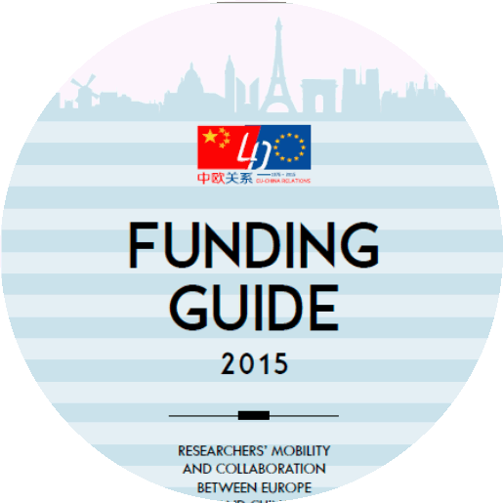
ONLY THE TIP OF THE ICEBERG: 28 COUNTRIES IN THE EU & 16 ASSOCIATED COUNTRIES
EU COUNTRIES
Austria Italy
Belgium Latvia
Bulgaria Lithuania
Croatia Luxembourg
Cyprus Malta
Czech Republic Netherlands
Denmark Poland
Estonia Portugal
Finland Romania
France Slovakia
Germany Slovenia
Greece Spain
Hungary Sweden
Ireland United Kingdoms
ASSOCIATED COUNTRIES
Albania Ukraine
Georgia Israel
Montenegro Serbia
FYRO Macedonia Turkey
Armenia Tunisia
Iceland Moldavia
Faroe Islands Bosnia and Herzegovina
Norway Switzerland
Notes:
These four examples are all very impressive but they are only the tip of the iceberg.
They are only four out of

Slide 58
Section 7
HOW TO FIND PARTNERS
IN EUROPE
01:50
Notes:
Questions for before – what is the best way to make partners in other countries?

Slide 59



HOW TO FIND PARTNERS IN EUROPE
Available Tools online
EURAXESS Jobs
EURAXESS Hosting Database
Special Organisation Networks
EURAXESS China
EURAXESS Partnering tools
Search Organisation DB of the EU
Funding Portal Partner Search
Research CORDIS Project DB

Slide 60

HOW TO FIND PARTNERS IN EUROPE
In reality we have to use our social skills
Make contacts when attending conferences
Cold approach colleagues you are aware of in your field - make sure to study the etiquette
Ask your professor or colleagues that have international experience to put you in touch with their international contacts
Make your self visible to get noticed – actively participate in events, find online communities, publish your research
DO SHORT TERM FELLOWSHIPS ABROAD
For example:
Marie Curie Fellowship
or
Individual Country Mobility Scheme
NETWORKING
MOBILITY

Slide 61
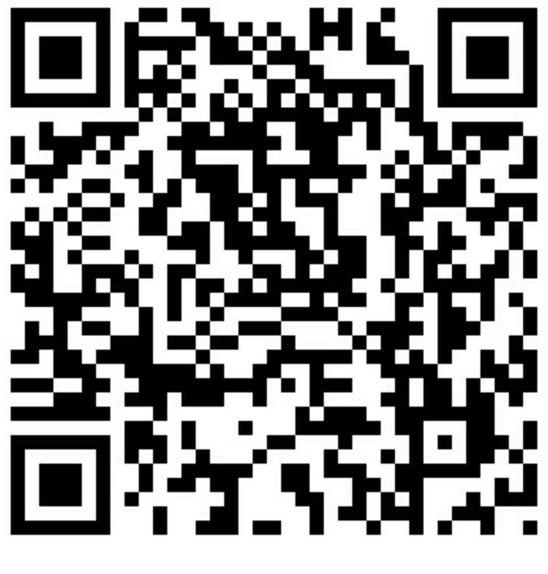

ROUNDTABLE
LETS SHARE OUR EXPERIENCE!
Questions?
Comments?
.
02:05
Join a
WeChat
Group for this event
Join EURAXESS Wechat channel
CHINA.EURAXESS.ORG
CHINA@EURAXESS.NET
Facebook, linkedin
微信: EURAXESS
NEED TO COMPLY WITH THE MOBILITY RULE

