Slide 1
EURAXESS Webinars 2024
ERC and African researchers
© Art & Build Architect / Montois Partners / credits: S. Brison

Slide 2
Opportunities for researchers in Third Countries
Additional “start-up” funding for scientists moving to Europe (EUR 1 Million irrespective of grant scheme)
Grantee can keep affiliation with home institute outside Europe (“significant part” of work time in Europe, at least 50%)
Team members can be based outside Europe, depending on project

Slide 3
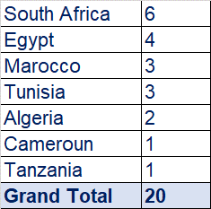
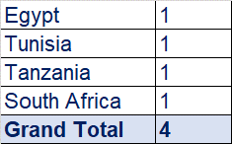
ERC grantees national of African countries
2007-2024
Horizon Europe only

Slide 4
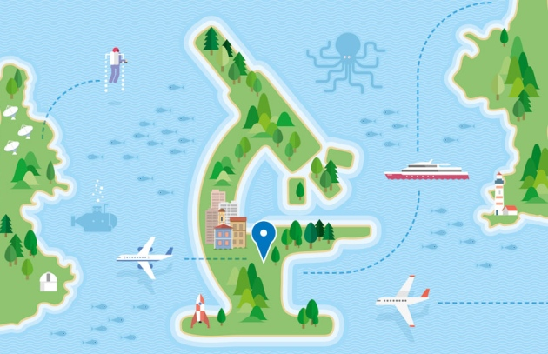
ERC Synergy open to the world
One Principal Investigator per Synergy Grant Group (except the Coordinator) can be based in a Third Country.

Slide 5
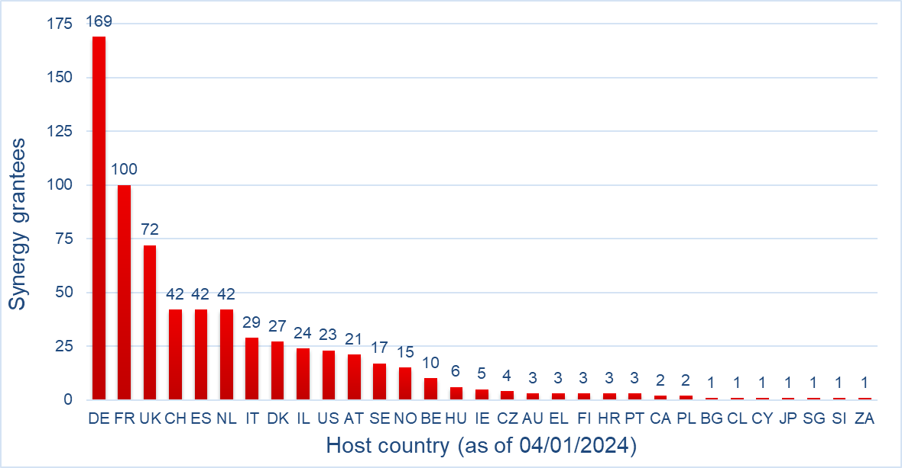
Synergy grantees in Third Countries

Slide 6
1 Synergy grantee in South Africa
ERC Synergy 2023

Slide 7
ERC Implementing Arrangements (IA)
The Implementing Arrangements are international initiatives promoting opportunity for researchers to visit and collaborate with ERC teams, partially supported by non-European agencies.
ERC Implementing Arrangement with the South Africa National Research Foundation signed on October 2015.

Slide 8
ERC IA State-of-play: ERC PIs Participation 2012-2023

Slide 9
ERC IA State-of-play: visits to ERC projects 2012-2022
† For 2019-2020 ERC calls for EoI, many countries did not launch or postponed internal calls, because of pandemics mobility limitations.
* Many visits for 2021 ERC call for EoI started on 2022 because of pandemics mobility limitations.
* * Preliminary data for 2022 ERC call for EoI.

Slide 10
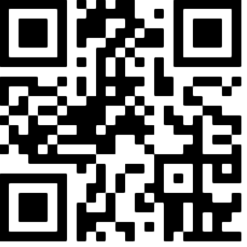
Thank You!
More information: erc.europa.eu
Follow us on social media
@ERC_Research
European Research Council
European Research Council
European-Research-Council
Notes:
You can find us on LinkedIn, Facebook and YouTube simply by searching by European Research Council

