Slide 1
Opportunities for young people in 2022

Slide 2
Introducing the European Year of Youth
2022

Slide 3
Why now?
It is timely:
the COVID-19 pandemic had an unprecedented impact on education, employment & mental health
54 %

Slide 4
What is it all about:
Renew the positive perspectives for young people, while highlighting how the green and digital transitions and other Union policies offer opportunities for young people
​Empower and support young people, including through youth work, especially young people with fewer opportunities, to acquire relevant knowledge and competences and thus become active and engaged citizens and actors of change.​
Supporting young people to acquire a better understanding of, and actively promoting the various opportunities available to them, be it from the EU, national, regional or local level​
Mainstreaming youth policy across all relevant Union policy fields in line with the 2019–2027 European Union Youth Strategy to encourage the bringing of a youth perspective into policymaking at all levels.​
54 %

Slide 5
What do young people say:
Call for ideas on the European Year of Youth launched on 22 October 2021
Almost 5000 responses
Most preferred interaction: with ‘Young people from other European countries’
62,9% do not know or not sure how to make their voice heard
Preferred way of making their voice heard is ‘debates and interactive dialogues’

Slide 6
Who can be part of it
All young people!
54 %

Slide 7
What topics?
European Learning Mobility
Employment and Inclusion
Policy Dialogues and Participation
Green
Digital
Culture
Health, Well-being and Sports
Youth and the World

Slide 8
What is ahead of you?
conferences, events, and policy initiatives to promote an inclusive and accessible debate on challenges and on the course of action that stakeholders at different levels can take​
promoting youth participation: tools, channels, programmes enabling youth to reach policymakers​
gathering ideas using participatory methods to co-create and co-implement the Year​
information, education and awareness-raising campaigns to convey values such as respect, equality, justice, solidarity, volunteering​
creating spaces and tools for exchanges on turning challenges into opportunities and ideas into actions in an entrepreneurial spirit​
studies and research on the situation of youth in the Union​
promoting programmes, funding opportunities, projects, actions & networks of relevance to young people

Slide 9
How can YOU get involved?
Check out the European Year of Youth page of the European Youth Portal and take part in the activities you will find there
Check out the policy tab on the European Year of Youth page and learn about what the EU is doing with and for youth across all policy areas
Encourage your youth organisations/schools to organise youth related activities throughout the Year and to upload them to the European Year of Youth page
Take part in our upcoming Social Media activities linked to the Year
Take part in the next surveys/consultations and share your ideas!
Spread the world and help us reach out every corner of the EU, raise awareness within your community, school, among your friends about the Year

Slide 10
Use the logo
THE LOGO​: The speech bubble becomes the central layout element
Available in 7 colours and all languages: https://europa.eu/youth/year-of-youth/communication-material_en
THE HASHTAG: use #EYY2022 and #EuropeanYearofYouth
54 %

Slide 11
European Youth Portal
What is the European Year of Youth? | European Youth Portal (europa.eu)​
54 %

Slide 12
European Youth Portal
Everyone can upload their activities on the European Youth Portal, which will be flagged as activities under the Year.
The EYY site provides information about European Union opportunities and activities across Europe. ​
You can find many activities (conferences, festivals, debates, expos, sports events...) dedicated to young people under the Activities section. ​
54 %

Slide 13
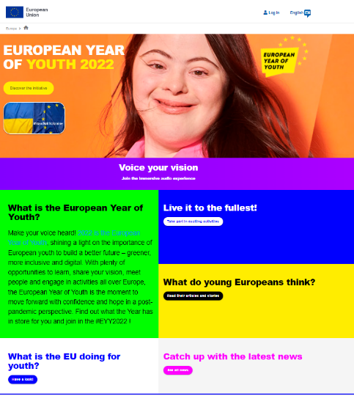
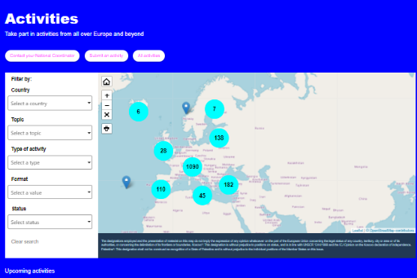

Slide 14
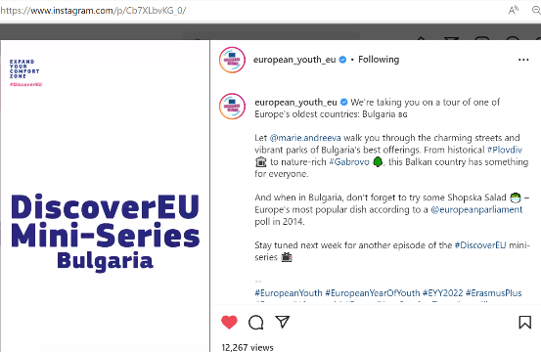
Social media

Slide 15
Keep in touch
European Youth Portal
European Year of Youth site
Erasmus+ website
@EUEuropeanYouth
@EuropeanSolidarityCorps Official group
@DiscoverEU Official group
@EUErasmusPlusProgramme
@EuropeanYouthEU
@EUErasmusPlus
@european_youth_eu

