Slide 1
Towards a European Strategy for Universities
Stijn DELAURE
European Commission, DG Research & Innovation
R&I Actors and Research Careers
EURAXESS BHO 02-12-2021

Slide 2
The New European Research Area
What is the new ERA?
What are the objecties of the new ERA?
Boost market uptake
Strengthen the mobility of researchers and free flow of knowledge and technology
Prioritise investments in research and innovation
Improve access to excellence

Slide 3
ERA Policy Agenda: action in support of universities
Council Recommendation on a Pact for Research and Innovation in Europe
Conclusions on the future governance of the European Research Area (ERA) → incl. Policy Agenda
Priority Area 2: Taking up together the challenges posed by the twin green and digital transformation, and increasing society’s participation in the ERA
Action 13: Empower Higher Education Institutions to develop in line with the ERA, and in synergy with the European Education Area
Support universities in their digital transition, including through initiatives such as Connected Universities;
Develop and adopt a policy approach to equip researchers with the skills needed for an interoperable career in academia and beyond
Policy approach on future EU level support for the further development of HE institutions, including through a European Excellence Initiative and the consolidation of the European Universities Initiative

Slide 4
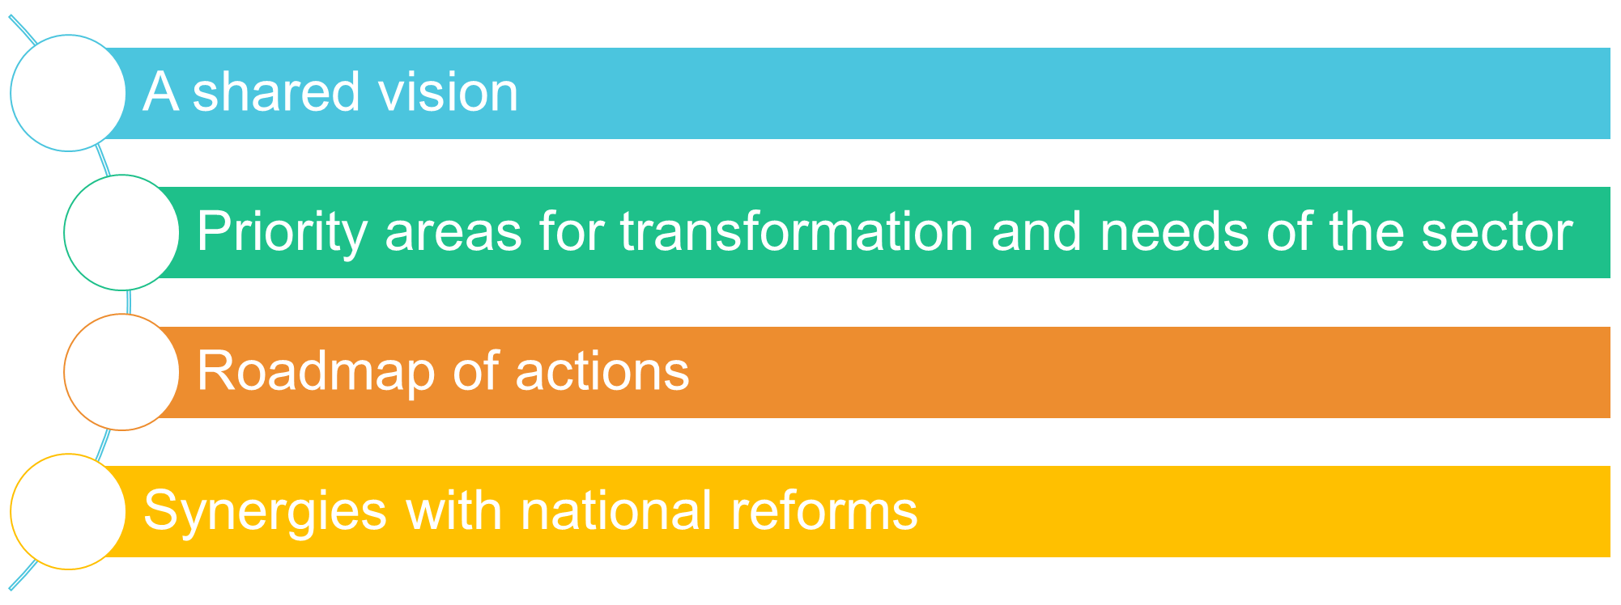
Towards a European Strategy for Universities Realising synergies between EEA and ERA
EEA: European Education Area
ERA: European Research Area

Slide 5
Towards a European Strategy for Universities Key priority areas to empower higher education sector
Supporting the European way of life
Key actors of change for the twin green and digital transition
Drivers of Europe’s global role and leadership

Slide 6
European Universities Initiative Exemplifying synergies between education and R&I
41 European Universities alliances (284⁺ institutions), deep cooperation in education and R&I
Piloted by Erasmus+, 39 supported by Horizon 2020, selected based on inclusiveness and excellence
Joint strategies for education and R&I
Challenge-based approach
Embedded and seamless mobility
Innovative pedagogies & flexible curricula
Sharing of resources, courses & infrastructure
Cooperation with surrounding ecosystems
Erasmus+ call 2022 to consolidate existing alliances and create new alliances is open

Slide 7
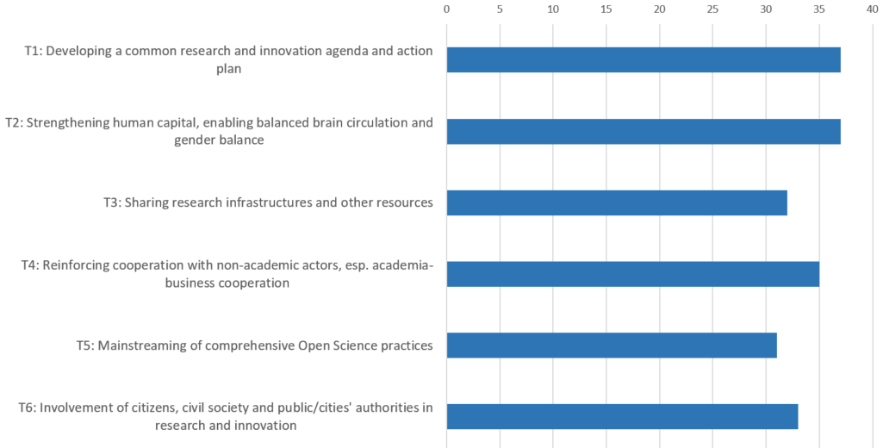
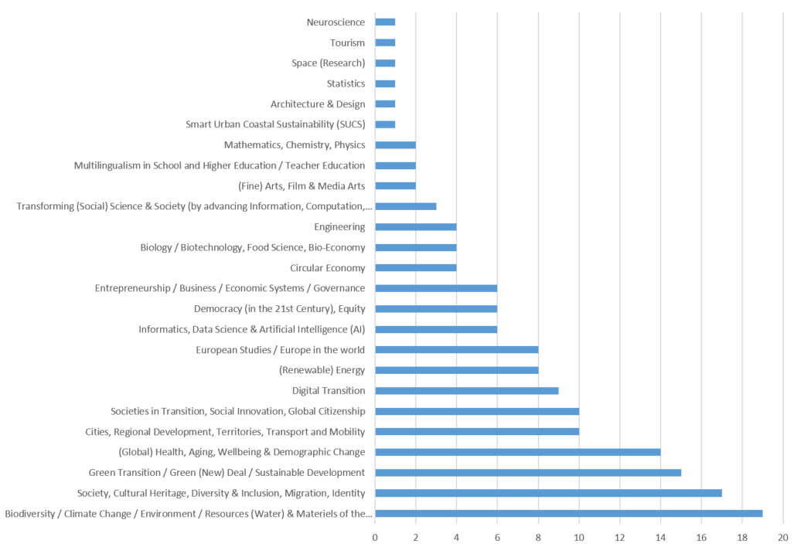
European Universities Initiative Role models for institutional change
0 5 10 15 20 25 30 35 40
Common R&I agenda
Strengthening human capital
Sharing infrastructures
Reinforcing cooperation with non-academic sector
Mainstreaming Open Science practices
Engaging citizens & society
Health & well-being
Sustainable development
Society, cultural heritage
Climate change, resources

Slide 8
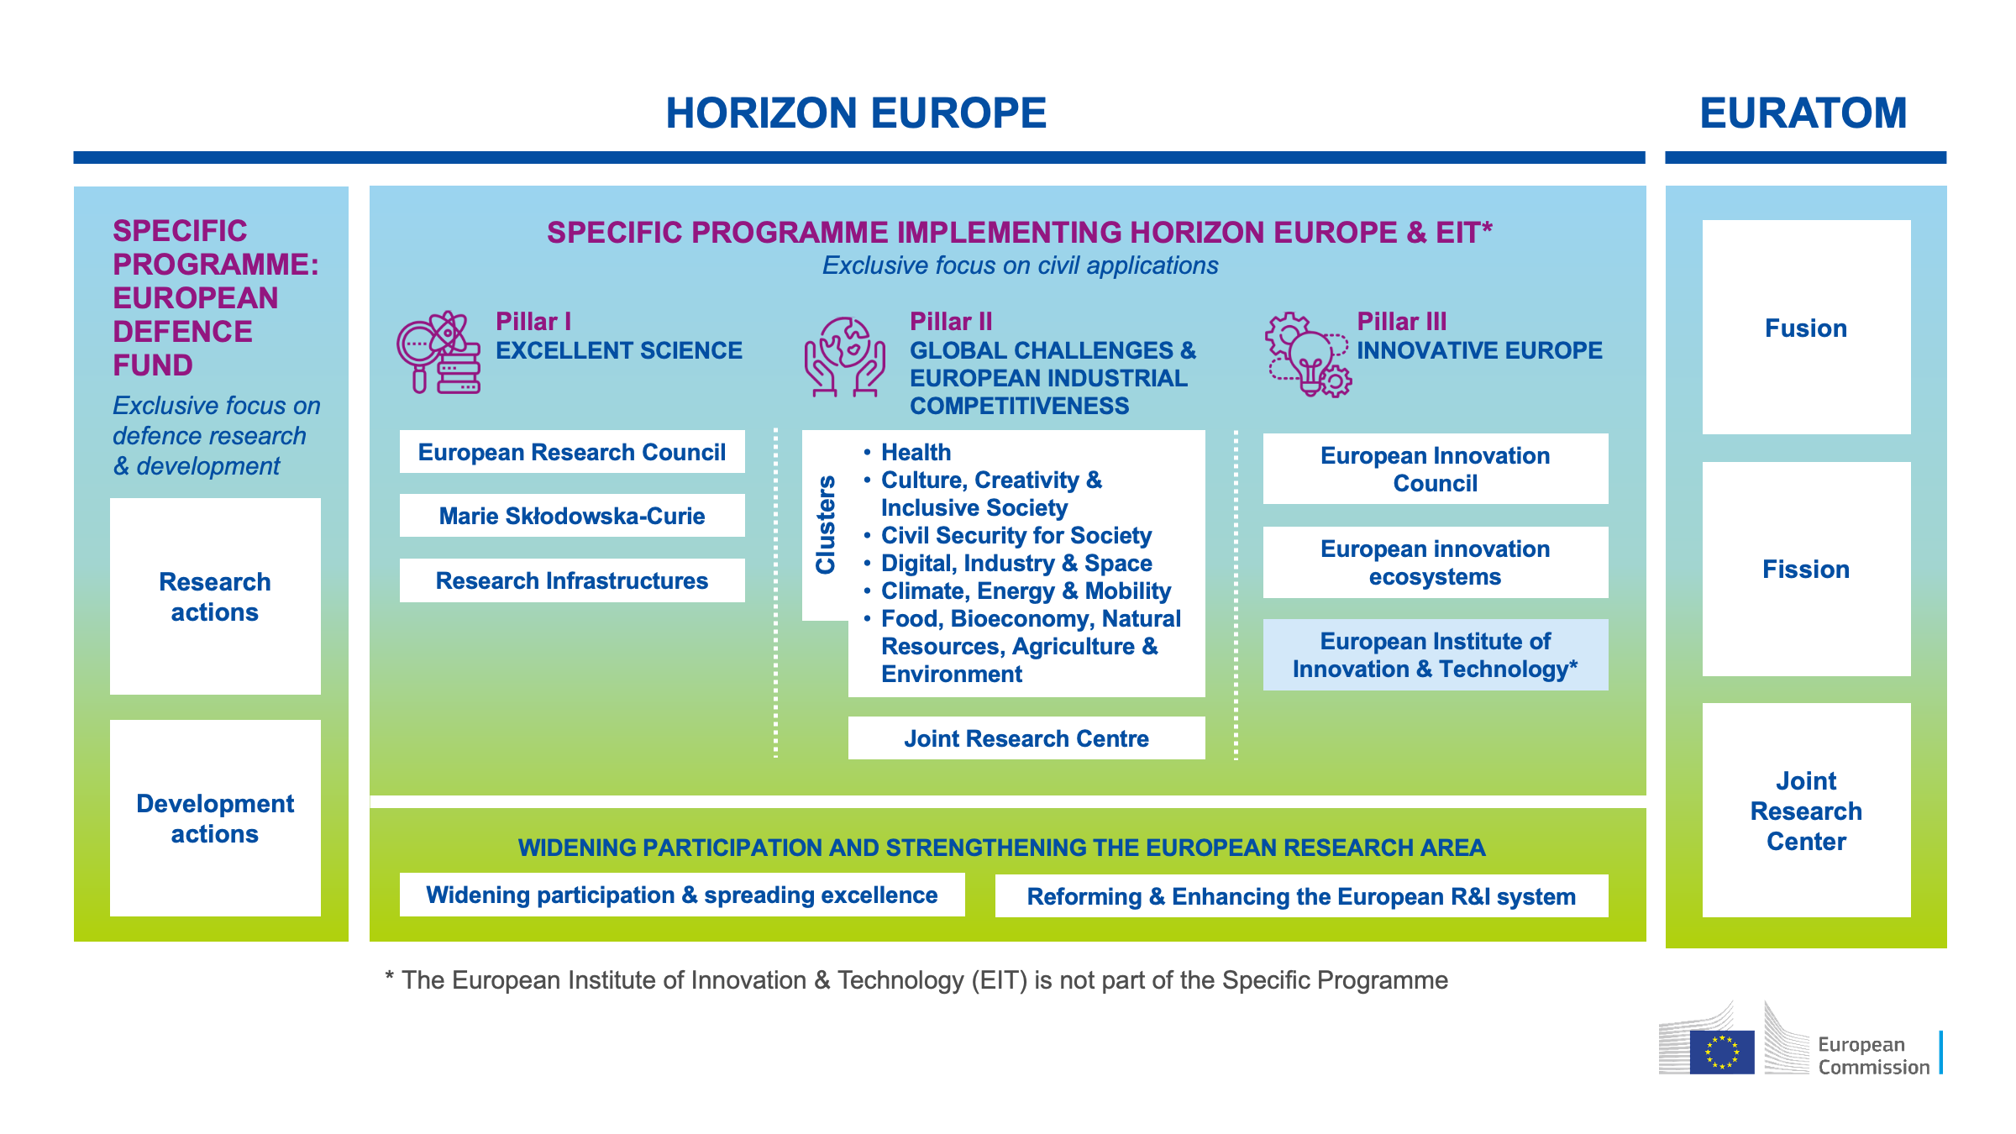

Slide 9
Widening participation and strengthening the ERA Horizon Europe contributing to realising the ERA
2. Improving access to excellence
Networking for research managers
European Excellence Initiative
ERA Talents
1. Prioritising investments & reforms
4. Deepening the ERA
Acceleration services for HEI
Strengthening R&I talents/careers
Support for reform of assessment
3. Translating R&I results into economic value
ERA/Excellence Hubs for interconnected ecosystems

Slide 10
Thank you!
For more info:
The new European Research Area: https://ec.europa.eu/info/research-and-innovation/strategy/strategy-2020-2024/our-digital-future/era_en
European Universities Initiative: https://ec.europa.eu/education/education-in-the-eu/european-education-area/european-universities-initiative_en
Horizon Europe:
https://ec.europa.eu/info/research-and-innovation/funding/funding-opportunities/funding-programmes-and-open-calls/horizon-europe_en

