Slide 1
EURES
The European Network of Employment Services
& The Job Mobility Portal
15 June 2022, DG EMPL/E1

Slide 2
Overview
What is EURES and what does it do?
State of play of EURES
EURES grant programs

Slide 3
What is EURES and what does it do?

Slide 4
EURES history
Since 1994 EURES has operated as a cooperation network
2016 Regulation introduced a substantial reform focused on:
Job vacancies and CVs on the EURES portal
Matching between vacancies and CVs
Delivery of a broader range of services with a greater impact
Consistent level and range of support services across all countries

Slide 5
EURES Objectives
Facilitating the exercise of the rights of free movement;
Implementing a coordinated strategy for employment and for promoting a skilled, trained and adaptable workforce;
Improving the functioning, cohesion and integration of the labour markets in the Union, including at cross-border level;
Promoting voluntary geographical and occupational mobility in the Union (including cross-border) on a fair basis and in compliance with Union and national law and practice;
Supporting transitions into the labour market, thereby promoting the social and employment objectives

Slide 6
EURES Services (in EURES member countries)
Matching of job vacancies (JVs) and CVs on the common IT platform and the EURES portal
Information and guidance and other support services for workers and employers
Post-recruitment assistance
Access to information on Living and Working conditions in other Member States
Specific support services for frontier workers and employers in cross-border regions
Dynamic recruitment events through European (Online) Job Days platform

Slide 7
EURES Governance
European Coordination Group (ECG) = ECO + NCOs
European Coordination Office (ECO) – the European Labour Authority
National Coordination Offices (NCOs)
EURES Members and Partners

Slide 8
Roles for the Commission and ELA
ELA: EURES European Coordination Office (ECO)
European Commission
Operative responsibility, ECO
Governance of network activities and the European Coordination Group
Horizontal support of the network
Working program, EURES portal, training, communication, working with Members and Partners, EOJDs, PMS, labour analysis, helpdesk, mutual learning events..
Legislative
Monitor compliance
Policies
IT-development
Grant programs
Targeted Mobility Schemes and Cross Border Partnerships

Slide 9
State of play - EURES

Slide 10
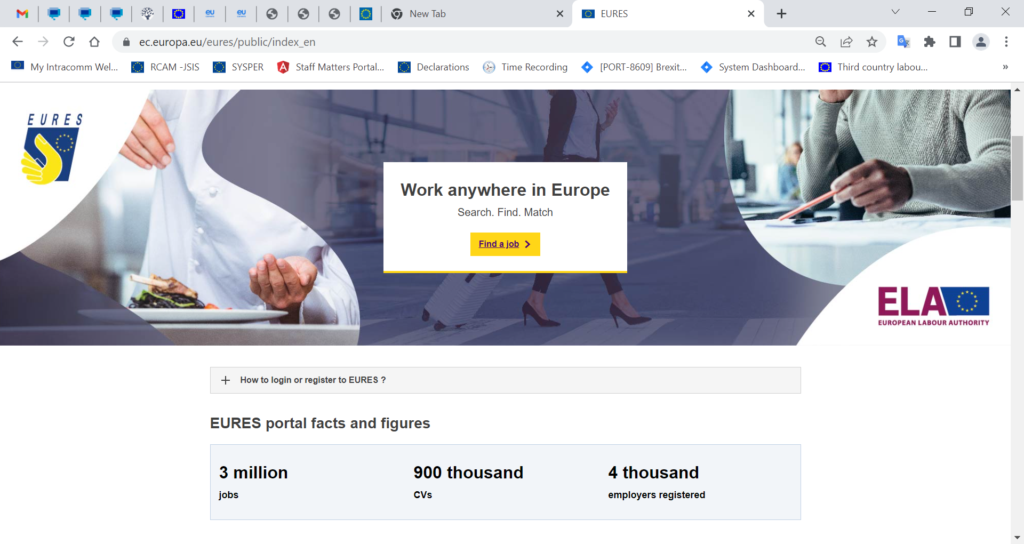
State of play – EURES
ECO and all operational activities transferred to ELA in 2021
EURES Portal
Currently 3 million job vacancies and over 900.000 CVs
Continuous developments and improvements
Human network of EURES advisers
Over 1000 across 31 European Countries

Slide 11
Activities
Governance
Communication
Training/EURES Academy
Labour market analysis
Performance Management System
European online Job Days
Enlargement of the EURES network

Slide 12
Admission of and working with private Members and Partners
The 2016 EURES regulation requires all the countries to set in place a system of admission of private organisations as Members or Partners
Innovative and ambitious measure
May 2022
24 Private Members
76 Partners
Advantages and challenges

Slide 13
Ex-Post Evaluation of EURES, report 2021
EURES is unique and works well, but can improve
EURES is not visible enough
EURES needs all CVs and vacancies
And all of them encoded with ESCO
To do automated matching
EURES needs to expand its network of Members and Partners
https://eur-lex.europa.eu/legal-content/EN/TXT/?uri=CELEX%3A52021DC0452&qid=1630504338973
https://eur-lex.europa.eu/legal-content/EN/TXT/?uri=CELEX%3A52021DC0452&qid=1630504338973
Notes:
https://eur-lex.europa.eu/legal-content/EN/TXT/PDF/?uri=CELEX:52021SC0217&rid=6

Slide 14
EURES grant programs

Slide 15
EURES Targeted Mobility Schemes (TMS)
An instrument to address labour market imbalances
Financed under the Employment and Social Innovation ("EaSI") strand of the ESF+
The services provided by the EURES TMS implementing projects include direct funding for target groups for the following purposes:
interview trip; relocation to the country of destination; language training; recognition of qualifications; family relocation grant; integration programme for SMEs for the new worker(s), trainee(s) or apprentice(s).
There are four projects in implementation (lead by Italy, Germany and Sweden)
2022: New call for proposals will be launched
https://ec.europa.eu/eures/public/eures-services/eures-targeted-mobility-scheme_en

Slide 16
EURES Cross Border Partnerships
EURES helps cross-border workers to overcome obstacles by providing financial support to cross-border partnerships, under the umbrella of EaSI, the EU programme for employment and social innovation.
EU internal border regions cover 40% of EU territory and are home to almost 2 million cross-border commuters.
Cross-border workers face a number of obstacles on a daily basis, such as different national practices, social security systems, taxation rules and legal system
8 cross-border partnerships, involving 14 countries
https://ec.europa.eu/eures/public/eures-services/eures-cross-border-regions_en
https://ec.europa.eu/eures/public/eures-services/eures-cross-border-regions_en

Slide 17
Thank you!
© European Union 2021
Unless otherwise noted the reuse of this presentation is authorised under the CC BY 4.0 license. For any use or reproduction of elements that are not owned by the EU, permission may need to be sought directly from the respective right holders.

