Slide 1
The 1st Meeting of the European National Scientists Networks in China
EURAXESS is a European Commission‘s Directorate General for Research and Innovation initiative
http://china.euraxess.org

Slide 2
EURAXESS is a unique pan-European initiative delivering information and support services to professional researchers regardless of their career stage.
Backed by the European Union and its Member States, it supports researcher mobility and career development, while enhancing scientific collaboration between Europe and the world.
http://china.euraxess.org

Slide 3
EURAXESS : GATEWAY TO THE EUROPEAN RESEARCH AREA
通向欧洲研究领域的大门
EURAXESS PORTAL
EUROPEAN RESEARCH AREA
EURAXESS WORLDWIDE
EURAXESS CENTRES
http://china.euraxess.org

Slide 4
EXCELLENCE
CREATIVITY
DIVERSITY
欧洲研究领域
http://china.euraxess.org

Slide 5
Search for new job & funding opportunities
Find answers to your questions when moving to a new country
Connect with employers and other researchers
Explore the collection of resources that will help you to navigate through your career
http://china.euraxess.org

Slide 6
Free relocation advice
Support for your career development
Networking opportunities for you and your family
http://china.euraxess.org

Slide 7
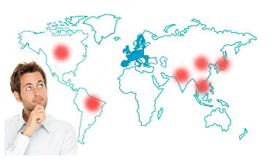
Keep yourself updated about opportunities in Europe
Benefit from networking and collaboration opportunities
http://china.euraxess.org

Slide 8
EURAXESS : CHINA
中国网络
Finding information to move between China and Europe
查找中国和欧洲的来往信息
Finding Funding & Jobs
查找经费资助及就业信息
Meeting new potential research partners
认识新的研究合作伙伴
Networking, Sharing Intelligence & Experience
联络、共享资讯与经验
http://china.euraxess.org

Slide 9
EURAXESS : CHINA
中国网络
Website
网站
Newsletter, Publications
通讯及其他出版物
Events
活动
http://china.euraxess.org

Slide 10
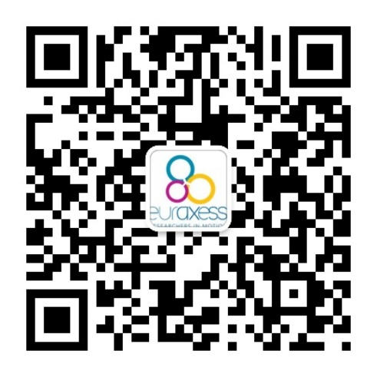
EURAXESS : CHINA
中国网络
DEVELOP YOUR NETWORK OF CONTACTS IN THE SINO-EUROPEAN RESEARCH COMMUNITY
在欧-中研究群体中建立自己的联系网络
KEEP TRACK OF THE LATEST DEVELOPMENTS IN SINO-EUROPEAN RESEARCH
了解最新发展趋势
FIND OUT NEW FUNDING AND CAREER OPPORTUNITIES
发现资金和就业机会
EURAXESS IS YOUR PARTNER FOR RELOCATING TO EUROPE
EURAXESS是您转向欧洲的伙伴
FREE TO JOIN
免费注册
CHINA.EURAXESS.ORG
CHINA@EURAXESS.NET
Facebook, linkedin 微信: EURAXESS
http://china.euraxess.org

