Slide 1
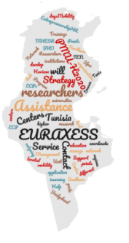
Tunisian EURAXESS Network
« TEN Project »
Project lead by : Ministry of Higher Education and Scientific Research
Speaker : Dr. Amine ELLEUCH
Associate Professor at the Faculty of Science of Sfax (FSS), University of Sfax, Tunisia
National Contact Point for Horizon Europe for the thematics: Food (cluster6) & Reforming and Enhancing the European R&I system
Co-coordinator of TEN Project
EURAXESS BHO Meeting
December 2nd, 2021, 9h50 A.M

Slide 2
Plan
Introduction
The project
Sustainbility
Notes:
EURAXESS is a unique pan-European initiative of the European Research Area, providing information and assistance services to researchers regardless their career stage. Backed by the European Commission and 42 European countries, it supports researcher mobility and career development, while enhancing scientific collaboration between Europe and the world.

Slide 3
Facts about the Tunisia 1/2
More than 11,500 researches in Tunisia (3450 seniors and 8050 juniors)
About 14,000 PhDs and 3000 master degrees are currently going.
392 research laboratories and 215 units with regional outreach and an international reputation.
Tunisia leads the continent in terms of scientific output averaged by GDP or population.
Plan
The project
Sustainbility
Introduction
Notes:
Added to its strategic geographic position in the middle of the Euro-Mediterranean area, Tunisia has been a socio-cultural hub for centuries with a well-known record of accomplishment in scientific outcomes.

Slide 4
Facts about the Tunisia 2/2
Associated to Horizon 2020 since 2016
first associated country in Africa and Arab world to Horizon 2020
Process of association to Horizon Europe advanced already finalized .
Notes:
Added to its strategic geographic position in the middle of the Euro-Mediterranean area, Tunisia has been a socio-cultural hub for centuries with a well-known record of accomplishment in scientific outcomes.

Slide 5
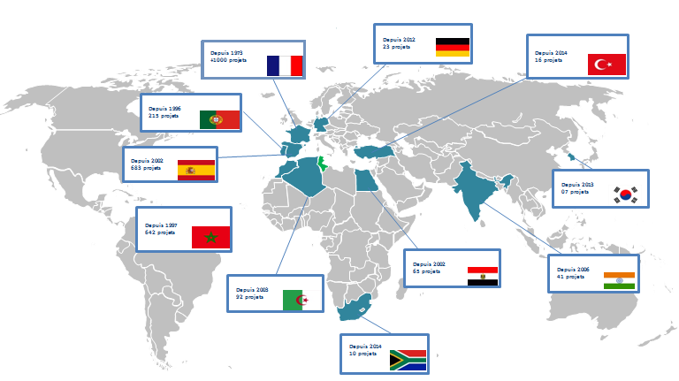
EU-TN bilateral collaborations with the ERA – and Beyons-
Plan
The project
Sustainbility
Introduction
Notes:
The most highlighted partnership involves Tunisia and France with more than 1,000 projects since 1973. UTIQUE 2021 is one of the ongoing projects led by the Ministry for Europe and Foreign Affairs and the Ministry of Higher Education, Research and Innovation promoting new collaborations to the benefit of young researchers and doctoral students.

Slide 6
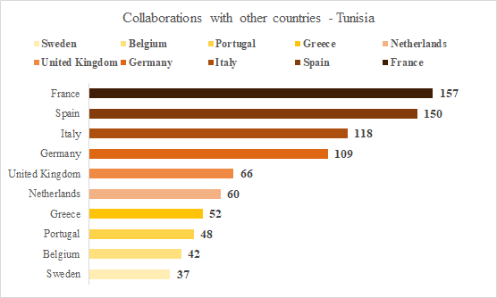
EU-TN bilateral collaborations since 1973
Plan
The project
Sustainbility
Introduction
Notes:
bilateral Scientific cooperations started since the nighteens with ERA- and beyond ; France, Spain and Italy are the hosts of the highest number of collaborations In term of projects involving Tunisia with respectively 157, 150, and 118 collaboration links

Slide 7
Help Researchers
600 Institutions
+ 1500 Persons
42 Countries
Provide Information
Assistance Services
Unique pan-European initiative of the European Research Area, providing information and assistance services to researchers regardless their career stage.
Supports researcher mobility and career development, while enhancing scientific collaboration between Europe and the world.
Plan
The project
Sustainbility
Introduction
Notes:
EURAXESS is a unique pan-European initiative of the European Research Area, providing information and assistance services to researchers regardless their career stage. Backed by the European Commission and 42 European countries, it supports researcher mobility and career development, while enhancing scientific collaboration between Europe and the world.
Tunisia will be part of this initiative through starting-up the EURAXESS Tunisia Network in order to internationalize its research institutions contributing to career advancement of researchers.

Slide 8
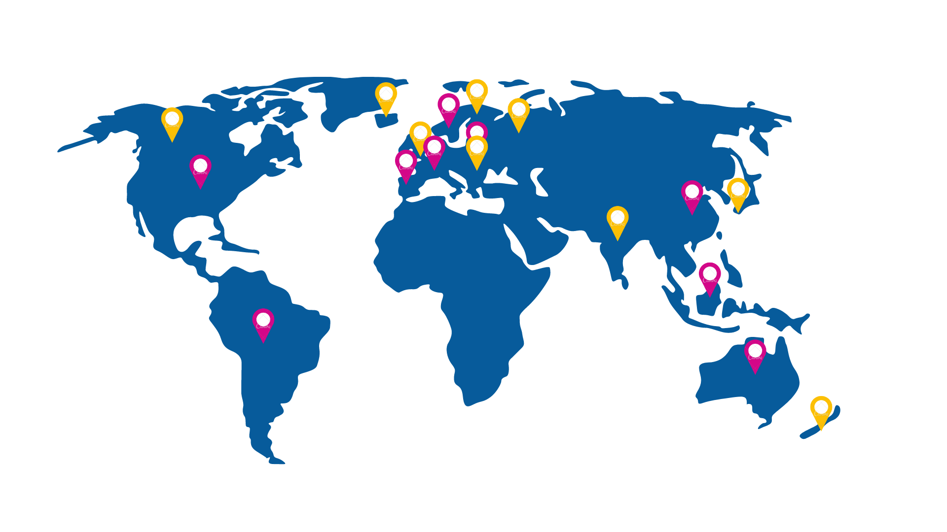
Tunisian EURAXESS Network
Budget: 200.000 €
Tunisia will be the first African and Arab country south of the European territory that adheres to the International EURAXESS Network through the implementation of TEN Project.
Duration : 3 Years (June2021 – May 2024)
5 Work Packages
Plan
The project
Sustainbility
Introduction
Notes:
EURAXESS Tunisia initiative will facilitate practical solutions to these issues for the benefit of the researchers themselves. It strives to become the global support tool for career development support and mobility for researchers contributing to the internationalization of the Tunisian R&I system.

Slide 9
November 2021
June 2021
Kick-off Event
April 2021
Internal kick-off meeting + start of the activities
Timeline of the Tunisian EURAXESS Network – TEN Project -
December 2020
Signature of the Grant Agreement
October 2020
Evaluation of the proposal by the EC + recieving the acceptance note
May 2020
Submission of the proposal of the Tunisian EURAXESS Network – TEN Project
January 2020
Open of H2020-IBA-SwafS-EURAXESS-TN-2020 Call
1st official contact with the EC
Plan
Introduction
Sustainbility
The project

Slide 10
November 2021
June 2021
Kick-off Event
April 2021
Internal kick-off meeting + start of the activities
Timeline of the Tunisian EURAXESS Network – TEN Project -
December 2020
Signature of the Grant Agreement
October 2020
Evaluation of the proposal by the EC + recieving the acceptance note
May 2020
September 2020
Submission of the proposal of the Tunisian EURAXESS Network – TEN Project
January 2020
Open of H2020-IBA-SwafS-EURAXESS-TN-2020 Call
Official request subbmited to the EU
Introduction
Sustainbility
The project
Plan

Slide 11
November 2021
June 2021
Kick-off Event
April 2021
Internal kick-off meeting + start of the activities
Timeline of the Tunisian EURAXESS Network – TEN Project -
December 2020
Signature of the Grant Agreement
October 2020
Evaluation of the proposal by the EC + recieving the acceptance note
September 2020
May 2020
Submission of the proposal of the Tunisian EURAXESS Network – TEN Project
January 2020
Open of H2020-IBA-SwafS-EURAXESS-TN-2020 Call
Open of H2020-IBA-SwafS-EURAXESS-TN-2020 Call
Official request subbmited to the EU
Introduction
Sustainbility
The project
Plan

Slide 12
November 2021
June 2021
Kick-off Event
April 2021
Internal kick-off meeting + start of the activities
Timeline of the Tunisian EURAXESS Network – TEN Project -
December 2020
Signature of the Grant Agreement
October 2020
Positive Evaluation of the proposal by the EC
September 2020
September 2020
Submission of the proposal of the Tunisian EURAXESS Network – TEN Project
January 2020
Open of H2020-IBA-SwafS-EURAXESS-TN-2020 Call
Open of H2020-IBA-SwafS-EURAXESS-TN-2020 Call
Official request subbmited to the EU
Plan
Introduction
Sustainbility
The project

Slide 13
November 2021
June 2021
Kick-off Event
April 2021
Internal kick-off meeting + start of the activities
Timeline of the Tunisian EURAXESS Network – TEN Project -
December 2020
Signature of the Grant Agreement
October 2020
Evaluation of the proposal by the EC + recieving the acceptance note
September 2020
September 2020
Submission of the proposal of the Tunisian EURAXESS Network – TEN Project
January 2020
Open of H2020-IBA-SwafS-EURAXESS-TN-2020 Call
Open of H2020-IBA-SwafS-EURAXESS-TN-2020 Call
Official request subbmited to the EU
Introduction
Sustainbility
The project
Plan

Slide 14
November 2021
June 2021
Kick-off Event
Timeline of the Tunisian EURAXESS Network – TEN Project -
April 2021
Start of the implementation of the project
December 2020
Signature of the Grant Agreement
October 2020
Evaluation of the proposal by the EC + recieving the acceptance note
September 2020
September 2020
Submission of the proposal of the Tunisian EURAXESS Network – TEN Project
January 2020
Open of H2020-IBA-SwafS-EURAXESS-TN-2020 Call
Open of H2020-IBA-SwafS-EURAXESS-TN-2020 Call
Official request subbmited to the EU
Plan
Introduction
Sustainbility
The project

Slide 15
November 2021
June 2021
Kick-off Event on site and on line - Tunisian EURAXESS Network
Timeline of The Tunisian EURAXESS Network – TEN Project -
April 2021
Start of the implementation of the project
December 2020
Signature of the Grant Agreement
October 2020
Evaluation of the proposal by the EC + recieving the acceptance note
September 2020
September 2020
Submission of the proposal of the Tunisian EURAXESS Network – TEN Project
January 2020
Open of H2020-IBA-SwafS-EURAXESS-TN-2020 Call
Open of H2020-IBA-SwafS-EURAXESS-TN-2020 Call
Official request subbmited to the EU
Plan
Introduction
Sustainbility
The project

Slide 16
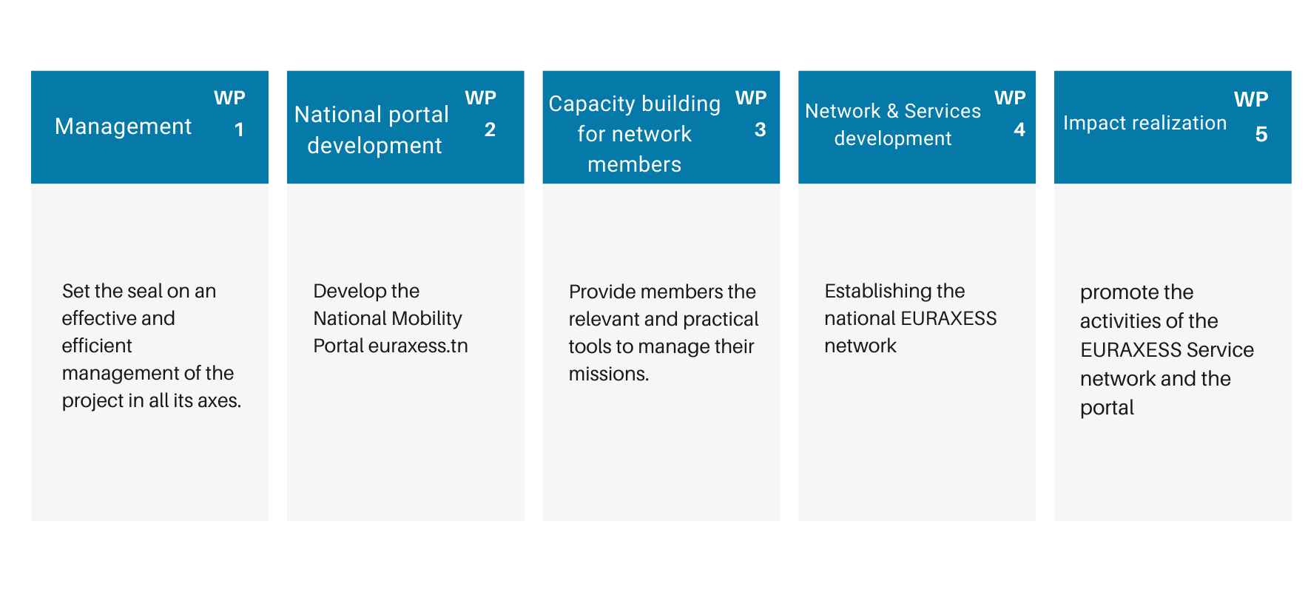
Project Coordinator : Myriam SKANDAJI KALLEL
Project Co-Coordinator : Amine ELLEUCH
https://www.euraxess.tn/
WP Leader
Amine ELLECH
WP Leader
Ahmed MAALEL
WP Leader
Amani CHARRAD
WP Leader
Leila TRIKI
WP Leader
Amira ZAKHAMA
Project manager : Ikhlass SHILI
Communication manager : Ahelm HAMMAMI
Introduction
Sustainbility
The project
Plan
Notes:
Chaque WP leader va détailler son WP

Slide 17
Work package 1 : Management
Ensure an efficient liaison between the management structures and effective coordination of activities between the project and external organizations to reach the fulfillment of project goals and objectives in line with the European Commission rules.
WP1 : Management
PROJECT Management and Quality control
Interaction with the EU commission
Steering Group
Ethics and Data protection
Sustainability
Plan
Introduction
Sustainbility
The project

Slide 18
Work package 2 : National portal development
EURAXESS National Portal to be implemented and hosted within the European Commission platform .
The National portal development will be as a single point of access to all information and services, relevant to incoming, outgoing and intersectoral mobility in Tunisia.
WP2 : National portal development
Portal devolepment and testing
Portal improvement
Jobs and partnering
Portal promotion
Plan
Introduction
Sustainbility
The project

Slide 19
Work package 3 : Capacity building for network members
Focus on trainings and capacity building activities to ensure that EURAXESS Service Centre and Contact Points network staff are fully trained to manage and deliver high quality services to assist in better career development of researchers.
WP3 : Capacity building for network members
Peer to peer learning with International EURAXESS Networks
Empowerment of the Tunisian team
Assessment and Follow-up
Plan
Introduction
Sustainbility
The project

Slide 20
Work package 4 : Network & services development
focus on Establishing the national EURAXESS NETWORK and to gather information material from various sources to provide assistance services for researchers concerning mobility issues
WP4 : Network & services development
Establishment of the Bridgehead organization, EURAXESS Service Centers and contact points
Career development and Help Desk (Assistance, Trainings, (Entrepreneurship))
Mobility Handbook (Mobility guide for incoming and outgoing researchers)
Plan
Introduction
Sustainbility
The project

Slide 21
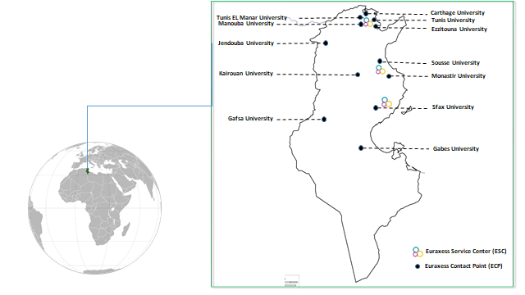
Location of the 3 EURAXESS centers and 13 EURAXESS contact points in Tunisian universities
Introduction
Sustainbility
The project
Plan

Slide 22
Work package 5 : Impact realization
Promote the activities of the EURAXESS Service network and the portal
Enhance the visibility of information and services delivered to the different target audiences.
WP5 : Impact realization
Awareness campaigns and workshops (Social media, Info-days…)
Newsletters
Portal launching event and EURAXESS Tunisia Career Days
Plan
Introduction
Sustainbility
The project

Slide 23
Sustainbility of the Tunisian EURAXESS Network
Recommendation :
Participate actively in all EURAXESS actions to have more visibility.
Enhance the visibility of EURAXESS Tunisia in Africa and the Middle East and motivate /help other African countries to establish their own network.
Establish an international EURAXESS action that gather the 5 continents (Africa, Europe, Asia, America, and Australia) to strengthen the cooperation and partnerships ties.
Plan
Introduction
The project
Sustainbility

Slide 24
Tunisian EURAXESS Network
More than ever, anchored
in the new EER
EURAXESS PORTAL
EUROPEAN RESEARCH AREA
EURAXESS WORLDWIDE
EURAXESS CENTRES

Slide 25
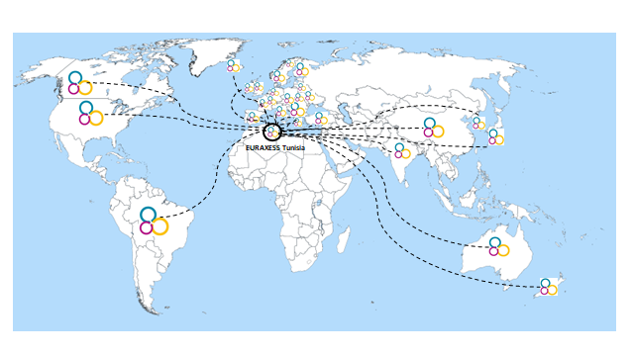
Thank you for Attention !
The Unit for the Management of European Union framework Programmes for Research and Innovation –
The Ministry of Higher Education
and Scientific Research of Tunisia
(amine.elleuch@fss.usf.tn)
Collaborations and partnerships with EURAXESS Entities is one of our priorities.
Don’t hesitate to contact us!

