Slide 1
Global Collaboration for Scientific Diasporas
EURAXESS, EU Network
TOP IV- T7.4 Project
Dr. Isser Peer
IP&D, Israel
■ 20 September 2019 ■ Beijing, China■

Slide 2
Global Collaboration
At the last part of the two interesting days
Three rounds:
The next steps
Tools
Networking and collaboration
■ 20 September 2019 ■ Beijing, China■

Slide 3
Perspective
Era of dramatic Changes
Good practice - ScienceAbroad
■ 20 September 2019 ■ Beijing, China■

Slide 4
The World Economic Forum
Davos

Slide 5
The Fourth Industrial Revolution, Industry 4.0
The Fourth Industrial Revolution Industry 4.0
A short video was presented

Slide 6
Global changes
The Forth Industrial Revolution or Industry 4.0
is changing the world and changing us
A dramatic change of work force and work place
Affecting the research community
A threat? Or opportunity?

Slide 7
HOW - 2
International Joint research
Take advantage of the power of common language and narrative
Consider how to foster the connection and bring these researchers back, not necessarily by physical reintegration
How the new opportunities can leverage scientific collaboration and excellence

Slide 8
Past and Current Activities
Database of Scientific Diaspora networks was created and is maintained
Organizing global joint events with scientific diasporas. In the past (TOP3), NA with EURAXESS NA office. Now, (TOP4), is planning events with China and Brazil. TOP5, more WW collaboration
Creating a platform for strengthening cooperation with Diaspora networks to create a EURAXESS Global network

Slide 9
Going Global
A short video was presented

Slide 10
The WW, EURAXESS NW and the Diaspora
Scientific Diaspora

Slide 11
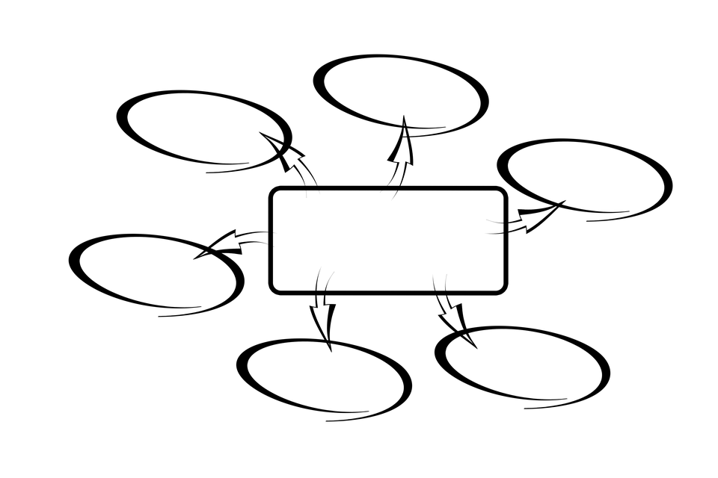
The Global Model
ES
FR
DE
IT
NA
ES
FR
China
NL
Halldor
Viki
LAC
EU WW
Charlotte
Ab
India
Cd
Ef

Slide 12
The Global Model – Level 1
DE
IT
Korea
ES
FR
EUROPE
Euraxess WorldWide
Mr. Simon GRIMLEY
Mrs. Charlotte GRAWITZ
Mr. Samrat KUMAR
Mr. Matthieu PY
Mrs. Viktoria BODNAROVA
Mr. Halldor BERG
DE
ES
DE
ES
North America
China
IT
IT
FR
FR
DE
DE
Japan & Korea
ES
ES
LAC
IT
IT
FR
FR
DE
IT
India
ES
FR

Slide 13
The Global Model – Level 2
DE
IT
Korea
ES
FR
EUROPE
Euraxess WorldWide
Mr. Simon GRIMLEY
Mrs. Charlotte GRAWITZ
Mr. Samrat KUMAR
Mr. Matthieu PY
Mrs. Viktoria BODNAROVA
Mr. Halldor BERG
DE
ES
DE
ES
North America
China
IT
IT
FR
FR
DE
DE
Japan & Korea
ES
ES
LAC
IT
IT
FR
FR
DE
IT
India
ES
FR

Slide 14
Good Practice
The Israeli Experience
ScienceAbroad

Slide 15
Science Abroad // A global community of Israeli researchers
3000+
researchers
300
campuses
23
countries
23
centers

Slide 16
Goals
To create a support network for researchers and their families, in order to ease their stay abroad and allow them to focus and succeed in their research.
To facilitate the return of Israeli scientists to industry-based research tracks and entrepreneurial opportunities in Israel.

Slide 17
Objectives
To increase the exposure of employment opportunities in Israel for researchers living abroad, emphasizing industry and entrepreneurship.
To provide members with the necessary tools toward their integration in various employment tracks: Industry, academia, government, entrepreneurship, and assist in obtaining relevant job interviews.

Slide 18
Critical Mass
Professional and Social Meetings with key figures from the Israeli industry, academia and government. These meetings help researchers become familiar with Israel’s employment market and enable them to consult on furthering their career paths and create professional networks.
Employment Fairs that facilitate local job interviews with Israeli employers and extend to subsidized flights if required.

Slide 19
Critical Mass
Online Webinars featuring an introduction to employment in Israel, job-hunting tools, tips for transitioning from academia to industry, technological entrepreneurship promotion and exposure to projects recruiting scientists, in academia, industry and government.
Entrepreneurship and Industry Workshops that introduce support tools and present success stories relating to technological entrepreneurship.

Slide 20
Critical Mass
Industry Workshop in Israel – A five-day workshop in cooperation with partners from the pharma and biotech industry in Israel, which aims to provide tools and offers an introduction to applied research for scientists. Flights are subsidized but not accommodation ;)
Regional Branches Worldwide foster international communities of Israeli scientists and their families, run by volunteer researchers who coordinate professional events for members.

Slide 21
Thanks
Thank you so far
Questions?
The next step

Slide 22
Roundtable
A Network of European Researchers in China – The Next Steps
What is their structure, scope and scale
The benefit of such network
Challenges
Identifying best practices
Tools for joint work
Guide for European Researchers Coming to China
Guide for reintegration in Europe
Improving Networking and Collaboration in China
A formation of a network of European researchers
Guided by working group of representatives of different national networks and other stakeholders and hosted by EURAXESS
Open to all European Researchers based in China.
Discussion about criteria of members, format of network, structure, possible tasks etc

