Slide 1
Industrial Symbiosis in HorizonEU H4C flagship initiative
Dominique Planchon – RTD E3
Dominique.Planchon@ec.europa.eu
20 July 2021

Slide 2
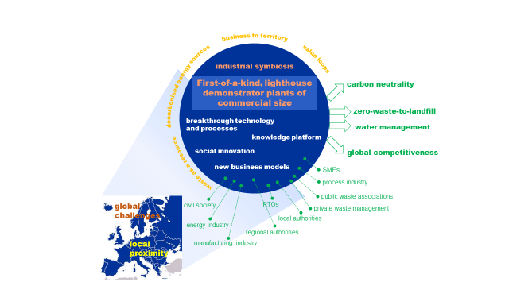
‘A new flagship initiative – Hubs for Circularity’ Concept, opportunities & challenges for successful implementation
As Part of Processes for Planet (P4P) Partnership roadmap, the Hubs for Circularity (H4C) will be a key instruments to advance the research and innovation agenda of European industries towards the Green Deal’s objectives. These first-of-a-kind, lighthouse demonstrator plants of (near) commercial size implementing industrial symbiosis and/or urban industrial symbiosis. The aim is to collectively achieve and demonstrate at scale, a leap towards circularity and carbon neutrality in the use of resources (feedstock, energy and water) in a profitable way.
H4Cs have a strong technological focus and industrial dimension, but their implementation leverages elements well beyond research and innovation. Specific implementation (including funding) strategies will have to be co -designed, ensuring the participation of all stakeholders; industry, Small and medium-sized enterprises (SMEs), research and technology organizations (RTOs), local authorities, educational institutions and civil society.

Slide 3
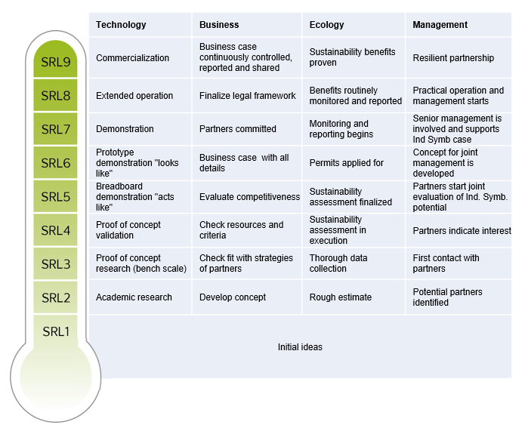
H4C - Expert Recommendations
Supply-driven business model evolve in a more forward-thinking demand-based by-design approach.
Facilitation (public or private): essential to foster the development of Industrial Symbiosis.
Start within an existing group of companies in local proximity, be it an industrial park or a more loosely arranged cluster.
Industrial Symbiosis approach can be applied broadly to many different industrial sectors.
Use of symbiosis readiness levels SRLs
*Study and portfolio review of the projects on industrial symbiosis in DG Research and Innovation
https://op.europa.eu/en/publication-detail/-/publication/f26dfd11-6288-11ea-b735-01aa75ed71a1
Notes:
How:
We need a technology focus, but not of a single plant but needed for symbiosis, that is why we have the concept of symbiosis readiness level complementing TRLs (K. H. Sommer report https://op.europa.eu/fr/publication-detail/-/publication/f26dfd11-6288-11ea-b735-01aa75ed71a1 );
Starts with a partnership (P4P) that engage with us, extended number of stakeholders all over EU;
Full engagement with regions;
Leverage investments beyond R&I funds from HE;
Not only about energy intensive industries but also beyond: waste management actors, SMEs, local and regional authorities, educational authorities, civil society into an area development.
It is about creativity, digital tools and AI, for identifying cost-optimal pathways and new value chains and for the engineering of the circular economy (to make systems more effective and re-think negative externalisation).

Slide 4
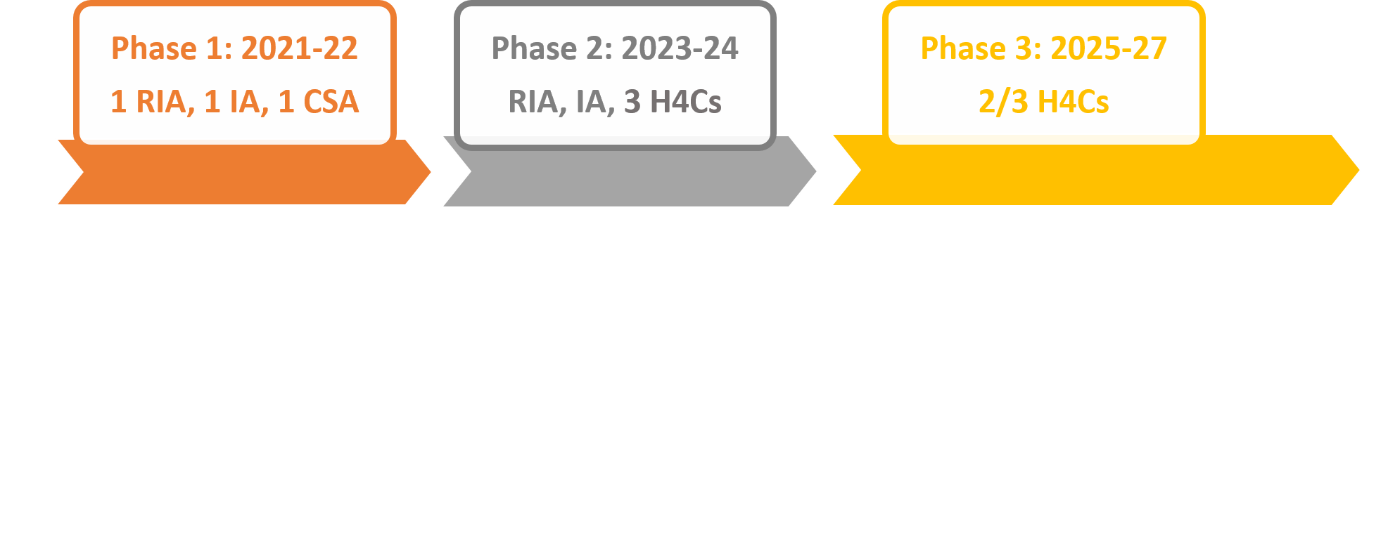
HE- Call for topic planning

Slide 5
Call - TWIN GREEN AND DIGITAL TRANSITION 2021
Hubs for circularity, a stepping stone towards climate neutrality and circularity in industry
HORIZON-CL4-2021-TWIN-TRANSITION-01-14: Deploying industrial-urban symbiosis solutions for the utilization of energy, water, industrial waste and by-products at regional scale (RIA)
HORIZON-CL4-2021-TWIN-TRANSITION-01-16: Hubs for Circularity European Community of Practice (ECoP) platform (CSA)

Slide 6
HORIZON-CL4-2021-TWIN-TRANSITION-01-14: Deploying industrial-urban symbiosis solutions for the utilization of energy, water, industrial waste and by-products at regional scale (Processes4Planet Partnership) (RIA)
Expected Outcomes :
Deploy real scale exemplary pilot solutions of the Industrial-Urban Symbiosis (I-US) concept, making the flows of energy, waste and water circular, achieving near-zero GHG emissions and near-zero water discharge;
Reduce by 50 % (in weight or volume) industrial waste generation and reduce significantly the associated GHG emissions, by re-using and transforming waste, by-products and side-streams into new resources or raw materials;
Plan a list of actions to overcome non-technological barriers for exploitation of cross-company symbiosis (i.e. waste regulations, standardisation, confidentiality and compliance, ownership, fair sharing of benefits, acceptance of the concept);
Set up facilitation services for helping implementation of symbiotic processes directed to local authorities, and relevant businesses, private/industry actors, especially SMEs;
Develop best practices for knowledge-sharing on technological and non-technological aspects (i.e. job profile optimisation) in close collaboration with the European Community of Practice (ECoP) CSA and other relevant bodies, dissemination the major innovation outcomes to support the implementation of I-US;
Explore and demonstrate replication potential in other regions (i.e. by setting up a network amongst waste associations to optimise flow of secondary raw materials);
Implement actions to facilitate relations and to involve the local community actors (authorities, associations, civil society, relevant businesses, especially SMEs, educational organisations, etc.), e.g. exchanging knowledge and human capital with the educational establishments and developing flexible learning resources.
Implement a social innovation spin-off action involving one of the local community actors.
Relevant indicators and metrics, with baseline values, should be stated clearly in the proposal.
EU contribution per project: EUR 8.00 – 12.00 million Indicative budget: EUR 28.00 million Type of Action: Research and Innovation Actions - TRL: Start at 4 and achieve 6
Notes:
Scope :
In March 2020, the European Commission launched the Circular Economy Action Plan for a cleaner and more competitive Europe. In order to accelerate the transition to a circular economy, exemplary pilot solutions integrating industrial urban symbiosis need to be exploited. The solutions could cover the reduction of waste, virgin raw materials and energy and water consumption, mainly by transforming underused waste materials (both industrial waste, industrial side streams, by-products and end of life urban waste) into feedstock for the process industries (urban mining). To support a wide implementation of industrial urban symbiosis for waste utilization, the regional dimension is important since connexion with local energy and utility networks, adjacent industrial infrastructures and available by-products is crucial and will have to be considered in a holistic approach.
Technology and social based innovations should prove the potential for novel symbiotic value chains in demonstrators involving multiple industrial sectors (combining non-exhaustively energy, process and manufacturing industries) in pilot industrial settings. Projects are expected to address several but not necessarily all following aspects:
A broad cross-sectorial symbiosis and circularity implementation from a regional perspective to potentially achieve climate neutrality by 2050 including cooperation with other suitable regions in terms of availability of resources, technologies, available infrastructures and knowledge transfer;
Cross-cutting solutions (processes and equipment) for the processing of side/waste streams specifically for the use as feedstock for plants and companies across sectors and/or across value chains, while increasing the resource efficiency/circularity in industrial value chains;
Process (re-)design and adaptation to integrate new processes (energy and material flow coupling, infrastructure and logistics) and create new synergies between sectors;
Integration of novel sensing technology, IoT and digital tools to support design (including AI driven tools for the discovery of hidden pathways), flow optimization and controls;
Concepts, tools and business models for the flexible and robust management of exchange streams in dynamic production environments to maximise the impact on sustainability while respecting the technical limitations, economic interests of the producers and the interests of citizens;
IT infrastructures and tools that provide a secure basis for the integrated management and the preservation of confidentiality of sensitive data;
Assessment methodologies and KPIs to measure the performance of symbiosis, including environmental, economic and social impacts (including SRL). Life cycle assessment and life cycle cost analysis should take into account existing sustainability standards (e.g. ISO 14000) and existing best practices;
Development/use (preferred) of common reporting methodologies for the assessment of industrial symbiosis activities and exchanges in close collaboration with the European Community of Practice (ECoP);
Tools to support companies in redefining their products process and systems from the point of view of design, production, logistic and business models, preferably based on the outcomes of previous projects (see for example SPIRE project portfolio on Industrial Symbiosis);
Study social aspects of the community and its improvement through the I-US where demonstration pilot is located (social innovation, underdevelopment, job quality gender and inclusiveness perspective);
Create societal awareness through a participative approach locally and more broadly, highlighting and communicating political and regulatory obstacle between regions/countries.
Proposals submitted under this topic should include a business case and exploitation strategy, as outlined in the introduction to this Destination. Interoperability for data sharing should be addressed.
Clustering and cooperation with other selected projects under this cross-cutting call and others in HE, with European initiatives (as for example: Circular Cities and Regions Initiative (CCRI) and European Circular Economy Stakeholder Panel (ECESP)), as well as building on existing projects is strongly encouraged, see also Industrial Symbiosis Report from March 2020.
In order to achieve the expected outcomes, international cooperation is advised on IS/I-US/circularity technologies and their implementation in processes, with INCO countries advanced in the field that could bring mutual benefit from different perspective.
This topic implements the co-programmed European partnership Processes4Planet.

Slide 7
HORIZON-CL4-2021-TWIN-TRANSITION-01-16: Hubs for Circularity European Community of Practice (ECoP) platform (Processes4Planet Partnership) (CSA)
Expected Outcomes :
Establish a European Community of Practice (ECoP) as an effective and sustainable forum/platform connecting hubs for circularity (H4C) and all actors willing to invest in industrial urban-symbiosis (I-US), towards building new circular value chains;
Provide up-to-date support to the H4C by collecting and evaluating knowledge, tools, models and solutions and making them accessible to the community, preparing training material dedicated to circular practitioners that can drive the H4C roll out across Europe;
Define a set of methodologies and kits of specific KPIs (e.g. a kit for any single industrial sector) to enable the progress quantification of circularity and symbiosis with particular attention to the definition of gaps to be closed in order to reach the expected impact.
Analyse collaboration models, non-technological barriers, tools, technologies and existing solutions for I-US and circularity, especially those from previously funded projects;
Provide a state-of-play analysis of regions/areas best suited for the first implementation of advanced H4C in Europe, coupled with a detailed study of the strength and weaknesses of the regions/areas selected, including a symbiosis maturity level (Symbiosis Readiness Level, SRL) and a number of specific scenarios for the technology and process implementation;
Establish a roadmap on how to achieve an effective implementation of a certain number of first-of-a-kind pilots of advanced H4C by 2026, supported by a solid blended funding strategy, targeting the accomplishment of 2050 Green Deal Goals;
Spread the H4C concept to all regions of Europe, support the H4C cooperation network and promote the transfer of the circular models across sectors and borders;

Slide 8
HORIZON-CL4-2021-TWIN-TRANSITION-01-16: Hubs for Circularity European Community of Practice (ECoP) platform (Processes4Planet Partnership) (CSA)
Expected Outcomes (cont) :
Stimulate public and private investments in circular economy projects;
Set up an effective collaboration with stakeholders represented in the P4Planet partnership, including non-governmental associations, and provide a solid plan for the continuation and self-financing of ECoP after the completion of the project;
Drive and coordinate business-to-territory relationships in the area in which the H4C, or neighbouring H4C, are located (i.e. with authorities, SMEs, associations, educational organisations, civil society, etc.).
EU contribution per project: around EUR 2.00 million Indicative budget: EUR 2.00 million Type of Action: Coordination and Support Actions TRL: -
Notes:
Scope :
Circularity is an essential part of the industry transformation towards climate-neutrality and long-term competitiveness. H4C are defined as first-of-a-kind, lighthouse demonstrator plants of commercial size implementing industrial symbiosis or urban industrial symbiosis with the aim of achieving a step change in circular utilization of resources and GHG emission reductions, within a given representative geographical area. H4C have strong technological focus and industrial dimension, but their implementation leverages elements well beyond R&I. Specific implementation (including funding) strategies will have to be designed, ensuring the participation of all stakeholders (Industry, SMEs, local authorities, educational institutions and civil society). The common target is to collectively achieve and demonstrate at scale a leap towards circularity and carbon neutrality in the use of resources (feedstock, energy and water) in a profitable way.
The ECoP is a tool for connecting the Hubs and the community of interest into a network for exchanging tools and knowledge across regions. It has also been proposed by Processes4Planet partnership. The project will embrace possibly all existing H4C and circular systemic activities and strongly link with the activities of relevant European Partnerships, such as P4Planet.
The ECoP should:
Gather, evaluate and synthesise state-of-the-art knowledge on circularity and industrial symbiosis and work out their benefits for climate neutrality and competitiveness in relation to their possible applications. This work should embrace the outcomes of all previously funded projects and be subject to constant updates;
Characterise, classify and evaluate systematically symbiosis and circularity-related solutions with a constant update of symbiosis and circularity-related solutions;
Draw up a list of specifications/criteria for best suited areas/regions taking into account lifting up or expanding existing hubs;
Analyse in detail suitable regions/areas in the EU for H4C implementation. The regions/areas to consider should involve all alternative resource streams relevant for process industries as potential source of feedstock or as utilities, I-US scenarios and infrastructures that are already in place; scrutinise co-investment scenarios (combination of public and private means) to reach high Symbiosis Readiness Levels (SRL).
Analyse proven involvement of regions and local communities;
Identify high-potential regions/areas, for developing the first demonstrator of H4C by 2026. Such identification should be justified on the basis of objective criteria and should be open to further regions in the course of the project. Criteria should focus on process level, symbiosis process implementation, commitment level of the local authorities and communities, regional specificities (business/industrial policy and strategies), additional funding, potential private investors, etc. These hubs should become lighthouse examples of win-win cooperation between industry, SMEs, public authorities, educational institutions and civil society on circular economy beyond 2026;
The H4C could be thematic at first (e.g. focus on valorisation of emissions or circular use of plastic waste, etc.) and evolve after a successful first demonstration into a broader concept, attracting other players from other industry sectors at local, regional, national or European level and enabling industrial symbiosis in new areas and processes;
Propose stakeholder events for local and regional authorities creating awareness on industrial opportunities and challenges based on the analysis;
Connect the regional H4C and ensure a mutually profitable knowledge and experience exchange;
Provide support and advice to the community members, as well as, tutorials and learning framework about state-of-the-art solutions (for technical and non-technical problems);
Promote the role and service of enablers/facilitators as a new type of service to industry, regions and civil society;
Support the transfer of knowledge, tools and innovation across the H4C, and the programming groups or ad-hoc task forces;
Engage with stakeholders, such as, universities or other educational institutions to facilitate the training of circular practitioners. These practitioners should have an in-depth understanding of I-US, the state-of-the-art tools and databases and newest business models;
Track regional needs based on feedback of H4C and other supporting members in order to optimise the support;
Enable and regularly update evaluation of I-US projects by providing systematic knowledge on gaps and potential impacts, and favour connection with regions/areas of high potential for a first successful implementation of a H4C;
Identify potential sites for setting up emerging new hubs based on mapping of I-US and circular activities as a continuous update and extension of the pre-implementation analysis.
The EU funded projects under Process4Planet, Made in Europe and Clean Steel but also under cluster 6 dealing with circularity will be required to provide complete information and full collaboration to the ECoP platform.
Clustering and cooperation with other selected projects under this cross-cutting call and others in HE, and with European initiatives (as for example Circular Cities and Regions Initiative (CCRI) and European Circular Economy Stakeholder Panel (ECESP)), building on existing H2020 projects is strongly encouraged, see also Industrial Symbiosis Report from March 2020..
This topic implements the co-programmed European partnership Processes4Planet.
Enabling circularity of resources in the process industries, including waste and CO2/CO.

Slide 9
Work Programme topic
1. What are you looking for?
Green industrial transition through implementation of IS, IUS and circularity in large scale demonstrators.
Industrial symbiosis is the process by which wastes or by‐products of an industry or industrial process become the raw materials for another. ... This process serves to reduce the environmental footprint of the industries involved.
innovative approach that brings together companies from all business sectors with the aim of improving cross industry resource efficiency through the commercial trading of materials, energy and water and sharing assets, logistics and expertise.
Clustering industries around common green targets.

Slide 10
Work Programme topic
2. What do you NOT want?
1 single circular loop targeting one single value chain;
Small scale demonstrators;
Development addressing only waste utilisation of a single process;

Slide 11
Clarification : What is and what is not a social innovation spin-off action
It’s not a repetition of the expected outcome of involving the local community (authorities, SMEs, education, etc.) also covered in these topics and inherent to a H4C.
It’s something special, an added-value we are bringing to the topic for the sake of social innovation.
It’s just 1 concrete action, not a collection of them, focused on 1 local community actor because if the target is too broad, it loses the impact (and divert the funding).
It is not expected to be duly described in the proposal. Because social needs, the ones for which we can really bring an innovative solution thanks to a H4C, arise on the field. At the stage of proposal, consortia might have spotted something or even have some social needs identified, but definitely not a duly plan of a spin-off action when the focus is on starting a H4C of industrial symbiosis and get the local community involved. An innovative idea comes with the time, while collaborating with the local community and observing what is going on in a territory, only then realising which local group can really benefit from some direct or indirect action from a H4C.
It’s not about collaborating with local educational establishments introducing new material in the curricula..
It’s about creating an action with ‘own life’,something that can be marketed by itself. It may continue after the end of the funding or not and can or cannot end up as a commercial activity.

Slide 12
Work Programme topic – topic evolution
3. Is this new or has it been called before?
No previous topics addressing IUS, zero-landfill and water utilization in a systemic and holistic way;
See Klaus Somer report for an overview of previous work https://op.europa.eu/fr/publication-detail/-/publication/f26dfd11-6288-11ea-b735-01aa75ed71a1

Slide 13
Work Programme topic – topic evolution
4. Current project portfolio
See Klaus Somer report for an overview of previous work https://op.europa.eu/fr/publication-detail/-/publication/f26dfd11-6288-11ea-b735-01aa75ed71a1

Slide 14
Work Programme topic – Key actors
5. Who are the types of main stakeholders that are addressed?
Large and medium companies, SMEs
Public regional and local authorities
Research entities, higher educational institutions
Civil society
6. Is there a key group of actors (eg. Partnership or other) driving this?
Processes4Planet partnership

Slide 15
Work Programme topic
7. Are there any additional / background documents?
P4P roadmap
Klaus Somer report
Circular economy action plan
Zeropollution action plan
Industrial strategy
Chemical strategy
Green deal

Slide 16
Future Outlook
8. Do you have information about future trends, emerging initiatives, roadmaps, type of stakeholders in this area?
Some examples:
Kalundborg symbiosis
Smart Delta Resources
City of Lahti

