Slide 1
ASEAN - Horizon Europe Launch Event
Space - Overview
20 July 2021

Slide 2
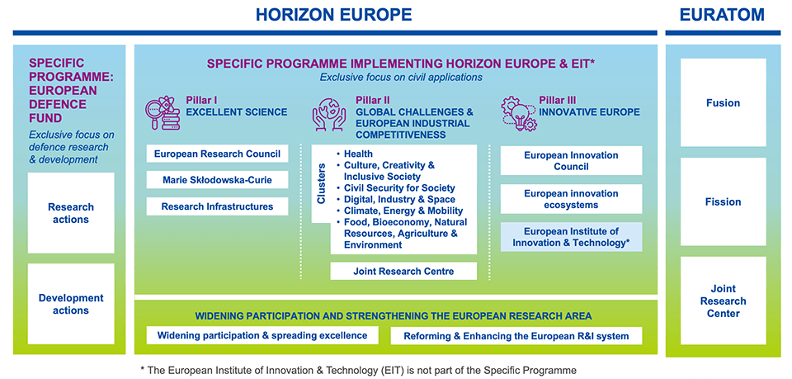
Space under Horizon Europe
Manufacturing Technologies
Key Digital Technologies
Advanced Materials
Emerging Enabling Technologies
Artificial Intelligence and Robotics
Next Generation Internet
Advanced Computing and Big Data
Circular Industries
Low-carbon and Clean Industries
Space
Notes:
European Research Council: ‘Frontier Research’ – Grants for researchers
Marie Curie Fellowships
EIC pilot: SME instrument
Total budget for Cluster 4: 15,3 bEur, including Next Generation EU

Slide 3
Horizon Europe Space
Upstream Space
EU Space Programme Components and emerging initiatives
Foster competitiveness of space systems
EGNNS
Evolution of space and ground infrastructures
Evolution of services
EGNNS and Copernicus
Strategic Research and Innovation Agenda
SRIA
Development of applications
Reinforce our capacity to access and use space
Innovative Capabilities
SSA
GOVSATCOM
Quantum
Ecosystem for Entrepreneurship - Cassini
Targeted and strategic actions
Synergies with Data Strategy AI, HPC
Critical Technologies for
Non-Dependence
Space Science
Education and Skills
IOD / IOV
International Cooperation
3

Slide 4
Eligibility conditions: same as Space Programme
In accordance with paragraph 11 of Annex IV of the Regulation (EU) 2021/695 establishing Horizon Europe, this action is implemented with regard to eligibility of legal entities in accordance with the Union Space Programme. In particular, for the reasons of EU strategic autonomy in space and the security and integrity of EU space assets, in order to guarantee the protection of the strategic interests of the Union and its Member States, legal entities established in any Member State will be eligible to participate where these entities comply with the conditions established in Article 24 of the Regulation (EU) 2021/696. https://eur-lex.europa.eu/legal-content/EN/AUTO/?uri=uriserv:OJ.L_.2021.170.01.0069.01.ENG&toc=OJ:L:2021:170:TOC
2022-SST: 5 grants to identified beneficiary = SST Partnership
2022-SPACE-02-61: GOVSATCOM
4

Slide 5
Eligibility conditions: Article 22(5)
2021-SPACE-01-11: End-to-end satellite communication
2021-SPACE-01-21: Reusability for EU strategic space launchers
2021-SPACE-01-22: Low cost high thrust propulsion
2021-SPACE-01-23: New space transportation solutions
2022-SPACE-01-21: Multi sites flexible industrial platform
2021-SPACE-01-43: Copernicus Security and Emergency Services
2021-SPACE-01-62: Quantum technologies for space gravimetry
2021-SPACE-01-81: Space technologies for European non-dependence
2022-SPACE-01-81: Space technologies for European non-dependence
5

Slide 6
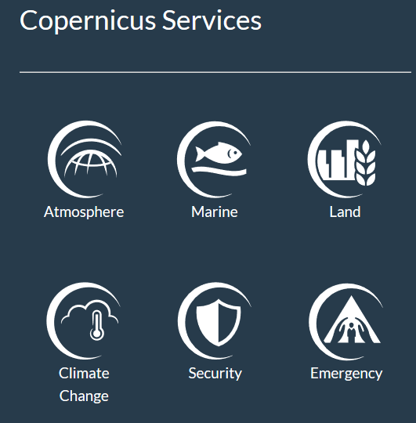
Call - STRATEGIC AUTONOMY IN DEVELOPING, DEPLOYING AND USING GLOBAL SPACE-BASED INFRASTRUCTURES, SERVICES, APPLICATIONS AND DATA 2021
HORIZON-CL4-2021-SPACE-01-
Evolution of space and ground infrastructure for Galileo/EGNOS: under Other Actions
Evolution of Copernicus services
41: Copernicus Climate Change Service evolution
42: Copernicus Atmosphere Monitoring Service evolution
43: Copernicus Security and Emergency Services evolution
44: Copernicus evolution for cross-services thematic domains
Evolution of EGNSS Services: under Other Actions
Innovative space capabilities: SSA, GOVSATCOM, Quantum
62: Quantum technologies for space gravimetry
Space entrepreneurship ecosystem (including "New Space" and start-ups) and skills: under Other Actions
Targeted and strategic actions supporting the EU space sector
81: Space technologies for European non-dependence and competitiveness
6

Slide 7
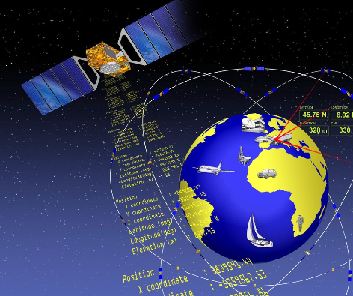
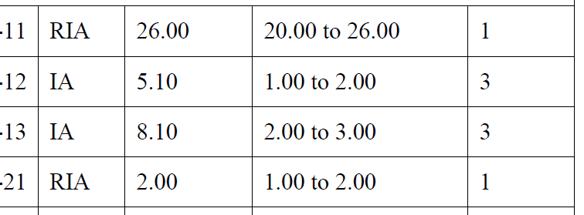
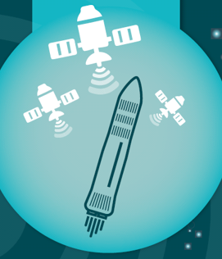
Call - STRATEGIC AUTONOMY IN DEVELOPING, DEPLOYING AND USING GLOBAL SPACE-BASED INFRASTRUCTURES, SERVICES, APPLICATIONS AND DATA 2022 HORIZON-CL4-2022-SPACE-01
85,7 MEur
28/10/2021 – 16/02/2022
HORIZON-CL4-2022-SPACE-01-
Foster competitiveness of space systems
11: Future space ecosystems: on-orbit operations, preparation of orbital demonstration mission
12: Technologies and generic building blocks for Electrical Propulsion
13: End-to-end Earth observation systems and associated services
Reinforce EU capacity to access and use space
21: Multi sites flexible industrial platform and standardised technology for improving interoperability of European access to space ground
7

Slide 8
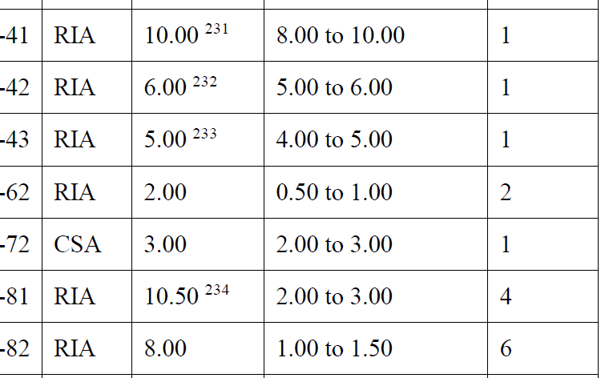
Call - STRATEGIC AUTONOMY IN DEVELOPING, DEPLOYING AND USING GLOBAL SPACE-BASED INFRASTRUCTURES, SERVICES, APPLICATIONS AND DATA 2022
HORIZON-CL4-2022-SPACE-01-
Evolution of space and ground infrastructure for Galileo/EGNOS: under other actions
Evolution of services of the EU space programme components: Copernicus
41: Copernicus Marine Environment Monitoring Service evolution
42: Copernicus Anthropogenic CO₂ Emissions
Monitoring & Verification Support (MVS) capacity
43: Copernicus Land Monitoring Service evolution
Innovative space capabilities: SSA, GOVSATCOM, Quantum
62: Space Weather
Space entrepreneurship ecosystems (including "New Space" and start-ups) and skills
72: Education and skills for the EU space sector
Targeted and strategic actions supporting the EU space sector
81: Space technologies for European non-dependence and competitiveness
82: Space science and exploration technologies
8

Slide 9
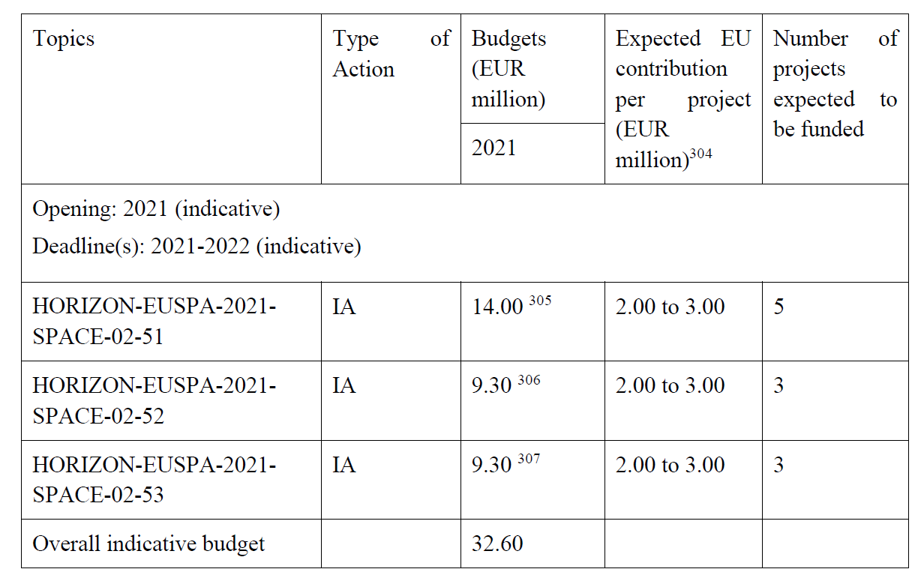
Calls by EUSPA: HORIZON-EUSPA-2021-SPACE-02
32,6 MEur
28/10/2021 – 16/02/2022 (TBC)
HORIZON-EUSPA-2021-SPACE-02-
51: EGNSS and Copernicus applications fostering the European Green deal
52: EGNSS applications for Safety and Crisis management
53: EGNSS applications for the Digital Age
9

Slide 10
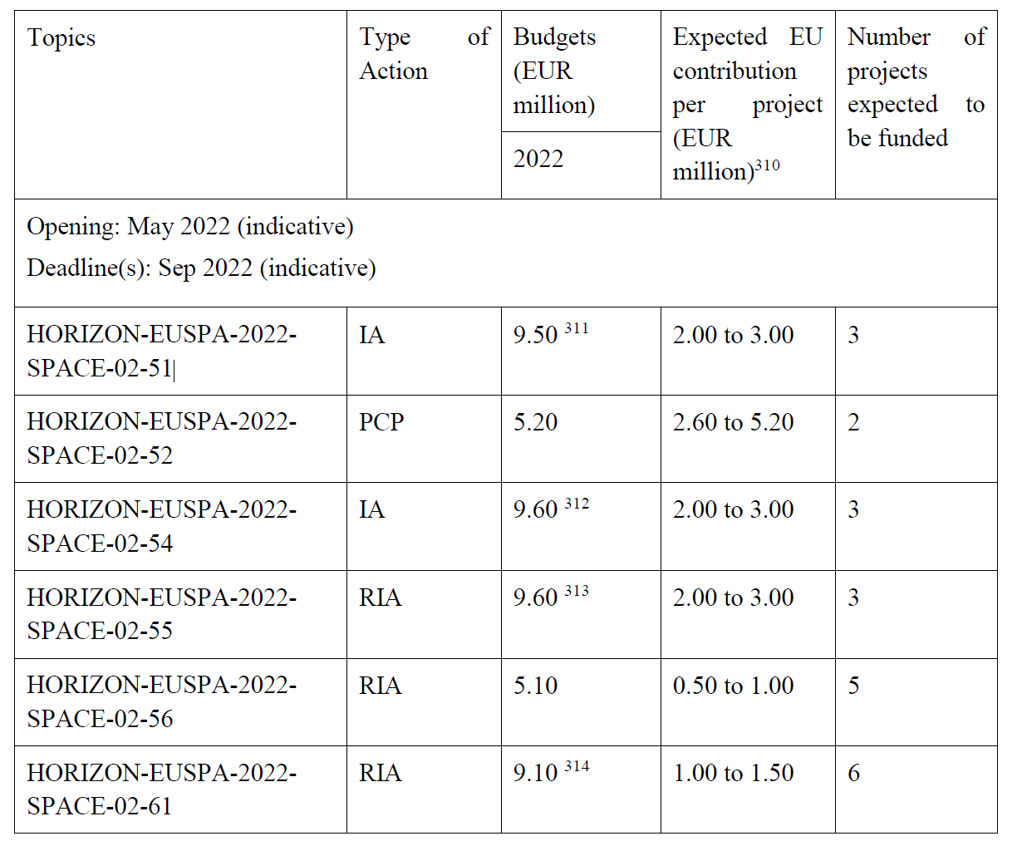
Calls by EUSPA: HORIZON-EUSPA-2022-SPACE-02
48,1 MEur
27/10/2022 – 16/02/2023
(TBC)
HORIZON-EUSPA-2022-SPACE-02-
51: EGNSS applications for Smart mobility
52: Public sector as Galileo and/or Copernicus user
54: Copernicus downstream applications and the European Data Economy
55: Large-scale Copernicus data uptake with AI and HPC
56: Designing space-based downstream applications with international partners
61: GOVSATCOM Service developments and demonstrations
10

Slide 11
HORIZON-EUSPA-2022-SPACE-02-56: Designing space-based downstream applications with international partners (RIA)
Cooperation with International partners
To promote the uptake of satellite navigation , position and timing,
To enable non EU countries to benefit from the advanced and unique features offered by EGNOS and Galileo, particularly in transport and regulated domains.
To promote the uptake of Copernicus globally, exploiting possibilities for integrating in-situ, space data and information technologies.
Building the Copernicus full, free and open data policy, the Commission seeks to facilitate access to Copernicus data and information for interested international partners.
Administrative cooperation arrangements on Copernicus data access and Earth observation data exchange have already been signed with several countries; the United States, Australia, Ukraine, Chile, Colombia, Serbia, African Union, India and Brazil.

Slide 12
HORIZON-EUSPA-2022-SPACE-02-56: Designing space-based downstream applications with international partners (RIA)
Expected outcome
Projects with international cooperation partner countries are expected to contribute to the three following high-level outcomes:
The use of EGNSS and sharing of expertise with public and/or private entities to introduce EU-space based applications/solutions leveraging their innovative, unique features, in particular Galileo differentiators (authentication, high accuracy) and EU know-how.
The use of Copernicus data, to develop jointly algorithms, services and/or products, which serve local user needs and/or enhance the Copernicus global product quality.
The combined use of EGNSS and Copernicus to develop innovative downstream applications combining positing navigation and timing with Earth observation services.

Slide 13
HORIZON-EUSPA-2022-SPACE-02-56: Designing space-based downstream applications with international partners (RIA)
For proposals under this topic:
Proposals dealing with EGNSS are encouraged to involve the relevant players on the European side whenever relevant (e.g. European Union Aviation Safety Agency (EASA), European Satellite Service Providers (ESSP) or Member States’ Air Navigation Service Providers for EGNOS Safety of Life service to aviation, European Maritime Safety Agency (EMSA), ERA for other transports. Participation of industry, in particular SMEs, is encouraged;
When dealing with Copernicus based applications, participation of at least one partner from a country that has signed a Copernicus Cooperation Arrangement is required;
Proposals are encouraged to use the Copernicus Data and Information Access Services (DIAS), or other existing data access solutions instead of setting up their own download and processing infrastructure.
They are also encouraged to integrate third-party data (including in-situ data) and envisage data assimilation into models and products made available on the Copernicus platform of the Copernicus services.
Participation of partners involved in international GEO initiatives is encouraged.
Participation of industry, in particular SMEs, is encouraged.

Slide 14
HORIZON-EUSPA-2022-SPACE-02-56: Designing space-based downstream applications with international partners (RIA)
Specific Conditions
Expected EU contribution per project | EU contribution between EUR 1.00 and 1.50 million
Indicative budget | The total indicative budget : EUR 5.10 million.
Type of Action | Research and Innovation Actions
Eligibility conditions | The conditions are described in General Annex B. The following exceptions apply: Due to the scope of this topic, legal entities established in countries that have signed an administrative cooperation arrangements on Copernicus data access and Earth observation data exchange are exceptionally eligible for Union funding. Currently, these countries are: the United States, Australia, Ukraine, Chile, Colombia, Serbia, African Union, India and Brazil. Discussions towards similar cooperation have been started with other countries and regions (including United Nations Agencies and Asia-Pacific countries).
Technology Readiness Level | Activities are expected to achieve TRL3-4 by the end of the project – see General Annex B.

Slide 15
Video and related documents:
https://www.horizon-europe-infodays2021.eu/event/cluster-4-digital-industry-space
# HorizonEU
http://ec.europa.eu/horizon-europe

