Slide 1
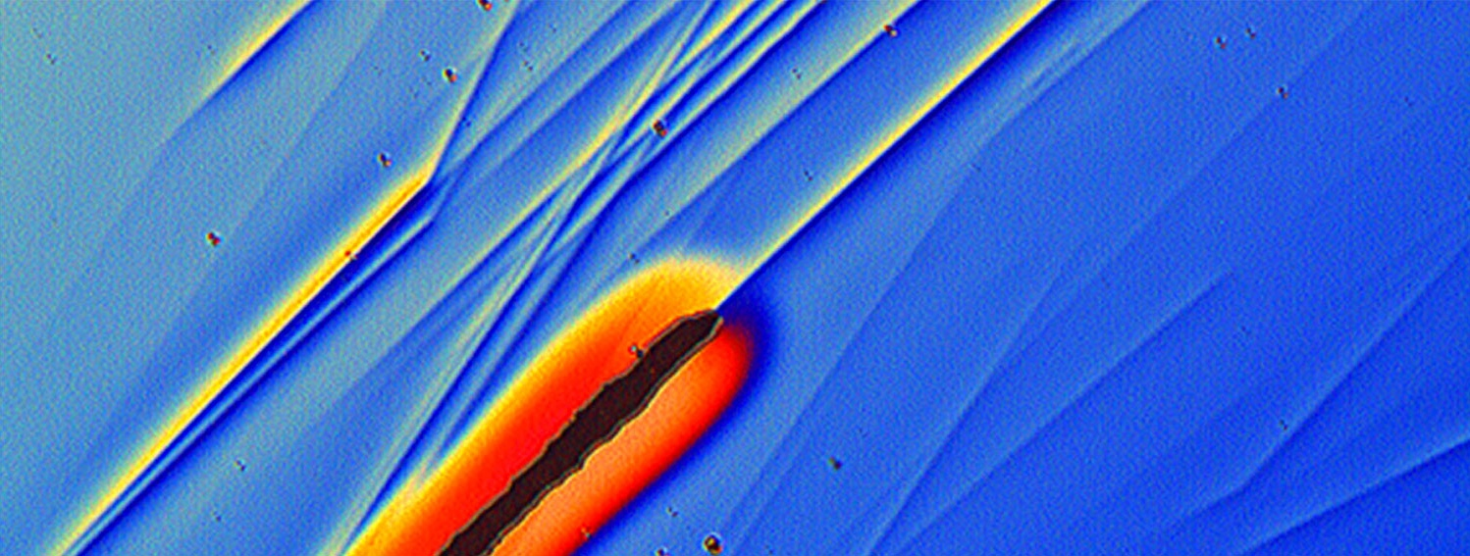
CNRS : a global player in the international landscape of science, technology and innovation
CNRS : a global player in the international landscape
of science, technology and innovation
Jean-Paul Toutain
Director of the Regional Office in ASEAN and Oceania

Slide 2
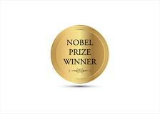
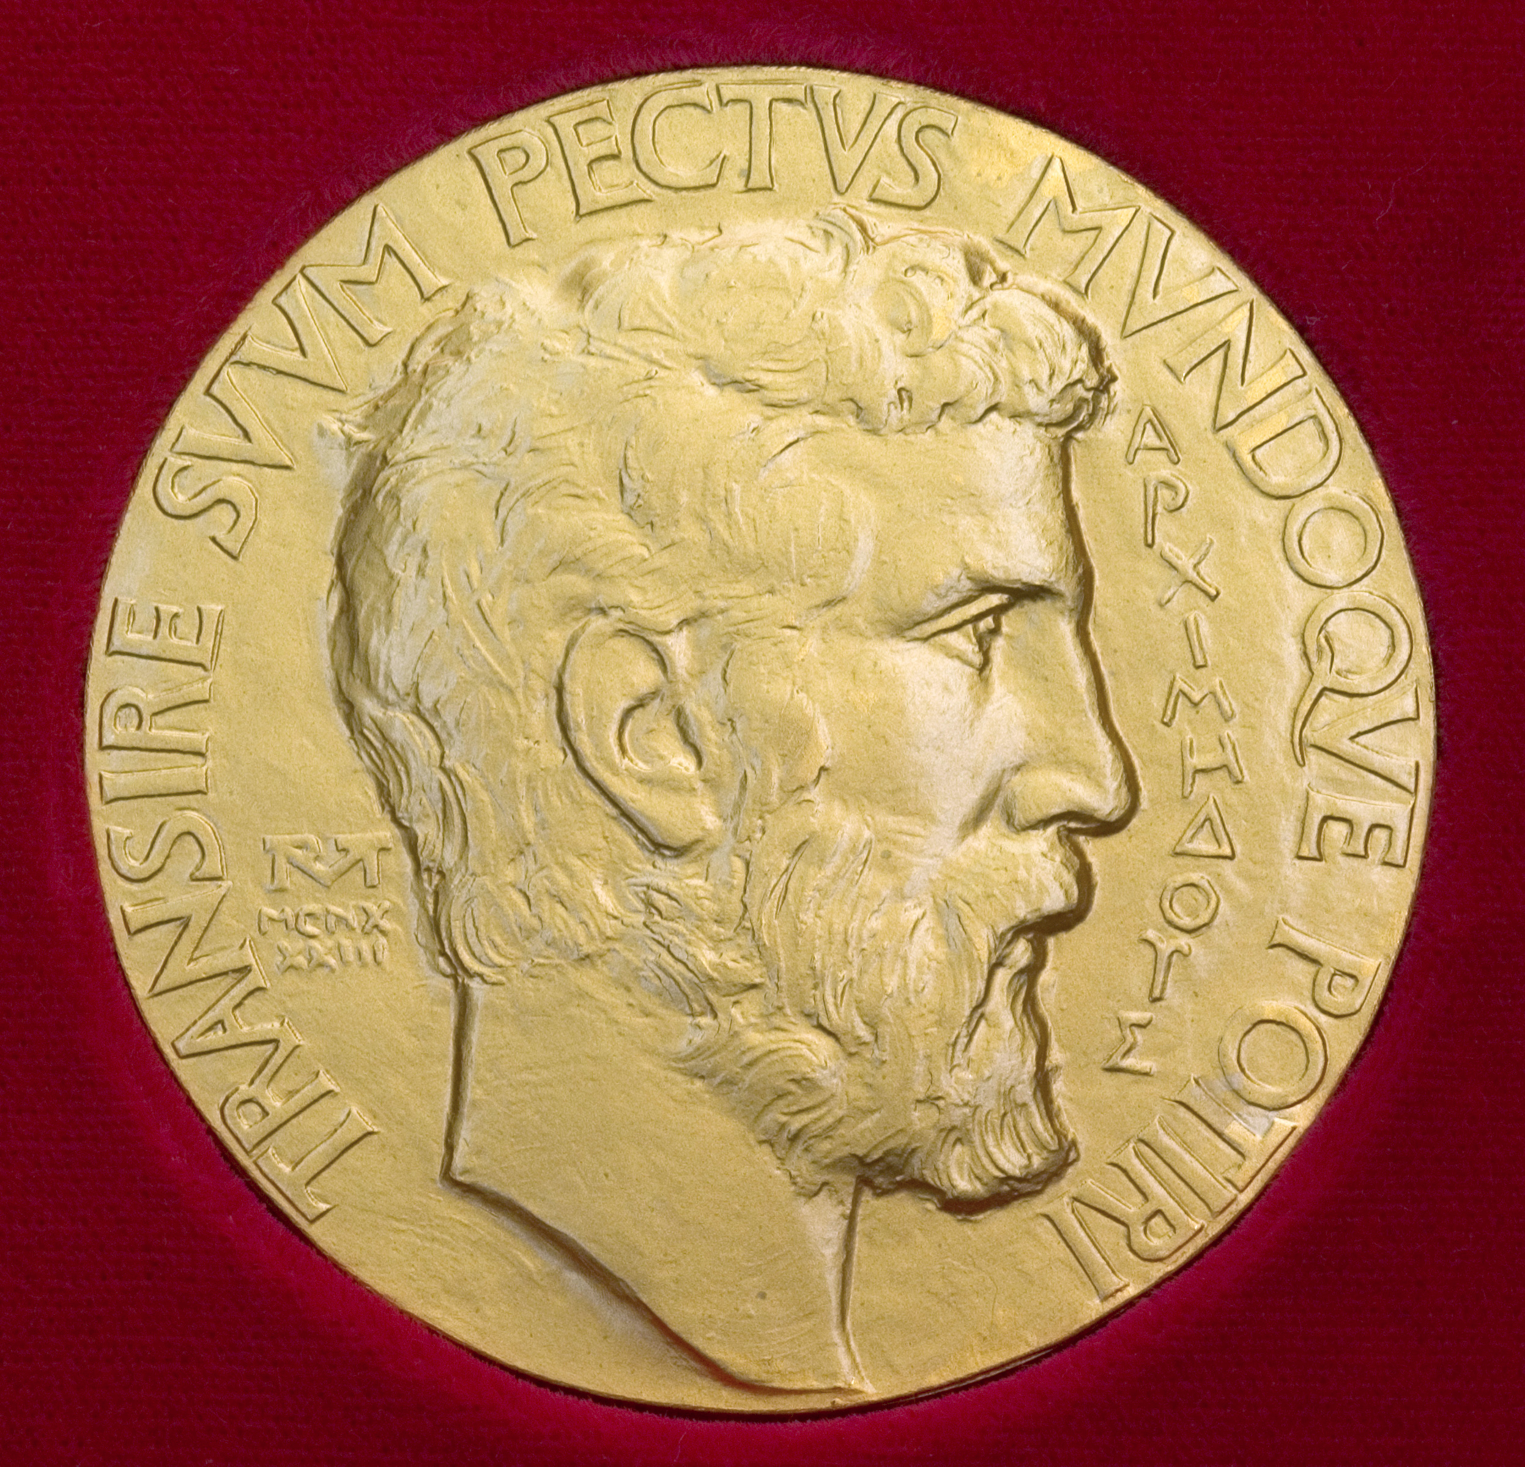
CNRS in a nutschell
32.000
1100
3,5bn€
50.000
22/12
150
Notes:
<number>

Slide 3
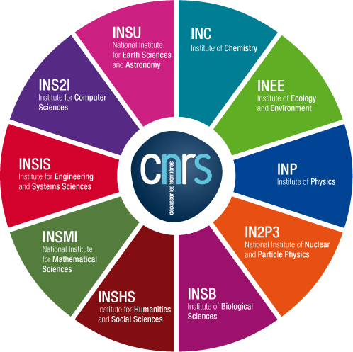
CNRS : organization
CNRS covers all fields of research
Chemistry
Ecology and the environment
Physics
Nuclear and particle physics
Biological sciences
Humanities and social sciences
Mathematical sciences
Engineering and systems sciences
Information science and technology
Geosciences and astronomy
10 CNRS INSTITUTES (=DIVISIONS)
Notes:
<number>

Slide 4
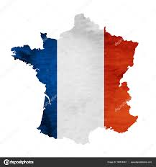
CNRS : main missions
Basic research
Training
Share knowledge
Societal impact
French policy
Notes:
<number>

Slide 5
CNRS engagment for basic science
The heart of CNRS engagement : explore frontier research and their applications with 2 strategies :
Focus on emergent topics thanks to dedicated fundings of 13 cross-cutting domains : modeling the living world, human behaviour, quantum calculation, multi-function materials, cybersecurity, complex systems, C cycles …
Tackle interdisciplinary challenges : climate change, inequalities, artificial intelligence, environment & health, smart cities, energy transition, big data, large infrastructures.

Slide 6
CNRS engagment with industry
150 joint laboratories with industry
4 abroad
China (Solvay)
United-States (Solvay)
Japan (Saint Gobain)
Singapore (Thalès)
To be launched
Australia (Naval Group)
Notes:
<number>

Slide 7
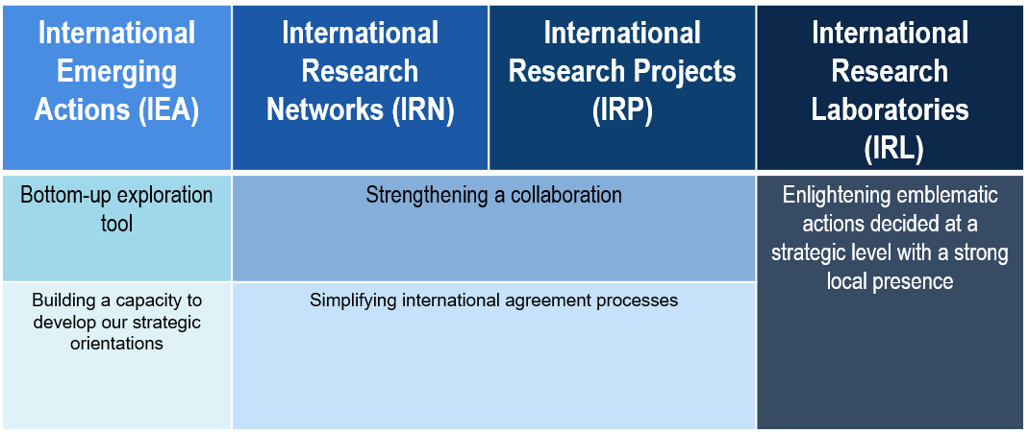
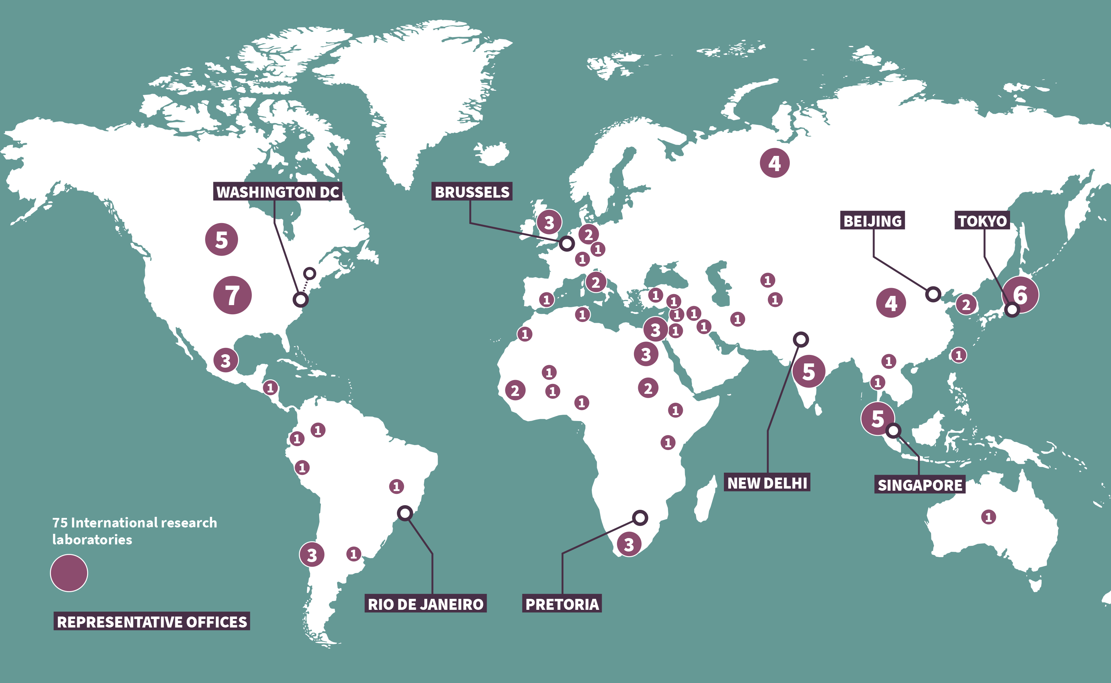
CNRS : international tools and network
A large network
8 offices abroad (Singapore)
75 IRL (5 in ASEAN, 1 in Australia)
Notes:
<number>

Slide 8
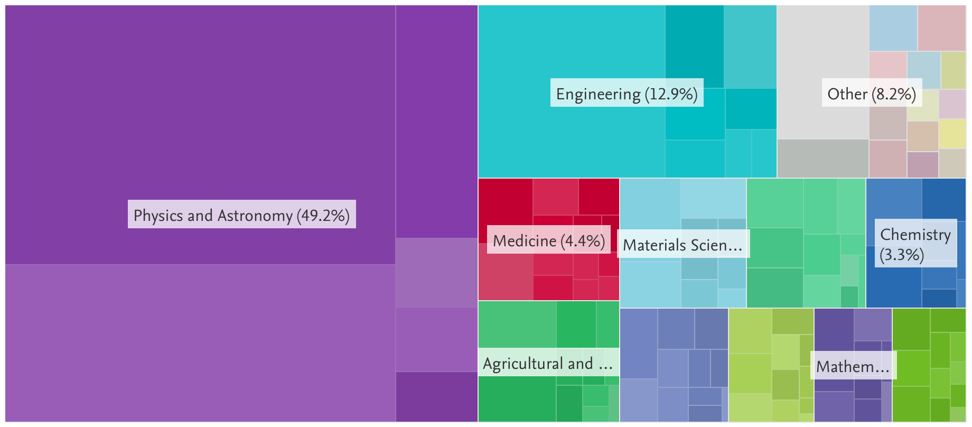
CNRS – Malaysia cooperation 2015-2019
France ranks 16th (2581 papers)
CNRS ranks 3st (1481 papers : 57%, 1st France)
CNRS missions to Malaysia
279
Partners
Univ. Malaya : 1121 papers (75%)
SciVal/Elsevier

Slide 9
CNRS in Malaysia 1/3 : IRP IFM NatProLab
International French Malaysian Natural Product Laboratory (2015-2022)
Topic ➔ Chemistry of natural substances, systematic survey various Malaysian forests & collection of biodiversity
Partners ➔ Univ. Malaya (Dept of Chemistry) and CNRS (ICSN, Gif sur Yvette)
Key indicators ➔
PhD (Malaysia) 1 (2)
International papers 50
Mal. Researchers trained 6 (ex = new mass spectrometry techniques)
International seminars 1/year
Orientée vers le bien commun
Share knowledge
Towards scientific community, medias and the general public

Slide 10
CNRS in Malaysia 2/3 : IRP Food, culture and health
2016-2020
Topic ➔ Food studies : Asian Food barometer, eating out, social interactions
Partners ➔ Taylor’s university (CRIT) and CNRS – University of Toulouse (UMR CERTOP)
Dynamics ➔ beginning (1987) ➔ bachelor (1999) ➔ Master(2005) ➔ chair of food studies (2012) ➔ research Program (2016, LIA) ➔ 37 years old partnership
Key indicators ➔
PhD (Malaysia) 4 (2) Master HM & FS 368
Malaysian Researchers trained 14 International papers 30
Int seminars (since 2005) 30 Grants 14
Industrial partners : Ajinimoto, Nestlé, Cniel, Danone…
Perspectives : increasing mobility of researcherhs, miror site for the Ovalie platform
Orientée vers le bien commun
Share knowledge
Towards scientific community, medias and the general public
Notes:
CRIT : CENTRE FOR RESEARCH AND INNOVATION IN TOURISM
Cniel : dairy French national organisation
<number>

Slide 11
CNRS in Malaysia 3/3 : other programs
1 international emerging action (IEA)
SHARKSEA
- Ecology, evolution, climate change
- Univ. Malaya (Dept of Geology) and CNRS – University of Lyon
And … participation to several networks in ASEAN : paleontology, Asian studies, and other projects (chemistry, …)

Slide 12
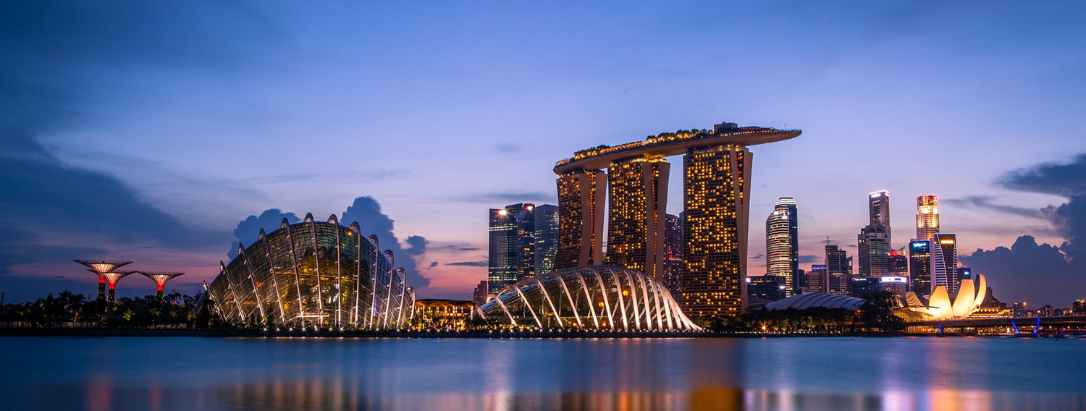
THANK YOU FOR YOUR ATTENTION
Thank you for your attention
Notes:
<number>

Slide 13
CNRS – ASEAN cooperation bilateral programs
Singapore
4 IRL (engineering, Q physics, AI, biology)
➔ 7 researchers posted
2 IRP (engineering)
2 IRN (energy, humanities)
1 IEA (chemistry)
1 subsidiary CNRS@CREATE
Vietnam
3 IRP (math, ecology, chemistry, )
4 IEA (chemistry, ecology, math, engineering)
Thailand
1 IRL (Asian studies)
1 IRN (ecology)
2 IEA (physics, ecology)
Malaysia
2 IRP (chemistry, food)
1 IEA (ecology)
Indonesia
1 IEA (ecology)

