Slide 1

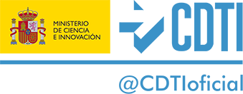
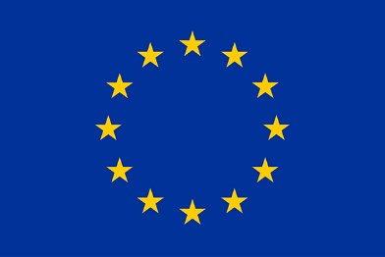
Accelerating the Impact of Innovation through SPAIN-ASEAN Strategic Partnerships in Bioeconomy, Urban and Food Sustainability
Rosa Chapela Pérez
CETMAR
rchapela@cetmar.org

Slide 2
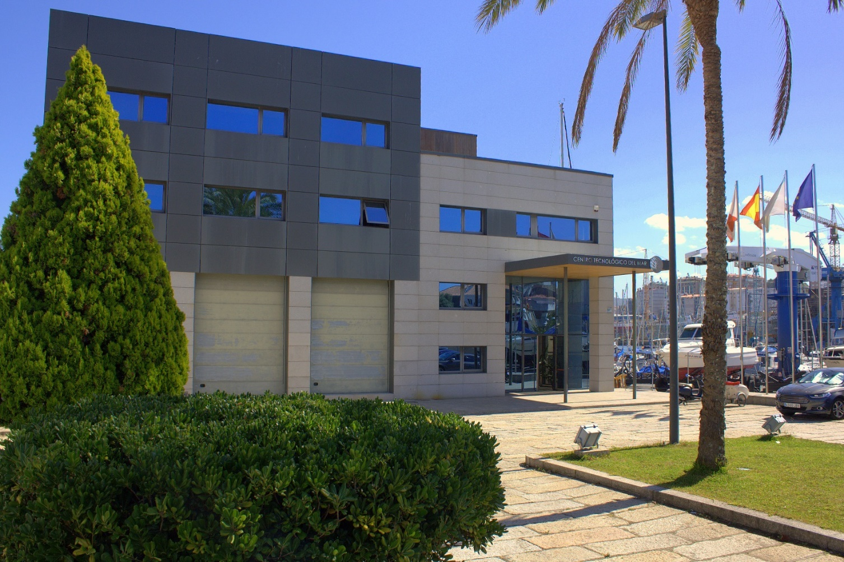
Context
Centro Tecnológico del Mar – Fundación CETMAR
CETMAR is a public foundation, promoted by Galician Government -Xunta de Galicia- and the Ministry of Science and Innovation.

Slide 3
Very high employment dependency
Presence in many fishing areas
Galicia:
Aquaculture production
Marine education and research centres in Galicia
Maritime & fisheries Public administration
> 50% of the Spanish employment
Vessels:
Small-Scale > 3,950
Coastal > 340
Distant > 80
Long-distant >100
Context
Total fisheries sector employment in Europe
 | > 20,000
 | 10,000 – 20,000
 | 7,500 – 10,000
 | 5,000 – 7,500
 | 2,500 – 5,000
 | 1,000 – 2,500
 | < 1,000

Slide 4


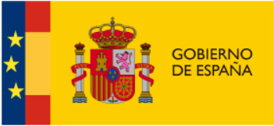






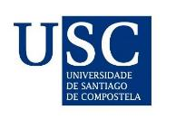
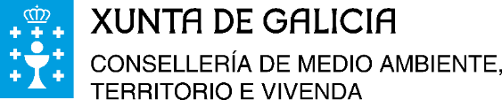


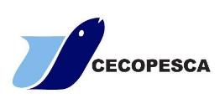

Board of Trustees

Slide 5
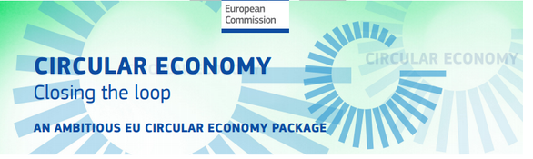
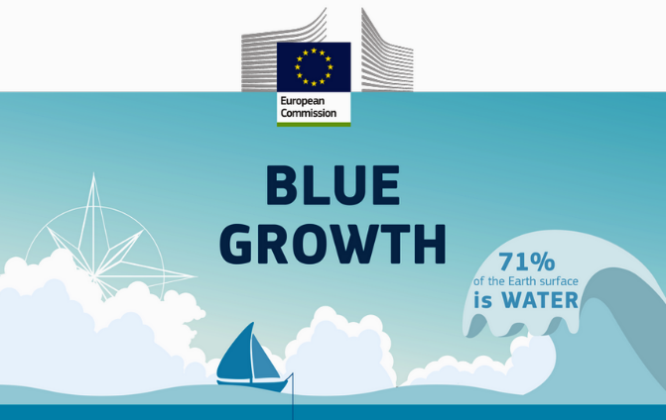
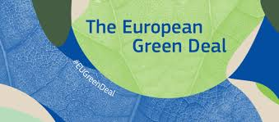
A more sustainable and competitive maritime and fishing sector
Circular economy
Blue Growth
Sustainability: Economy, society environment
Boosting R+D+I
Maritime sectors
Mission
Meeting platform
Interinstitutional
Interdisciplinary
Administrations
Cooperation
Research Centres
Maritime
Sector (Industry)

Slide 6
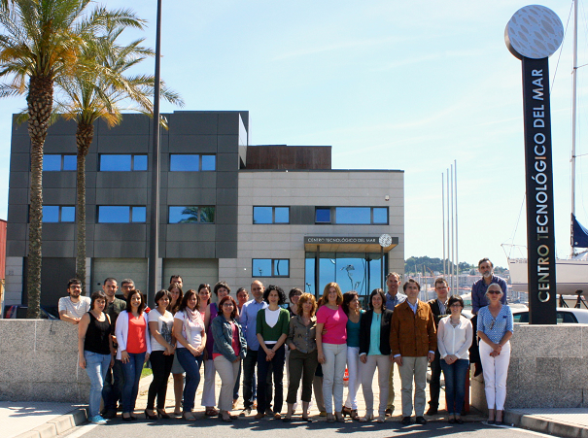
Areas of activity
Control and management of the marine environment and resources
Technology of Fisheries Products
Marine Technology Unit
International Cooperation
Technology Transfer and Promotion
Fisheries Socioeconomic
Training

Slide 7
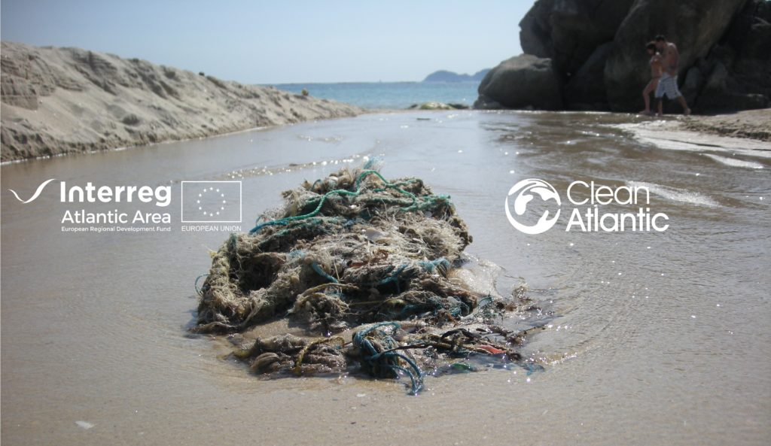
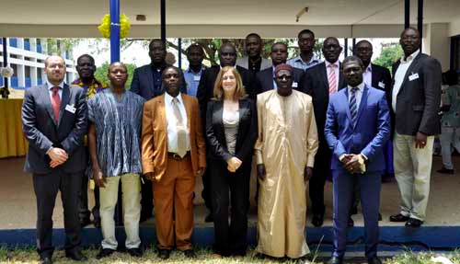
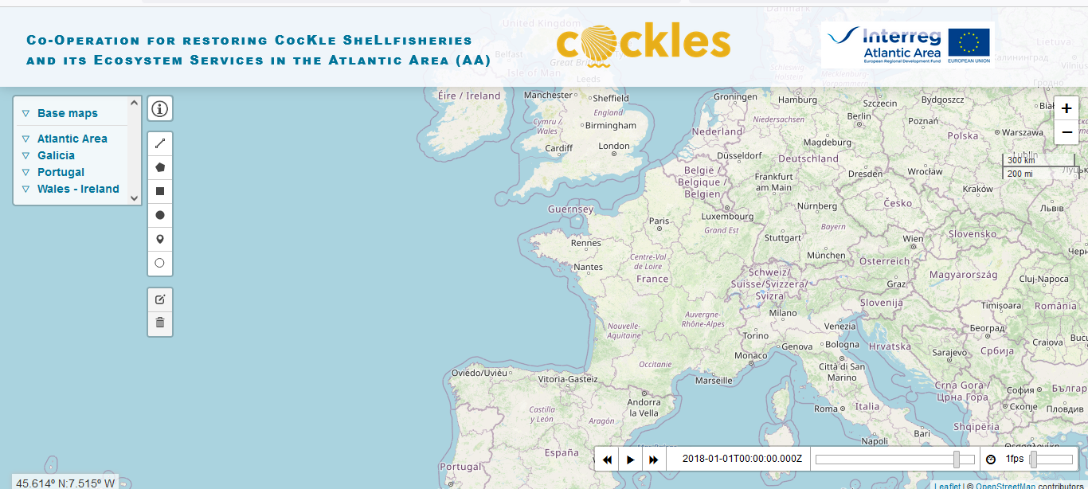

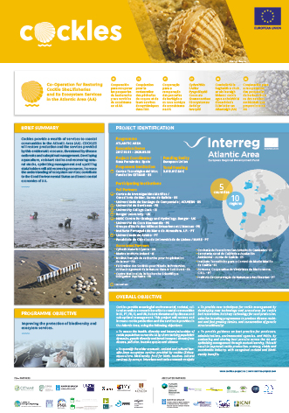
Strategic lines
Protection of the coastal and marine environment: fight against marine pollution from land and ocean based sources
  Oil and chemical spill preparedness & response& mitigation. Contingency planning : ARCOPOL projects (Interreg Atlantic Area), MARENDA (Europeaid), MARINER and MANIFESTS (DG ECHO)
  Prevention and Reduction of Marine Litter : CleanAtlantic (Interreg Atlantic Area)
  Emergent Pollutants (NORWATER, POCTEP)
Sustainable management of marine resources
  Management Plans and Tools, Maritime Spatial Planning
  Environmental management of fishing and aquaculture
Knowledge transfer towards the broad community of marine and maritime stakeholders and, among other purposes, for the improvement of fish and shellfish resources' management and production (Oysterecover, Cockles, FishGenome, Fishn'co, SeafoodAge...)

Slide 8
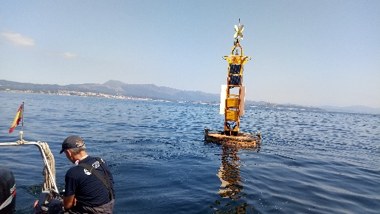

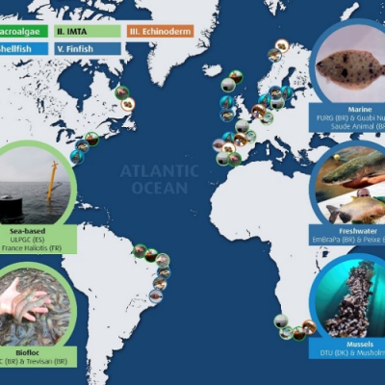

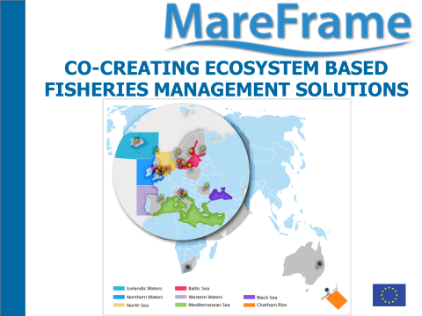
Strategic lines
Sectoral Skills Strategies, Training Materials and courses (Mates)
Supporting marine technology development and coastal observation as the key to understand weather, climate and marine ecosystems. (RAIA Observatory)
Create and expande the marine and maritime knowledge
Fisheries Socio-economics
  Fisheries and aquaculture governance (AquaVitae, ClimeFish,)
  Sustainable marine and maritime management (Mareframe, CabFishman, EcoFishman, …)
  Strengthen well-being in coastal communities
  Stakeholder engagement
  Economic impacts, marketing, competitivenness of seafood products (PrimeFish)

Slide 9
strategic lines
New uses of marine by-products and compounds (Valbiomar Project, Novomar..)
Initiatives on macro-algae uses and management
International cooperation
D,R&I strategic lines
Development and implementation of community-base aquaculture projects.
Capacity building for fisheries and aquaculture research.
Improved fisheries and aquaculture governance through direct collaboration with local administrations.

Slide 10
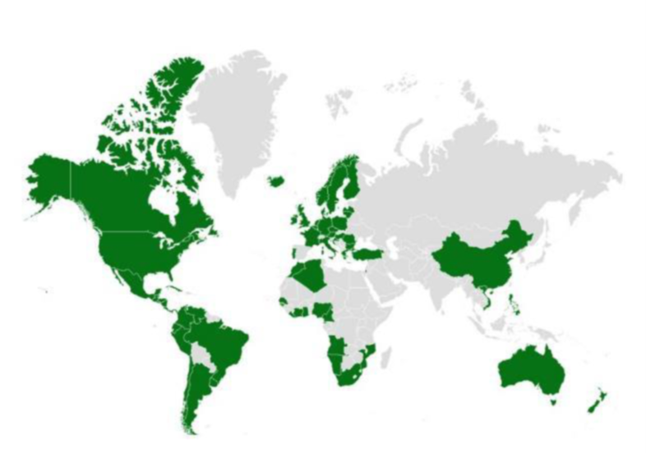
We develop projects and services together with partners from 70 countries of the world
AREA OF ACTIVITY

Slide 11
ACUIPESCA PERÚ Increase the competitiveness of the artisanal fishing and aquaculture sector in Sechura Bay through institutional and organizational strengthening, the adoption of technologies and environmental sustainability.
NATMIRC III Reinforcement of the National Center of Information and Marine Research of Namibia (NATMIRC) supporting the decision making process regarding fisheries management.
PESCA SEGURA EL SALVADOR Improvement of technical and material capacities of the Salvadoran artisanal fleet to enable a safe and sustainable fishing activity.
Background

Slide 12

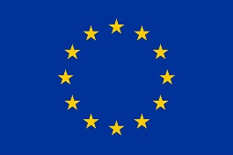
PrimeFish project H2020
Participation of fisheries economist from University of Nha Trang (Vietnam)
Improving the competitiveness of the European fisheries and aquaculture sector
The participation of Vietnamese partners allowed for a more complete analysis of the sector by introducing the panga as a case study: a species cultivated in Vietnam and with great commercial success in Europe
This project has received funding from the European Union’s Horizon 2020 Research and Innovation programme under Grant Agreements PrimeFish- 635761.

Slide 13
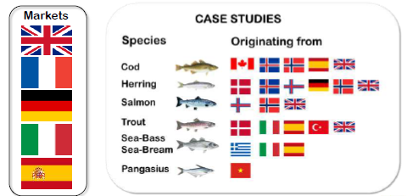
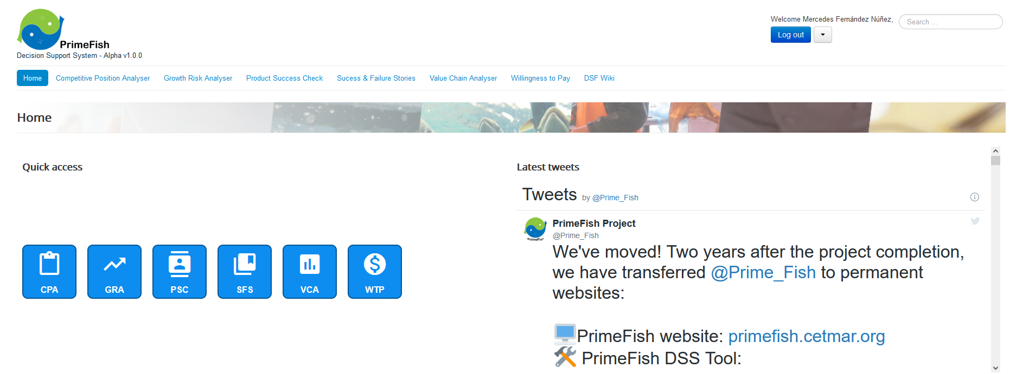
PrimeFish project H2020
Market and consumers
Competitiveness and economic performance
Value chain relations
Tackles the challenges that European seafood producers are facing:
increased competition from products from overseas
fluctuations and variation in the prices of seafood products
many new fish products fail on markets
producers are unable to meet the demands and expectations of consumers
inappropriate regulations influence the competitiveness of seafood producers
Helping Fishing & Aquaculture
(Industry) Stakeholders to make better
business decisions

Slide 14
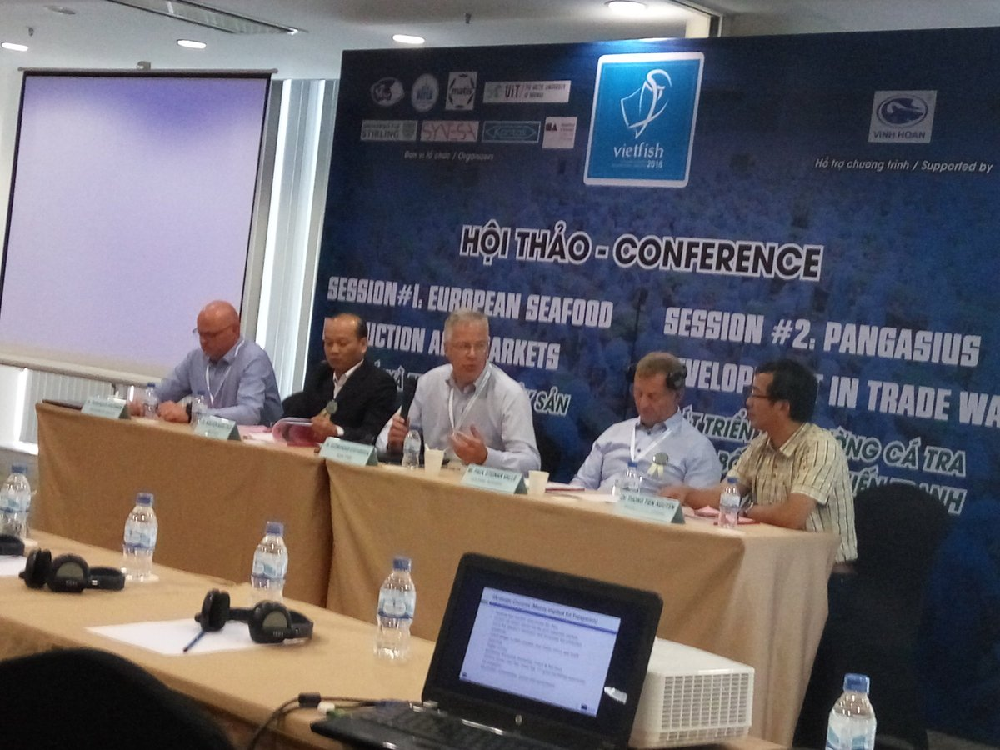
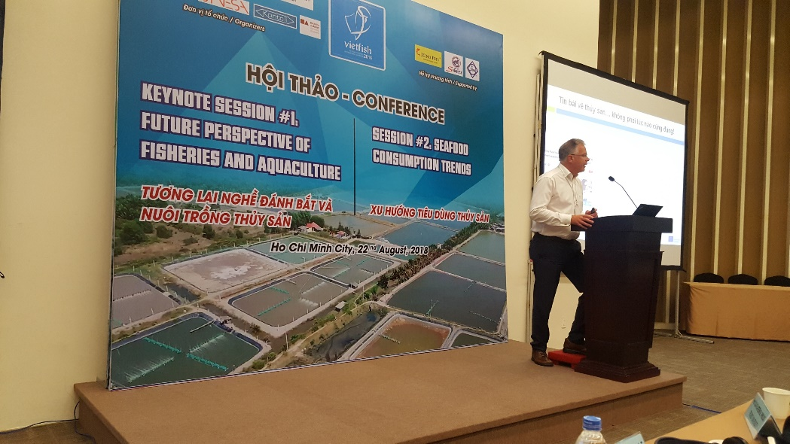
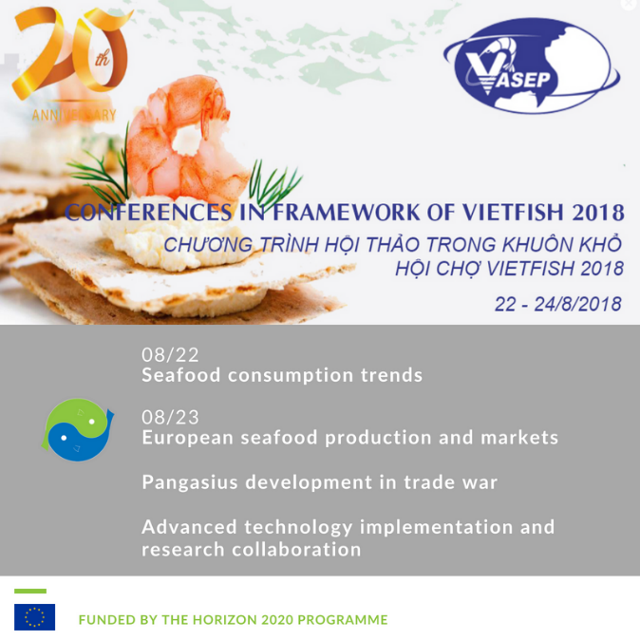
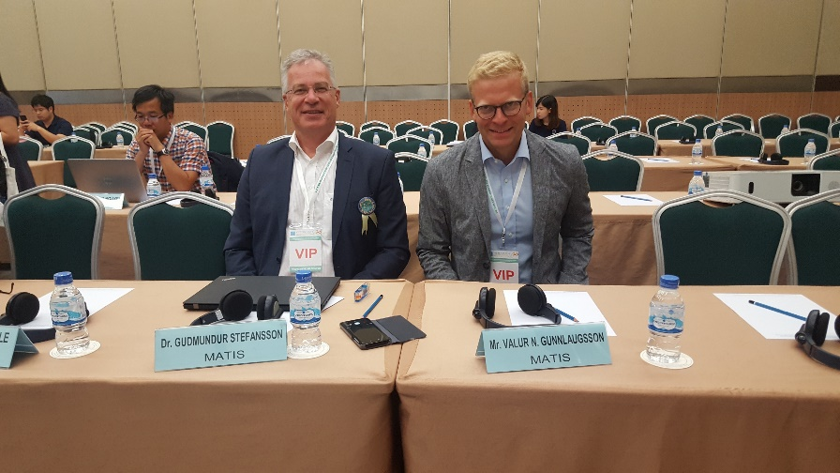
PrimeFish VietFish 2018
PrimeFish project H2020
World/EU Fisheries-Performance and Governance
World/EU Aquaculture-Performance and Opportunities
Seafood Consumption and Market Trends
Seafood Markets and Regulations
Economic Sustainability and Competitiveness
Value Chain Governance in Seafood Industry
Emerging Technologies in Fisheries, Aquaculture and Post-harvesting
Fisheries, Aquaculture and Climate Change
Research and Capacity Development in Fisheries and Aquaculture
Big data and Artificial Intelligent in fisheries and aquaculture

Slide 15
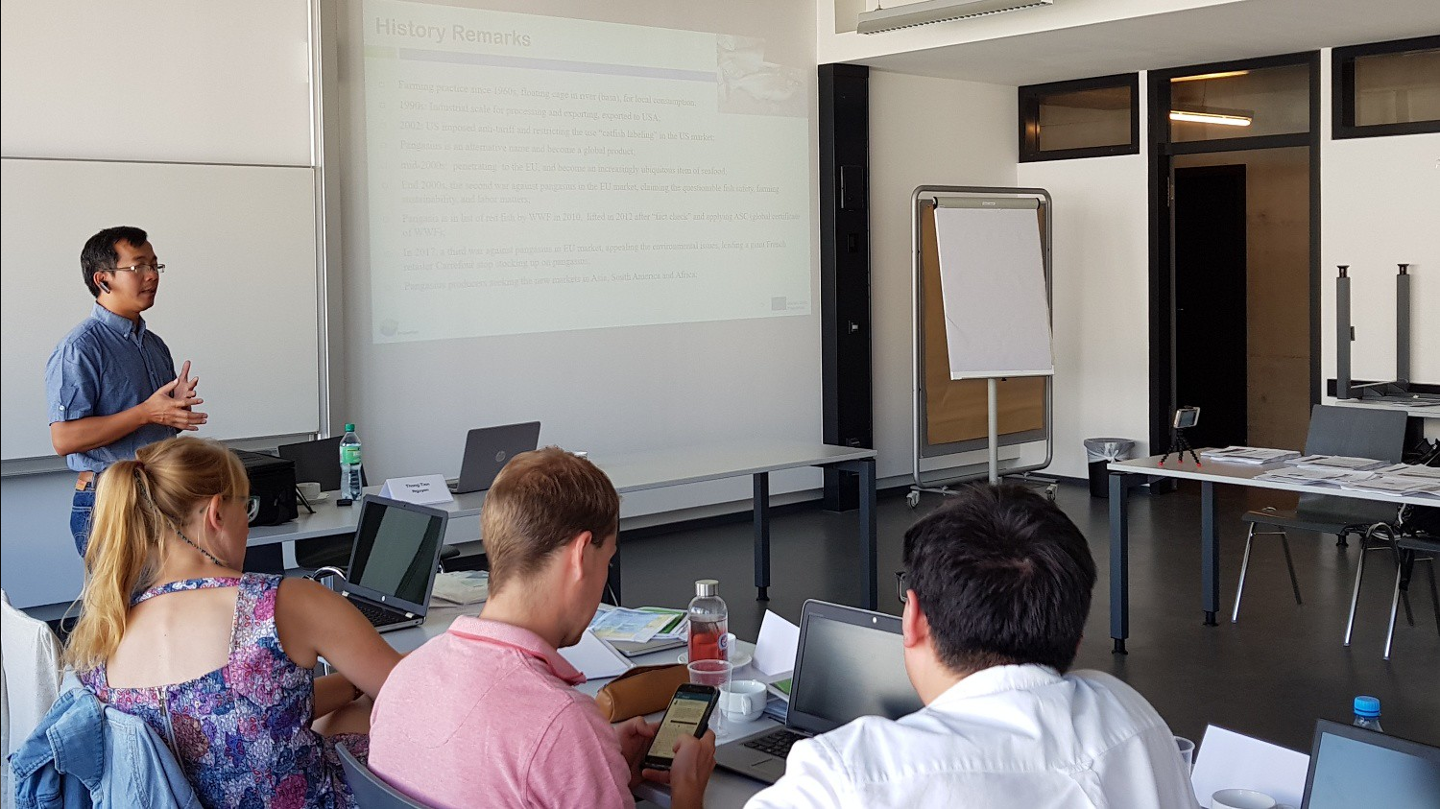
PrimeFish Summer School Bremerhaven 2018

Slide 16
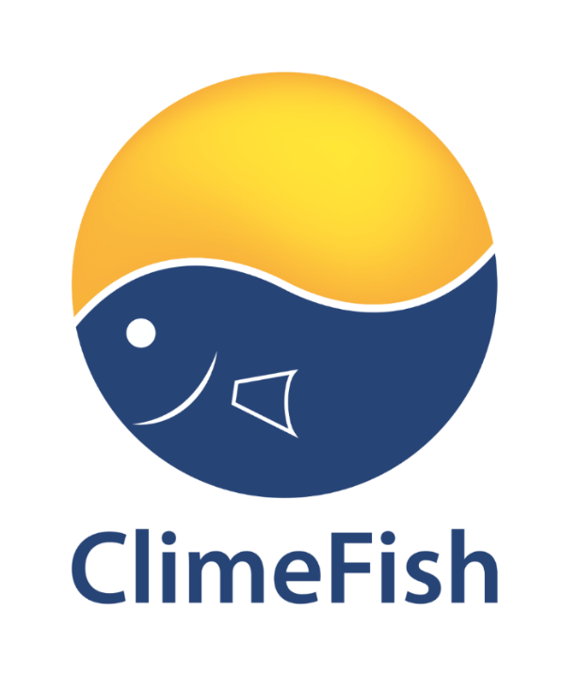
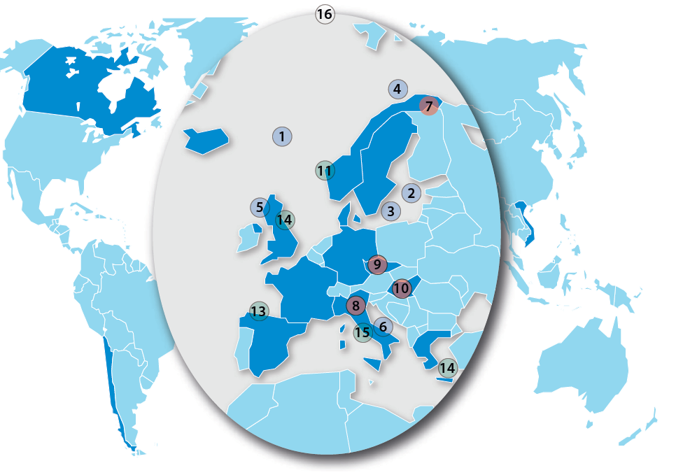

ClimeFish – a Horizon 2020 project
Co-creating a decision support framework to ensure sustainable fish production in Europe under climate change
series of training exercises were carried out for the formulation of adaptation plans in a selection three cases at the European level and two other cases outside Europe, including Vietnam.
Overall Goal:
Help ensure that the increase in seafood production comes in areas and for species where there is a potential for sustainable growth, given the expected climate scenarios
  Project Coordinator: The Arctic University of Norway
  Consortium: 21 participants from 16 countries
  Duration: 48 mnd
  Starting: 04/2016
  Ending: 03/2020
  Granted: 5 MEUR
  For three sectors:
  Sea fisheries
  Marine aquaculture
  Lake and ponds
These projects have received funding from the European Union’s Horizon 2020 Research and Innovation programme under Grant Agreements PrimeFish- 635761 and ClimeFish- 677039.

Slide 17
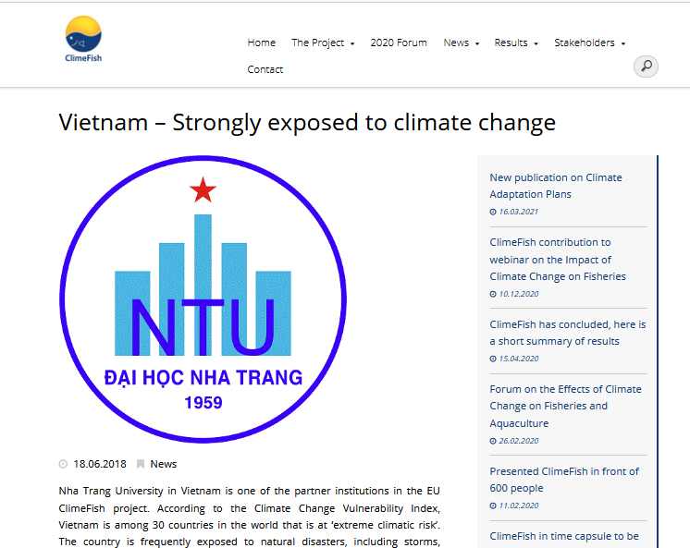
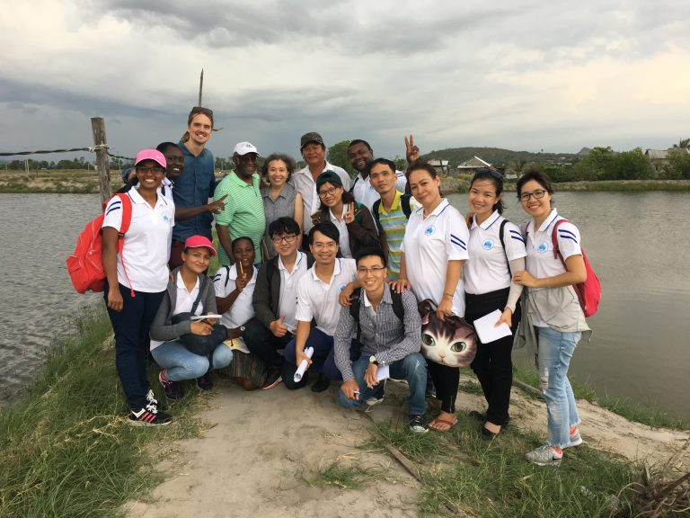
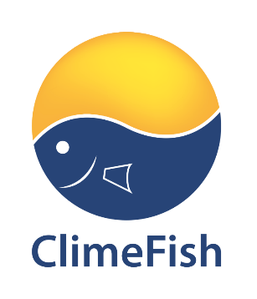
highlighted the need to apply mechanisms and support measures to fishermen in their activities and appreciated knowing the European experience for the development of adaptation plans for fishing in Khanh Hoa province
Climefish conference in Vietnam: Scientist, Department of Fisheries and the VINA TUNA Association
Notes:
Discussion- Climate change in Vietnam-
What is most effected and what are strategies?
Is aquaculture more vulnerable than fisheries to climate change?
What are the most sereve risks and most transformative opportunities for fisheries/aquaculture?
What adaptation strategies are needed for fisheries/aquaculture sectors?
Are there any decision support tools for fisheries and aquaculture stakeholders under CC? Do you think decision support framework important for fisheries and aquaculture stakeholders?
What can be learned from ClimeFish results

Slide 18
Thank you very much for your attention
rchapela@cetmar.org
gmartin@cetmar.org

