Slide 1
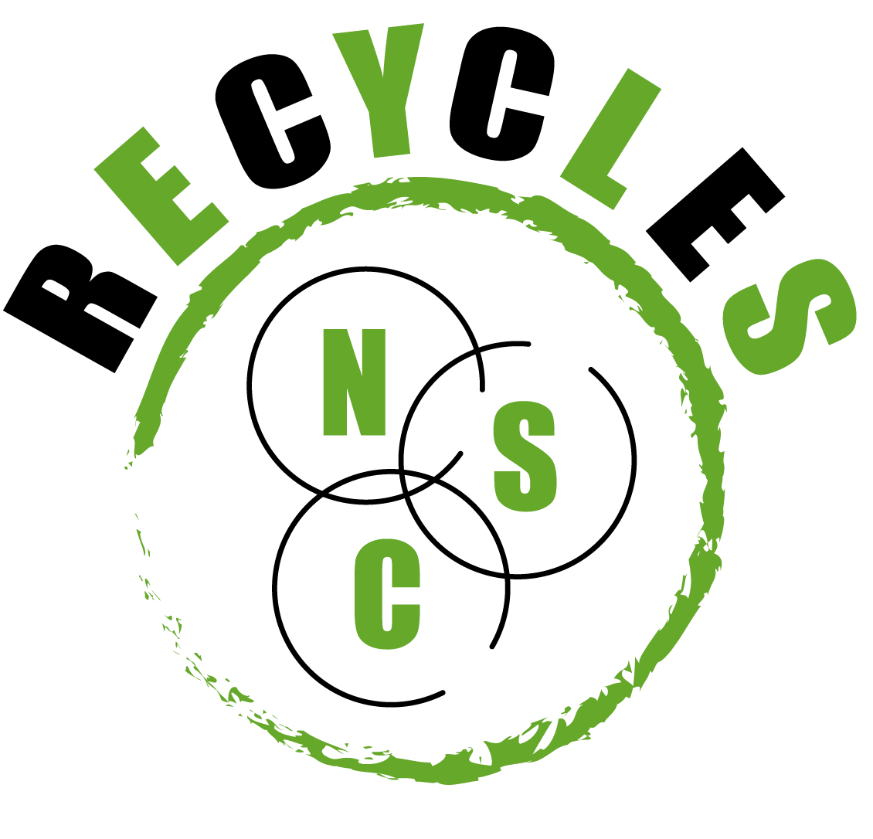






RECYCLES
Recovering carbon from contaminated matrices by exploiting the nitrogen and sulphur cycles
RecyclesEU
recycleseu
Recycles EU
Accelerating the Impact of Innovation through SPAIN – ASEAN Strategic Partnerships in Bioeconomy, Urban and Food Sustainability
Daniel González Alé
17/06/2021

Slide 2

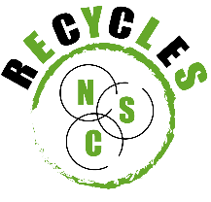
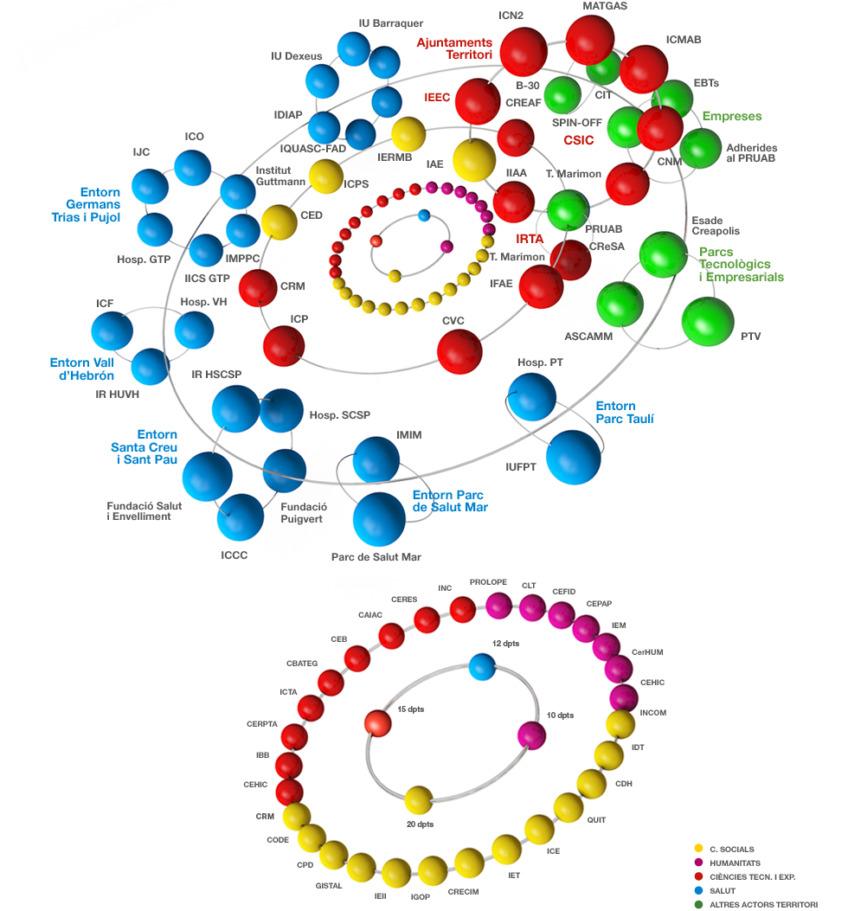
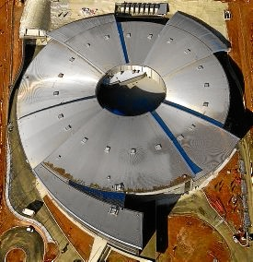
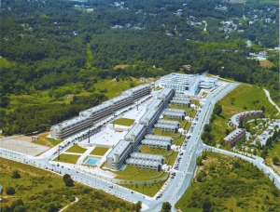
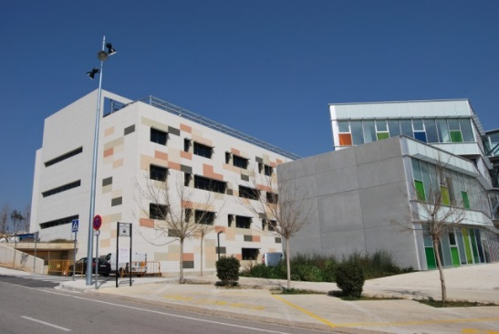
1. Universitat Autònoma de Barcelona
2666 teaching and research staff
(54% permanent)
2275 administrative staff
€319.74M expenditure budget
(56% public income)
SynchrotronALBA
105 bachelor's degrees
274 MSc degrees
25924 undergrad+MSc 37% int
Village
THE WUR 2020
157w
68 PhD programmes
4832 PhD students 36% int
International Welcome Point
57 departments
43 research institutes
69eu
Top 3 in Spain
Research park
44 Int. R+D+I projects
288 Nat. R+D+I projects
4568 SCI articles
17/06/2021

Slide 3
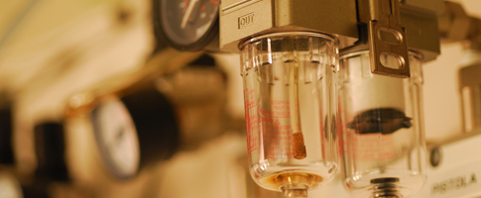
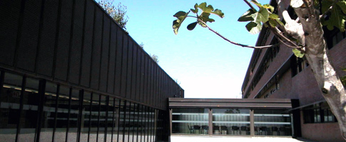
2. Department of Chemical, Biological
& Environmental Engineering
Composting Research Group (GICOM) https://www.gicom.cat/ Biodegradation of Industrial Contaminants and Waste Valorization Group https://www.uab.cat/web/biodegradacio-1241605186599.html Research Group on Biological Treatment and Valorisation of Liquid and Gaseous Effluents. Removal of Nutrients, Odours and Volatile Organic Compounds Group (GENOCOV) http://www.genocov.com/ Sustainability and Environmental Risk Prevention Group (SOSTENIPRA) https://www.sostenipra.cat/en/ Cell and Tissue Engineering Group https://www.uab.cat/web/enginyeria-cellular-1239951746456.html Bioprocess Engineering and Applied Biocatalysis Group https://www.uab.cat/web/GR-bioprocessos-1345711809736.html
135 People in the Department 72 Early Stage Researchers 5 Administrative + 4 Technical staff 22 Assistant Teaching Staff 27 Full-time Teaching Staff
6 Multidisciplinary Research Groups 3 Spin-off 70 SCI articles (2020) 25 Research Projects (11 International) 52 Research agreements (2020)
17/06/2021

Slide 4
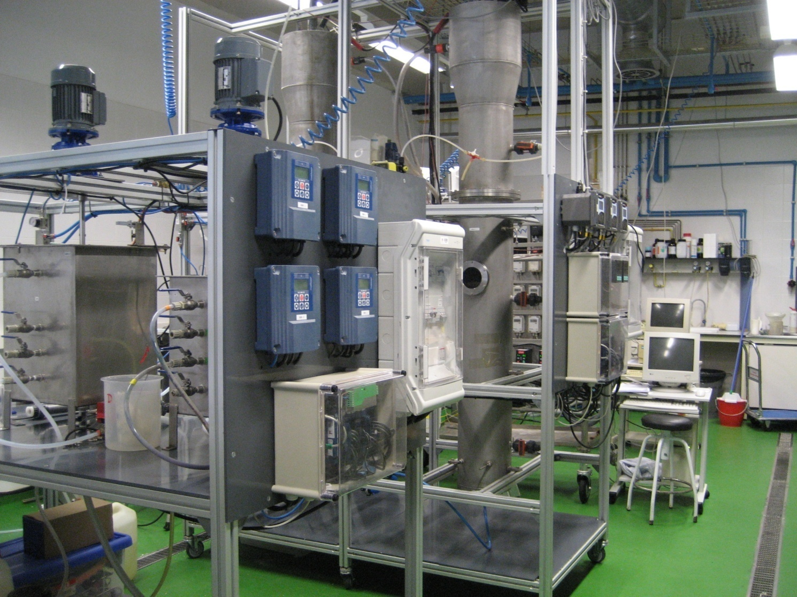
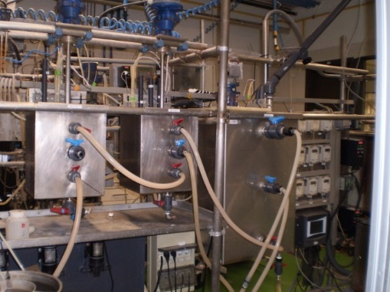
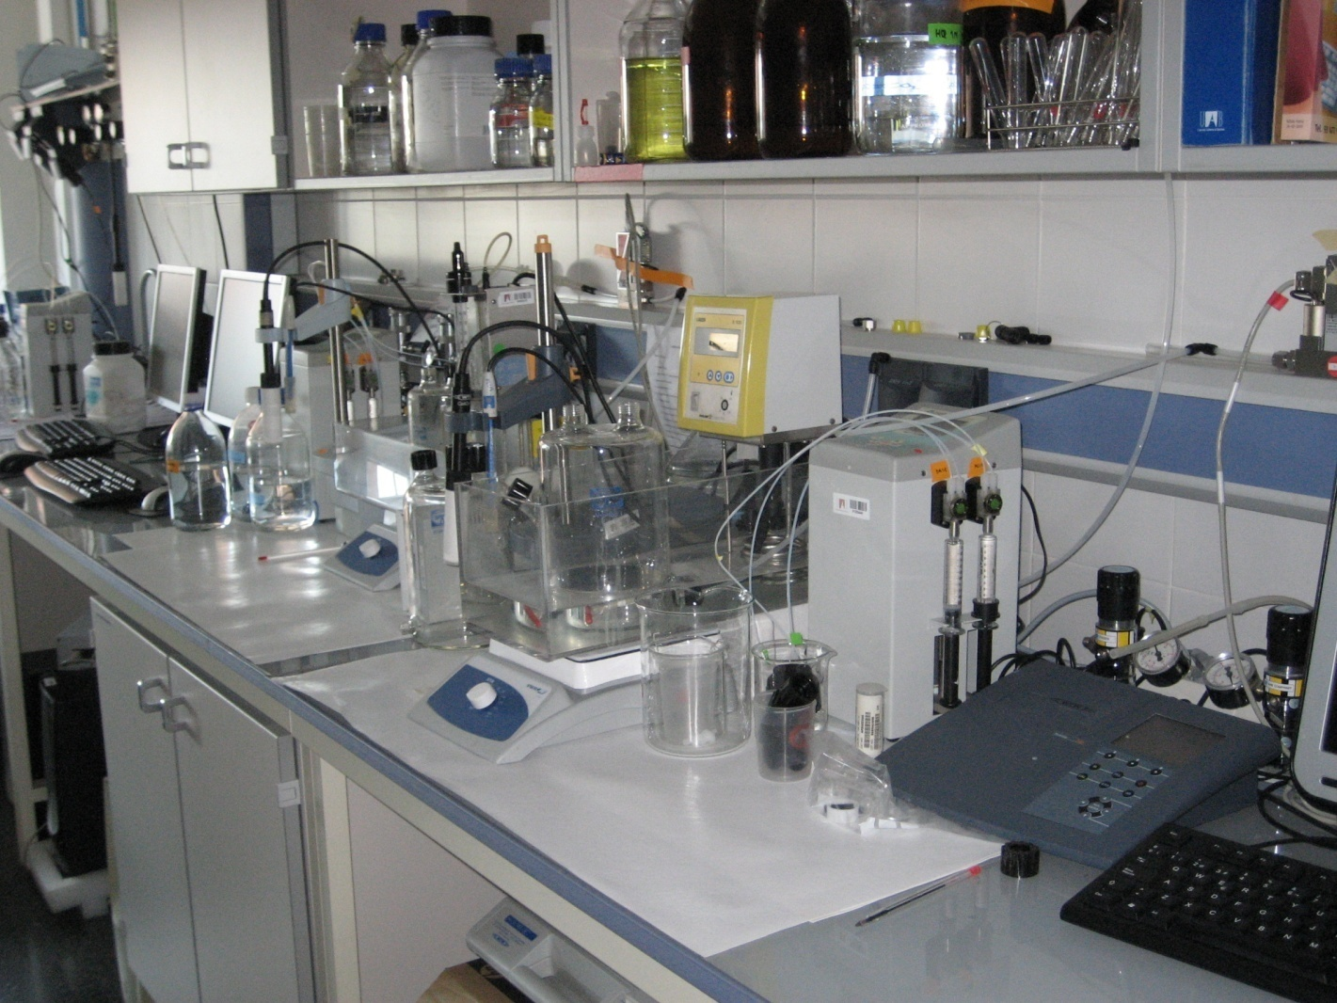

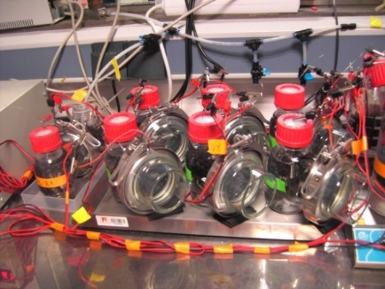
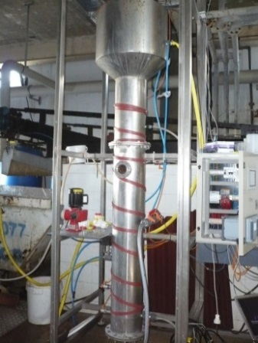
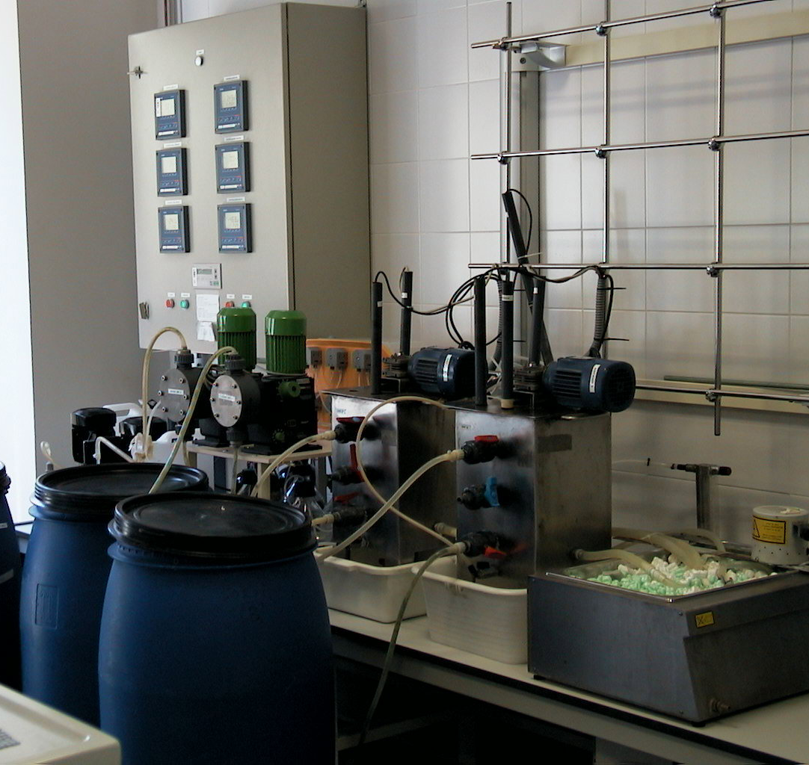
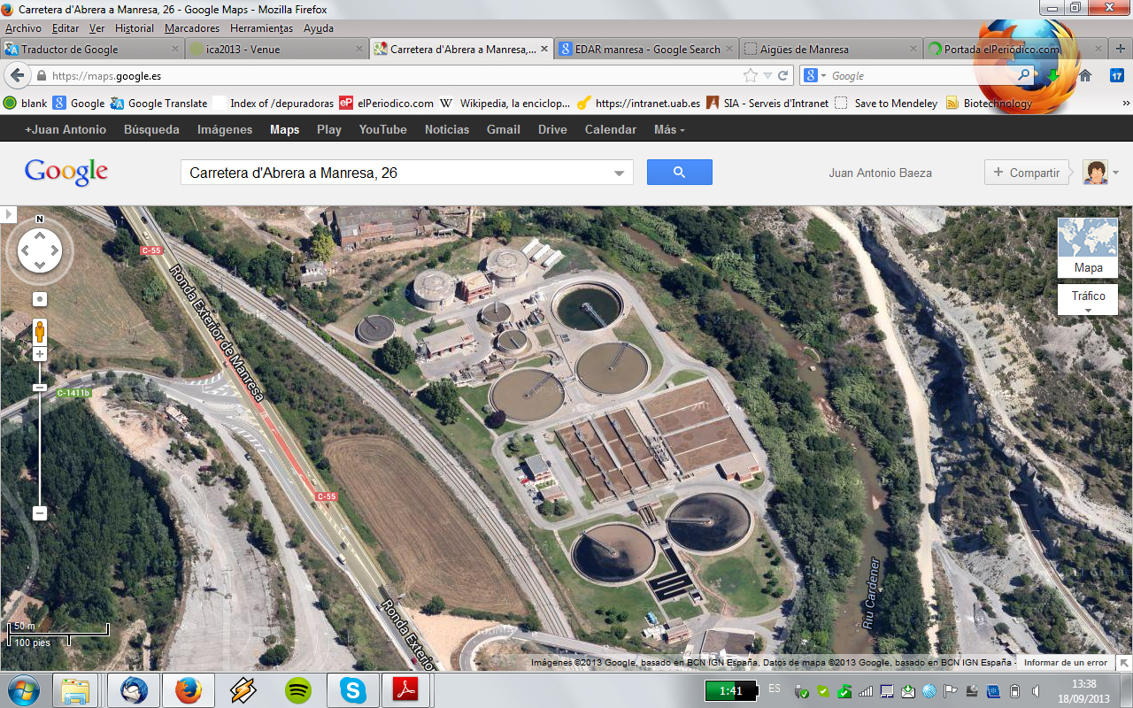
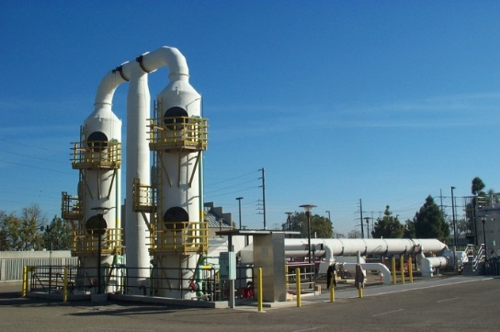
3. GENOCOV Research group
Our Goal
Understand, design and develop innovative biological treatments for urban and industrial wastewaters and polluted off-gases
… from a strong engineering approach (monitoring, modelling and control) of either continuous and batch systems
... and aiming at transferring our research to the productive sector
Research areas
Wastewater / Waste gases
From small lab-scale reactors to pilot plant
and industrial full-scale
17/06/2021

Slide 5

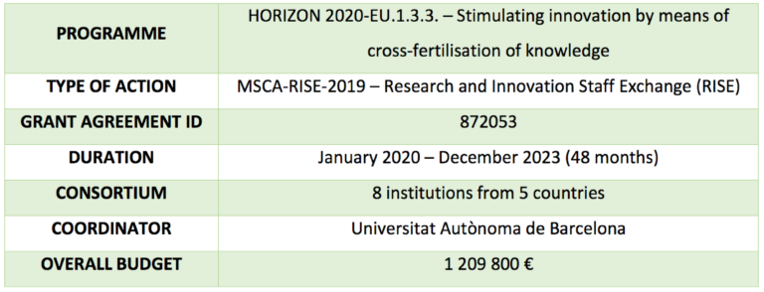
4. H2020-MSCA-RISE project: RECYCLES
Recovering carbon from contaminated matrices by
exploiting the nitrogen and sulphur cycles
17/06/2021

Slide 6
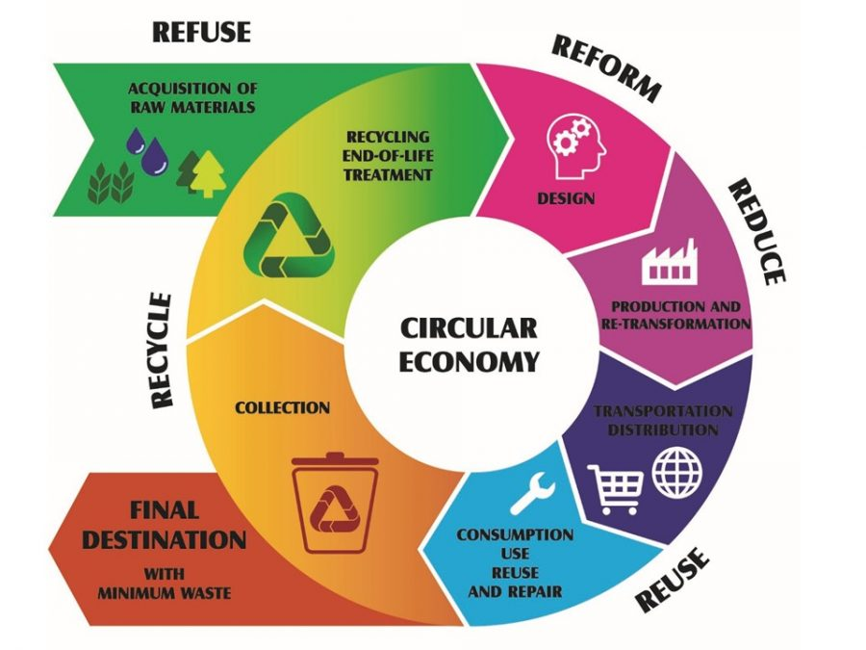
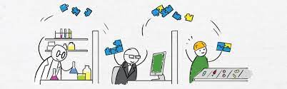
4. H2020-MSCA-RISE project: RECYCLES
Objectives
To enhance waste treatment processes in terms of sustainability for wastewaters and biogas treatment.
To shift from non environmentally friendly technologies towards optimal innovative processes:
  Energy & resource recovery are a priority
  Resources optimization
  Circular economy objective
To create an interdisciplinary and intersectoral collaboration network between academic and industrial partners from EU and non-EU countries.
To facilitate and increase researchers’ mobility.
To enhance knowledge and technology transfer.
17/06/2021

Slide 7
4. H2020-MSCA-RISE project: RECYCLES
Current interaction Universitat Autònoma de Barcelona – Prince of Songkla University
Latex industry
O₂
O₂
C + N
Highly loaded
WasteWater
Performance
issues
Anaerobic
digestion
Nitrification
Highly loaded
WasteWater
C + N + S
Anaerobic
digestion
N-rich WW
Aerated
ponds
NO₃⁻
NO₂⁻
C + N + S
Biogas H₂S
Biogas H₂S
BIOSULFUR
Autotrophic
denitrification
Partial S oxidation
Biogas desulfurization
Biogas desulfurization
Chemical
scrubbing
NO₂⁻
NO₃⁻
???
Burning
Electricity
PSA to methane
H₂
CO₂ removal
BIOMETHANE
17/06/2021

Slide 8
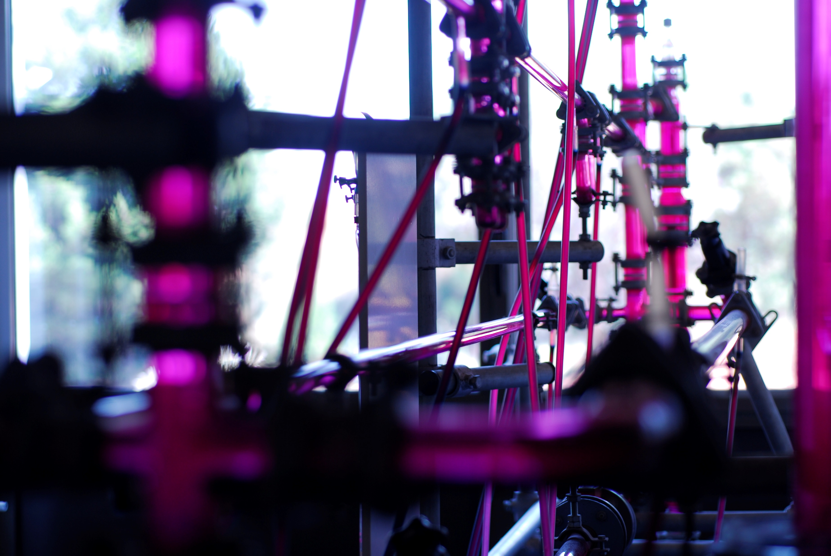
4. H2020-MSCA-RISE project: RECYCLES
Current interaction Universitat Autònoma de Barcelona – Prince of Songkla University
Research staff Exchange between Prince of Songkla University (PSU) and Universitat Autònoma de Barcelona (UAB) (2021-2025)
PhD thesis co-supervised between PSU and UAB
(2021-2024)
Potential for a bilateral benchmark agreement between both universities
Expertise sharing in environmental engineering for wastewater treatment and resource recovery facilities
17/06/2021

Slide 9
5. Interesting future interactions
Environmental Engineering
  Increased energy recovery through biogas upgrading
  Monitoring of odors and off-gases
  Engineering urban WWTP to become energy-positive facilities considering resource recovery (fertilizers, added-value chemicals)
  Production of bioplastics from waste through environmentally friendly process
  Use of bioelectrochemical systems from energy production (H₂)
Industrial Ecology
  Promoting urban-rural governance to transform food systems
  Reducing CO₂ emissions in the construction and agricultural sectors by combining energy sharing and local food production
17/06/2021

Slide 10
Thank you for your attention
RecyclesEU
recycleseu
Recycles EU
RECYCLES coordinator - david.gabriel@uab.cat
RECYCLES project manager - daniel.gonzalez.ale@uab.cat
Daniel González Alé
17/06/2021

