Slide 1
EURAXESS
researchers in motion​
Event
Event
Event
Site
Presenter

Slide 2
THE OUTLINE
The Initiative
The Instruments
The Portal
National Portals
EURAXESS Service Network
Worldwide
Get in touch

Slide 3
THE INITIATIVE

Slide 4
EURAXESS
The mission of the EURAXESS Service Network (hereafter referred to as "EURAXESS Network") is to facilitate building a common European labour market of researchers by providing free information services, and timely and high-quality support to facilitate the relocation and career development of researchers in Europe.
The EURAXESS initiative serves as an implementation tool, translating European Research Area policies into everyday working practice.

Slide 5
What do we do and why?
EURAXESS is a unique pan-European network with the goal to assist researchers in all questions regarding living and working in a new country and their career planning across sectors.
Core activity: information and support for mobility and career development of researchers
Policy goal behind: contributing to open, attractive, sustainable European labour market for researchers

Slide 6
EURAXESS Overview
Established in May 2004 as ERA-MORE
EURAXESS was introduced in 2008
Backed by 42 countries
An ERA (European Area) key initiative
Facilitating researchers’ mobility
Supporting career development
Ensuring attractive careers across Europe and beyond
Target audiences:
Researchers
Researcher institutions
Entrepreneurs and industry

Slide 7
The Instruments

Slide 8
EURAXESS Instruments
EURAXESS Portal
EURAXESS Services Network
EURAXESS Worldwide
EURAXESS
National Portals

Slide 9
The portal

Slide 10
EURAXESS Portal
Main EU Portal and country specific National Portals
EU Portal
Jobs & Funding
Career Development
National Portal
Jobs & Funding
Information & Assistance
My EURAXESS
Information & Assistance
EURAXESS Worldwide
My EURAXESS
Partnering
In English
In English + other

Slide 11
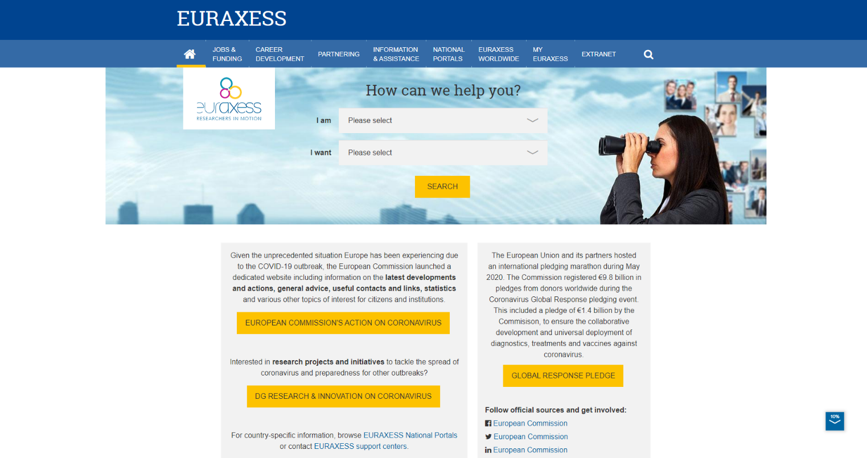
Frontpage EU Portal

Slide 12
EURAXESS jobs, funding & hosting
Jobs + funding and hosting database
80,000+ job vacancies listed annually - vacancies within academia and industry
300+ funding offers at EU and national level, travel grants and fellowships
800+ hosting posts
17,500+ registered organizations

Slide 13
Funder or Recruiter? None
EURAXESS is a facilitator and your link with funders and recruiters.
Any registered EURAXESS member can apply free of charge to the offers published in the jobs, funding and hosting data base. EURAXESS member organisations can also publish vacancies free of charge. The responsibility for the advertisements published on this website lies entirely with the employer. The application is handled uniquely by the employer, who is also fully responsible for the recruitment and selection processes. All hiring and compensation for work performed by the applicant is handled directly between the employee and the employer. EURAXESS does not perform any background checks on the EURAXESS members applying for jobs, nor on employers posting job opportunities. Employers and applicants are encouraged to request reference information from each other as needed to establish qualifications, credentials and overall fit between the employer and the applicant.
The European Commission is committed to personal data protection. Any personal data is processed in line with the Regulation (EC)45/2001. All personal information processed by the Directorate-General for Research and Innovation is treated accordingly.

Slide 14
EURAXESS contributions
EURAXESS contributes to an open transparent merit-based recruitment and to the implementation of the Charter & Code principles
EURAXESS hosts the 'Human Resources Strategy for Researchers' (HRS4R) e-tool. Organisations aligning their HR practices to the Charter & Code are recognized with the emblem.
EURAXESS and RESAVER contribute to researchers’ mobility and to remove barriers across the European Union. RESAVER is a pension plan that moves with you.

Slide 15
Partnering tool
Promote your profile
Find collaboration opportunities
Get spotted by organisations, universities and businesses

Slide 16
What's it in for you?
60,000+ registered researchers
Individual members: researchers, talent hunters, representatives of institutional members, entrepreneurs
17,500+ registered organisations
Find organisations around Europe, see their profile, awards or emblems and their recruitment policy

Slide 17
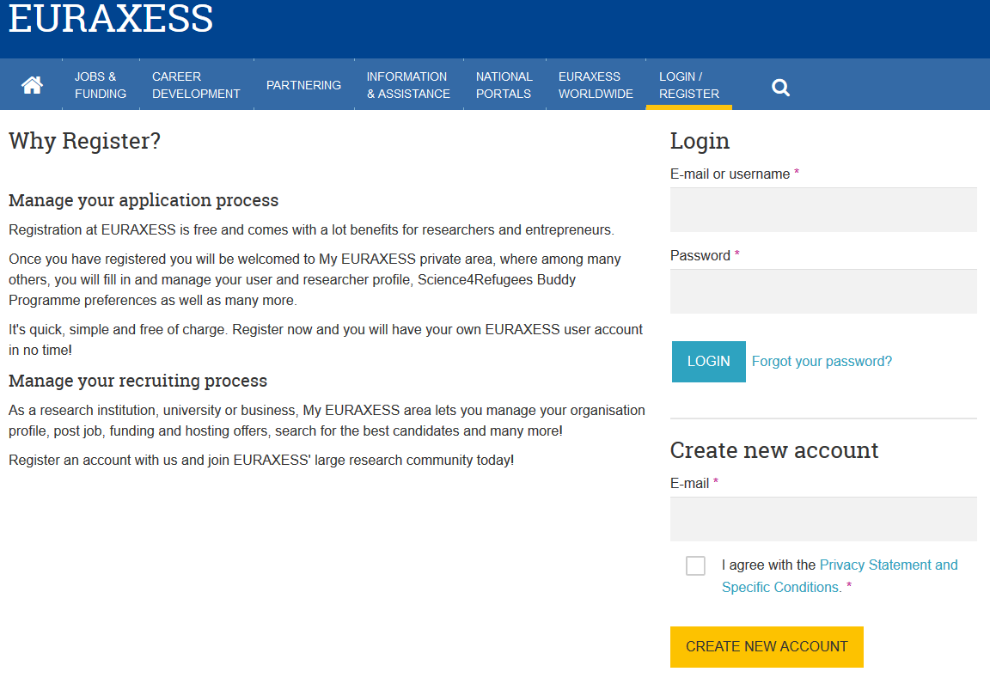
Registration
How to register an account?

Slide 18
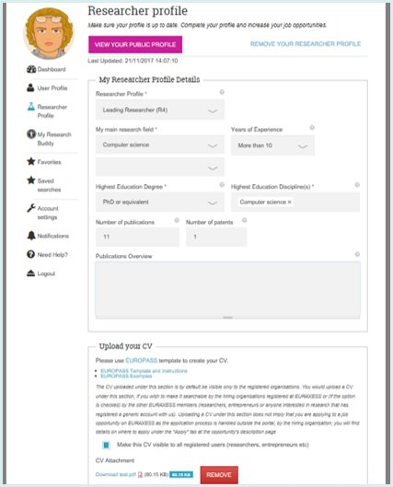
Enable your Researcher Profile
Declare your field of expertise, years of experience and publications
Get notified when vacancies match your profile
Upload your CV from Europass
Upload the Seal of Excellence and other awards
Make your profile visible in the Partnering tool
Get spotted by potential employers
Participate in the Science4Refugees initiative

Slide 19
Connect with other researchers & entrepreneurs

Slide 20
Science4Refugees

Slide 21
80,000 research positions published in 2019
Browse, get automated notifications on updated vacancies and apply

Slide 22
Customised job information for registered users
Save your job searches and get notified everytime a new job is posted
Save your favourite job offers and access them from your research profile
Get notifications based on your researcher profile
Get notified 6 months after your last profile update

Slide 23
Browse, get automated notifications on updated funding opportunities

Slide 24
Browse, get automated notifications on updated hosting opportunities

Slide 26
Career development
Supporting your career within academia and industry
Relevant information is available
Training resources:
Career Orientation tool
Industry Career Development Module
And more
Counselling in more than 84 CD information service centres and CD centres

Slide 29
Training resources

Slide 30
National portals

Slide 31
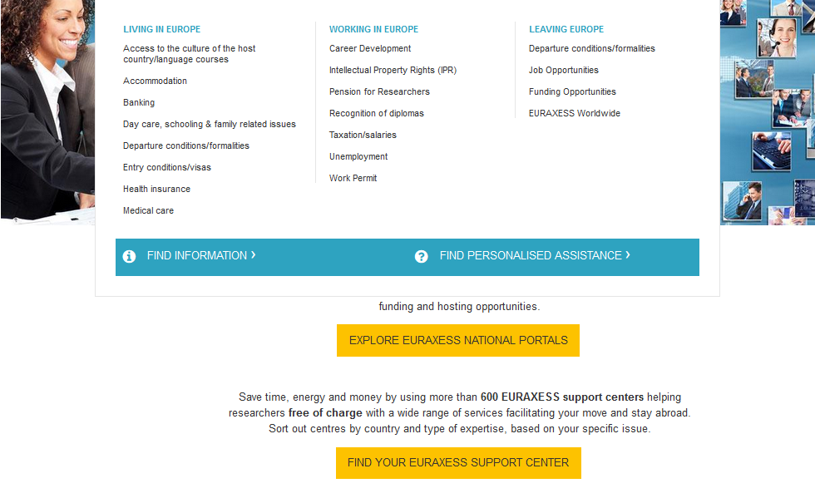
EURAXESS Portal

Slide 32
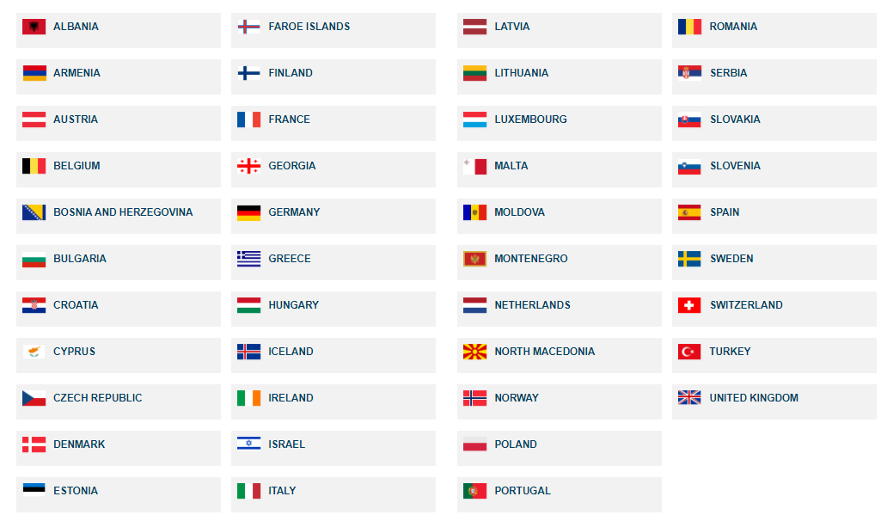
National portals
42 national portals with country-specific information for researchers
All portals have the same look and feel

Slide 33
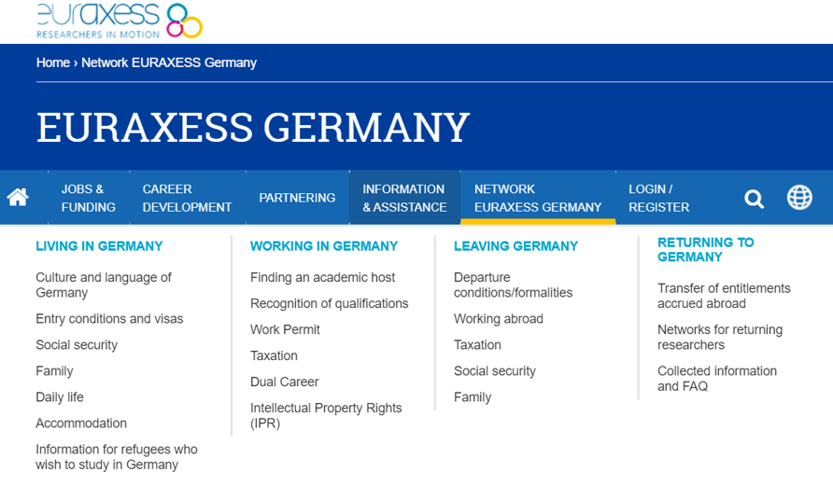
Country-specific information

Slide 34
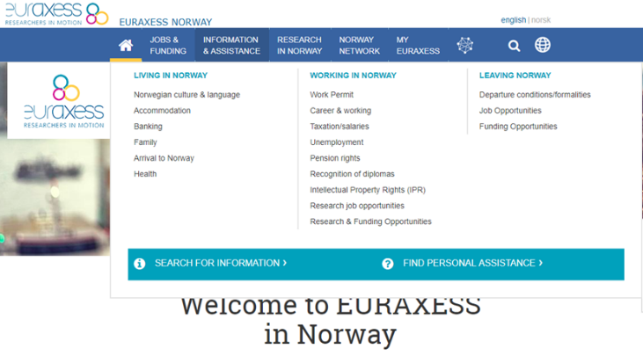
EURAXESS [country] national portal
Topics you want to present from your national portal
Job & Funding
Information & assistance
Research in ….
Network ...
Etc

Slide 35
The network

Slide 36
EURAXESS Centres
EURAXESS Centres in 42 countries (member states and associated countries)
Services provides towards the researchers and to some extend trailing spouses and kids
Personalised and tailored information provided free of charge
Notes:
This has ot be adapted nationally

Slide 37
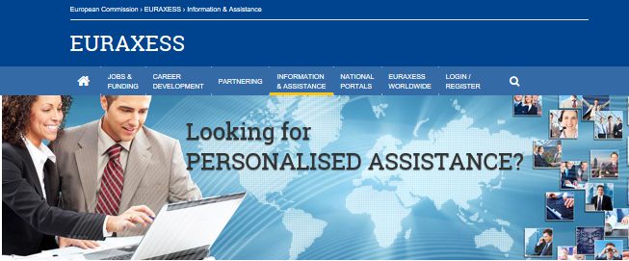
Geographical coverage and proximity
640+ support centers for researchers
1,500+ network members
Regional, national, local or within institution service provision

Slide 38
Main areas of intervention
Free assistance to resident, incoming and outgoing researchers (and their families) – Relocation & Career Development

Slide 39
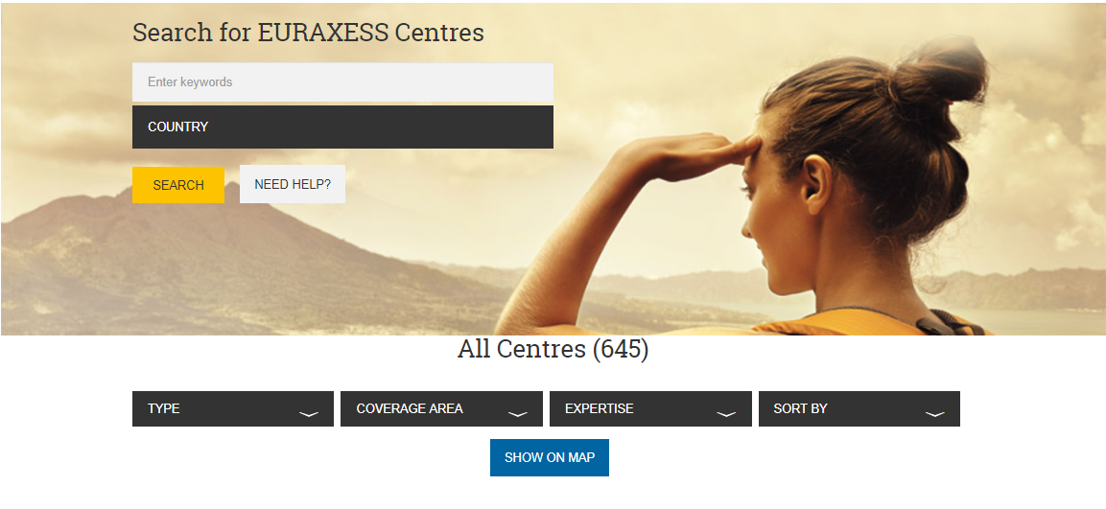
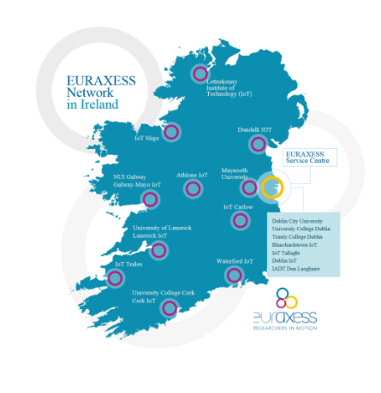
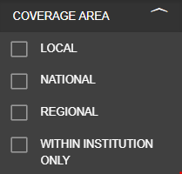
Find your nearest centre or the one located in your country of Interest
EURAXESS centres
Geographical coverage
Type of expertise

Slide 40
Types of services
450,000 mobility issues treated /year

Slide 41
Researchers working outside of Europe

Slide 42
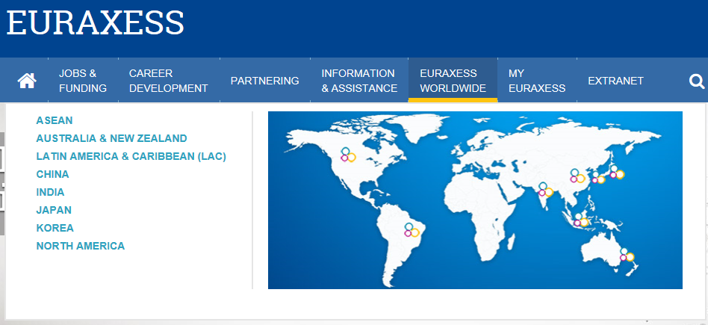
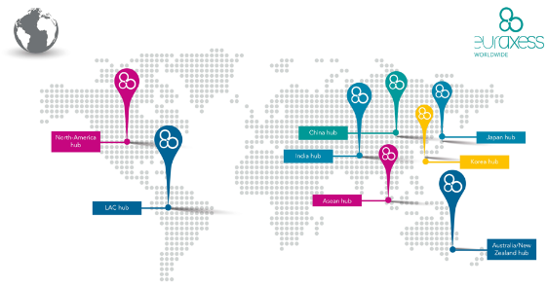
EURAXESS Worldwide
Membership of international researchers
Promote Europe as an attractive R&I destination
Attract R&I talent to Europe
Organise training sessions on funding schemes (focus on MSCA and ERC
Publication of newsletters and flashnotes
Outreach through infodays, events and missions
Create networking opportunities
8 international hubs
8 international portals

Slide 43
Special portals – EURAXESS Worldwide
8 portals with specialised content

Slide 44
Special portals – EURAXESS Worldwide
8 portals with specialised content
8 portals with specialised content

Slide 45
Follow and Contact
Facebook please add if relevant
LinkedIn please add if relevant
YouTube please add/change if relevant https://www.youtube.com/channel/UCYDwulgU3SrBgjsTuR_4RDg
Twitter please add if relevant
Add your organisation’s email address
EC functional mailbox on EURAXESS: RTD-RMP@ec.europa.eu
EC functional mailbox on C&C: RTD-CHARTER@ec.europa.eu
Technical issues: support@euraxess.org

