Slide 1
EURAXESS
researchers in motion​
Event
Event
Event
Site
Presenter

Slide 2
THE OUTLINE
The Initiative
EURAXESS Portal
Jobs, funding and hosting
Partnering Tool
Career Development
HRS4R
The Network
Worldwide
Get in touch

Slide 3
THE INITIATIVE

Slide 4
EURAXESS
The mission of the EURAXESS Service Network (hereafter referred to as "EURAXESS Network") is to facilitate building a common European labour market of researchers by providing free information services, and timely and high-quality support to facilitate the relocation and career development of researchers in Europe.
The EURAXESS initiative serves as an implementation tool, translating European Research Area policies into everyday working practice.

Slide 5
What do we do and why?
EURAXESS is a unique pan-European network with the goal to assist researchers in all questions regarding practicalities in a new country and their career planning, and member organisations on how to build mobility services and build an attractive work environment.
Core activities: information and support for mobility and career development of researchers
Information and support for member organisations on how to assist researchers with mobility issues and career
Policy goal: building an open, attractive, sustainable, common European labour market for researchers

Slide 6
EURAXESS Overview
Established in May 2004 as ERA-MORE
EURAXESS was introduced in 2008
Backed by more than 40 countries
An ERA (European Area) key initiative
Facilitating researchers’ mobility
Supporting career development
Ensuring attractive careers across Europe and beyond
Target audiences:
Researchers
Researcher institutions
Entrepreneurs and industry
Notes:
It was an early version of the network we know today and a few centres were launched across Europe providing early mobility services described as:
‘proximity assistance to researchers and their families on all issues relating to their mobility’.]
EURAXESS was introduced in 2008 and obtained rapidly a clear place in the European effort to build the ERA
EURAXESS as a network is enhanced continuously with the T.O.P, T.O.P II projects (Enhancing the outreach and effectiveness of the partners in the EURAXESS Services Network), TOP III and TOP IV project
HRS4R (Charter & Code)
Resaver

Slide 7
The Instruments

Slide 8
The portal

Slide 9
EURAXESS Portal Instruments
Job, funding, hosting database
Career Development
HRS4R
Partnering tool

Slide 10
EURAXESS Portal(s)
Main EU Portal and country specific National Portals
EU Portal
Jobs & Funding
Career Development
National Portal
Jobs & Funding
Information & Assistance
My EURAXESS
Information & Assistance
EURAXESS Worldwide
My EURAXESS
Researcher Profile
Organisation Profile
Researcher Profile
Organisation Profile
Search Jobs
Offer Jobs
Find funding
Partnering
In English
In English + other
some national portals are translated to their national language
if registered through the national portal users still have access to the EU portal

Slide 11
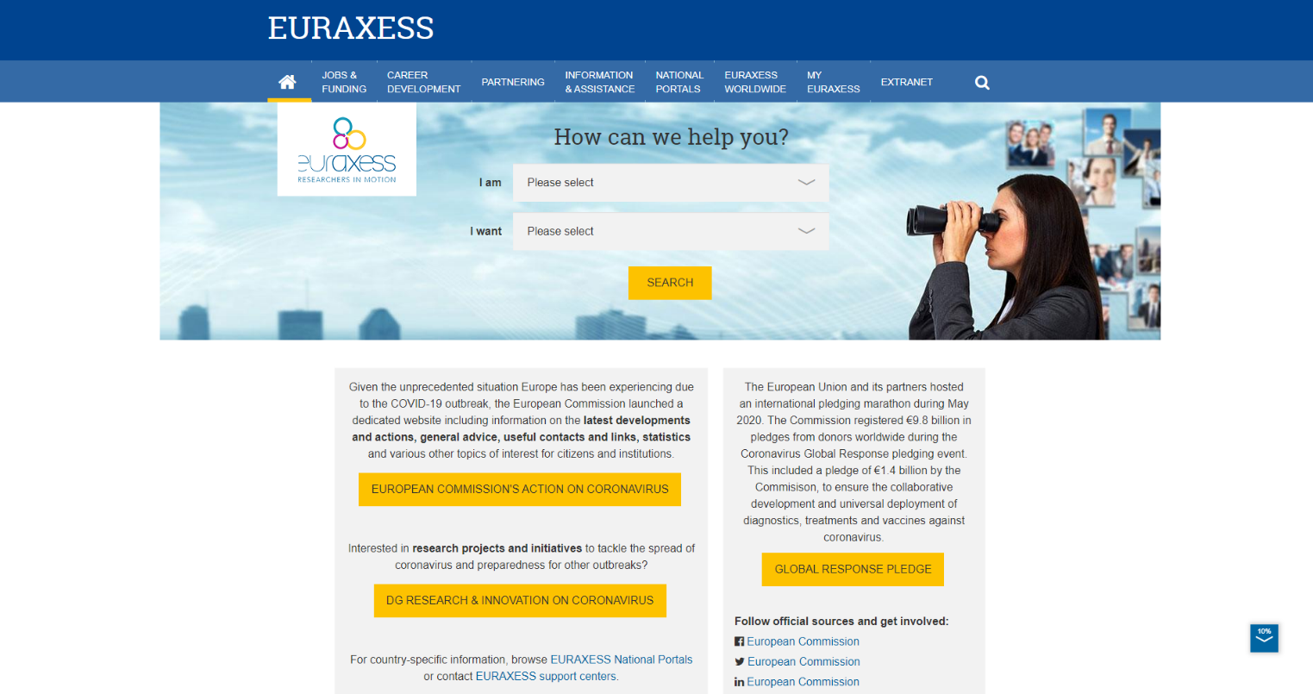
Frontpage EU Portal

Slide 12
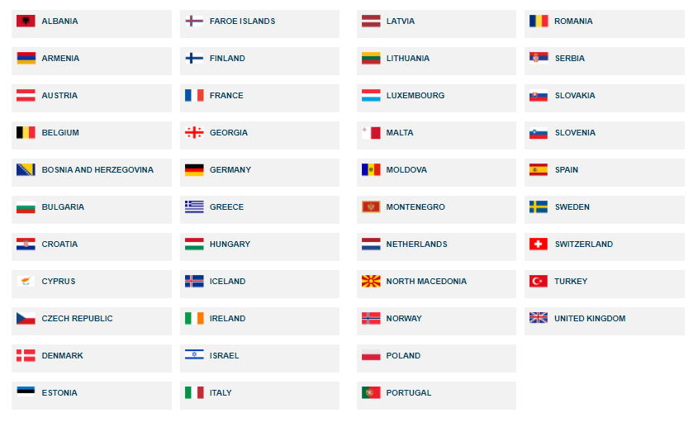
Country-specific portals
42 national portals with country-specific information for researchers

Slide 13
Jobs, Funding and Hosting Database
Post your offers free of charge
Create, edit or un-publish your vacancies
Get statistics on their performance
Gain visibility: 80% of visitors browse the database
Publish hosting opportunities

Slide 14
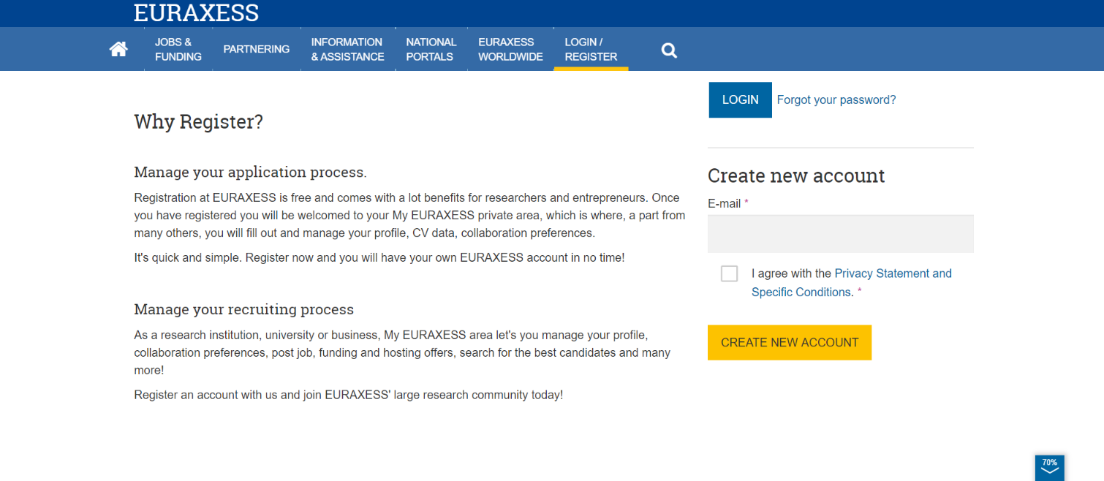
Registration
Individual registration is needed before registering an institution

Slide 15
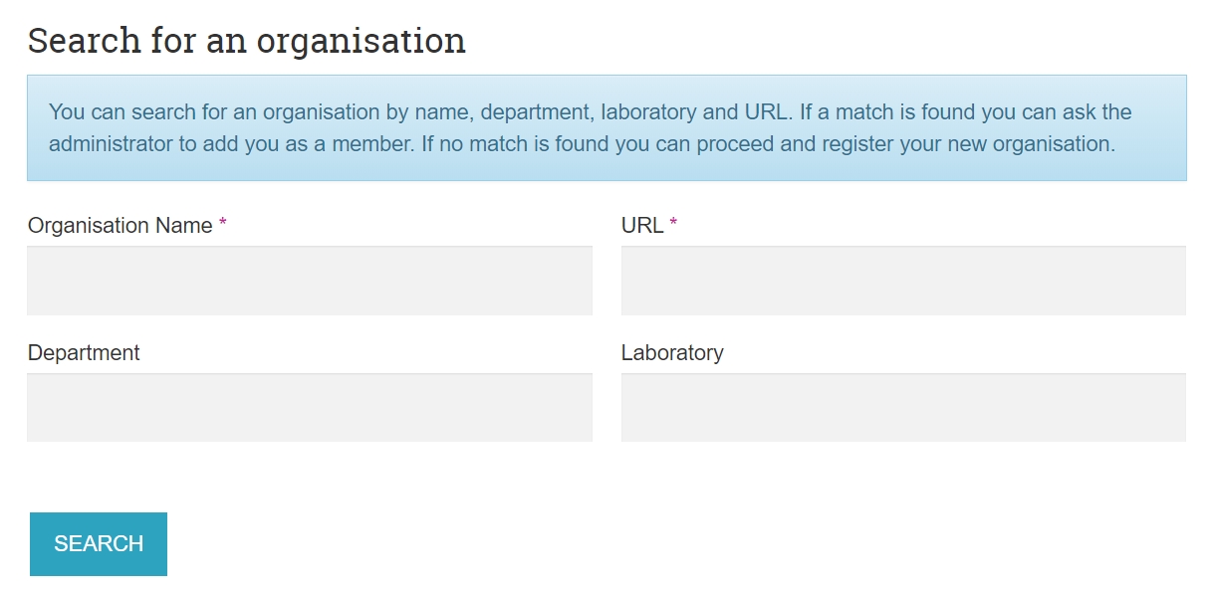
Join an existing organisation
If your email address domain matches an Org. URL, you will be invited to join
If you are not invited, click on Search/Register
Search for your organisation using name and URL
If shown in the results list, click on “contact organisation admin” to be request your addition as member

Slide 16
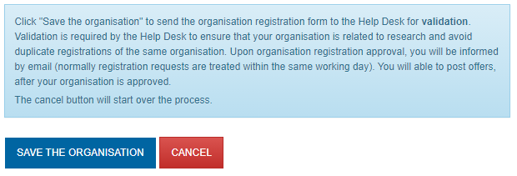
Register an organisation profile
If there are no matches to your search, proceed to register your organisation profile
Fill in the mandatory information about your organisation, and Save the organisation – The request will be reviewed by the Help Desk
LOGO
Once approved, fill in the Organisation profile information and promote your logos

Slide 17
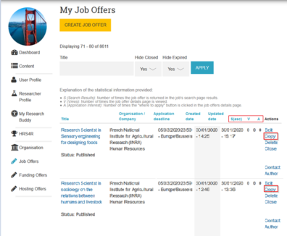
Organisation dashboard
Edit your organisation profile
Invite other members to join
Create, edit or un-publish your vacancies
See your job, funding and hosting offer statistics
Copy existing offers to create a new one
Some national network coordinators can post on behalf of Organisation

Slide 18
How to create job offers
Offer description
Researcher profile
Research field
Type of contract
Application deadline
Science4Refugees
How to apply
Org contact details
Work location
Number of positions
Add details per
position
Educational level
Skills
Languages
Experience
Website for details
Benefits
Eligibility criteria
Selection criteria
Other comments
You can select the corresponding EU Research Framework Programme from the "Basic Information" section
70% of the job add must be written in English
Submitted offers are manually approved by the help desk

Slide 19
Automatic import from other platforms
EURAXESS sends and receives job postings to /from these Job Platforms
Global Academy Jobs¹
ABG - Association Bernard Gregory
Academic Positions Europe
AcademicTransfer
Science Careers AAAS
EuroScienceJobs
Galaxie - Ministère de l'Enseignement Supérieur et de la Recherche
HiPEAC
Italian Ministry of Education, Universities and Research
JREC-IN Portal²
Nature Jobs
PharmaJobs
Reachmee
Qreer
ScienceCareers.eu
UniversityPositions
Smooth process
No additional time or resources needed
Technical schema available for jobs, funding and hosting
100% mapping
All updates reflected from one platform to the other
Export option is also available for jobs.
More information: https://euraxess.ec.europa.eu/api/

Slide 20
Partnering tool
Promote your organisation profile and emblems:
Seal of Excellence, HR award, or Science for Refugees
Browse the database of researchers to find talent for your teams
Find collaboration opportunities
Academic and non-academic players are welcome

Slide 21
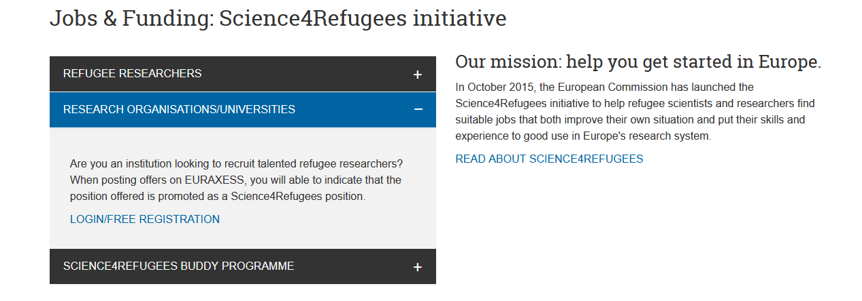
Science4Refugees
Promote your organisation as welcoming for refugee researchers

Slide 22
Career development
Gain free access to tools and resources to set up or enhance your career development services for researchers:
EURAXESS Employer Engagement Toolkit
REFLEX App and guide
Policy recommendations on researchers career development
Counselling in more than 84 CD information service centres and CD centres
Notes:
This slide is intended for use when presenting to Researchers. Hide it if not presenting to Researchers.

Slide 23
EURAXESS contributions
EURAXESS contributes to an open transparent merit-based recruitment and to the implementation of the Charter for Researchers & Code for the Recruitment of Researchers (C&C) principles
EURAXESS hosts the 'Human Resources Strategy for Researchers' (HRS4R) e-tool. Organisations aligning their HR practices to the Charter & Code are recognized with the emblem.
EURAXESS and RESAVER contribute to researchers’ mobility and to remove barriers across the European Union. RESAVER is a pension plan that moves with your employee.
Notes:
This slide is intended for use when presenting to non-Members of EURAXESS network. Hide it if presented to Members.

Slide 24
C&C and HRS4R Key facts and figures
1,250 Institutions have endorsed the Charter & Code principles
+570 research institutions from over 40 Countries received the HR excellence award
68 awarded in 2019
73 awarded in 2020
165 institutions are currently preparing their application for the Award
Notes:
Updated information visible in https://euraxess.ec.europa.eu/jobs/hrs4r/dashboard

Slide 25
C&C and HRS4R
Set of recommendations by the European Commission in 2005
The Charter is a set of principles for the roles, responsibilities and entitlements of researchers - Reference Framework
The Code of Conduct provides for transparency of the recruitment and selection process, ensuring equal treatment for all applicants - Includes obligations for employers and funders
HRS4R: C&C Implementation tool to set up an open, transparent sustainable European labour market for researchers
Organisations can apply for the HRS4R award that recognises their efforts to align their HR policies to the Charter & Code recommendations via the preparation of an Action Plan. The application and management process is done via the EURAXESS portal.
Notes:
This slide is intended for use when presenting to non-Members of EURAXESS network. Hide it if presented to Members.

Slide 26
The network of services

Slide 27
Why join EURAXESS network?
More visibility as a member of a large European network
Uniqueness of a professional, collaborative and international environment and professional support enabled by networking
Learning opportunities at European level
European and regional EURAXESS trainings, network conferences, Study Visits, programme, webinars, access to an e-training platform
Access to EURAXESS Extranet with exclusive tools and resources
Better collaboration at national level

Slide 28
How to join EURAXESS network?
Contact EURAXESS national coordinator in your country
Read and sign the Declaration for Commitment
Create an account at the EURAXESS portal
Notes:
This has ot be adapted nationally

Slide 29
Visibility by becoming a EURAXESS Centre
EURAXESS Centres in 42 countries (member states and associated countries)
Service provision within the institution, locally, national or regional
Services provided for the researchers and their families
Notes:
This has ot be adapted nationally

Slide 30
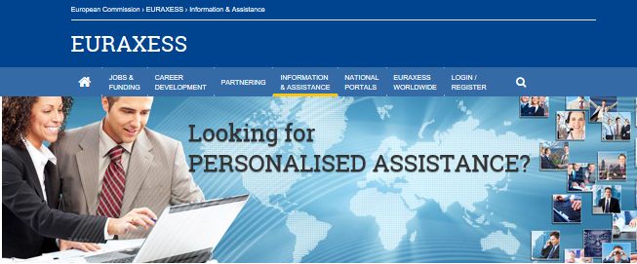
Join a collaborative international environment
630+ support centres for researchers
1500+ involved in network
Service provision usually within the institution only, but sometimes regionally or locally​​

Slide 31
Share best practices within the main
areas of intervention
Free assistance to resident, incoming and outgoing researchers and their families – Relocation & Career Development
Guidance for institutions on the Human Resources Strategy for Researchers (HRS4R)
Communities of practice at national level on the Charter & Code for Researchers (mainly by BHO).

Slide 32
Centres and services
National Coordinator (Bridgehead Organisation)
EURAXESS Support Center
EURAXESS Contact Point
450.000 mobility issues treated /year

Slide 33
EURAXESS outside of Europe

Slide 34
EURAXESS Worldwide
Membership of international researchers
Promote Europe as an attractive R&I destination
Attract R&I talent to Europe
8 international hubs (17 staff members)
8 international portals
Promote ERA from the angle of mobility​
Increase research collaboration​
Organise training on funding schemes​
Info days / Events​
Create networking opportunities

Slide 35
Follow and Contact
Facebook please add if relevant
LinkedIn please add if relevant
YouTube please add/change if relevant https://www.youtube.com/channel/UCYDwulgU3SrBgjsTuR_4RDg
Twitter please add if relevant
EURAXESS Functional mailbox: RTD-RMP@ec.europa.eu
Technical issues: support@euraxess.org
HRS4R functional mailbox: RTD-CHARTER@ec.europa.eu

